Slide 1
FT-IR measurement
Type : ATR method
Detector : DTGS
Crystal : diamond
Resolution : 4 cm⁻¹
Scan time : 32 scans
Range : 4000 ~ 500 cm⁻¹

Slide 2
FT-IR measurement
Type : Transmittance (vacuum)
Detector : DTGS
Resolution : 4 cm⁻¹
Scan time : 128 scans
Range : 5000 ~ 400 cm⁻¹
Epoxy
CH₂

Slide 3
[ 전체 스펙트럼_3회 측정]
C-O
방향족 C-H
C-H
C=O
C=C
O-H

Slide 4
[ 1 ]

Slide 5
[ 2 ]

Slide 6
[ 3 ]

Slide 7
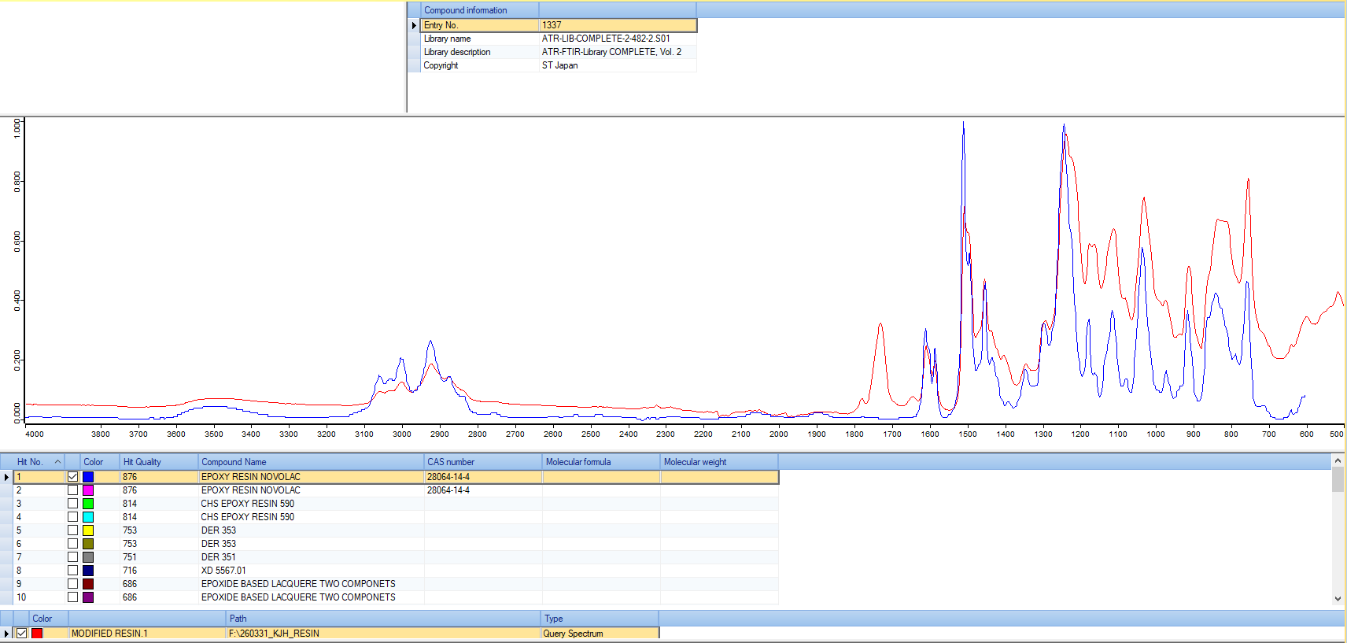
[ 1, 2 library 검색 결과 ]

Slide 8
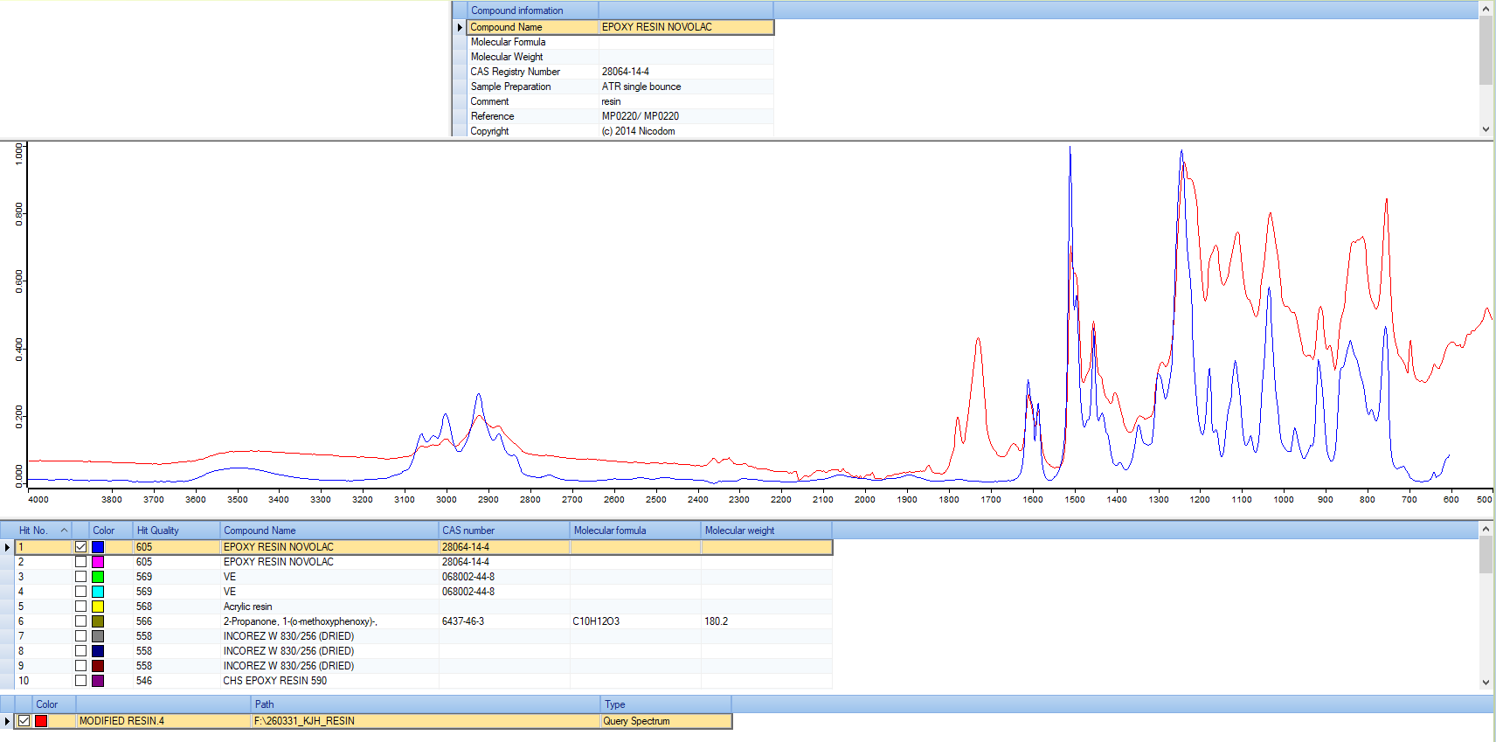
[ 3 library 검색 결과 ]

