Slide 1


PAD-FS a distributed data store
Course
Distributed Enabling Platforms
Project report
Davide Neri
University of Pisa and SSSUP Sant’Anna
a.a. 2015-2016

Slide 2
PAD-FS introduction
Distributed persitent data store
Written in Java and Apache Maven.
Store key value pairs.
Provides: replication, versioning, partitioning of the data, weak consistency model with quorum system.
Expose four main API: get, put, list, rm.

Slide 3
PAD-FS design choices
Partitioning: consistent hashing technique (SHA-1 by default), no virtuals nodes.
Passive replication: the keys are store into different nodes replicas ( 3 by default , master + 2 backups in the clockwise direction).
Quorum system: WRITE_NODES (2 by default) must finish a put, READ_NODES (2 by default) must finish a read operation.
Data versioning: vector clocks ([nodeID:integer]).
Gossiping: for memebership and node failure detection.
Conflicts resolution: on GET operation, conflicts are resolved by the user.

Slide 4
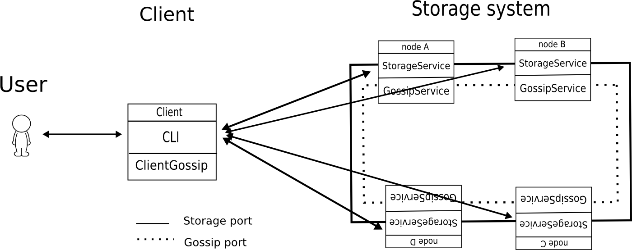
PAD-FS architecture
Who submit the operation

Slide 5
The Client node
An independent node interacting with the storage system.
Receive the user input operations and sends the operation to the master node.
The client has a total view of the system (same consistent hashing) updated with gossiping-like procedure.
Composed by to main modules:
  Cli: Command Line Interface that receives input from the user and send mesagges to the master node.
  ClientGossip: updates periodically the client's view of the system.

Slide 6
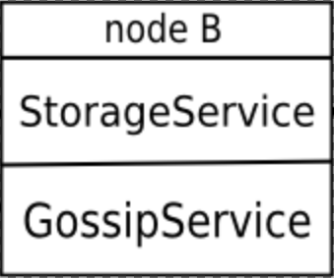
PAD-FS storage system
Composed by a set of independent storage nodes, implementing the distributed data store.
Each storage node is composed by two modules:
  StorageService: receives and performs the operations onto the local database (get,put,update,rm).
  GossipService: keeps update the membership with gossiping.

Slide 7
Pad-fs interfaces
PAD-FS client expose four main API operations:
  put(k,v): write/update the key k and the value v into the storage system.
  get(k): retrieve the value associated with the key k.
  list(IP): list all the pairs (key, values) stored into the storage node with IP address.
  rm(k): remove the value associated to the key k.

Slide 8
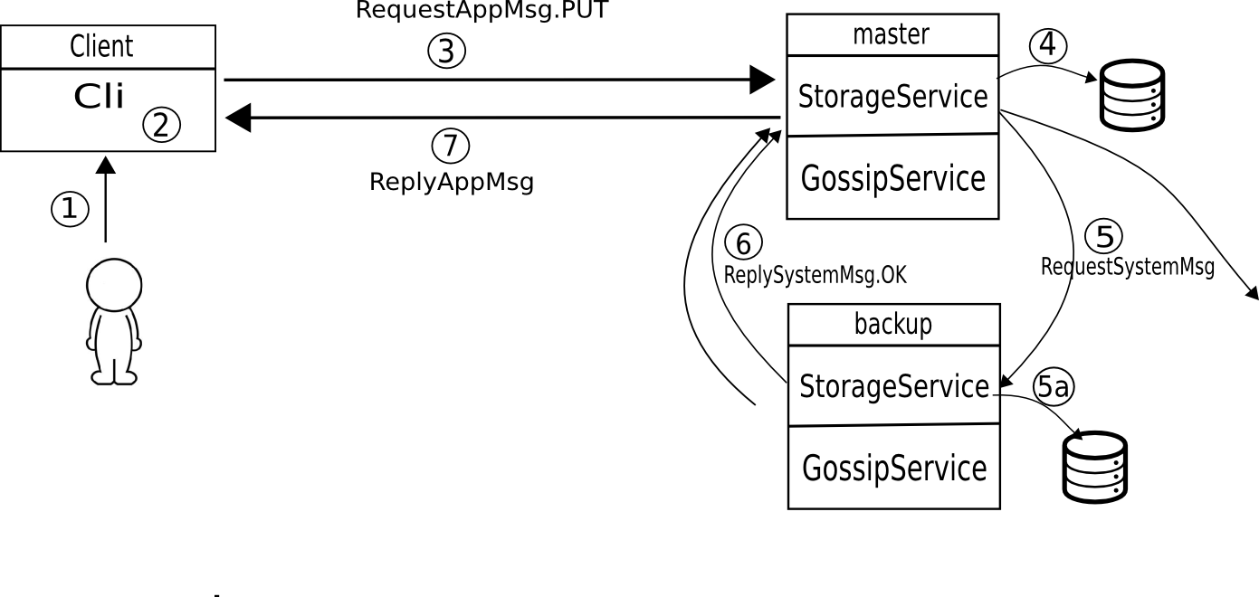
PUT(Key, value)
1) User performs PUT(k,v)
2) Client selects master node for key k
3) Client sends PUT message to the master node
4) master gets the value v from local db
5) master sends PUT to backups
5a) backup puts the value v into db
6) Reply OK msg to master
7) if WRITE_NODES responses than reply OK to Client.

Slide 9
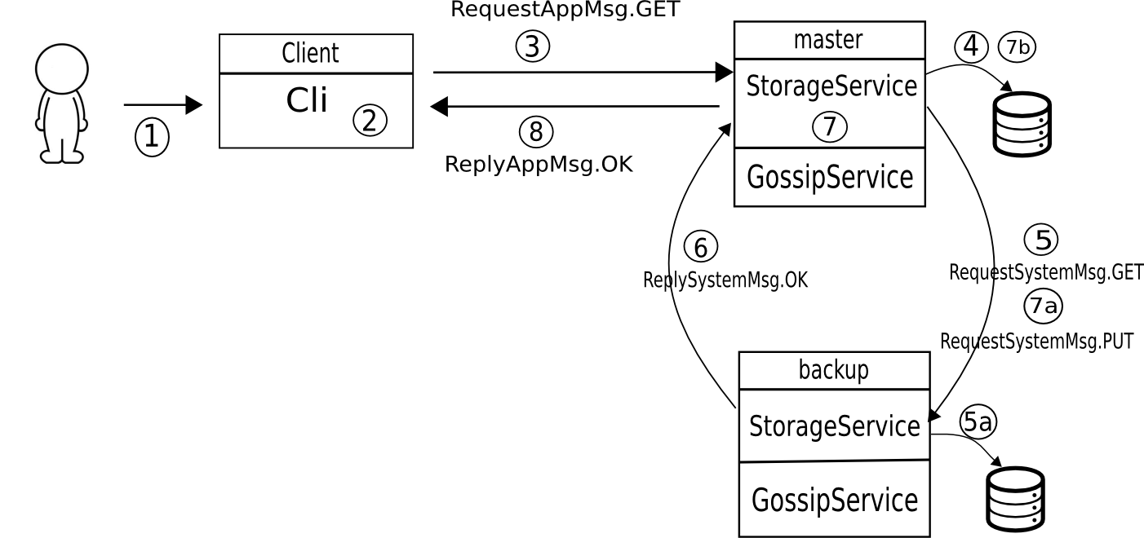
GET(Key)
1) User performs GET(k)
2) Client selects master node for k
3) Client sends GET message to the master
4) master gets the value from local db
5) master sends GET to backups
5a) backup gets the value from db
6) reply msg with the value
7) receive READ_NODES versions
8) reply OK msg with the value
7a) send latest versioned value
7b) store latest versioned into local db.

Slide 10
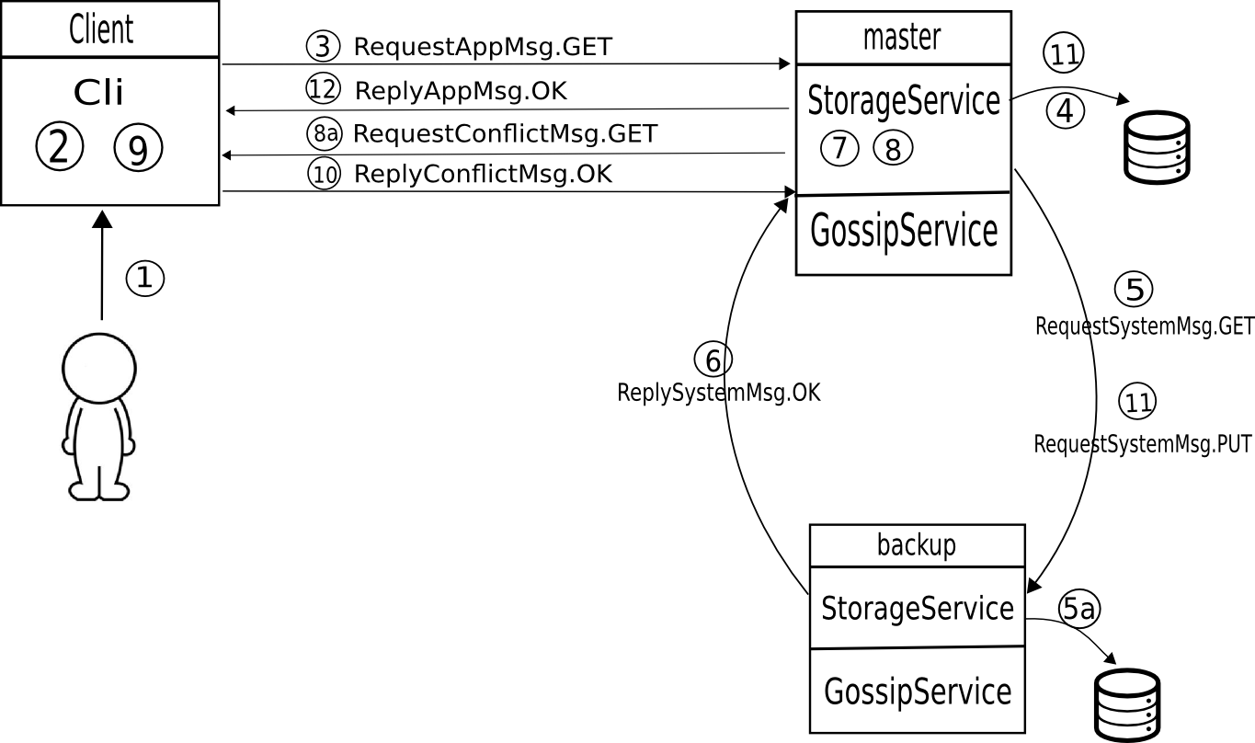
GET(Key) with conflict
… (1-7 equal to GET(k))
8) discover conflict in versions
8a) send versions to client
9) User selects a version
10) reply msg whit the selection
11) store into db the selected version
12) reply OK msg to client

Slide 11
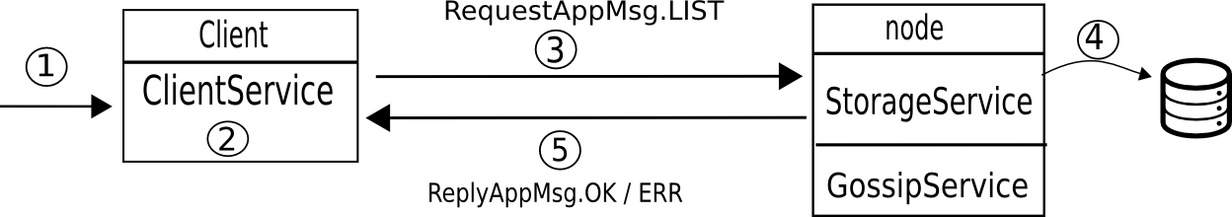
LIST(ip)
1) User performs LIST operartion
2) Client selects node with address ip
3) Client sends PUT message to the master node
4) master gets all the key value pairs from local db
5) master sends OK or ERR (if db is empty)

Slide 12
Special/limit cases
PAD-FS doesn't manage new node joining the system.
Only existing nodes can crash and going up again.
The consistent hash function is calculated on:
  hash(n.IP + n.id) for a Node n.
  hash(d.key) for a Data d.
The storage system must have at least 3 running nodes:
1 master + 2 backups.

Slide 13
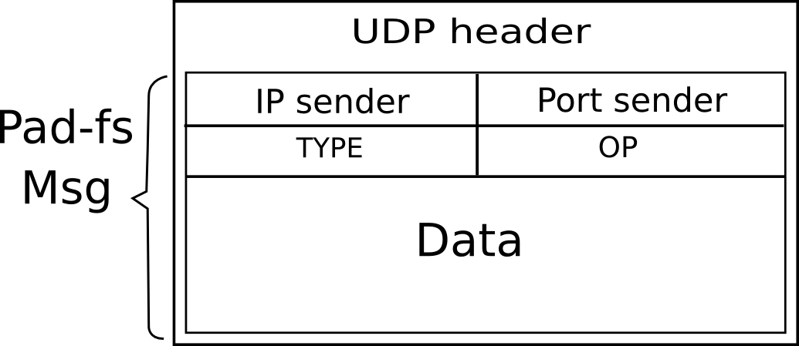
PAD-FS messages
Messages are sent into UDP packets.
Message fields:
      IP/port sender: the ip and port of the sender node
      Type: defines if it's a request or a reply message.
      OP: identify the operation (put,get, list, ok, err, dscv, rm).
      DATA: the payload of the message (different for any OP).
Messages can be divided in:
  Application messsages: sent only by the client to storage nodes.
  System Messages: sent only among storage nodes.

Slide 14
PAD-FS debug
Library used log4j
Two debugging levels:
  Info: prints only the useful information
  Debug: prints all the debug information.
/core/src/main/resources/log4j.properties: is the configuration file for setting the debug level for each class
Example: set info level for the client node:
log4j.logger.com.dido.pad.client=info

Slide 15
PAD-FS Project
PAD-FS has three subprojects:
  cli: contains the code of the Client
  core: contains the code for a single storage node.
  app: is an example of storage system runnable on a
  single local machine.
Run the Client 127.0.0.254 with seed node 127.0.0.1:
$ java -cp cli-0.2.jar com.dido.pad.cli.MainClient -ip 127.0.0.254 -id client 127.0.0.1:node1
Run a Storage node 127.0.0.2 with seed node 127.0.0.1
$ java -cp core-0.2.jar com.dido.pad.PadFsNode -ip 127.0.0.2 -id node2 127.0.0.1:node1

Slide 16
PAD-FS a distributed data store
Thank you for your attention
E-mail :davideneri18@gmail.com Github: dido18

