Slide 1
BUILD A DATA WAREHOUSE to manager train trips
Members:Duong Van Bi
Duong Thi My Duyen

Slide 2
TABLE OF CONTENTS
01
02
03
Introduction to the topic
Introduction to snowflake schema
Conclucion

Slide 3
01
Introduction to the topic

Slide 4
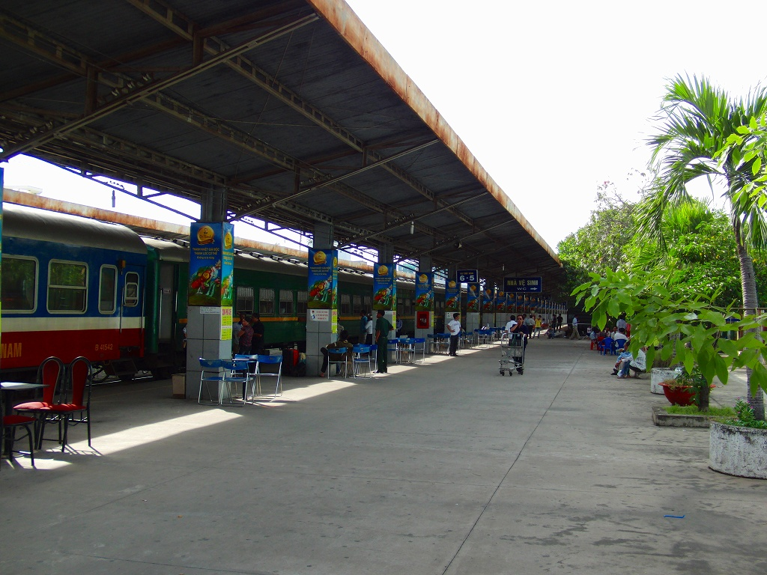
Introduction
In the railway system, the database is required to store the record or data of ticket bookings, status about train’s arrival, and departure. Also if trains get late, people get to know it through database update.
Build for a given railway unit
Provides data warehouse of train trips

Slide 5
02
Introduction to snowflake schema

Slide 6
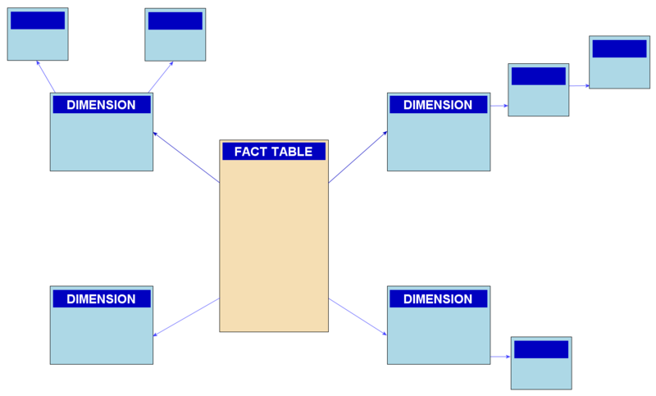
Snowfalke schema
A snowflake schema is a multi-dimensional data model that is an extension of a star schema, where dimension tables are broken down into subdimensions.
Snowflake schemas are commonly used for business intelligence and reporting in OLAP data warehouses, data marts, and relational databases.

Slide 7
03
conclusion

Slide 8
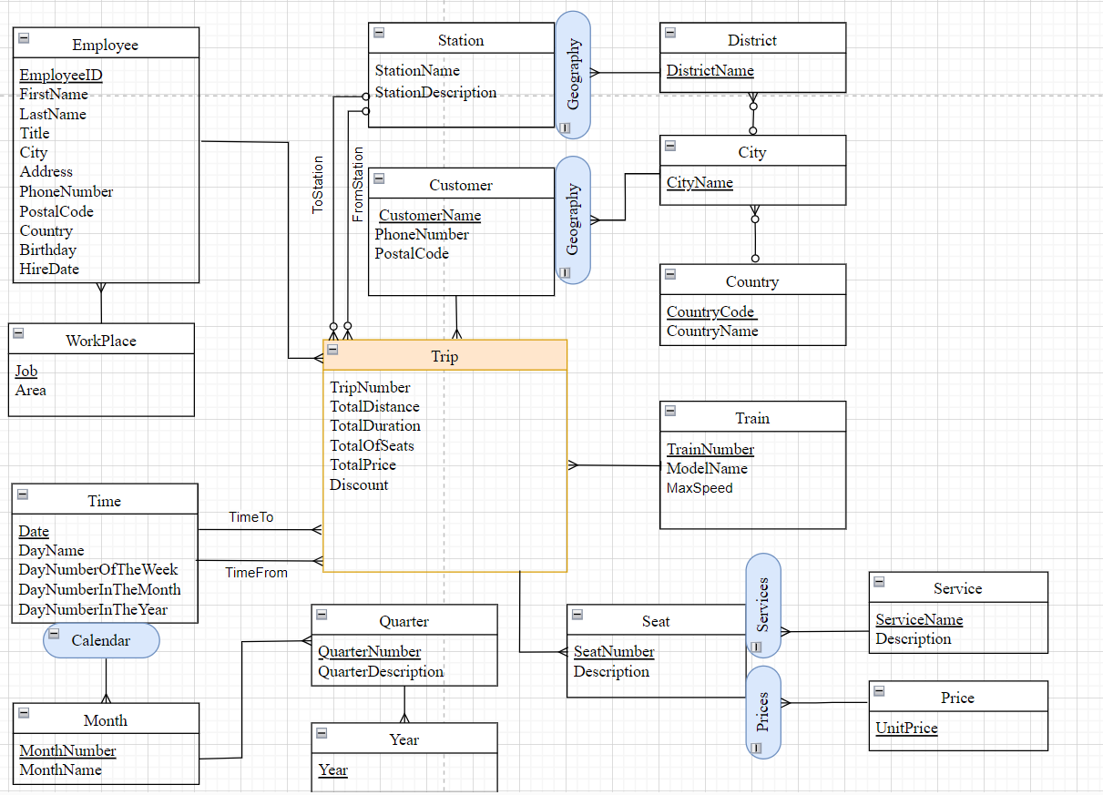

Slide 9
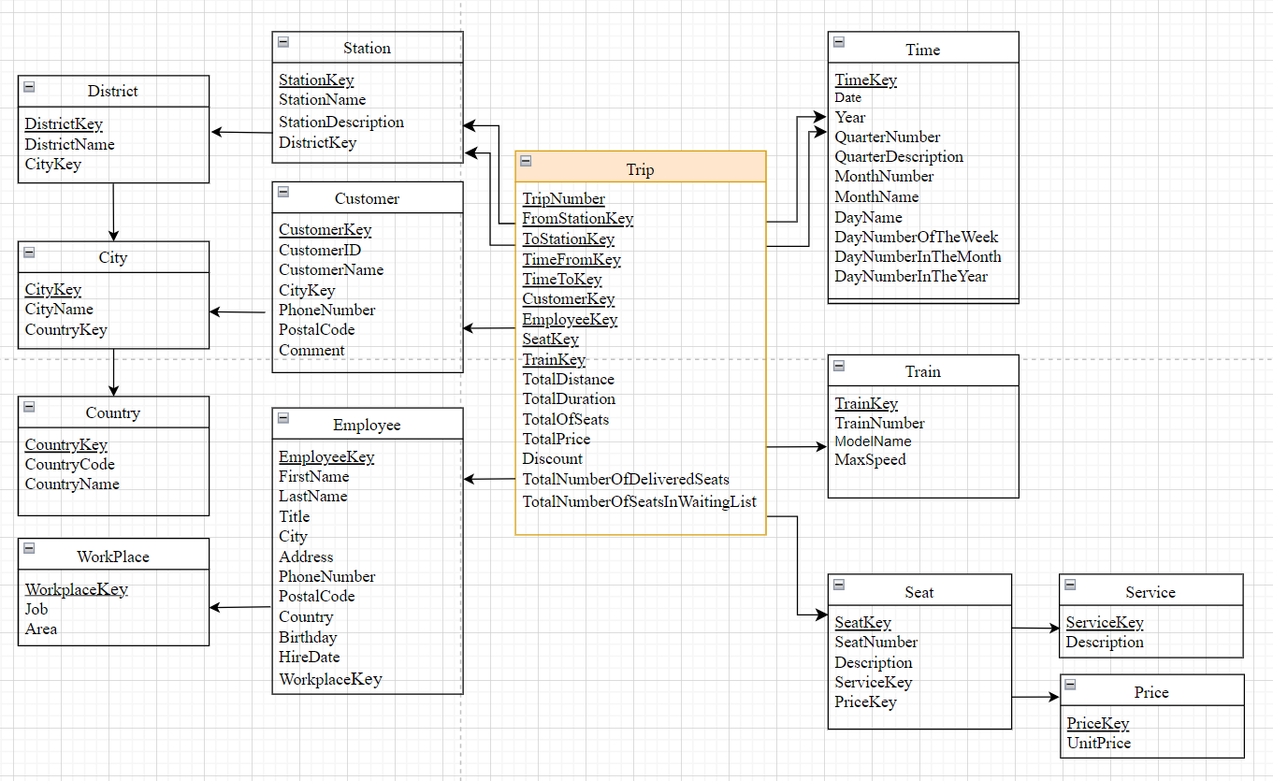

Slide 10
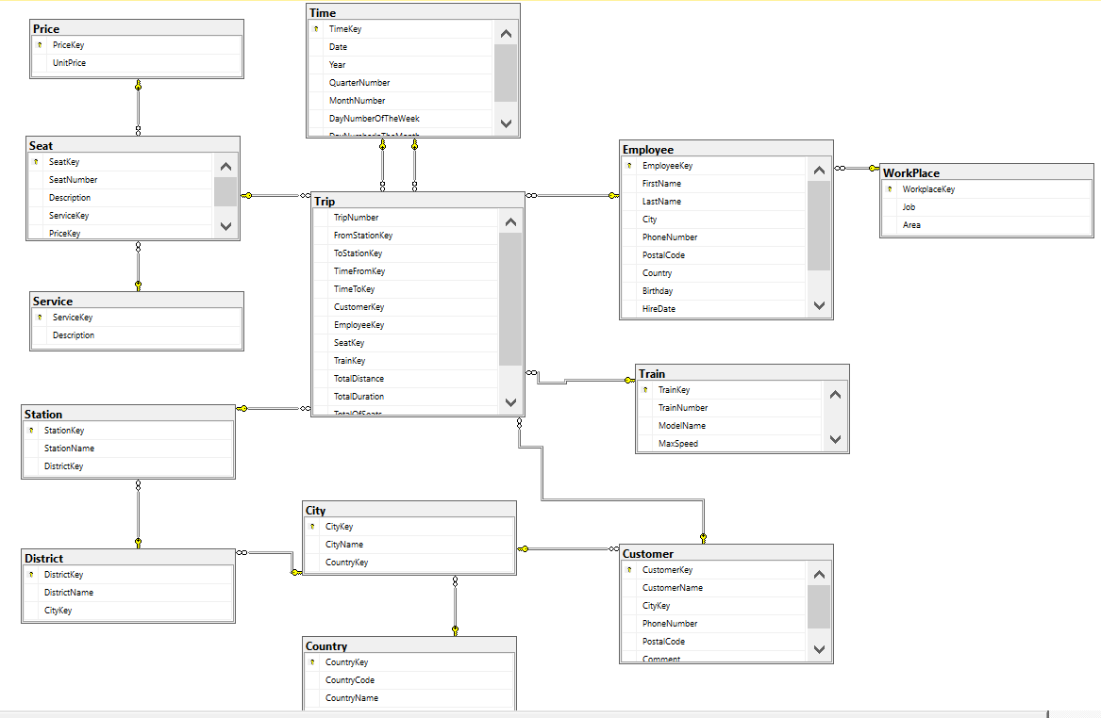

Slide 11
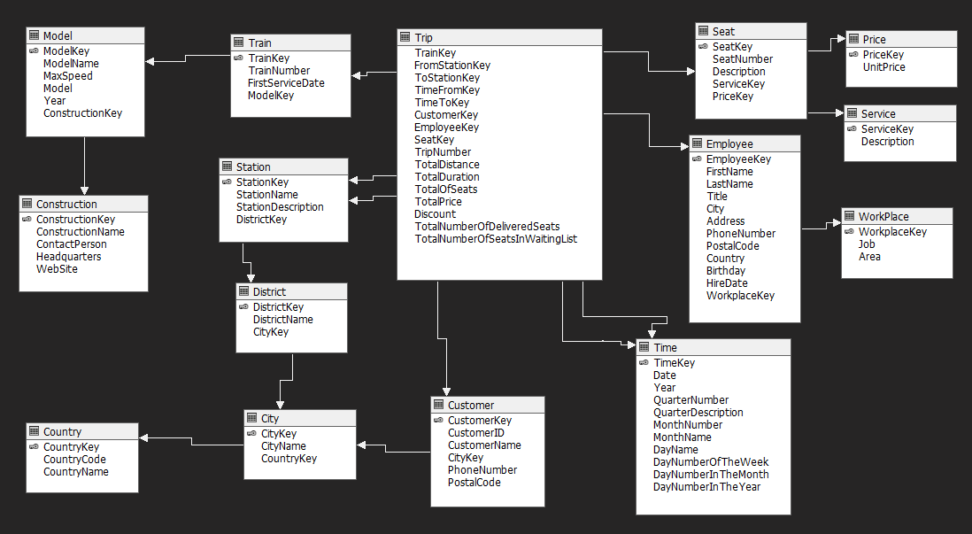

Slide 12
select S.TrainNumber,SUM(P.TotalPrice) as Total
from Train S, Trip P
where S.Trainkey=P.Trainkey
Group by S.TrainNumber
SELECT t1.TrainNumber, COUNT(e.LastName) as count_employee, count(c.CustomerName) as count_customer
FROM Trip t
JOIN Train t1 ON t.TrainKey = t1.TrainKey
JOIN Employee e ON t.EmployeeKey = e.EmployeeKey
JOIN Customer c ON t.CustomerKey = c.CustomerKey
GROUP BY t1.TrainNumber;
select s.Description,count(s.Description) as soluong
from Seat s,Trip T
where s.SeatKey=T.SeatKey
group by s.Description
SELECT t1.MonthNumber, sum(t2.TotalPrice) as"doanh thu theo thang"
FROM Time t1, Trip t2
where t1.TimeKey = t2.TimeToKey
GROUP BY t1.MonthNumber
select t1.QuarterDescription, sum(t2.totalprice) as doanhthuquy
from Time t1, Trip t2
where t1.TimeKey=t2.TimeToKey
group by t1.QuarterDescription

Slide 13
select t.TrainNumber as trainnum,c.ConstructionName as construc,m.ModelName as model,m.Year as year,m.MaxSpeed as maxspeed,c.ContactPerson as contact,c.Headquarters as head
from Train t, Model m, Construction c
where t.ModelKey=m.ModelKey and c.ConstructionKey=m.ConstructionKey
SELECT S1.StationName as ToStationName, S2.StationName as FromStationName,P.TrainNumber, T1.Date as TimeTo, T2.Date as TimeFrom
FROM Station S1
JOIN Trip T ON S1.StationKey = T.ToStationKey
JOIN Train P ON P.TrainKey = T.TrainKey
JOIN Station S2 ON S2.StationKey = T.FromStationKey
JOIN Time T1 ON T.TimeToKey = T1.TimeKey
JOIN Time T2 ON T.TimeFromKey = T2.TimeKey
select t.TrainNumber,c.ConstructionName,m.ModelName,m.Year,m.MaxSpeed,c.ContactPerson,c.Headquarters
from Train t, Model m, Construction c
where t.ModelKey=m.ModelKey and c.ConstructionKey=m.ConstructionKey
select e.FirstName,e.LastName,e.City,e.Country, e.PhoneNumber,S.TrainNumber
from Employee e,Trip T, Train S
where e.EmployeeKey=T.EmployeeKey and S.TrainKey=T.TrainKey

Slide 14
SELECT s.SeatNumber, e.CustomerName, e.PhoneNumber, p.UnitPrice, t1.Date as timeto, t2.Date as timefrom, S1.StationName as ToStationName, S2.StationName as FromStationName
FROM Trip T
JOIN Customer e ON T.CustomerKey = e.CustomerKey
JOIN Seat s ON s.SeatKey = T.SeatKey
JOIN Price p ON p.PriceKey = s.PriceKey
JOIN Time t1 ON t1.TimeKey = T.TimeToKey
JOIN Time t2 ON t2.TimeKey = T.TimeFromKey
JOIN Station S1 ON S1.StationKey = T.ToStationKey
JOIN Station S2 ON S2.StationKey = T.FromStationKey;

Slide 15

welcome!
Sarah doe
Venus has a beautiful name and is the second planet from the Sun. It’s terribly hot—even hotter than Mercury—and its atmosphere is extremely poisonous

Slide 16

welcome!
ANTHONY SMITH
Mercury is the closest planet to the Sun and the smallest one in the Solar System—it’s only a bit larger than the Moon

Slide 17
05
EVENTS
You can enter a subtitle here if you need it

Slide 18
REVIEW OF PAST EVENTS
Jupiter
mars
saturn
It’s the biggest planet of them all
It’s actually a very cold place
It’s one of the planets with rings
Mercury
venus
neptune
It’s the smallest planet of them all
Venus has a very toxic atmosphere
It’s very far away from the Sun

Slide 19
THIS IS A MAP
Mercury
Mercury is quite a small planet
mars
It’s actually a very cold place
VENUS
It has high temperatures

Slide 20
thanks!

