Slide 1



BUILDING THE FOUNDATIONS:
PREPARING NAMIBIAN BUSINESSES FOR AI ADOPTION AMIDST IT INFRASTRUCTURE CHALLENGES
Hubert Patrick Mouton

Slide 2

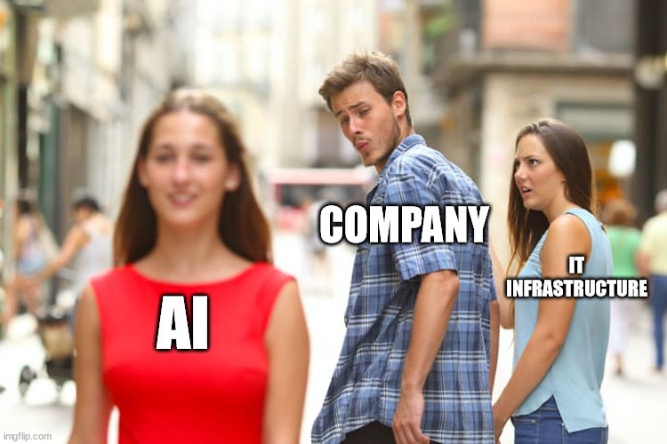
INTRODUCTION
Imagine operating in a world where intelligent insights inform every decision your company makes, where monotonous jobs are automated, and where creativity grows at a rate never seen before.
This is not the future—this is the power of Artificial Intelligence, and it’s revolutionizing industries across the globe.
But for Namibian businesses, the question is not just ‘Why AI?’ but ‘How do we get ready for it?’"

Slide 3
KEY IT INFRASTRUCTURE
COMPONENTS FOR AI
  Data Management: Efficient data storage, accessibility, and analytics are key to AI success, enhancing the accuracy of models and driving better insights.
  Software Engineering: Scalable and secure software ensures AI applications can grow and handle increasing demands without sacrificing performance or security.
  Cybersecurity: Strong cybersecurity measures protect AI systems and sensitive data from breaches and threats, ensuring secure and reliable AI operations.
  Computational Resources: They are critical for running applications, executing tasks, and handling data efficiently.

Slide 4
DATA MANAGEMENT
Data is the Lifeblood of AI: AI systems depend on quality data to function effectively, making robust data management critical.
Why Data Governance Matters:
  Consistency & Quality
  Compliance & Security
  Accessibility & Usability
Governance Policies Should Address:
  Data Ownership: Who is responsible for the data?
  Data Security: How is data protected from unauthorized access?
  Data Lifecycle: How is data stored, updated, and retired over time?
  Data Accessibility: Who can access, modify, or analyze the data?
Outcome:
  A solid governance framework ensures AI applications use high-quality, secure, and well-managed data, leading to more accurate insights and better business outcomes.

Slide 5
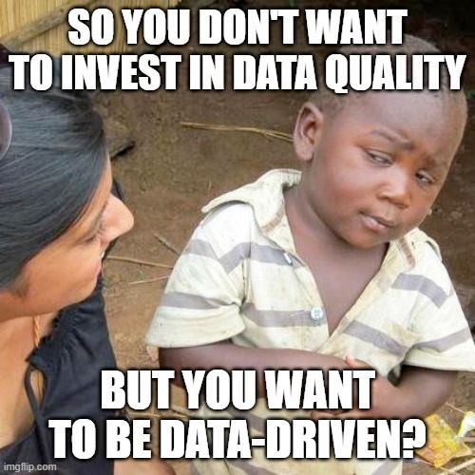
DATA MANAGEMENT

Slide 6
SOFTWARE INFRASTRUCTURE
AI systems depend on software tools to ingest and process massive amounts of data from various sources—structured and unstructured.
Why Software Architecture Matters:
  Ensures Maintainability
  Improves Security
  Foundation for Scalability
Problems that a Software Architecture Address:
  Integration Points: Define how the system will integrate with external services, APIs, or third-party applications.
  Maintainability & Flexibility: Design for easy updates, bug fixes, and future enhancements.
  Clarity
Outcome:
  A well-documented software architecture enables scalable, secure, and efficient AI systems, ensuring the application can grow with your business while maintaining performance and security.

Slide 7
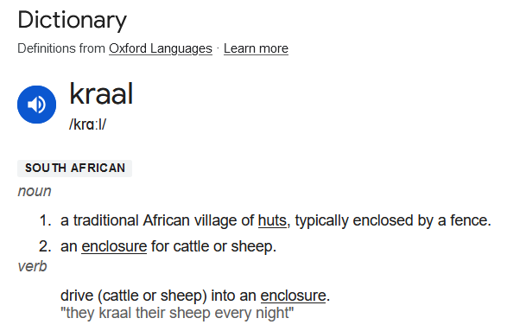
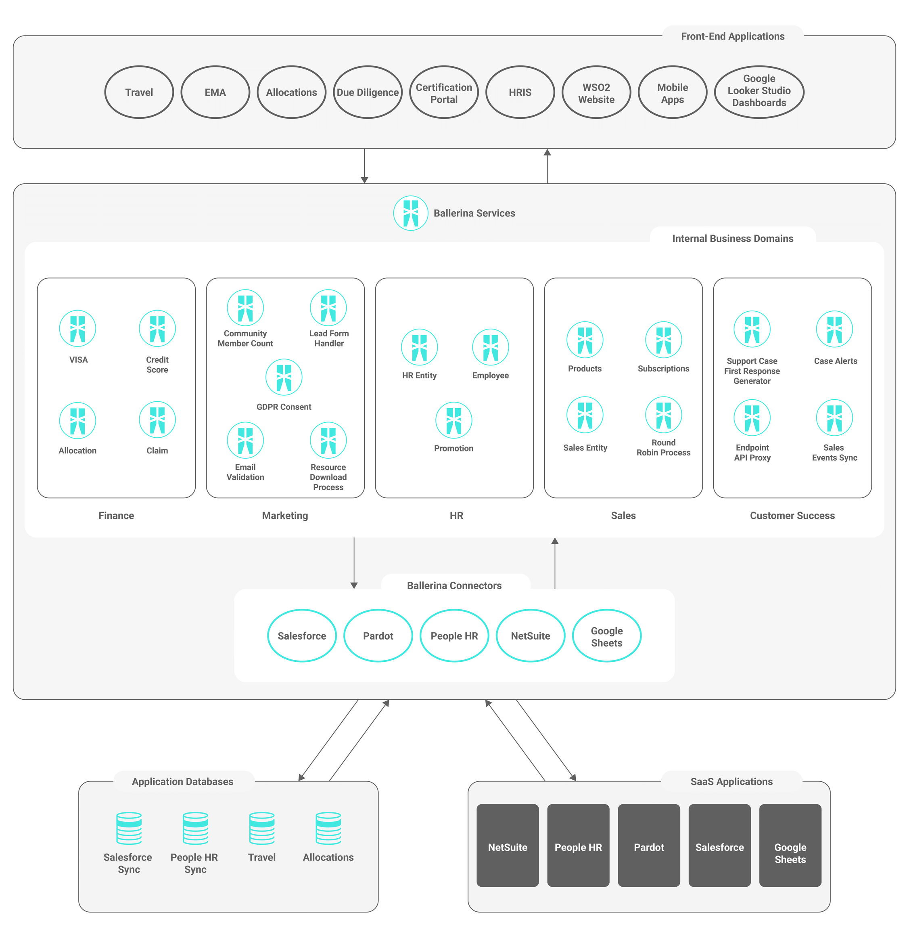
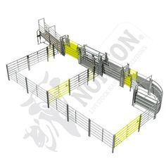
SOFTWARE INFRASTRUCTURE

Slide 8
CYBER SECURITY
In AI, cybersecurity focuses on protecting data, models, and systems from unauthorized access, tampering, and adversarial attacks to ensure integrity, privacy, and reliable performance.
Why Cybersecurity Matters in AI:
  AI systems handle sensitive data (e.g., customer info, financial records).
  Any breach can compromise data integrity, privacy, and trust.
  Attacks on AI models themselves (e.g., adversarial attacks) can disrupt operations or lead to faulty outputs.
Critical Cybersecurity Measures:
  Data Encryption:
  Access Control & Authentication:
  AI-Specific Security:
Outcome:
  Secure AI Operations: Robust cybersecurity ensures AI systems remain reliable and protect the confidentiality, integrity, and availability of data, safeguarding the entire operation.

Slide 9
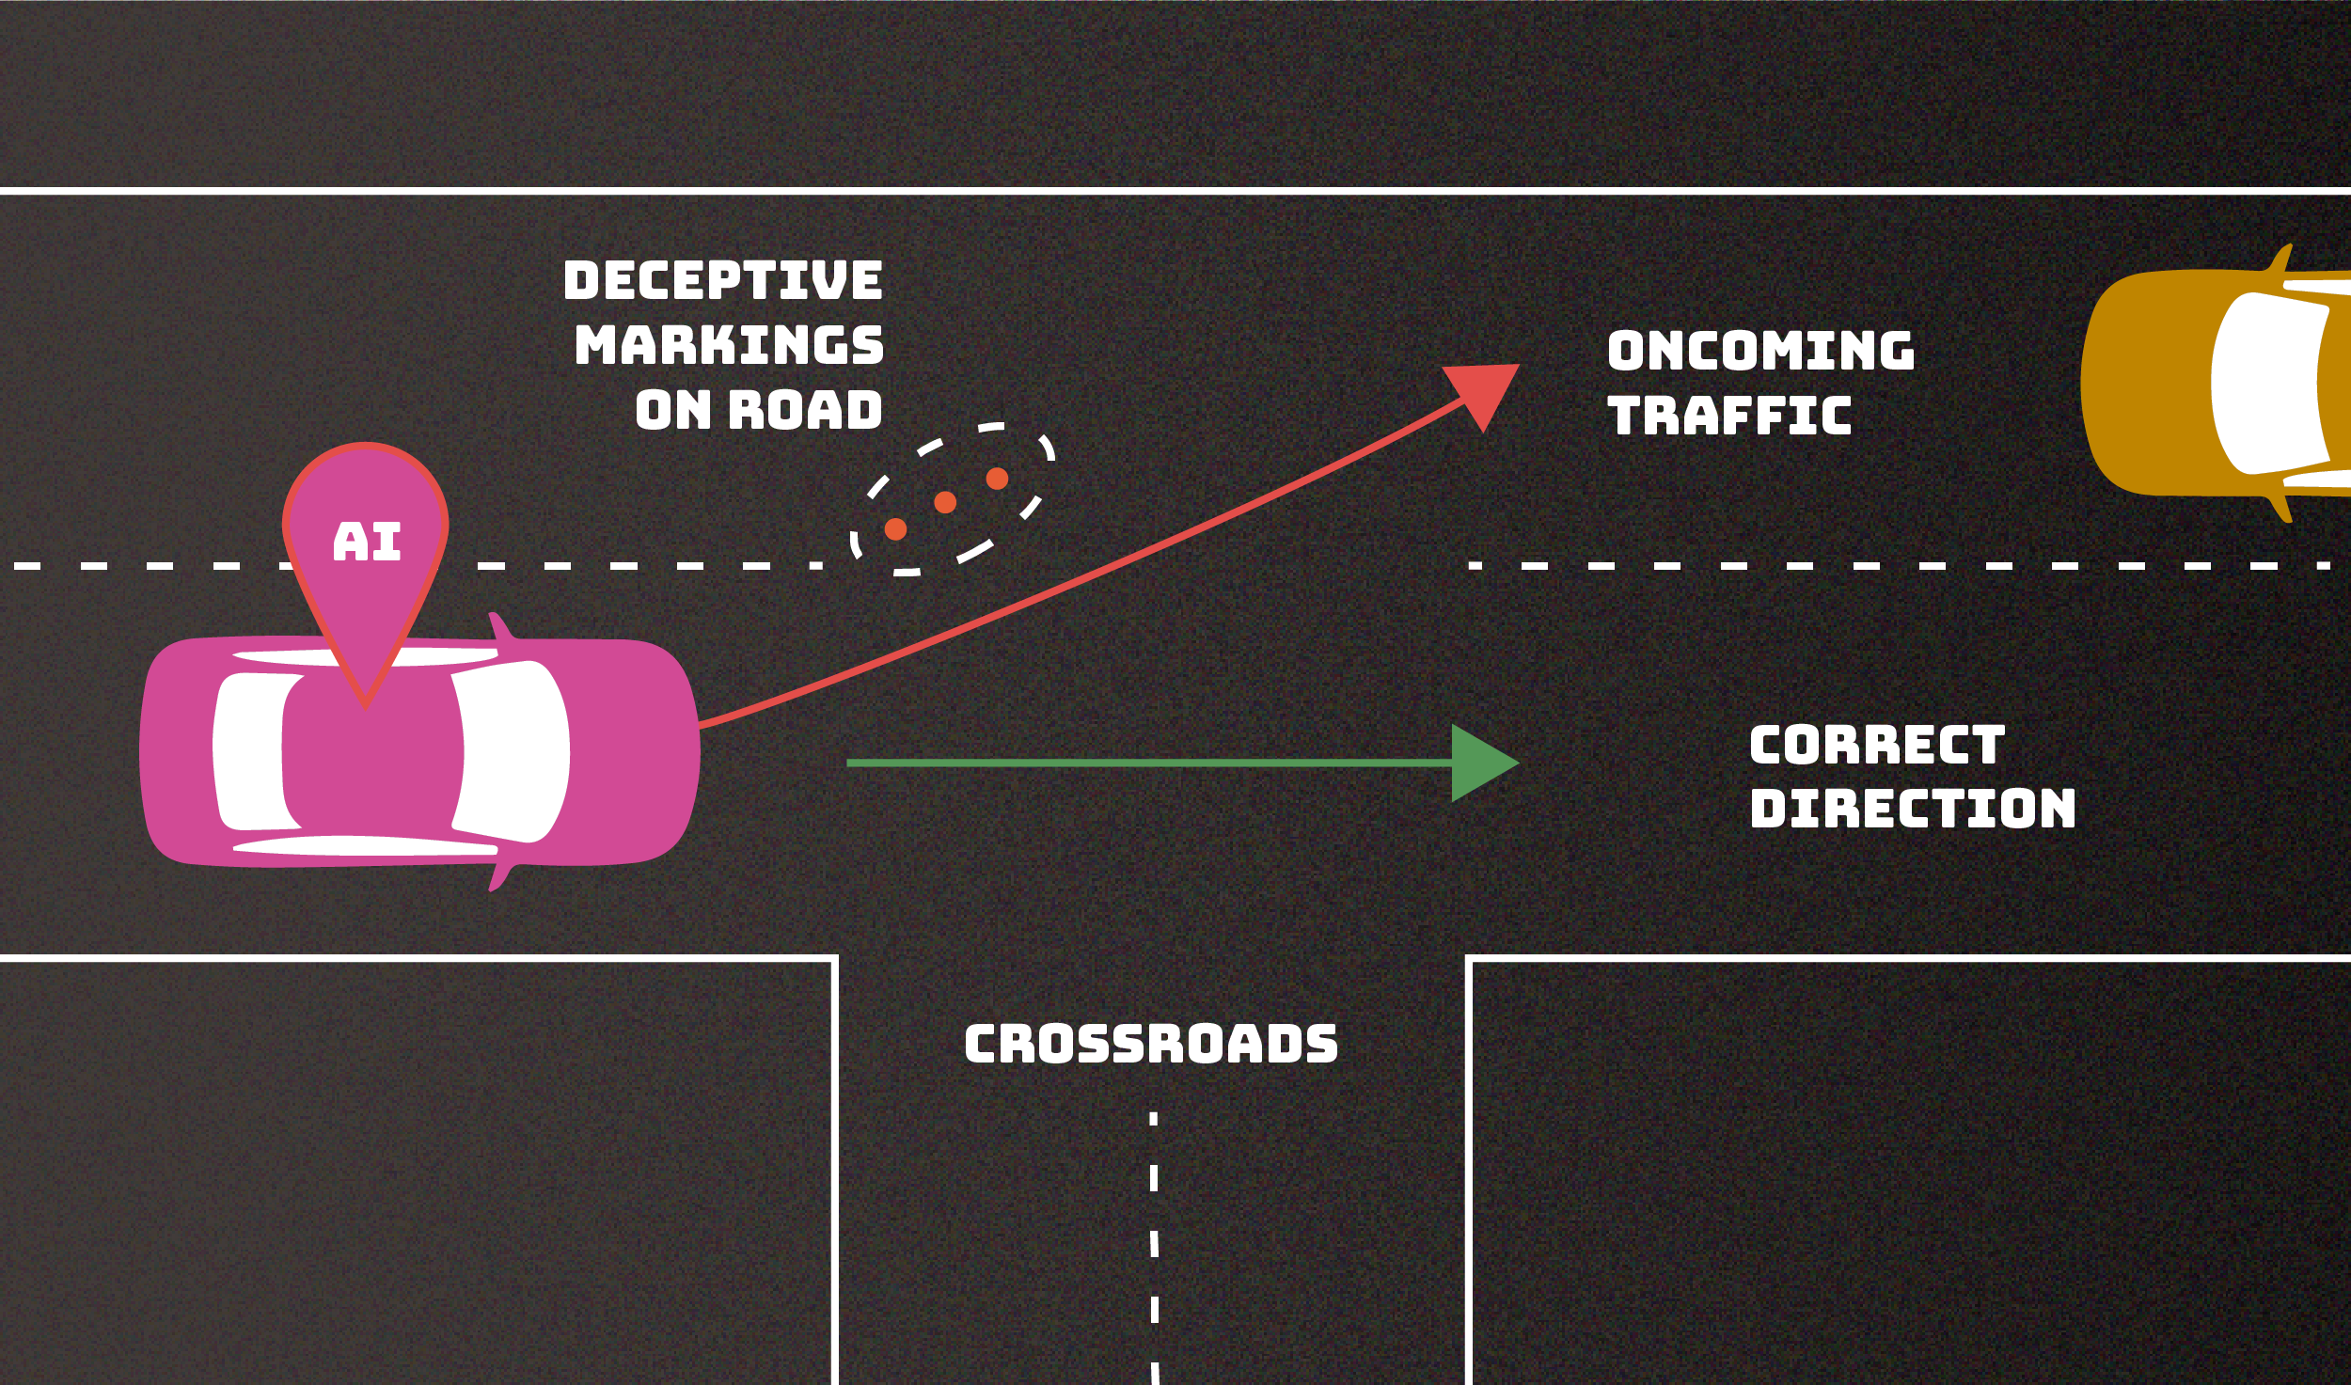
CYBER SECURITY

Slide 10

COMPUTATIONAL RESOURCES
Computational resources enable AI adoption by providing the processing power, memory, and storage needed for efficient model training, data handling, and deployment.
Why Computational Resources Matter in AI:
  Processing Power
  Storage
  Scalability
Outcome:
  A solid computational resource aspect in IT infrastructure enhances AI performance, scalability, reliability, and cost efficiency.

Slide 11

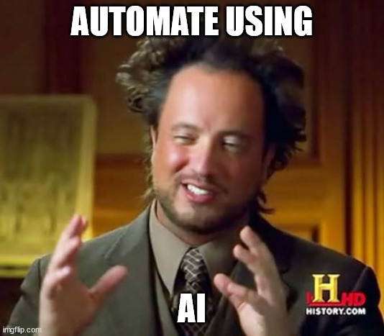
KEY
TAKAWAYS
  Data Governance
  Software Architecture
  Cybersecurity
  Computational Resources

Slide 12

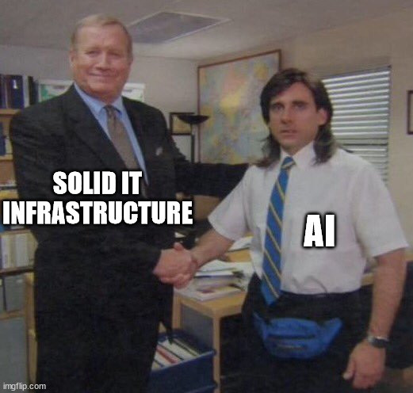
THANK YOU!
moutonh@telecom.na

