Slide 1


TOPIC
National Digital strategy Plan 2025 - 2029
“The Framework for Digital Transformation”
MS. LINDA AIPINGE-NAKALE
DIRECTOR: ICT DEVELOPMENT
MINISTRY OF INFORMATION AND COMMUNICATION TECHNOLOGY

Slide 2
OUTLINE
1
INTRODUCTION
2
HIGH LEVEL STATEMENTS
METHODOLOGY/APPROACH
3
4
5
6
CHALLENGES
POLICY ALIGHNMENT
ALIGNMENT
7
8
9
STRATEGIC FRAMEWORK
PILLAR FOCUS
10
IMPLEMENTATION
MONITORING & EVALUATION

Slide 3
INTRODUCTION
The National Digital Strategy (NDS)
a comprehensive blueprint for the Country
  to harness digital technologies for economic growth, social inclusion, and overall societal advancement

Slide 4
HIGH LEVEL STATEMENTS
To empower Namibians to thrive in a digital era by strategically leveraging digital innovations for national development.
1. To create a roadmap.
2. To bridge the digital divide.
3. To promote digital literacy.
4. To provide citizen-centric digital public services.
5. Create opportunities for all
1. Whole of Society
2. Sustainability
3. Agility

Slide 5
Challenges
Outdated/ inadequate digital infrastructure,
Inadequate digital skills and education
Outdated/ absent legislative and policy framework
Access to electricity/ affordability
Access to ICT services/ affordability
Mobile broadband penetration
E-government roll out
Low level of digitisation activities and integration of local content
Low intensity of mobile apps development
Security Concerns
Financial constraints/ investment in ICT

Slide 6
POLICY ALIGNMENT
Thematic Area | Policy/Regulation/Strategy
National Development Plans | Presidential 4IR Commission Report
 | Harambee Prosperity Plan II (HPP2)
 | National Development Plan
 | Vision 2030 for the Republic of Namibia
Digital Financial Services | National Payment System Vision and Strategy (2021–2025)
 | Electronic Transactions Act 4 of 2019
E-Government | E-government Strategic Action Plan 2014–2018
 | IT Policy for the Public Service 2008
 | E-government Policy for the Public Service 2005

Slide 7
POLICY ALIGNMENT
Thematic Area | Policy/Regulation/Strategy
Broadband Development | Namibia Broadband Policy (2018–2022)
 | Universal Service and Access Policy (2013)
 | Overarching ICT Policy 2009 (OICTP 2009)
Cybersecurity | National Cybersecurity Strategy and Awareness Raising Plan 2022–2027
 | Cybercrime Bill
Access to Information | Access to Information Act, 2022 (Act No. 8 of 2022)
 | Access to Information Regulations

Slide 8
POLICY ALIGNMENT
Thematic Area | Policy/Regulation/Strategy
Communication | Government Communication Strategy 2022–2027
 | Communications Amendment Act, 2020 (Act No. 6 of 2020)
 | Electronic Transactions Act 4 of 2019 (Partially Enacted 2020)
Draft Legislation/Strategies | Draft Data Protection Bill
 | Digital Government Strategic Roadmap for Namibia 2024–2026
 | Cybercrime Bill

Slide 9
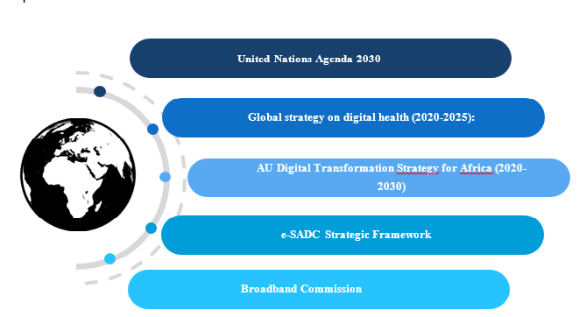
ALIGNMENT

Slide 10
METHODOLOGY/APROACH
Digital Landscape Assessment
Research & Analysis
Stakeholder Workshops
Inclusivity
1-On-1 Interviews
Validation of inputs
National Survey
Collect quantitative data for quantitative assessment
Benchmarking
Global Trends
Takes stock of challenges and issues of concerns from all stakeholders

Slide 11






STRATEGIC FRAMEWORK
VISION
Empower Namibians to thrive in a digital era by strategically leveraging digital innovations for national development.
MISSION
Realise a future where the benefits of digitalisation extend across the nation in the next 5 years; bridging the digital divide, promoting digital literacy, access digital public services and creating greater economic opportunities for all Namibians.
Digital Infrastructure
Digital Skills
Digital Government
Industry and Innovation
Policy and Regulation
PILLAR 1
PILLAR 2
PILLAR 3
PILLAR 4
PILLAR 4
CROSS-CUTTING THEMES
Gender and Youth | Cybersecurity | Emerging Technology
FOUNDATIONAL VALUES
Whole-of-society approach| Sustainability | Agility

Slide 12
PILLAR FOCUS
PILLAR 1: Infrastructure
SO2: Strong cybersecurity measures to protect digital infrastructure against emerging threats and vulnerabilities.
DO: Robust network resilience and disaster risk reduction strategies to ensure continuity of digital services in adverse situations.
SO1: Accelerate Digital Infrastructure Development and Accessibility
DO1: Accessibility and affordable digital services by investing in retail digital infrastructure and implementing policies that lower the costs of digital access
DO2: High-quality, reliable, digital infrastructure supporting a wide range of use cases, from basic access to advanced digital applications.

Slide 13
PILLAR FOCUS
PILLAR 2: Digital Skills
SO2: Digital Pedagogies and ICT Curriculum Reform
DO: Students are equipped with the skills required for innovation and problem-solving in a digital context.
SO1: Basic Literacy
DO: Basic digital literacy among all age groups, ensuring that every citizen can navigate the digital world with confidence.

Slide 14
PILLAR FOCUS
PILLAR 2: Digital Skills
SO4: Demand-led Skilling and Job Creation
DO: Prepare individuals for the digital economy, emphasizing hands-on, practical experience.
SO3: Educational Administration and Staff Capacity
DO: Capacitate digitally literate educators and administrators, focusing on the adoption of digital tools and resources in educational settings, thereby enhancing the quality and relevance of education.

Slide 15
PILLAR FOCUS
PILLAR 3: Digital Government
SO2: Digital Public Services
DO: Increased government data sharing to allow for improved accessibility and efficiency of public services through a single gateway portal for digital public services.
SO1: Digital Identity
DO: Empower Namibians with a unique digital ID which will form the core requirement to access digital public services.

Slide 16
PILLAR FOCUS
PILLAR 3: Digital Government
SO4: Government Data Centre and Cloud Plan
DO: Design proactive government data storage plans to ensure critical public digital infrastructure is secure and resilient.
SO3: Change Management and Public Sector Capacity
DO: Train a digitally literate public service that are champions of digital government with competent public sector IT specialists to maintain the government's IT infrastructure

Slide 17
PILLAR FOCUS
PILLAR 4: Digital and Innovation
SO2: Digital Industrialization Strategy
DO: Propel Namibia into a leading position in the digital economy, utilising tech in high impact economic and social sectors.
SO3: Research and Innovation Agenda
DO: Established mechanisms and partnerships for development-oriented and market driven research and development.
SO1: Entrepreneurship Ecosystem Deepening
DO: Establish a fertile ground for innovation and entrepreneurship to drive context relevant and bottom-up economic growth.

Slide 18
PILLAR FOCUS
PILLAR 5: Policy & Regulation
SO2: Adoption of Outstanding Legislation
DO: Adoption and implementation of this legislation creates an enabling environment for Namibia to leverage digital technologies for economic growth, innovation, and enhanced public service delivery
SO3:Regulatory Sandboxes
DO: Accelerated regulation of emerging digital services through responsive regulatory innovation
SO1: Emerging Technology Governance
DO: Ensuring that innovation is nurtured while implementing necessary security measures and ethical safeguards.

Slide 19
IMPLEMENTATION: GOVERNANCE MODEL
Ministry of ICT leadership provides high-level oversight on the development of the NDS.
MICT
MICT
The Steering Committee, called the ‘Executive Think Tank’ of the NDS is the coordination body for the implementation and monitoring of the Strategy.
National Digital Strategy Executive Think Tank
Implementation Stakeholders are entities involved with strategic actions in the implementation plan.
Implementation Stakeholders
MICT provides secretariat to support to the bodies involved in the strategy implementation.

Slide 20
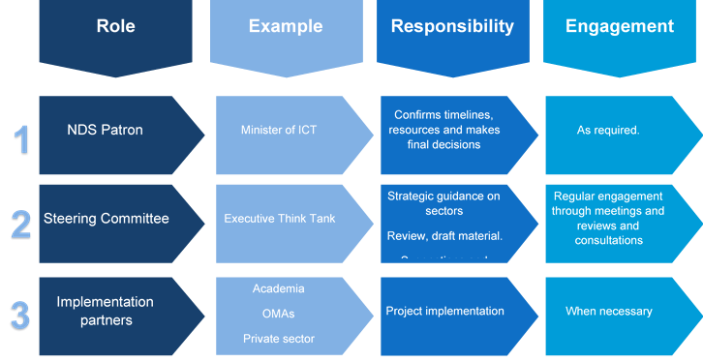
IMPLEMENTATION: ROLES & RESPONSIBILITIES

Slide 21
MONITORING, EVALUATION AND REPORTING APPROACH
Report | Prepared By | Submitted to
Quarterly Progress Report | M&E Sub Committee | NDSETT
Annual Report | NDSETT | Ministry of ICT
Mid Term Evaluation | NDSETT | Ministry of ICT
End term Evaluation | Minister of ICT | Cabinet

Slide 22
WAY FORWARD
Validation by
key stakeholders
Finalisation
Of the Strategy
Submit Strategy to Cabinet for approval and implementation
Launch the Strategy
Strategy implementation

Slide 23
THANK YOU!
Q & A?

