Slide 1






Education 4.0: Building Resilient Learners in the Digital Age
SPEAKER
BARTHROMEUS SHILEKA

Slide 2





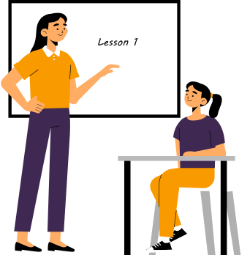
Introduction
The Fourth Industrial Revolution has ushered in an era of unprecedented technological advancement, transforming industries and societies worldwide. The education sector is no exception, with the convergence of digital transformation and artificial intelligence (AI) reshaping the way we learn and teach.

Slide 3




Personalized Learning
Understanding Education 4.0
Social constructivism
Education 4.0 is characterized by:
Technology Integration

Slide 4






Building Digital Resilience
Borcelle Company
Digital Literacy
Critical Thinking
Creativity and Innovation

Slide 5








The Educational Technology
of Namibia’s Simulations
Theoretical
Learning
Practical Learning

Slide 6











Leveraging Technology for Personalized Learning
Tailoring content and pacing to individual student needs
Creating immersive and engaging learning experiences.
Providing personalized guidance and feedback
Adaptive Learning Platforms
Intelligent Tutoring Systems
Virtual and Augmented Reality
Education 4.0

Slide 7



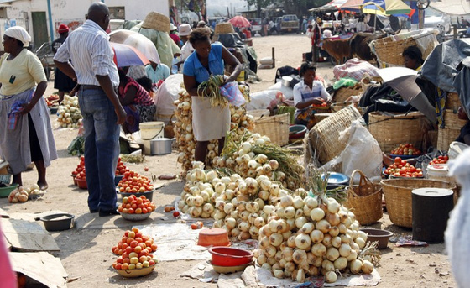
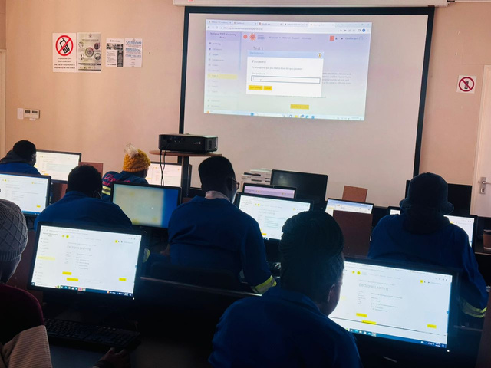
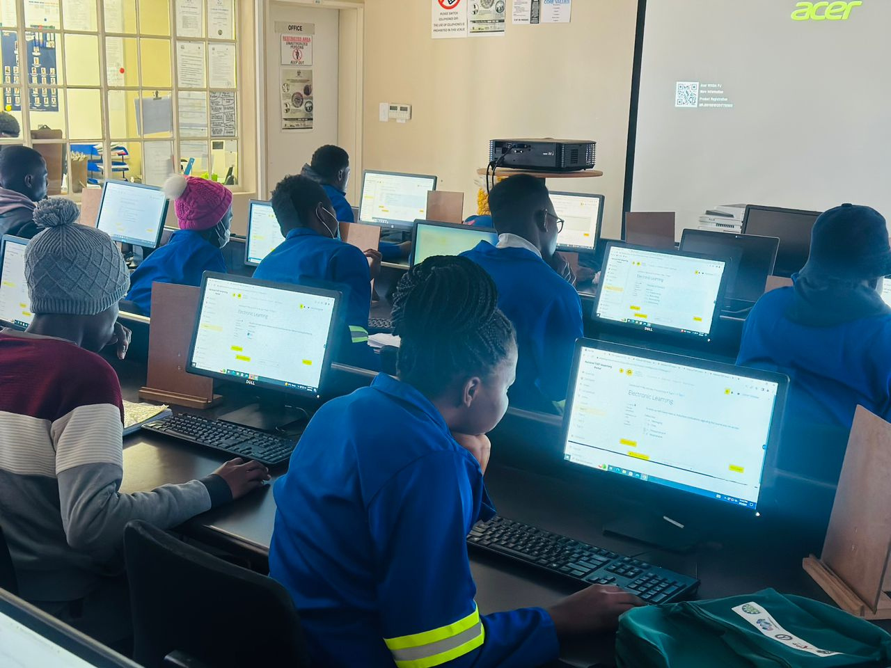
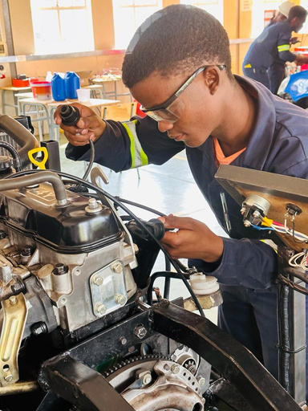




COMMUNITY IMPACT OF EDUCATION 4.0

Slide 8
INVOLVING STUDENTS IN SIMULATION DEVELOPMENT

Slide 9



Thank's For Listerning
Connect with us.
https://edutec4.mydurable.com/

