Slide 1




Faculty of Computing and Informatics
Role of High-Performance Computing in
Digital Transformation, Data Science and Artificial Intelligence
Presented By:
Arpit Jain
Centre Head
India - Namibia Centre of Excellence
in Information Technology, NUST

Slide 2

Agenda
01 High Performance Computing
02 HPC in Artificial Intelligence
03 HPC in Digital Transformation
04 HPC PARAM !ARUB
05 OPPORTUNITY

Slide 3
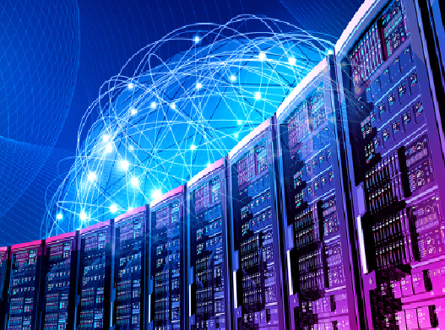
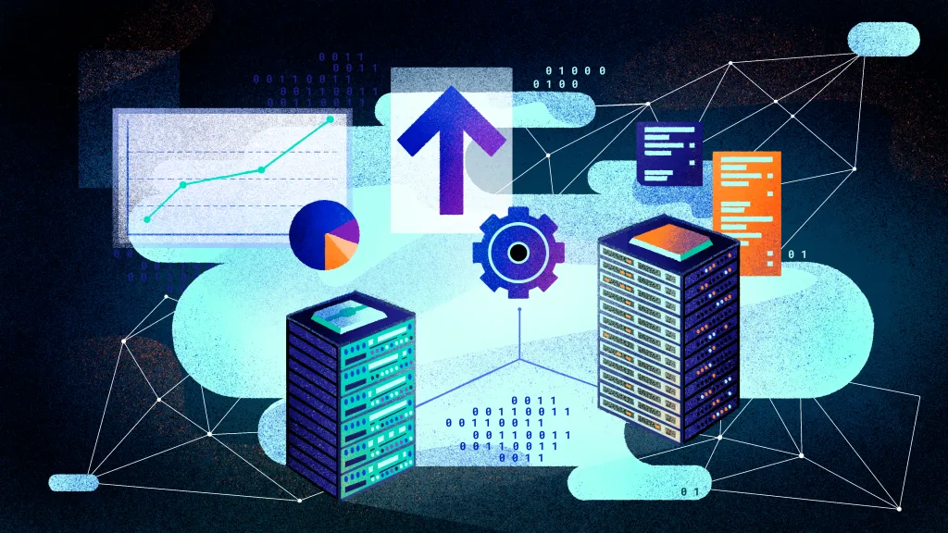
High Performance Computing
HPC is a technology that uses clusters of powerful processors that work in parallel to process massive, multidimensional data sets and solve complex problems at extremely high speeds.
Parallel Computing
Large-scale computations by dividing tasks across multiple processors.
Specialised Applications and storage
Domain-specific applications and massive storage to manage vast amounts of data.
Accelerators (GPUs/FPUs)
Hardware accelerators like GPUs that boost performance for specific computational tasks.
Resource Management Software
Manages job scheduling, load balancing, and resource allocation across the HPC system.

Slide 4
Existing Challenges
Industries face several challenges related to computational resources that can hinder efficiency, innovation, and competitiveness.
Insufficient Processing Power
Lack of adequate computational power to handle complex simulations, data analysis, and AI workloads.
Inability to Handle Big Data
Limited capacity to process and analyze large datasets, leading to missed insights and opportunities.
High Costs
Managing the high costs of acquiring, maintaining, and upgrading advanced computational infrastructure.
Inadequate Real-Time Analytics
Slower decision-making in industries like finance and healthcare due to the lack of real-time data processing.
Lack of Resources
Skills and expertise required to maintain and update IT infrastructure in a rapidly changing tech landscape.
Performance
Ensuring optimal performance of applications and services, particularly as demand fluctuates.

Slide 5
Why we need HPC ?
Organizations need High-Performance Computing (HPC) to solve complex problems, process large volumes of data, and gain a competitive edge in their respective fields
Accelerated Research and Development
Faster Innovation
Cutting-Edge Research
Data-Intensive Tasks
Big Data Analytics
Artificial Intelligence and Machine Learning
Cost Efficiency and Competitive Advantage
Reduction of Time to Market
Optimization and Efficiency
Advanced Visualization and Rendering
Graphics and Animation
Scientific Visualization
Improved Decision-Making
Real-Time Analytics
Risk Management
Innovation and New Technologies
IoT and Edge Computing
Digital transformation

Slide 6
Impact of High Performance Computing
HPC workloads uncover new insights that advance human knowledge and create significant competitive advantages.
HPC sequences DNA and automates data mining.
Artificial intelligence (AI) algorithms and simulations like those enabling self-driving automobiles.
That analyze terabytes of data streaming from IoT sensors, radar and GPS systems in real-time to make split-second decisions.
Computing and Informatics
Engineering
Scientific Domain
Health and Applied Science
Natural resources
Spatial Science
And many more.....

Slide 7




HPC Use Cases
HEALTHCARE, GENOMICS AND LIFE SCIENCES
HPC applications in healthcare and life sciences include medical record management, drug discovery and design, rapid cancer diagnosis and molecular modeling. HPC visualization helps scientists gather insights from simulations and quickly analyze data.
BANKING
AND
FINANCIAL SERVICES
Performs high-frequency trading, risk analysis, and financial forecasting. In addition to automated trading and fraud detection, HPC powers applications in simulations.
GOVERNMENT
AND
DEFENSE
Two growing HPC use cases in this area are weather forecasting and climate modeling, both of which involve processing vast amounts of historical meteorological data and millions of daily changes in climate-related data points. Other government and defense applications include energy research and intelligence work.
ENERGY
AND
SEISMIC ANALYSIS
In cases that sometimes overlap with government and defense, energy-related HPC applications include seismic data processing, reservoir simulation and modeling, geospatial analytics, wind simulation and terrain mapping.

Slide 8
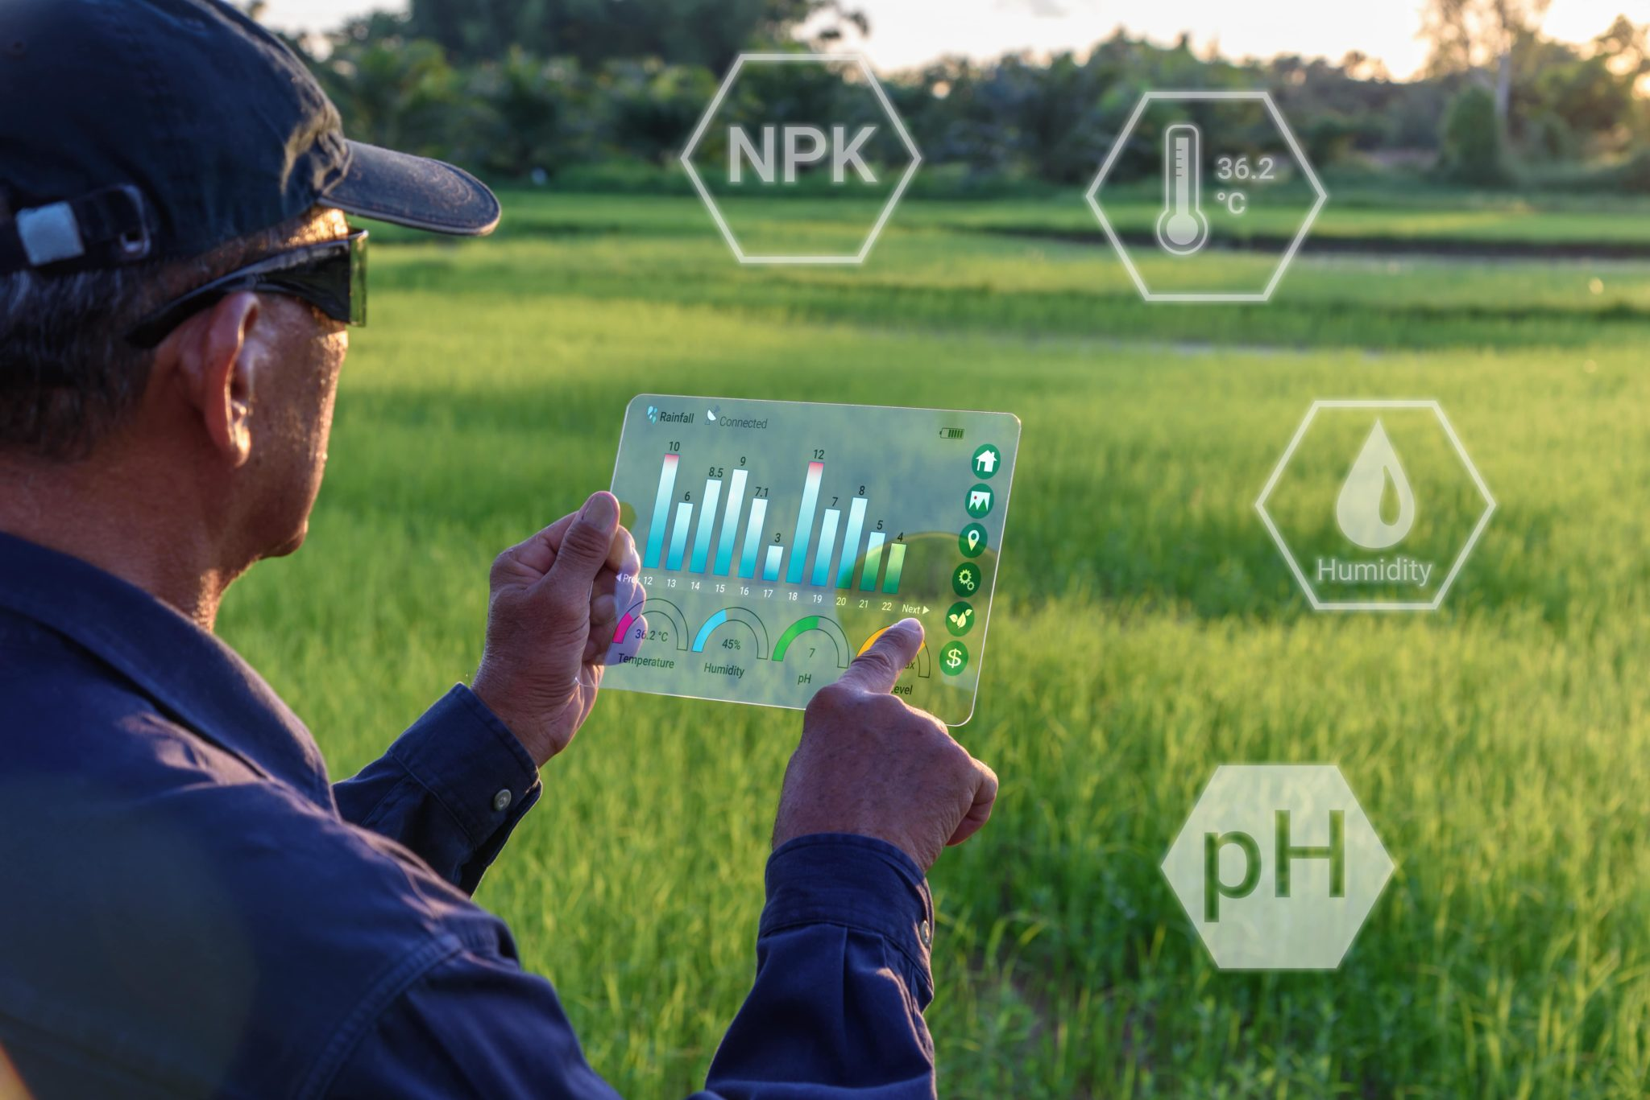
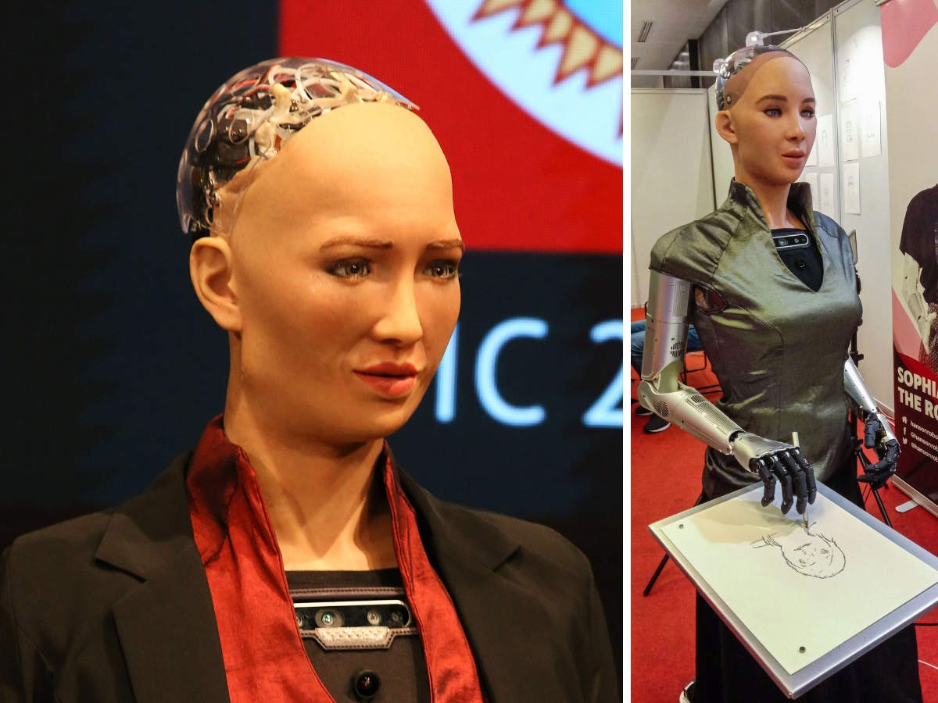
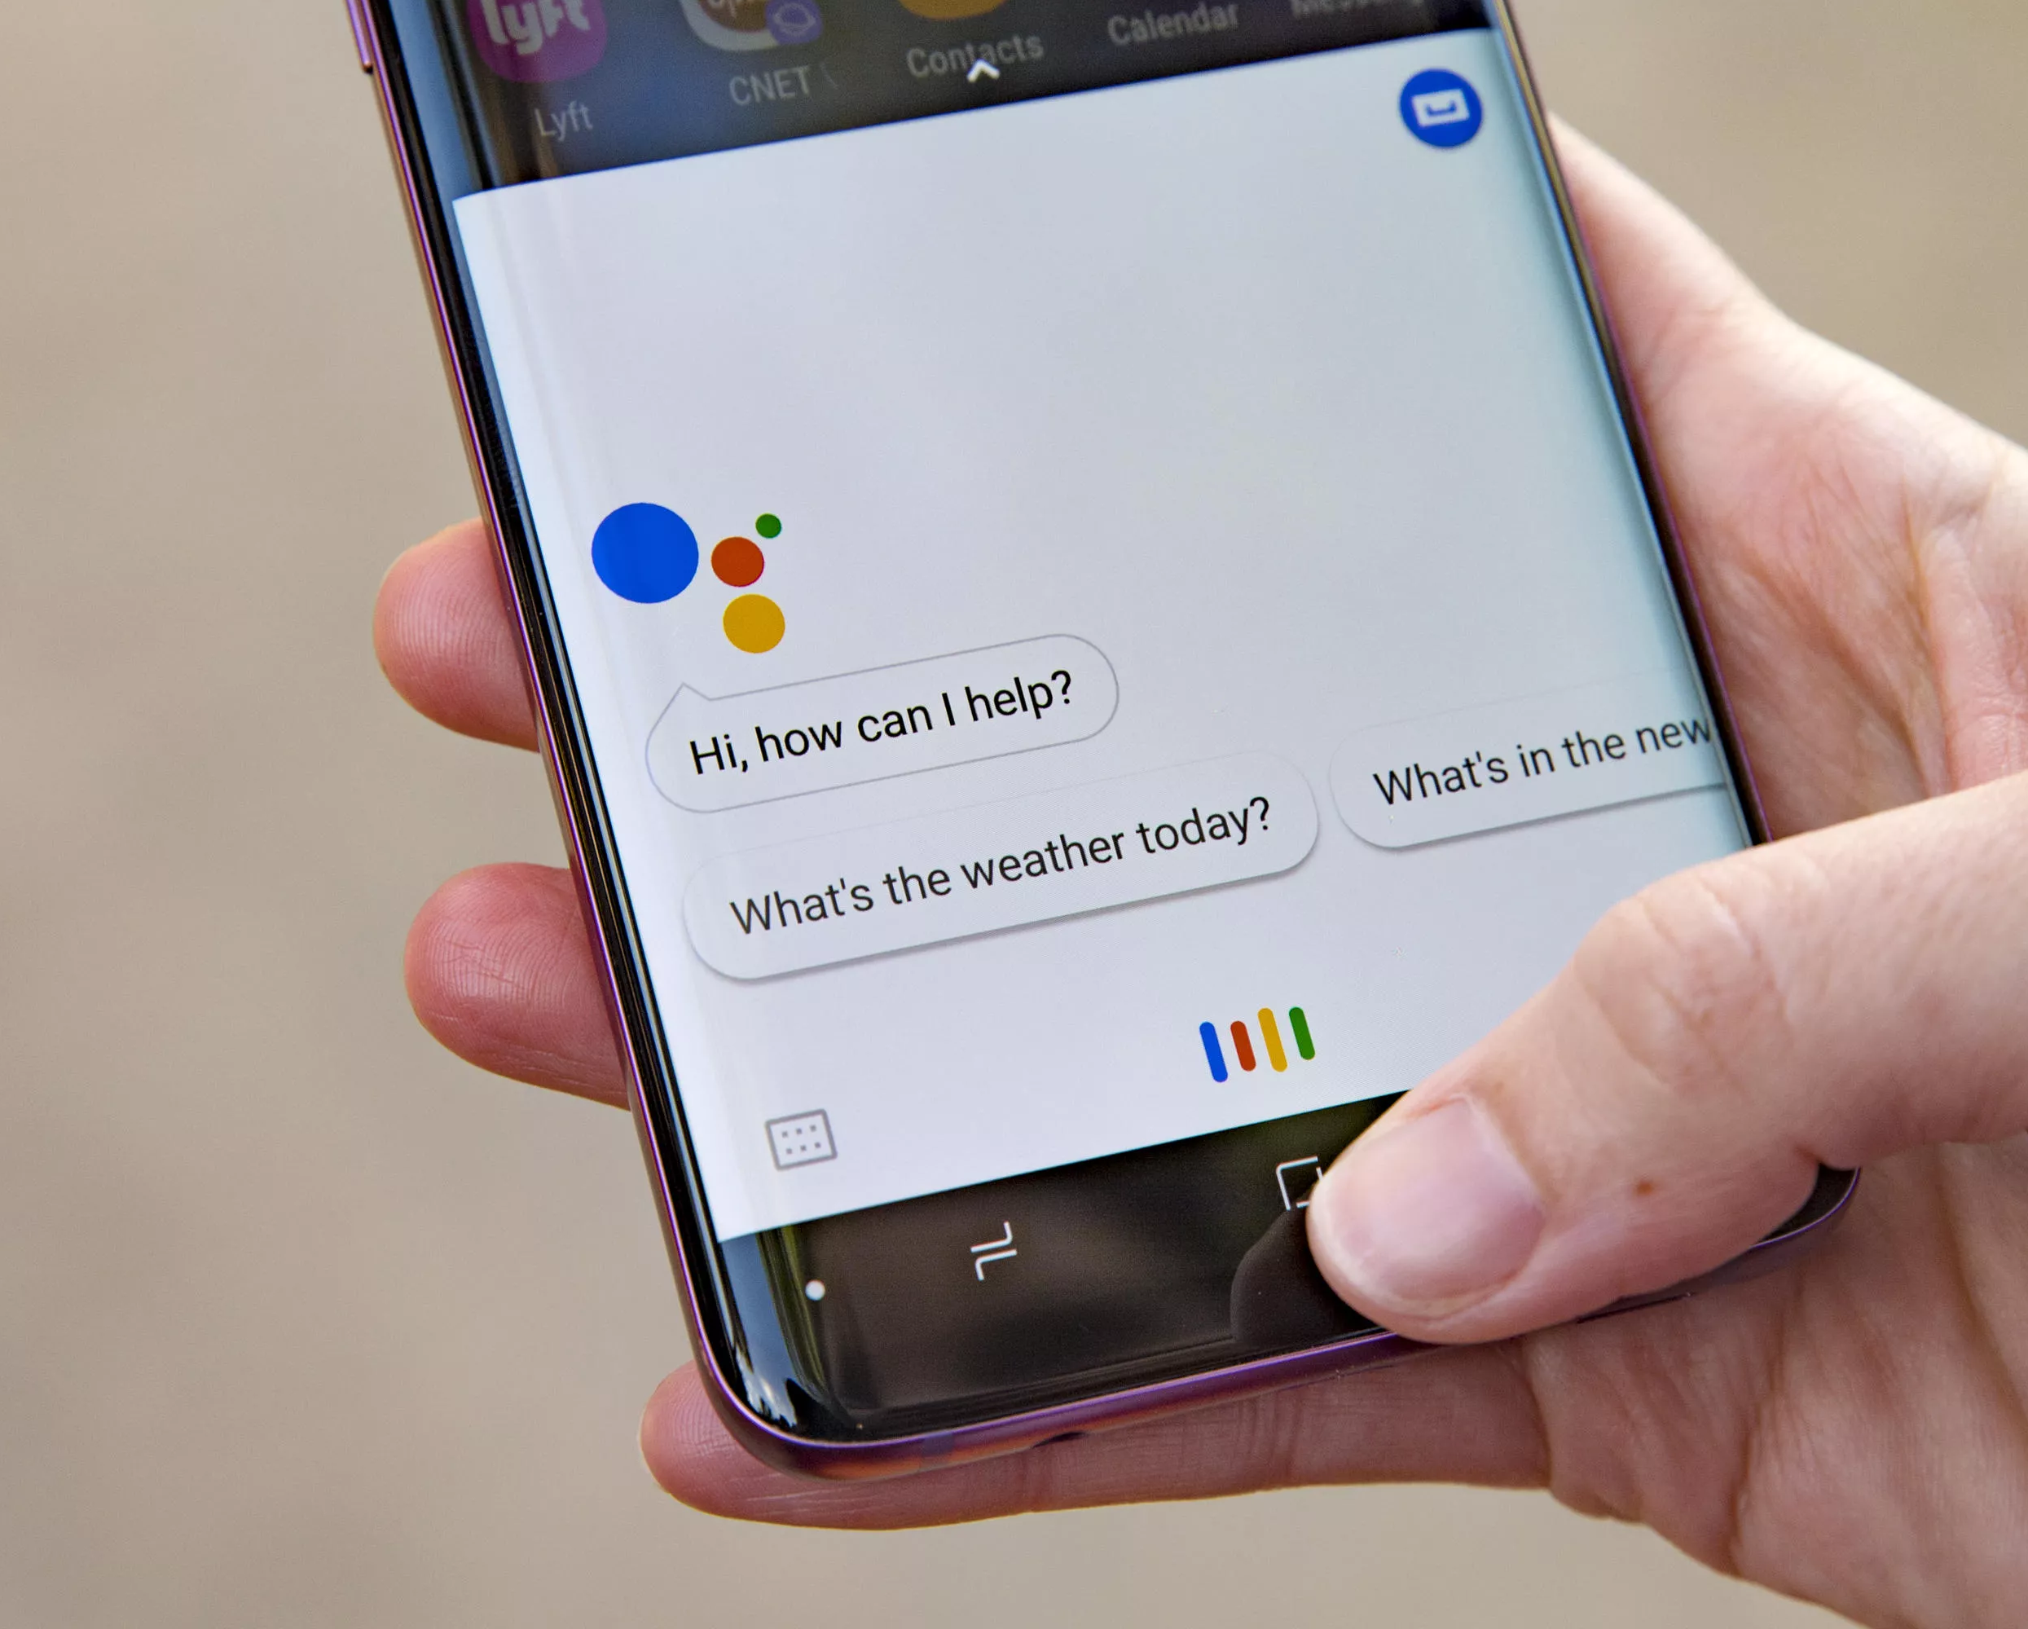

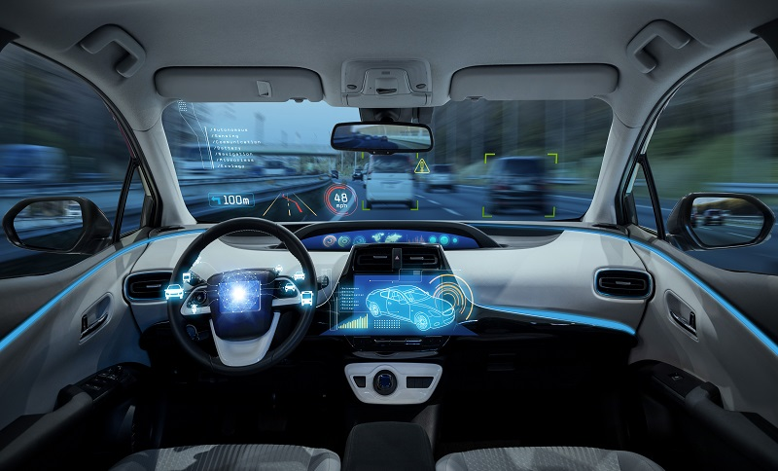
AI in Agriculture
HPC in Artificial Intelligence
AI in Autonomous Vehicle

Slide 9
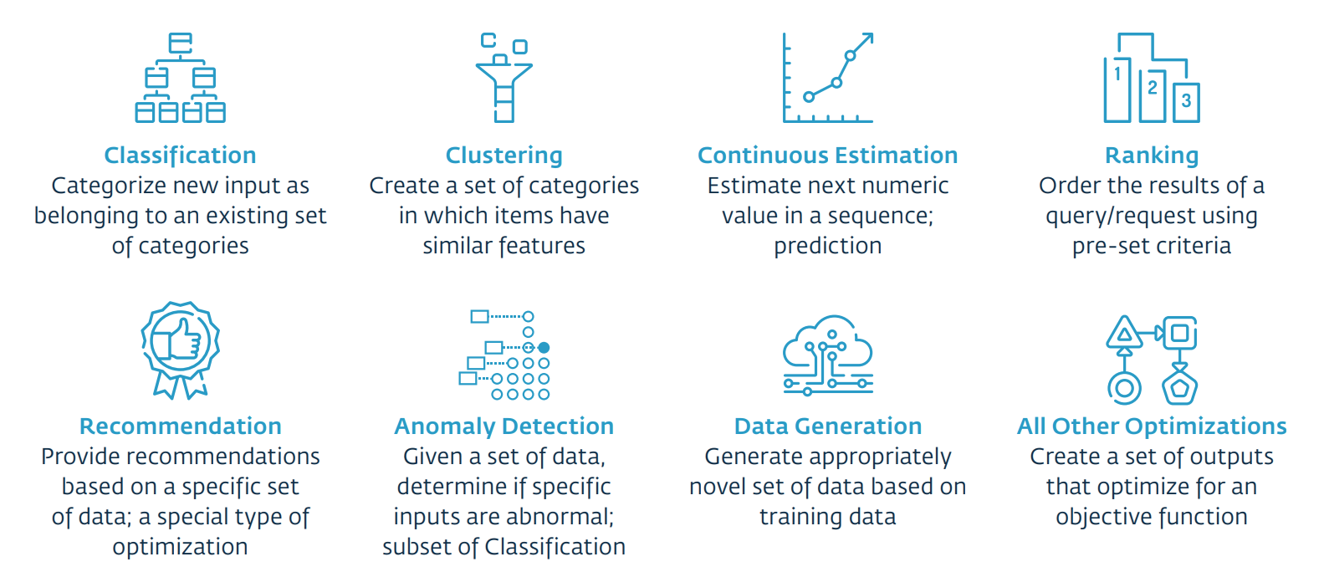
HPC in Artificial Intelligence
A wide range of problem types are addressed by AI

Slide 10
Digital Transformation
EDUCATION
MOBILITY
LOGIN
SECURITY
Face to Face
DRIVER
Passwords
Cyber Security
Online Learning
Autonomous
Biometrics
IOT Security
DECISION
INTERFACES
DATA
INDUSTRIES
Data & Spreadsheet
Buttons
Data Volume
Humans
Artificial Intelligence
Voice
Big Data Analytics
Robots

Slide 11
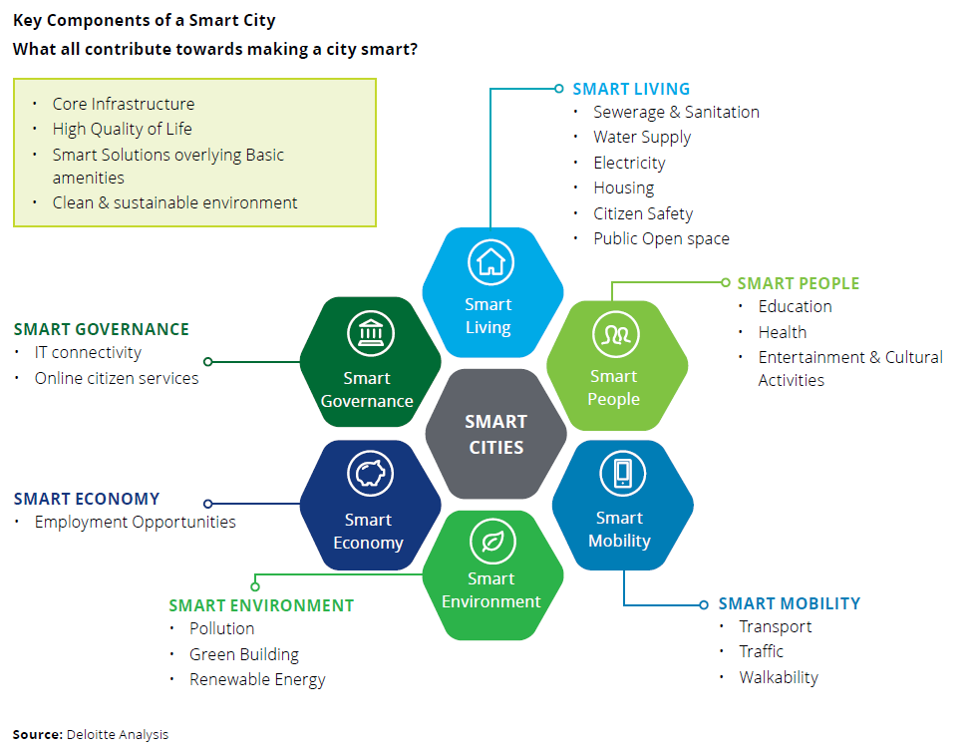
Smart City
HPC helps in managing and analysing vast amounts of data from sensors and IoT devices to improve city infrastructure, traffic management, and public services.

Slide 12




HPC and Digital Transformation
Impact of HPC on Digital Transformation
Speed and Efficiency
Accelerates data processing and business processes
Innovation
Facilitates the development of new products and services by handling complex simulations and analyses.
Competitive Advantage
Enables businesses to stay ahead by leveraging advanced analytics and insights.
Handling Big Data
Ability to handle large-scale data and analyses that drive business innovation.

Slide 13
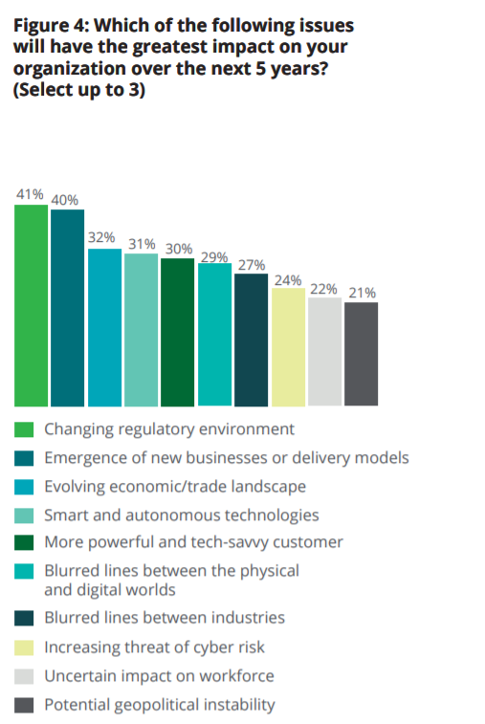
Impact on Organization
TRENDING QUESTION
Which of the following issues will have the greatest impact on your organization over the next 5 years?
Source : Deloitte Analysis

Slide 14
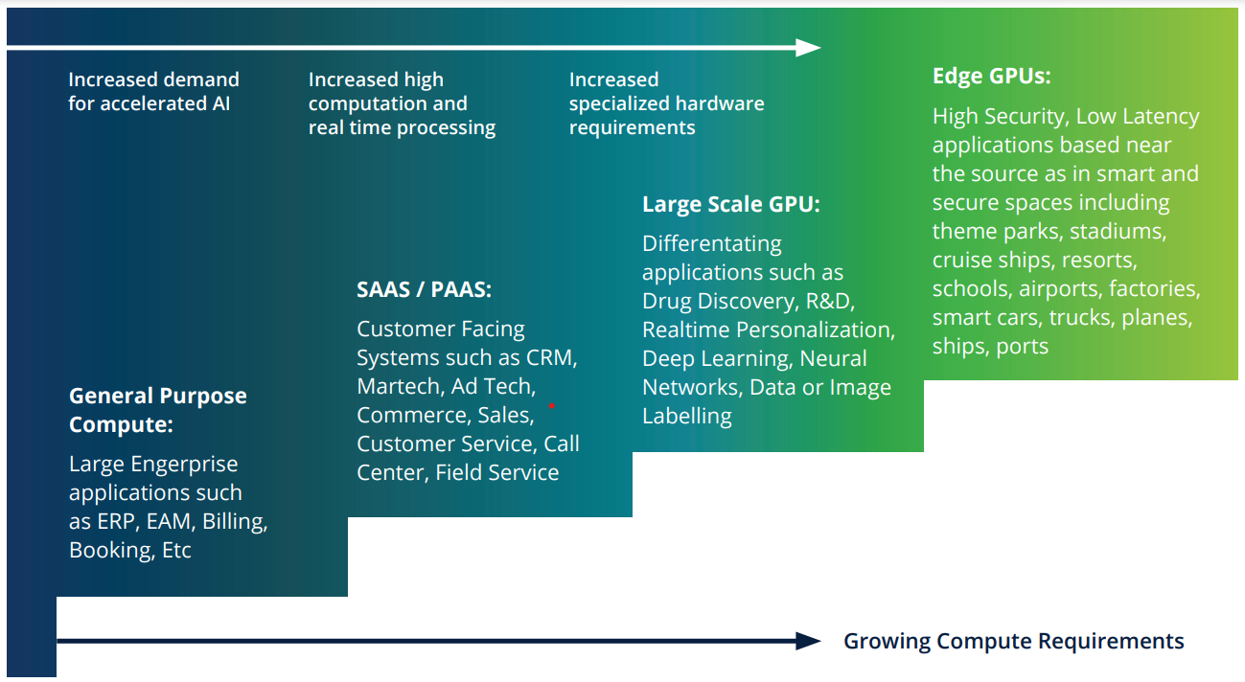
Source: Deloitte: The Economics of High-Performance Computing

Slide 15
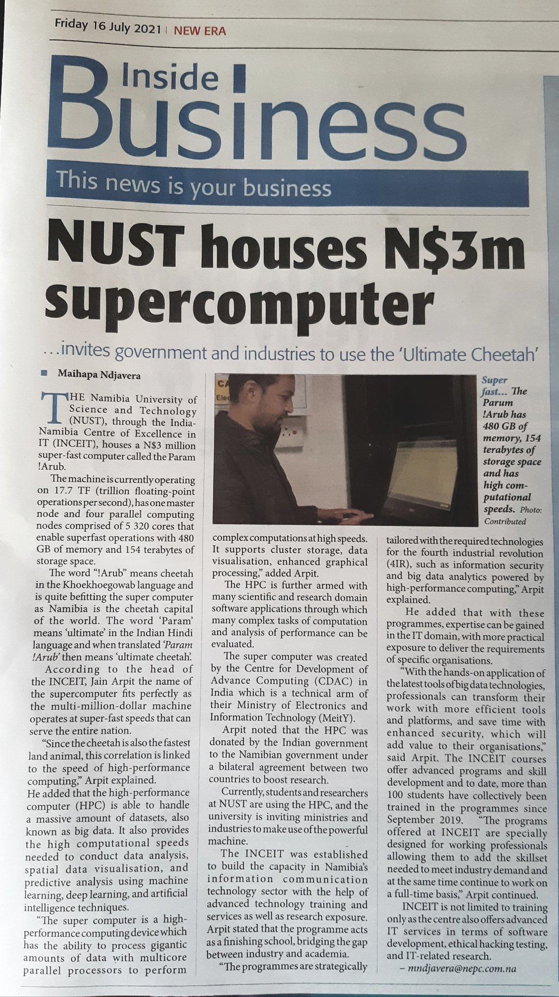
Good News What sets us apart?
Strategic Partnership Opportunities
Expertise and Experience
Comprehensive Research Approach
Timely and Actionable Insights
Client-Centric Approach
Global Market Coverage
Cutting-edge Research Technology
Industry-Specific Expertise
Interdisciplinary Approach

Slide 16
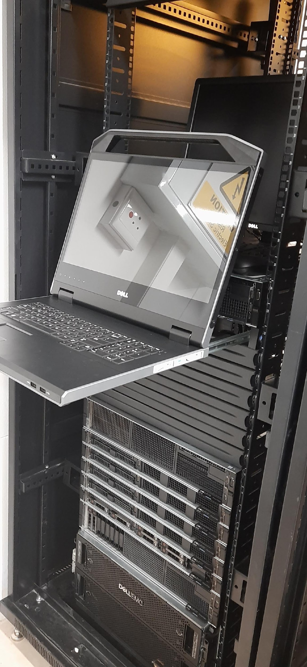
PARAM !ARUB
High Performance Computing
The name is inspired from the fastest animal Chetah.
The word PARAM is from Indian language means Ultimate.
!ARUB from Nama Damara native language of Namibia which means the animal Chetah one of the fastest animal and found more in Namibia.
Our High-Performance Computing device is ultimate fastest supercomputer which can serve whole nation.

Slide 17
HPC Infrastructure
Master Node
Compute Nodes
1 node (Dell PowerEdge R-640)
32 cores
2 x Intel Xeon Gold 6130, 16-core, 2.10 GHz
192 GB of physical memory
Compute power of 1.075 Teraflops
4 nodes
128 cores
2 x Intel Xeon Gold 6130, 16-core, 2.10 GHz
96 GB of physical memory per node
Compute power of 4.3 Teraflops
Compute Node with GPU
Visualization Node
1 node (Dell PowerEdge R-740)
32 cpu cores
2 x Intel Xeon Gold 6130, 16-core, 2.10 GHz
96 GB of physical memory
GPU accelerator 1 x NVIDIA Tesla v100
Compute power of 8.075 Teraflops/s
1 node(Dell PowerEdge R-740)
32 cpu cores
2 x Intel Xeon Gold 6130, 16-core, 2.10 GHz
96 GB of physical memory
Nvidia Quadro 1x P4000
CUDA Cores 1792

Slide 18
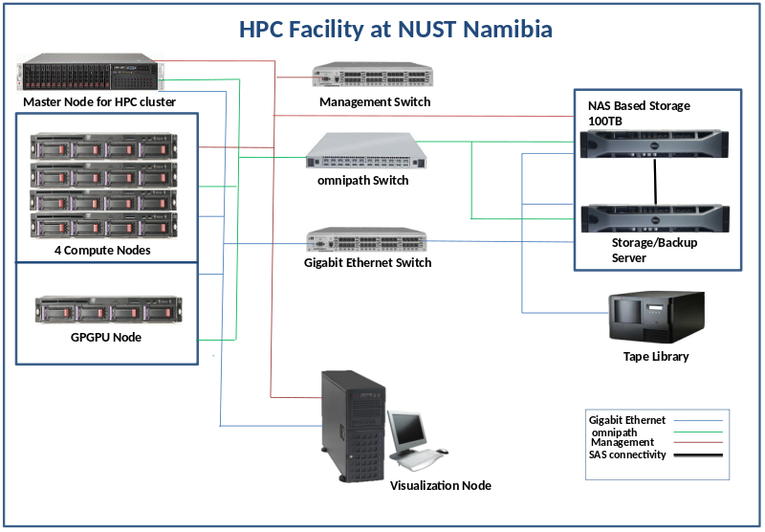
HPC Architecture
Notes:
‹#›

Slide 19

Opportunity

Slide 20




HPC as a Service
We offers HPC as a Service (HPCaaS) to various industries, research institutions, and government bodies to meet their computational needs
SCALABLE
RESOURCES
DIVERSE
APPLICATION SUPPORT
EXPERTISE AND TECHNICAL SUPPORT
ACCESS TO SUPERCOMPUTING INFRASTRUCTURE

Slide 21
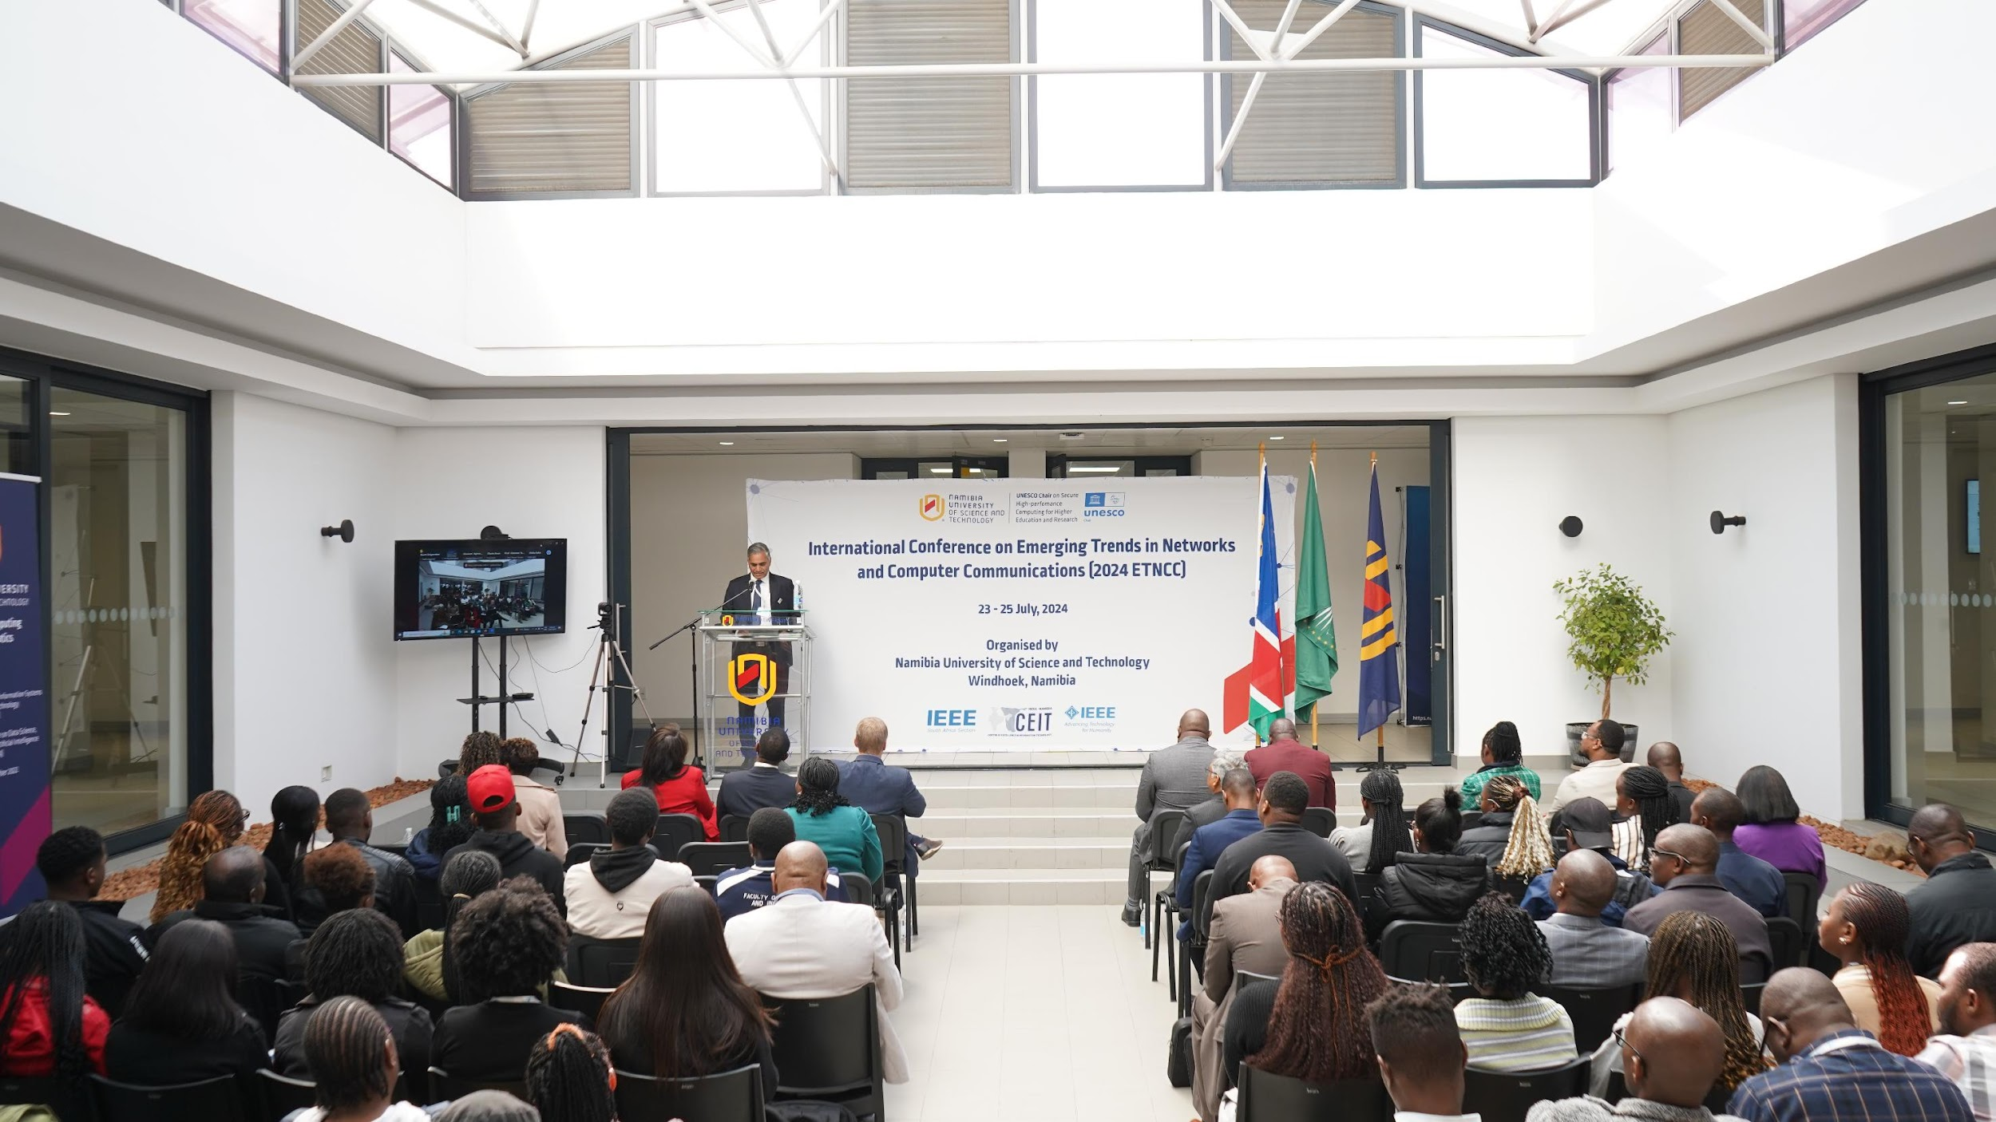
HPC as a Research
Establish the high-level Super Computing facility in Namibia.
Establish programmes leading to a Ph.D. degree in the related field of Smart and Secure Environment (SSE)
Promote research in the field of SSE in Namibia, the Southern African Development Community (SADC) region
Create a platform for national and international exchanges of ideas through conferences and workshops
Collaborate with UNESCO, Category 2 centres under the auspices of UNESCO and other UNESCO Chairs to develop relevant programmes and activities.
UNESCO Chair
on
Secure High-Performance Computing for Higher Education and Research

Slide 22
Education and Skill Development
Doctor of Philosophy in Computer Science
Master in Data Science
HPC utilized to train students and researchers in fields like computational science, AI, and data analytics, preparing the next generation of experts.
NUST offers industry demanding advanced computing programmes as mentioned
Bachelor in Artificial Intelligence
Certificate in Big Data Technologies
Certificate in High Performance Computing

Slide 23
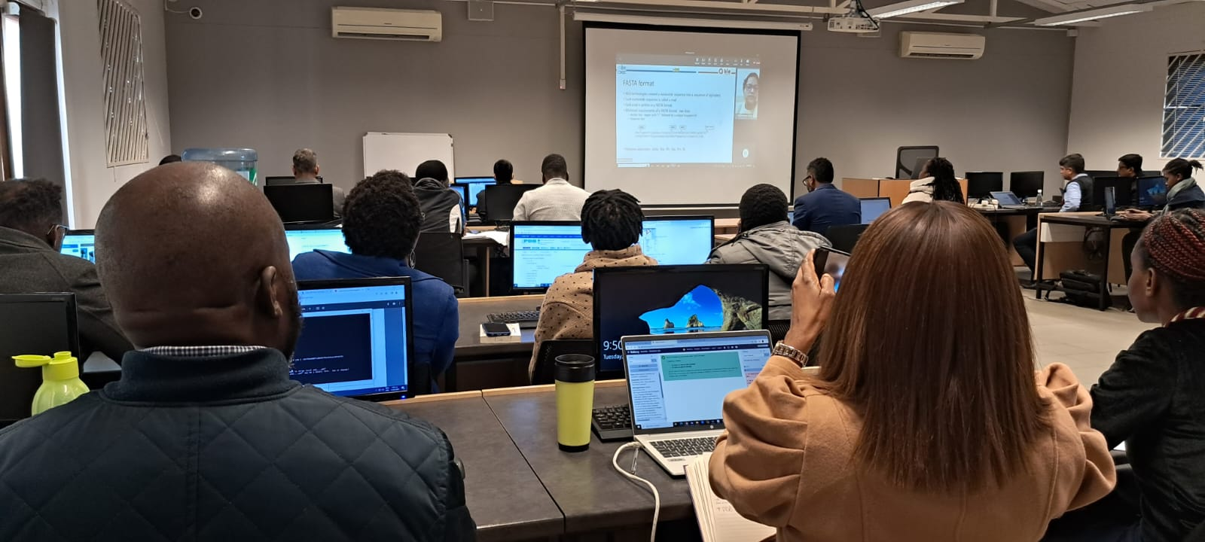
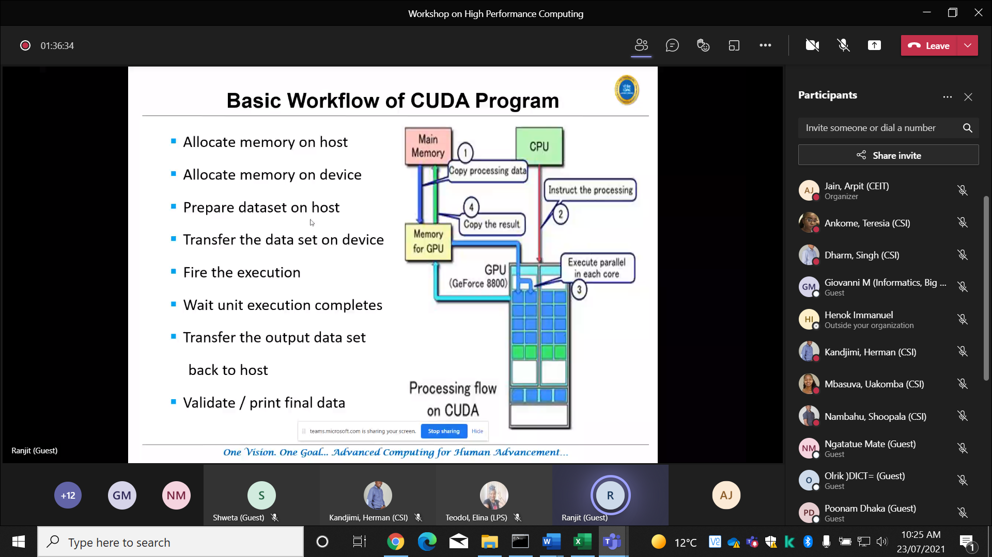
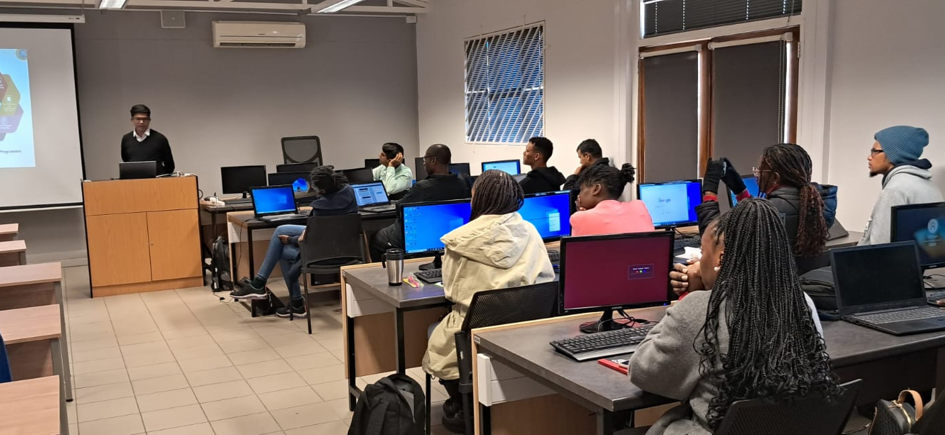
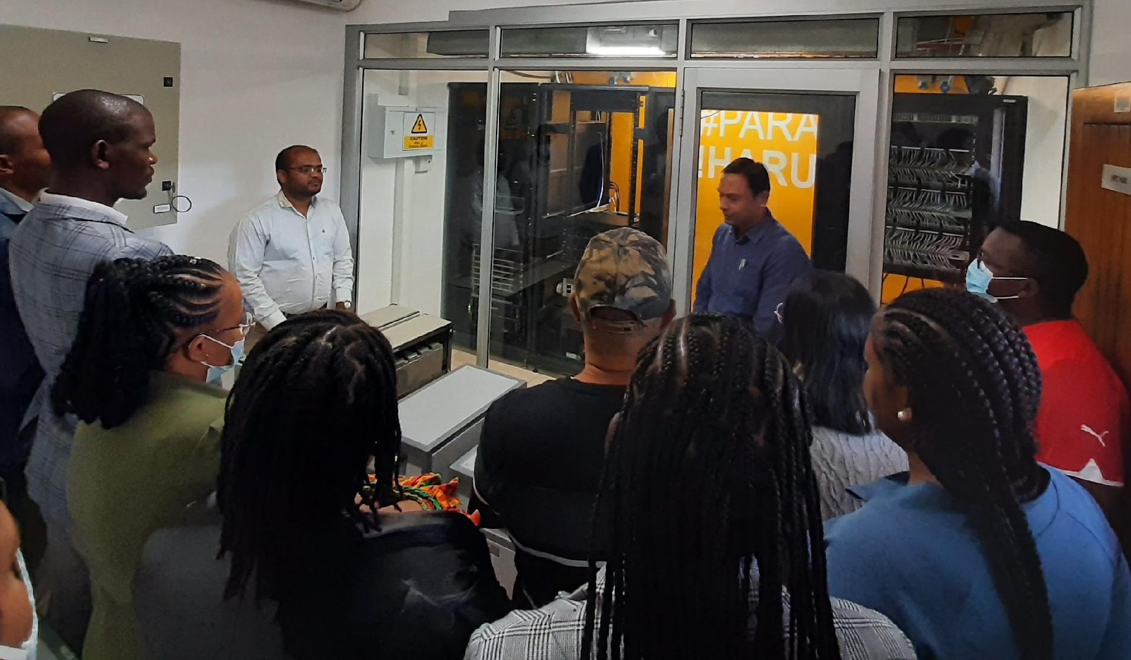
HPC Workshops

Slide 24
Conclusion
High-Performance Computing (HPC) is a critical enabler of innovation across numerous industries, from scientific research and AI development to engineering, finance, and healthcare.
Industries need HPC to stay competitive, optimize operations, innovate quickly, and tackle complex challenges that require vast computational power and data processing capabilities.
By offering immense computational power, HPC accelerates problem-solving, drives breakthroughs, and enhances efficiency.
The opportunities presented by HPC, from scientific research to AI development and smart city planning, are vast and growing.

Slide 25
Lets engage, collaborate and exchange our innovative ideas to harness the power of High-Performance Computing (HPC) in accelerating scientific research, optimize industry operations, and drive technological advancements for shaping a prosperous future for Namibia.

Slide 26

Contact us at:
Arpit Jain
Centre Head, INCEIT
Email: ajain@nust.na
Tel:+264 61 207 2814 | Mob:+264 81 218 5128
W: https://inceit.nust.na
THANK YOU

