Slide 1


Leveraging Open Source Software in the age of AI
A strategic advantage for SMEs and corporations
Sakaria Ndadi

Slide 2



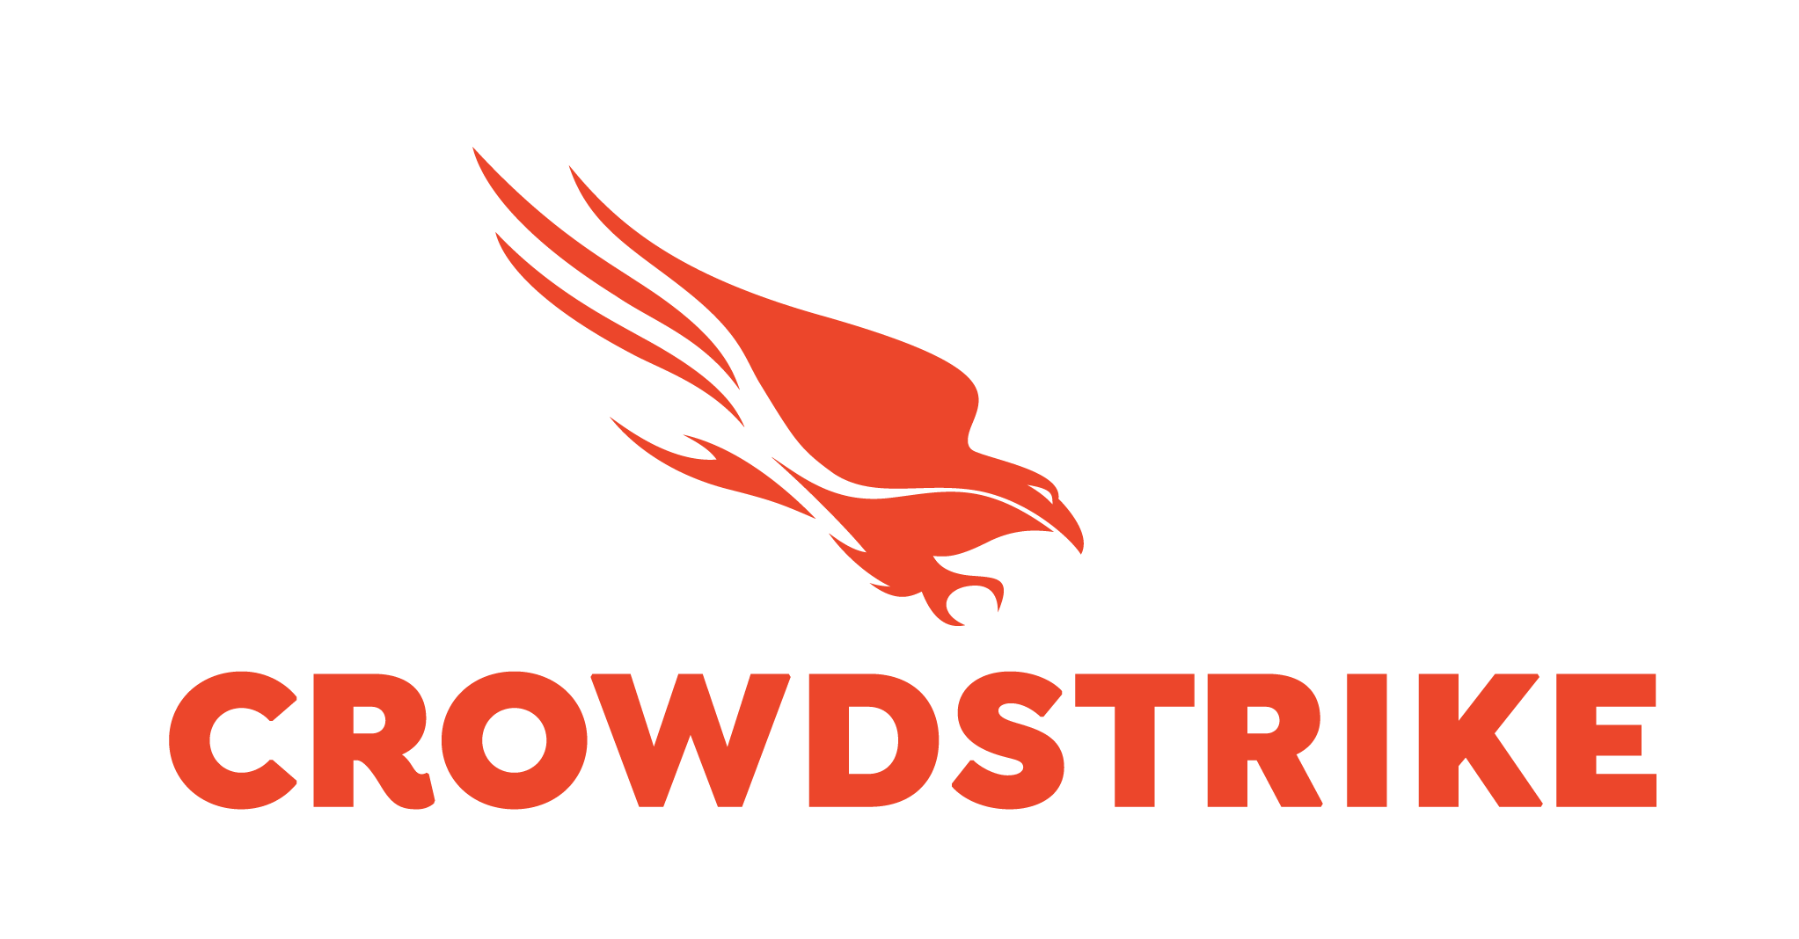
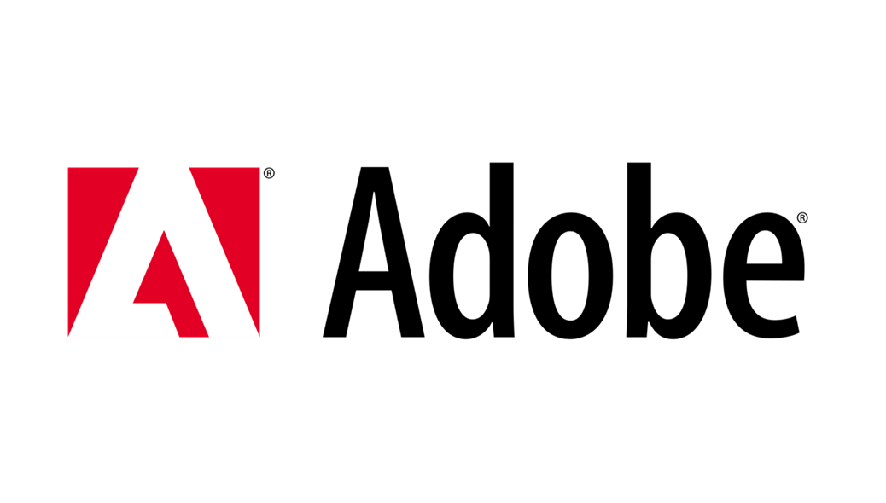

Slide 3
Quotes
“If you are not paying for the product, you are the product.”
“Sometimes you win by not losing.”
“Your product is only as good as your marketing.”
“Garbage in, garbage out.”

Slide 4


Types of Software

Slide 5
Advantages of integrating Open Source software into business
Cost Management
Scalability and Flexibility
Security and Data Governance
Community support and Innovation
Notes:
Businesses that strategically adopt open-source software can reduce costs, improve security, enhance flexibility, and foster innovation, all of which are essential for thriving in the age of digital transformation and AI.

Slide 6



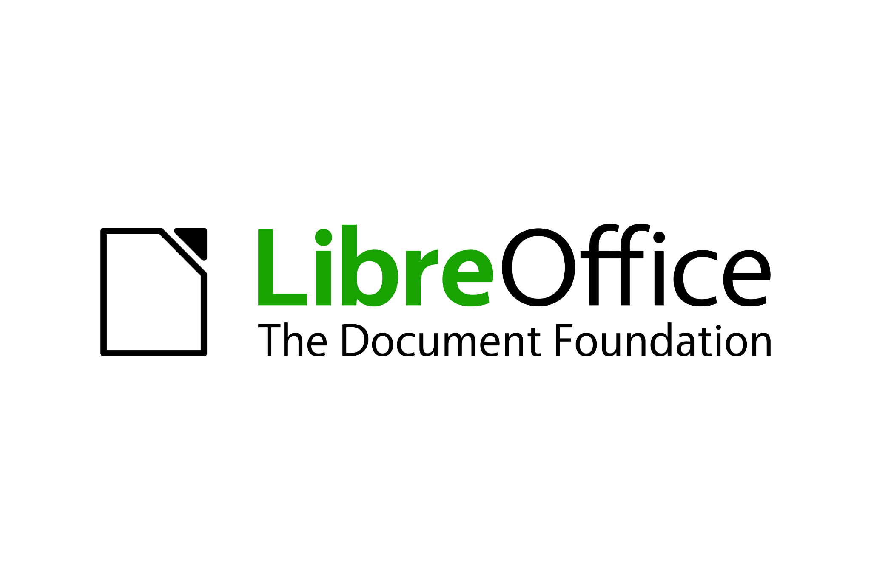
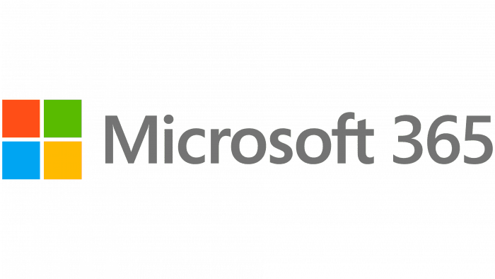
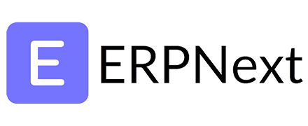
Examples of what you know and their alternatives.

Slide 7
Data governance and policy perspectives
How important is your data?
What are your business policies when it comes to managing your data?
Who can have your data?

Slide 8
Conclusion
Notes:
In conclusion, this presentation aimed to broaden your understanding of the diverse technology landscape available to businesses, emphasizing the importance of considering both open-source and proprietary software options. While this presentation hasn't swayed your existing preferences, it's essential to recognize that each type of software carries its own set of advantages and disadvantages.
Ultimately, the best choice for your business depends on your specific needs, budget, and risk tolerance. By carefully evaluating the pros and cons of both open-source and proprietary software, you can make informed decisions that align with your business objectives and drive success.

Slide 9
Q & A
sakariandadi@gmail.com / ndadis@telecom.na

