Slide 1

Namibia AI Readiness
AI Regulatory Frameworks, Promotion of AI Innovation, Opportunities for Youth and AI’s role in advancing Research, Science, Technology and Innovation
9 September 2024
Namibia ICT Summit
Prof. Anicia Peters
CEO: National Commission on Research, Science and Technology, Namibia
Co-Chair: Africa 4IR Working Group – AU Africa Scientific Research & Innovation Council (ASRIC) (2024-present)
  Chair: Namibia Presidential Task Force on the Fourth Industrial Revolution (2021-2022)

Slide 2


Who am I?
CEO: NCRST
Chairperson: Namibia Presidential 4IR Task Force (2021-2022)
Co-Chair: AU-ASRIC 4IR Working Group: Africa 4IR Policy & Strategy
Past: UNAM, NUST, Silicon Valley USA, Oregon State University, Iowa State University, Ministry of Finance
WHO & World Bank: E-Health Strategy/Digital Health Curricula; E-GP Strategy
Founder of Africa Human Computer Interaction (AfriCHI)
ACM local Chapters for SIGCHI, Professional Chapter, past Women Chapter
Google Scholar 2012; Google Inclusion Awardee 2020; Google AI 2021 grant
Several Awards, e.g. Boeing, ISU, Africa Women Rolemodel in Tech, Namibia Business Hall of Fame
Inaugural Editorial Board member of African Scientific Journal
Editor for ‘AI for Scientific Discovery’ Proceedings, NASEM USA
Various international Committees
Working on the intersection of Human Computer Interaction and AI (HCI-AI)
University of West-London: Supervision of PhD candidate in AI and XR

Slide 3

National Commission on Research, Science and Technology
Established by the Research, Science & Technology Act No 23 of 2004
Coordinate, Promote and Develop Research, Science & Technology plus Innovation
National Research, Science and Technology Fund
National Programme on Research, Science, Technology & Innovation
Regulatory Functions (Register Research Institutes, GMO Permits, etc)
Establishment of Thematic National Research Councils
  Biosafety Council (Biosafety Act No 7 of 2006)
  National Space Science Council
  Indigenous Knowledge Systems Council
Policy Research, Advice and Briefs
National Innovation Coordination (SAIC, Africa NIA Network)
Science Promotion programmes (STEM promotion, Science Fairs, Math Olympiads, etc)
Technology programmes (e.g. Applied Science, TT, Emerging Technologies)
RSTI National Information Collection and Dissemination, Systems plus Open Science

Slide 4

Intertwined Concerns
Pressing concerns
  Climate change and green industrialisation
  Water-Energy-Food Security Nexus
  One Health
  4IR technology, esp. Artificial Intelligence as enabler, driver
Geopolitical tensions impacting all

Slide 5

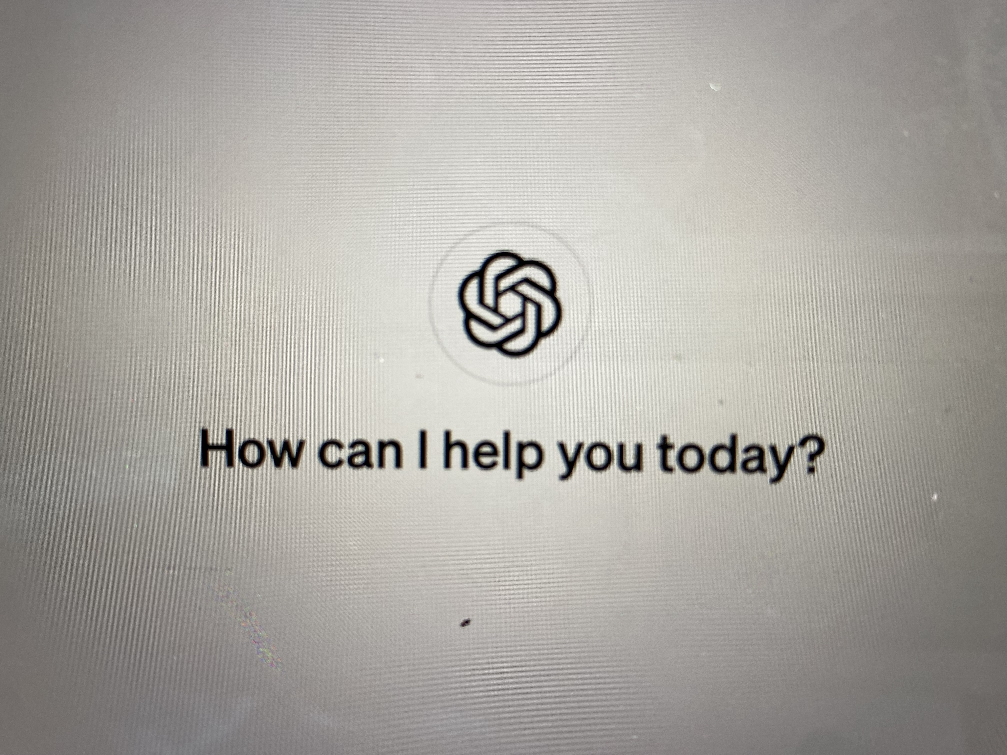

The Rise of AI
A transformative force, evolving rapidly
Netscape moment for AI: Unleashing OpenAI's ChatGPT
Dilemma: Desire for human-like AI vs resistance and ethical concerns
Human control must remain paramount
https://guidebookgallery.org/splashes/netscape
https://chat.openai.com/
http://bit.ly/3u09K5h

Slide 6

Examples: AI Strategic Direction
Hiroshima Process International Code of Conduct for Organisations Developing Advanced AI Systems
UNESCO Ethics of AI
USA Executive Order on AI
Europe:
  AI Act
  EU 5-year AI Vision (Research, Science and Tech)
Africa
  AU Continental AI Strategy
  UNESCO Windhoek Statement on AI in Southern Africa
  Africa 4IR Policy and Strategy (in dev)
Namibia
  4IR Task Force – 13 Recommendations
  National Programme on RSTI
  Draft UNESCO AI Readiness Assessment
  National AI Working Group

Slide 7

Africa and AI:
Promise & Peril
Potential to revolutionise various sectors and alleviate many of Africa's challenges
Own AI solutions underdeveloped, overreliances on imported AI research and technologies, skills, infrastructure, financing, conductive regulatory framework
Negative and unintended consequences

Slide 8

Unintended Consequences
Deepening digital divide
Deepening of inequalities and biases
Exclusion of Africa/Namibia due to data poverty
Future of Work / Job losses
Unequal development of legislation
Weaponization of AI
Exclusion of Africa’s values, indigenous knowledge in AI solutions
Unethical and irresponsible development of AI
Human-centered AI
Potential loss of indigenous languages
Etc

Slide 9

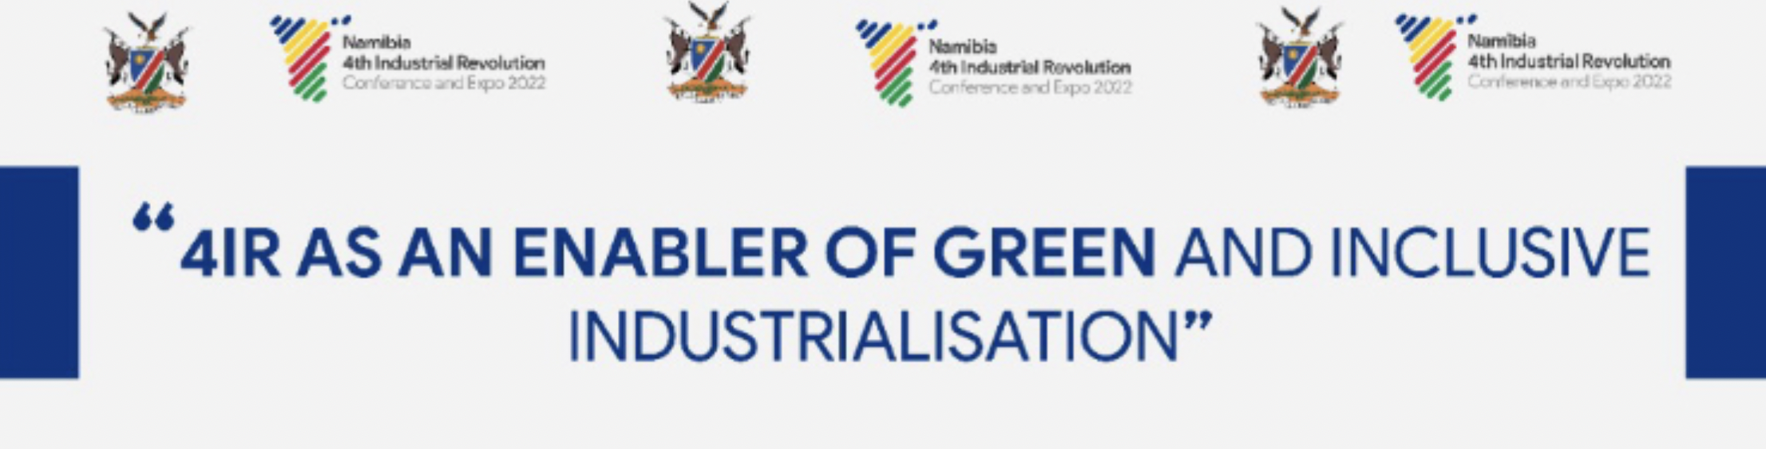
Namibia AI Opportunities
Namibia's youthful population and emerging startup ecosystem provide a fertile ground for technological innovation and AI development.
Technological leapfrogging
Plenty of challenges to be solved, e.g.
  Climate Adaptation, Mitigation & Resilience
  Clean water and sanitation
  Energy
  Food security
  One Health
  Education and Skills
  Space Science and Technologies
  Innovation and Manufacturing
  Indigenous Knowledge Management
Ethics, responsible, trustworthy, human-centered AI development

Slide 10

Namibia AI Challenges
Includes:
Specialised skills
Educational Reform
Legislative and regulatory framework
Infrastructure (data centers, energy, equipment, telecommunications, etc)
Funding
Data poverty
Cybersecurity
Ethics
Human centered AI

Slide 11

Namibia: Initiatives
Draft Overarching ICT Policy (& related ones)
Digital Transformation Strategy
4IR Task Force Report
National 4IR Conference and Expo
UNESCO Southern Africa Subregional Forum on AI
Capacity Building:
  Curriculum development efforts
  Data Science (UNAM and NUST)
  Bachelors AI and HCI (NUST)
  Human Centered AI Dev for for startups)
AI Virtual Institute at UNAM
NCRST: Research and Innovation grants; NPRSTI
National AI Working Group
Telecoms Infrastructure (e.g. 5G)

Slide 12
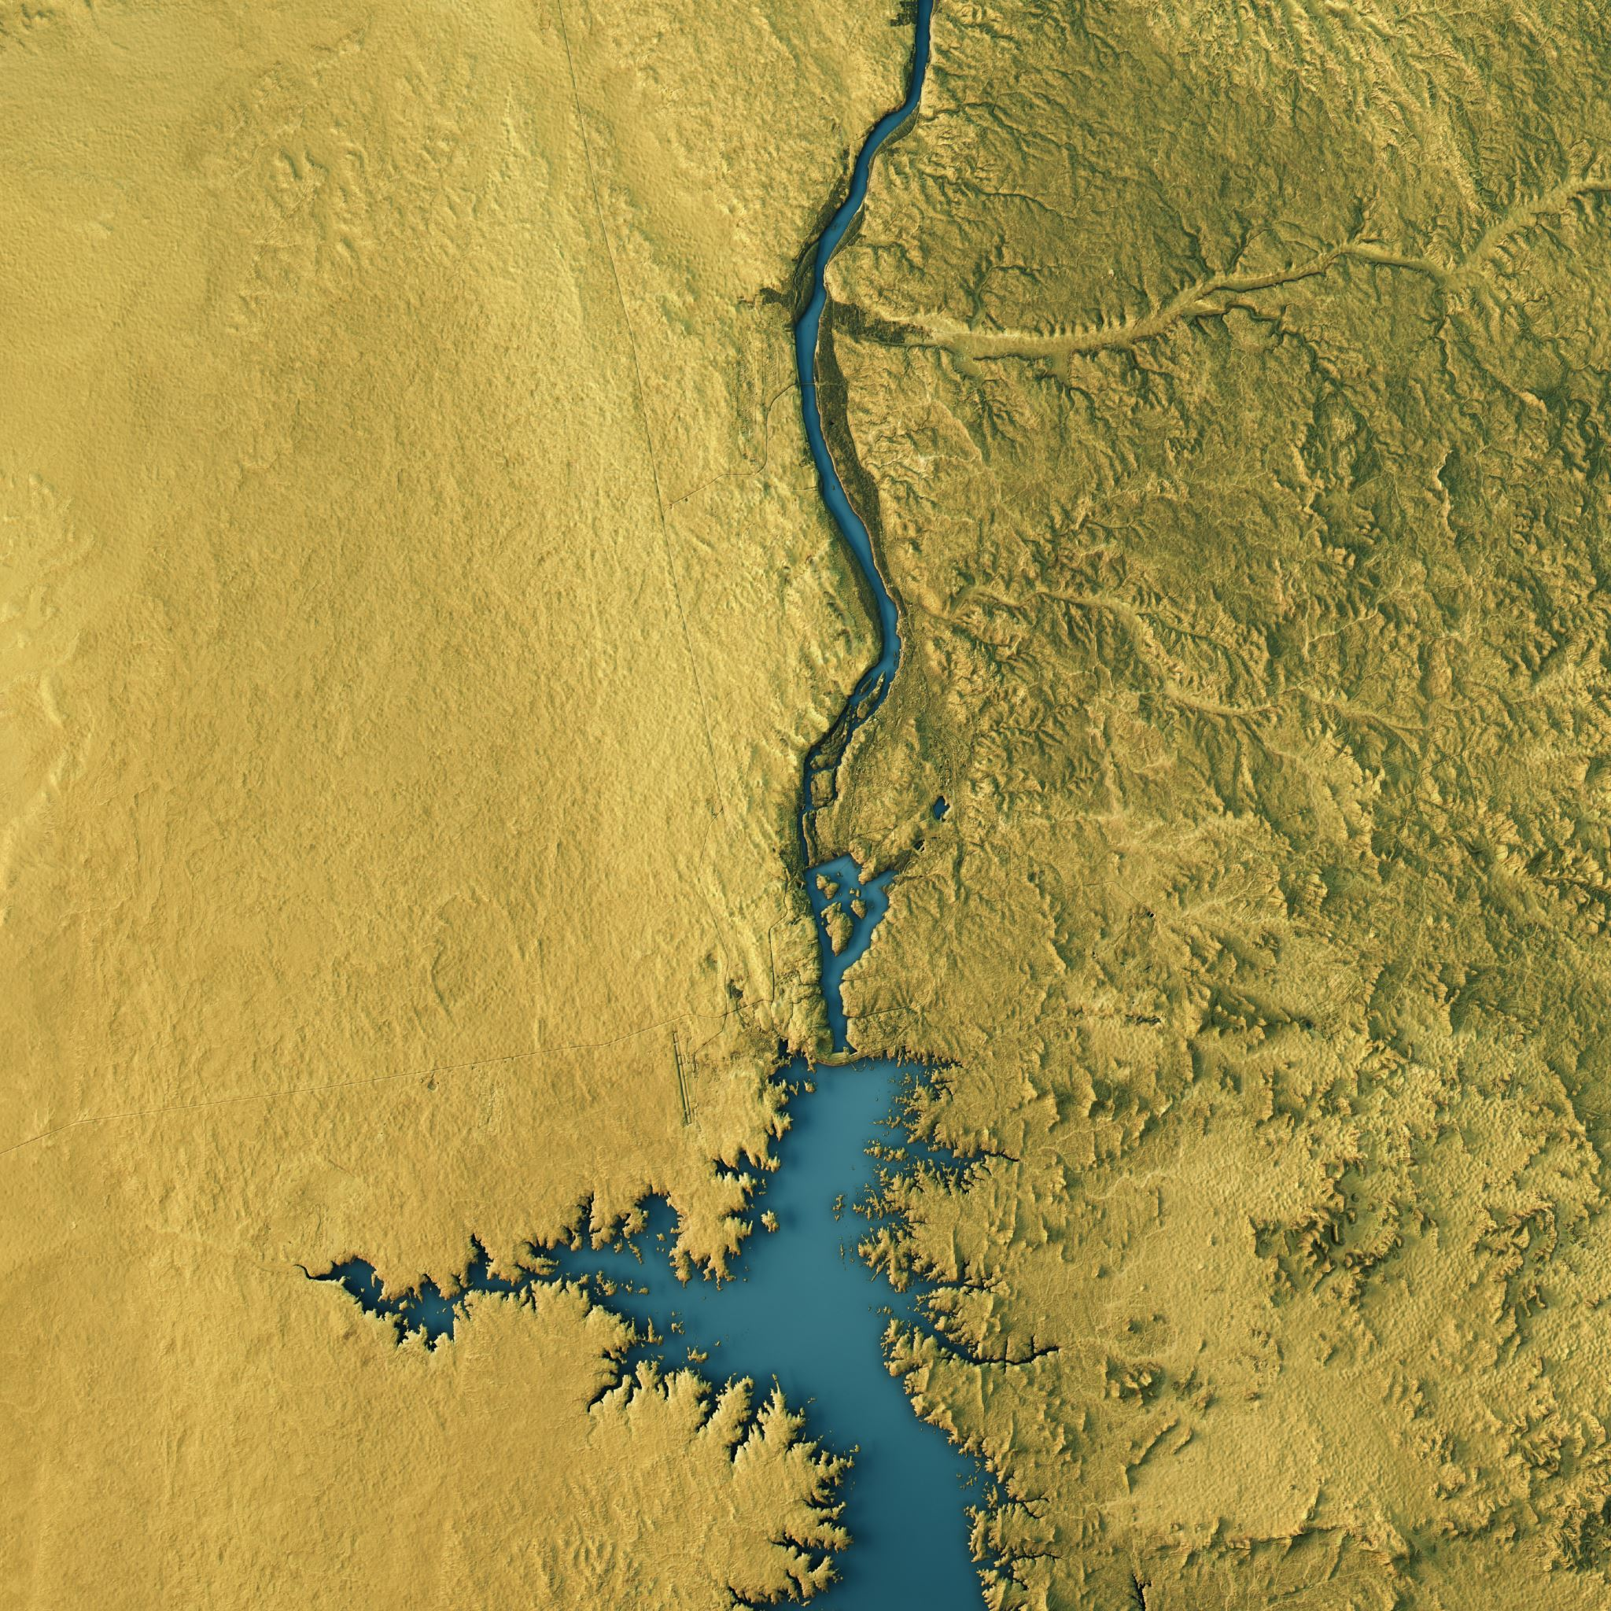
Future Opportunities: AI
Align and integrate with National Research Priorities
AI Scientific Solutions to Namibia’s challenges
AI in Production and Manufacturing Environments
Regional and National AI Research Institutes
AI Governance and enabler frameworks
AI StartUps, SMEs and MSMEs
Rapid Upskilling and reskilling: Youth, Educators
Enabling emerging industries for Green Hydrogen, Oil and Gas, Critical Raw Materials, Blue Economy

Slide 13

National AI Working Group
Steering Committee: NPC, NCRST, MHETI, MICT, OPM, MEAC, MHSS, NUST, UNAM, IUM (MOD, CRAN invited)
  Thematic Technical Groups: Diverse experts.
R&D and Innovation Strategy for AI
Education and Skills: Develop Namibian expertise in AI
Co-design the priority areas and implement
Infrastructure
Data Governance and Infrastructure
Partnerships
Develop standards and guidelines for ethical, responsible and human-centered AI RD&I in Namibia
AI Innovators and StartUps
Establish the National AI Institute

Slide 14
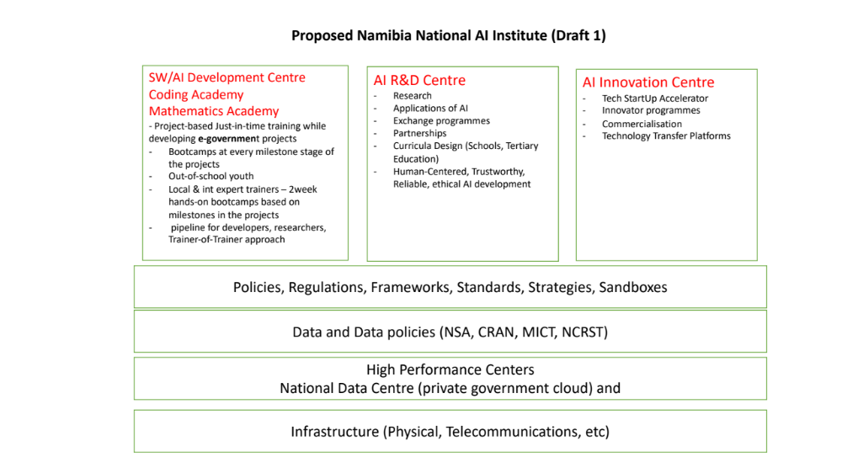
National AI Working Group
R&D and Innovation Strategy for AI
Co-design the priority areas
Develop Namibian expertise in AI
Infrastructure
Data Governance
Partnerships
Develop standards and guidelines for ethical, responsible and human-centered AI RD&I
Community Co-design
Encourage responsible innovation
National AI Institute

Slide 15

OpenAI Dall-E Generated

Slide 16

The End

