Slide 1

The Noise Before Defeat
The Need For Holistic And Strategic Threat Management Programs

Slide 2
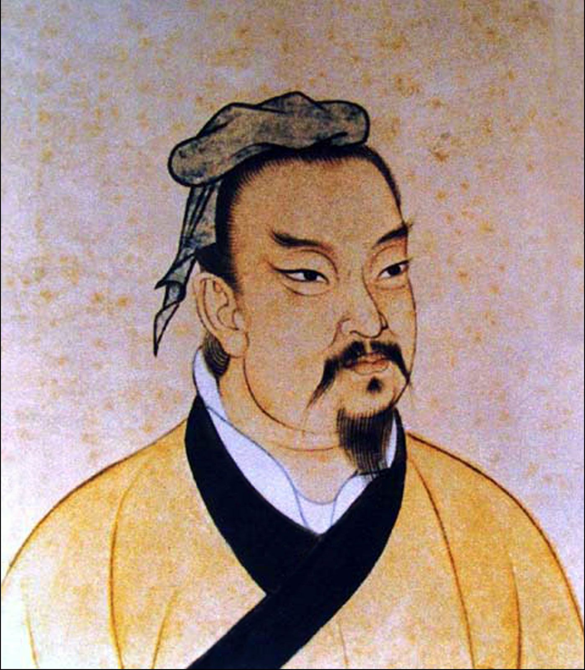
“Strategy without tactics is the slowest route to victory. Tactics without strategy is the noise before defeat”.
Notes:
Explain quote and speak about the what the tactics without strategy looks like, i.e. disjointed, reactive, costly, lack of visibility, lack of formal knowledge transfer, assurance is a moment in time.
Cyber defence without a guiding strategy and a corresponding threat management program is doomed to reactivity.
The noise can come in many forms, disjointed activities, employee dissatisfaction, lack of communications, and no buy-in from leadership.

Slide 3

This is what the noise before defeat looks like.
Notes:
Tie into the Noise before defeat. Strategy without tactics = Great plan, poor execution. All trained up but off the mark. Executive Protection, Emergency medicine, and strategy.

Slide 4

The Epistemology of Strategy
Strategy, in warfare, is the science or art of employing all the military, economic, political, and other resources of a country to achieve the objects of war.
Notes:
Epistemology is a branch of philosophy that investigates the nature, scope, and limits of knowledge.
What is strategy?
Where does it originate, The term strategy derives from the Greek strategos, an elected general in ancient Athens. The strategoi were mainly military leaders with combined political and military authority, which is the essence of strategy. Because strategy is about the relationship between means and ends, the term has applications well beyond war.
Thucydides’ (thoo·si·duh·deez) History of the Peloponnesian War (c. 404 bce) contains marvelous renditions of speeches in which the leaders of different states attempt to persuade their listeners to follow a given course of action. Furthermore, strategy invariably rests on assumptions of many kinds—about what is lawful or moral, about what technology can achieve, about conditions of geopolitics and resource availability—that are unstated or even subconscious.
how is a strategy brought to life?
Carl von Clausewitz says in an introductory note to On War, “When it is not a question of acting oneself but of persuading others in discussion, the need is for clear ideas and the ability to show their connection with each other”—hence the discipline of strategic thought.

Slide 5
Why Strategy?
Because Risk.
Probability x Impact = Risk
Notes:
Epistemology of risk.
Risk is defined as being exposed to danger, as such, risk arises due the result of exposure.
Risk calculation refers to the process of determining the potential risks associated with different attack vectors by assessing their likelihood and the maximum consequence to the security goals.
But if Risk is the measured value, then it is the level of exposure or the threat itself which must be changed to change the Risk value.

Slide 6
Silhouette x Vulnerability^{Asset} = Exposure
Deception
Controls
Adversaries see an organisation’s cyber silhouette → Vulnerabilities are targeted to gain access to assets → Assets are categorised by criticality → Deception conceals or disrupts the silhouette → Control covers the exposure surface → less exposure = less risk
Notes:
How exposed is my organisation?
How long has it been exposed?
What is the exposed element connected to?
Can the implementation of one control/measure reduce the level of exposure to multiple elements?
These are the questions that are associated with a continuous threat management program.
What are we defending, what are we defending it from? How are we defending it? How much value am I getting from the defence efforts

Slide 7
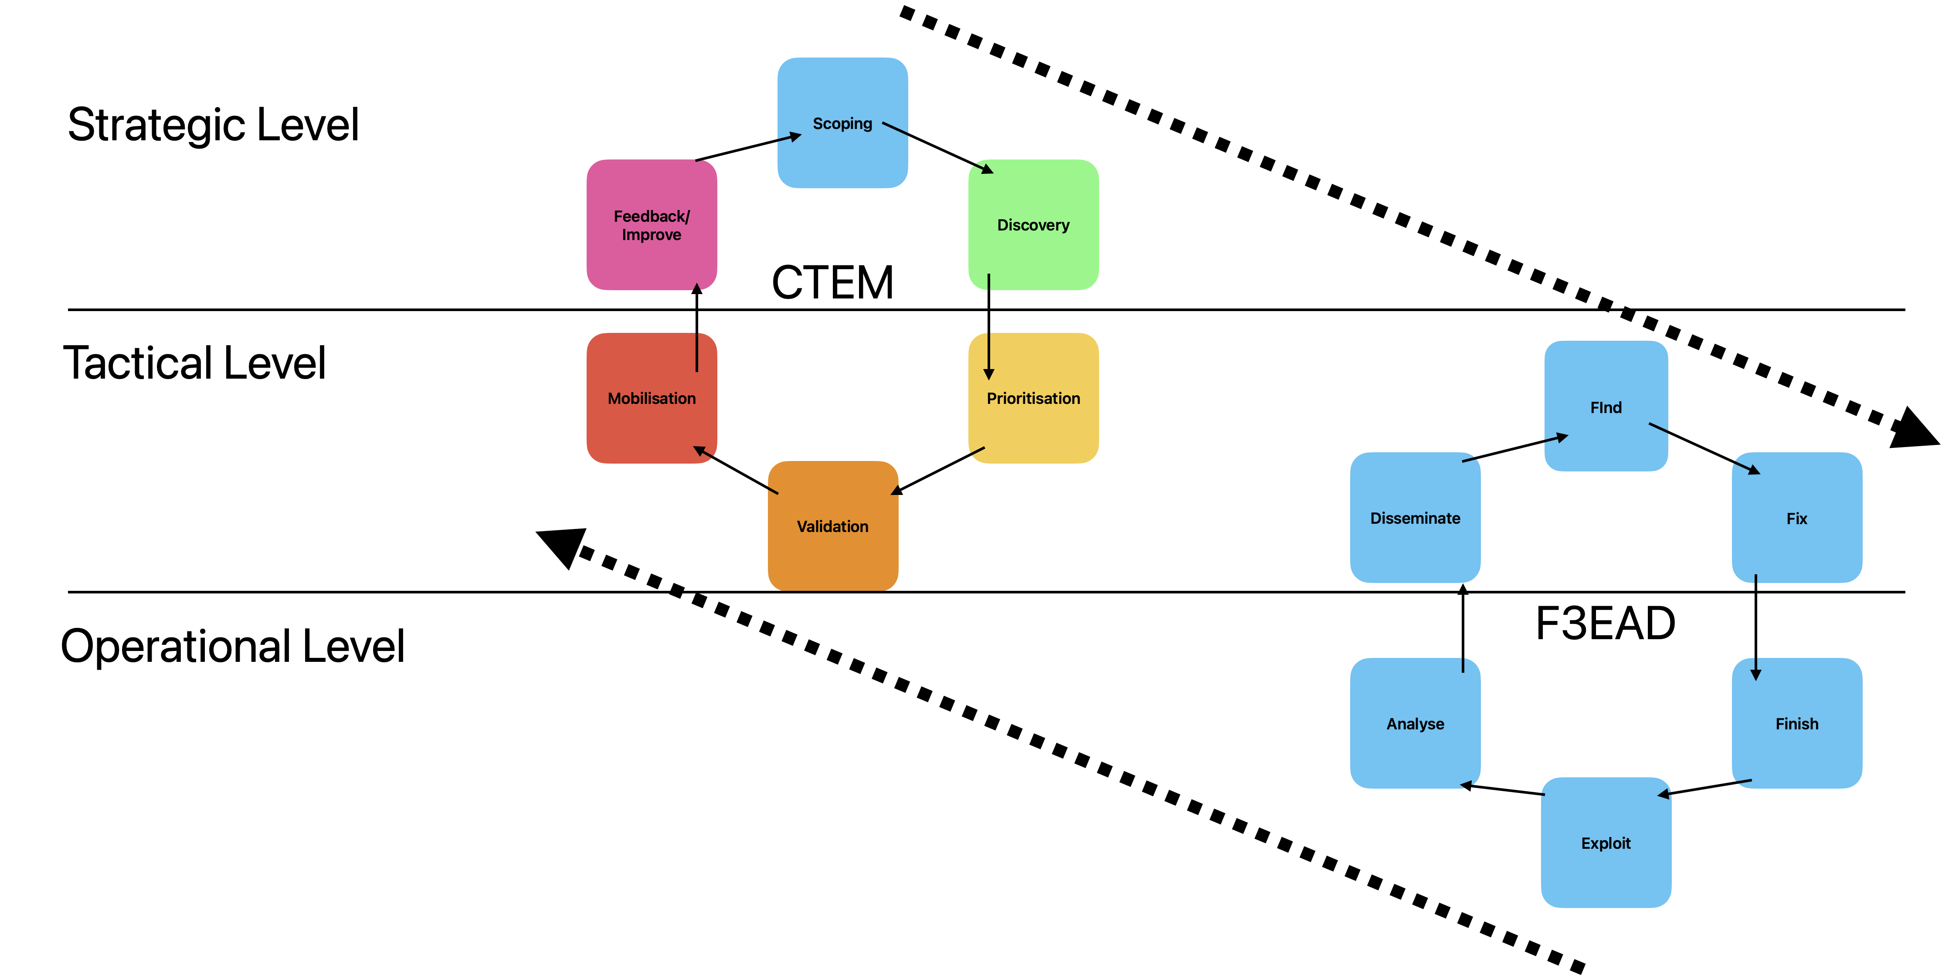
F3EAD | Description
Find | Essentially ‘picking up the scent’ of the adversary, with the classic “Who, What, When, Where, and Why” questions being used within this phase to identify a candidate target.
Fix | Verification of the target(s) identified within the previous phase, which typically involves multiple data points. This phase effectively transforms the intelligence gained within the “Find” phase into evidence that can be used as basis for action within the next stage.
Finish | Based on the evidence generated from the previous two phases, the commander of the operation then imposes their will on the target.
Exploit | Deconstruction of the evidence generated from the finish phase.
Analyse | Results are analysed to answer the intelligence requirements.
Disseminate | Integrate exploited intel with the wider intelligence picture.
From The Strategic To The Operational
Notes:
We all love the term, “a strategy doc is a living document” but for that to be true it requires a means to ingest information (sensory data) and a means to produce an output affect (output and action) = Continuous Threat Exposure Management.

Slide 8






Threat Management Program
(SOAR)
GUARDIAN
INCIDENT RESPONSE PROGRAM
Environment readiness assessment
Secure node placement
End-to-end coverage
Threat hunting & first responder training
Threat lifecycle controls
Ingestion opportunities
Deception technology
Automated defence & risk reduction
Custom detection use cases
Tabletop exercise
IRP development
Defence-in-depth repository
Risk-based exception handling/reporting
Playbook & battle box development
CSIRT assist response retainers
Rehearsals, informed/uninformed
CASE
MANAGEMENT
24/7
THREAT HUNTING
SOCAAS
CYBER
REPORTING
COMPROMISE
ASSESSMENTS
DETECTION
NETWORK
DETECTION
RESPONSE
CYBER THREAT INTELIGENCE
PREVENTION
ASSURANCE
CYBER STRATEGY
DEVELOPMENT
DECEPTION
HONEYPOTS
INTRUSION
PREVENTION
SPECIALISED RISK REDUCTION SERVICES
COMPLIANCE
AUTOMATION
SECURE ACCESS
SERVICE EDGE
( SASE)
Vulnerability management practice implementation
Cyber risk treatment policy development
Capability maturity assessments
Cyber strategy development
Attack surface visualization
Deceptive tech strategy development
VAPT & webapp assessments
Dark web analysis & threat modeling.
Inline and independent forensic investigations
ASSURANCE & MANAGEMENT REPORTING
THREAT
MANAGEMENT
Incident workflows maturity
Incident response metrics
Framework visualisation
Incident response performance
Policy violation monitoring
Native asset management
VMI – fusion of risk sources
Notes:
We all love the term, “a strategy doc is a living document” but for that to be true it requires a means to ingest information (sensory data) and a means to produce an output affect (output and action) = Continuous Threat Exposure Management.
Senses- SIEM
Nervous system – SOAR
Immune system – NDR, EDR, IPS, Firewalls
The heart is at the core, but it too can become weak, or sick – vulnerabilities
Bad lifestyle – people and processes
Hence, the continuous threat management methodology.

Slide 9
How To Articulate Risk
Align Cyber Risk with Organisational Objectives
Prioritise Risks Based on Impact
Emphasize ROI and Competitive Advantage
1
2
3
Speak the Language of Business
Quantify the Risk
Focus on High-Impact Threats
Use Risk Scenarios
Cost-benefit Analysis
Competitive Edge
Propose Clear, Actionable Plans
Simplify Communication
Highlight Regulatory and Legal Implications
4
5
6
Avoid Jargon
Use Visuals
Present Solutions, Not Just Problems
Demonstrate Preparedness
Compliance Focus
Legal Risks
Notes:
1. Align Cyber Risk with Business Objectives
Speak the Language of Business: Frame cybersecurity issues in terms of their impact on business goals, such as revenue, reputation, and operational continuity. For instance, rather than discussing the technical details of a vulnerability, emphasize how it could lead to significant financial losses or damage the company’s brand if exploited.
Quantify the Risk: Use metrics that matter to the board, such as potential financial losses, regulatory fines, or downtime costs, to articulate the risk. This approach makes the abstract concept of cyber threats more concrete and relatable.
2. Prioritize Risks Based on Impact
Focus on High-impact Threats: Present the most critical risks that could significantly affect the business. Use clear examples of recent industry breaches or incidents to illustrate the potential consequences.
Use Risk Scenarios: Develop and present realistic scenarios that demonstrate how specific cybersecurity risks could impact the company. This can help ExCo members visualize the risks and understand the urgency of addressing them.
3. Emphasize ROI and Competitive Advantage
Cost-benefit Analysis: Show how investing in cybersecurity can prevent larger expenses down the line, such as breach remediation costs or loss of customer trust. Highlighting the return on investment (ROI) can make the case more compelling.
Competitive Edge: Position strong cybersecurity as a business enabler that can differentiate the company in the marketplace, attract customers, and comply with regulatory requirements, thereby providing a competitive advantage.
4. Simplify Communication
Avoid Jargon: Replace technical jargon with clear, concise language. For example, instead of talking about "zero-day vulnerabilities," discuss the potential for undetected weaknesses that could be exploited by attackers.
Use Visuals: Leverage charts, graphs, and dashboards to visually communicate key points. Visual aids can help convey complex information more effectively and keep the board engaged.
5. Propose Clear, Actionable Plans
Present Solutions, Not Just Problems: Always accompany any identified risks with proposed actions. Provide a clear roadmap of steps the company can take to mitigate risks, including timelines, required resources, and expected outcomes.
Demonstrate Preparedness: Highlight the organization’s preparedness and how existing measures (like incident response plans) reduce risks, but also point out any gaps that need addressing.
6. Highlight Regulatory and Legal Implications
Compliance Focus: Explain how cyber risks intersect with regulatory requirements. Non-compliance can lead to legal penalties, and understanding these implications is often a priority for board members.
Legal Risks: Discuss potential legal liabilities that could arise from a breach, such as class-action lawsuits or regulatory fines, making it clear that cybersecurity is also a matter of legal risk management.

Slide 10

Thank You, Let’s Connect

