Slide 1
Knowledge Management Systems
Assignment 9: AuraDB Knowledge Graph Creation
Prepared by: Aivars Šeļegovskis
Student ID: 231RDM021
Checked by: Mārīte Kirikova

Slide 2
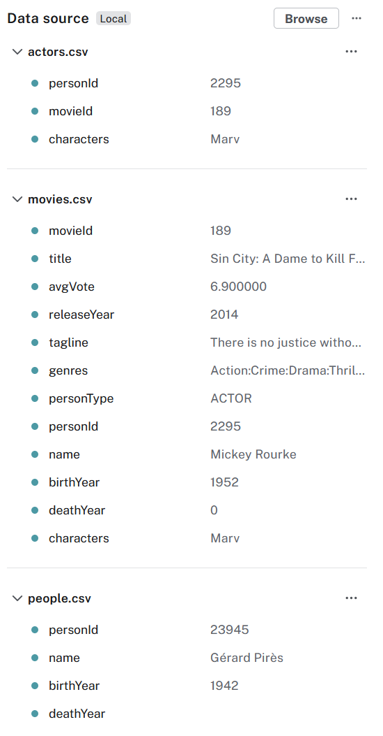
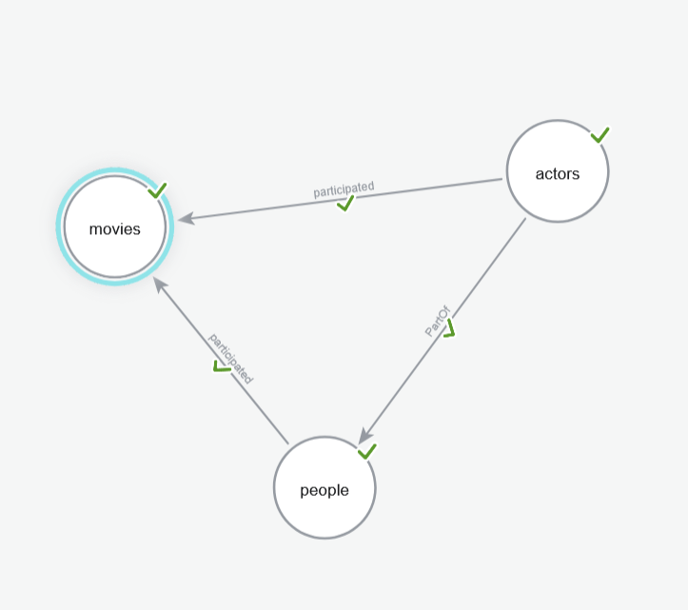
Screenshots from AuraDB
Data after import
Graph model

Slide 3
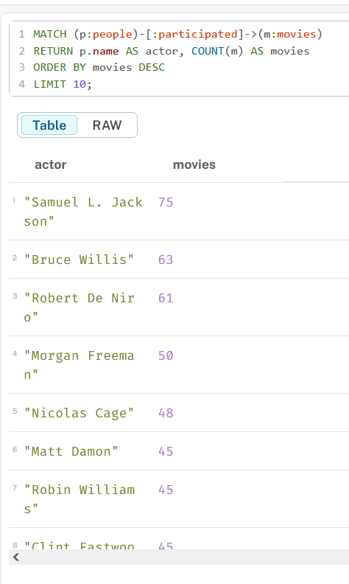
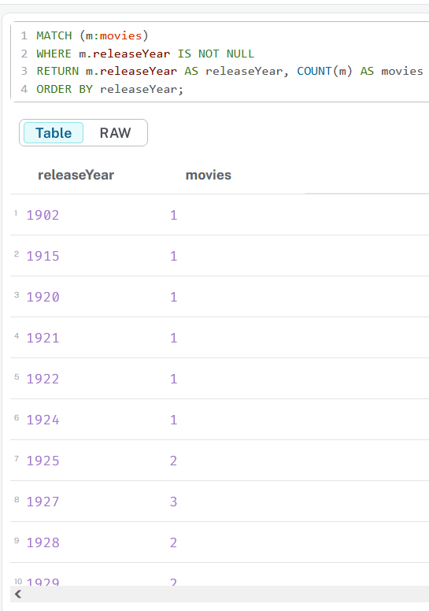
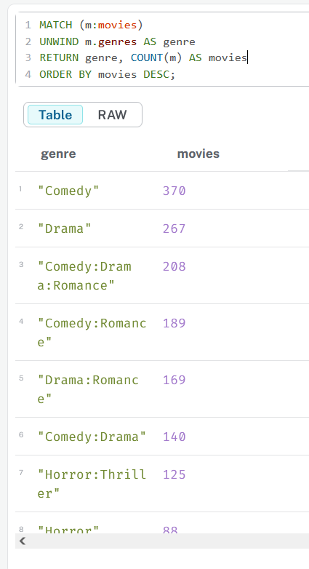
Queries
1) Top 10 actors by number of movies
2) Number of movies per year
3) Movies per genre
MATCH (p:people)-[:participated]->(m:movies)
RETURN p.name AS actor, COUNT(m) AS movies
ORDER BY movies DESC
LIMIT 10;
MATCH (m:movies)
WHERE m.releaseYear IS NOT NULL
RETURN m.releaseYear AS releaseYear, COUNT(m) AS movies
ORDER BY releaseYear;
MATCH (m:movies)
UNWIND m.genres AS genre
RETURN genre, COUNT(m) AS movies
ORDER BY movies DESC;

