Slide 1
MCARAT
A COMMAND BASED INTERACTIVE FINITE ELEMENT PROGRAM DEVELOPED BY BARIŞ İRHAN USING MATLAB

Slide 2
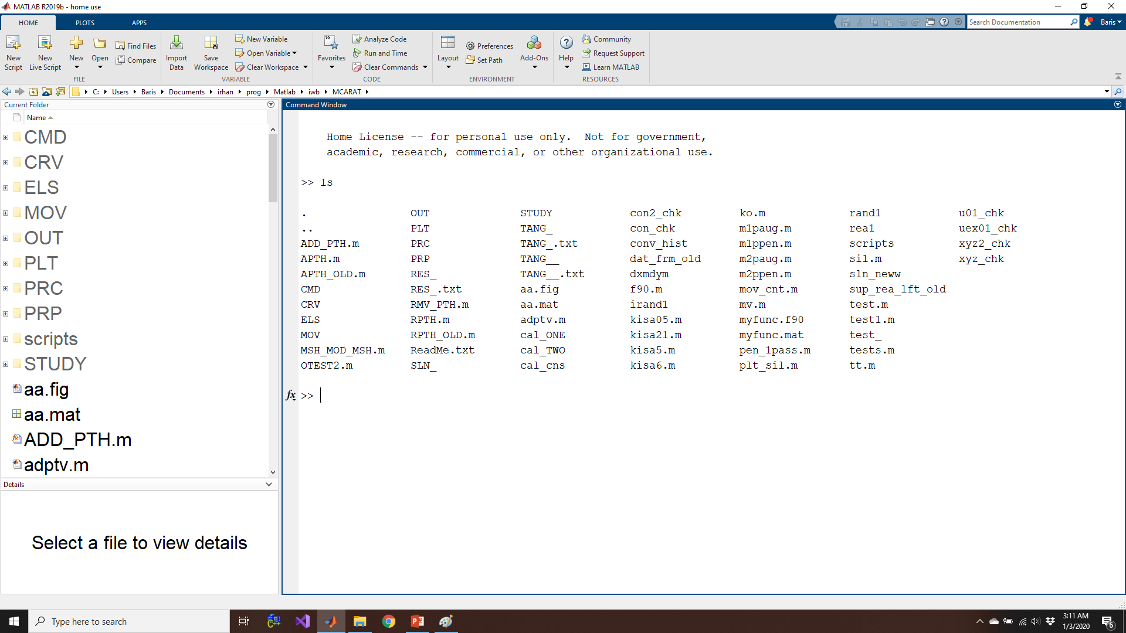
Folder Tree

Slide 3
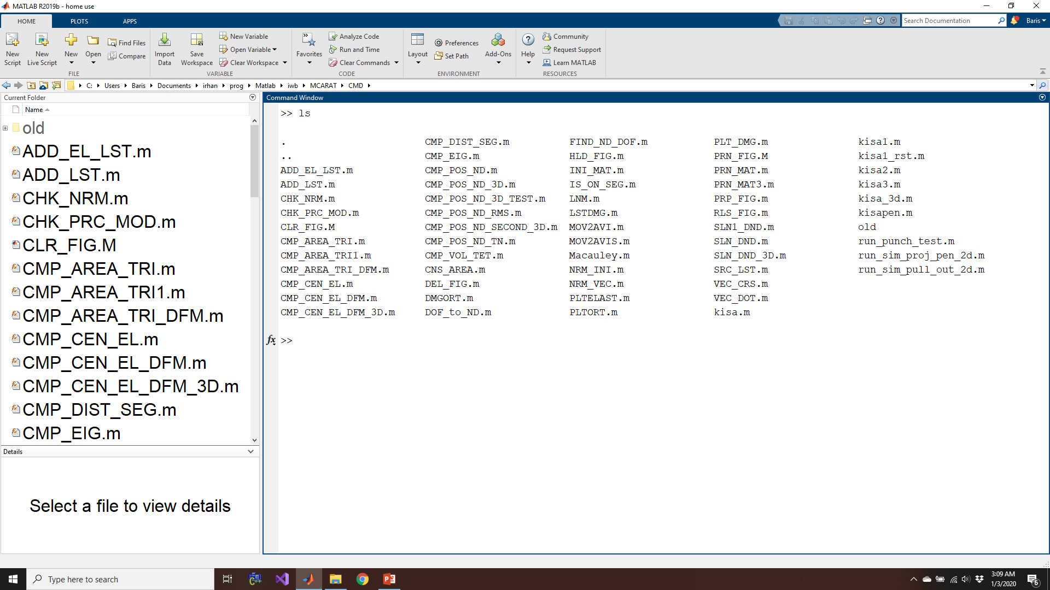
CMD Folder

Slide 4
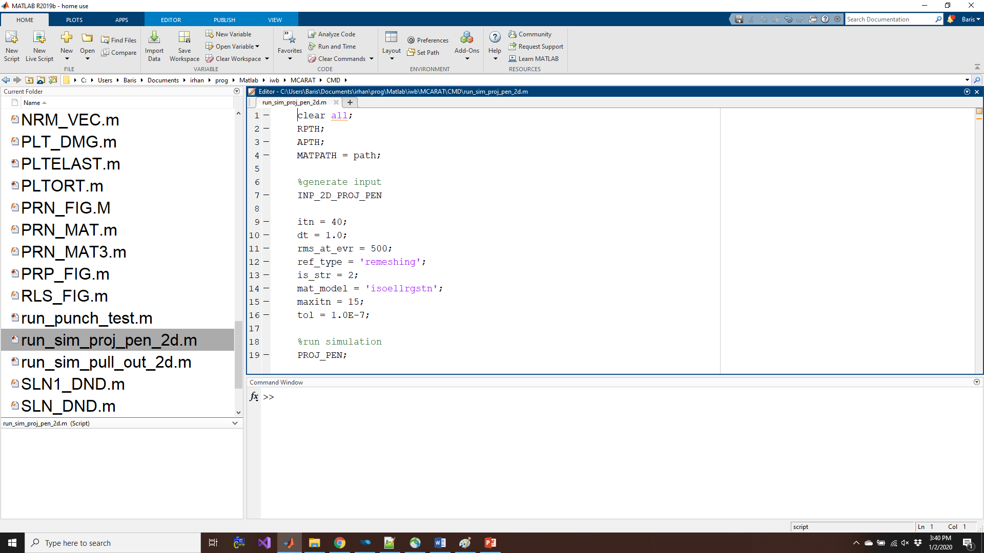
Example: Command to run 2D projectile penetration

Slide 5
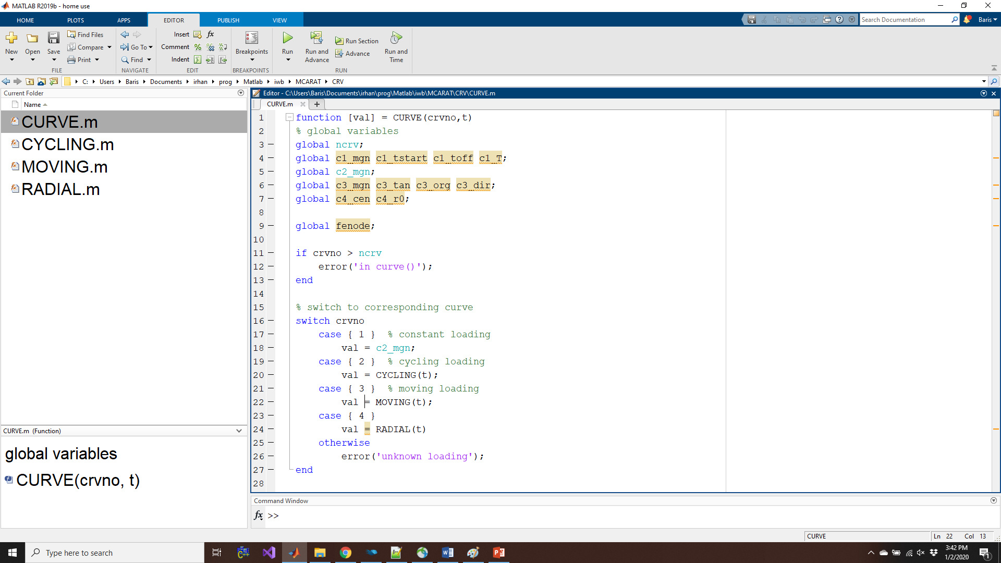
CRV Folder

Slide 6
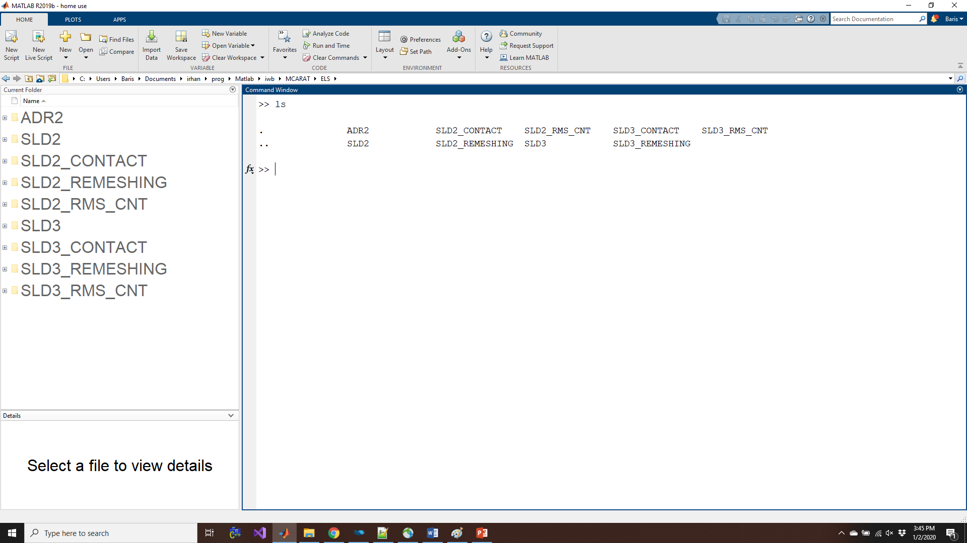
ELS Folder

Slide 7
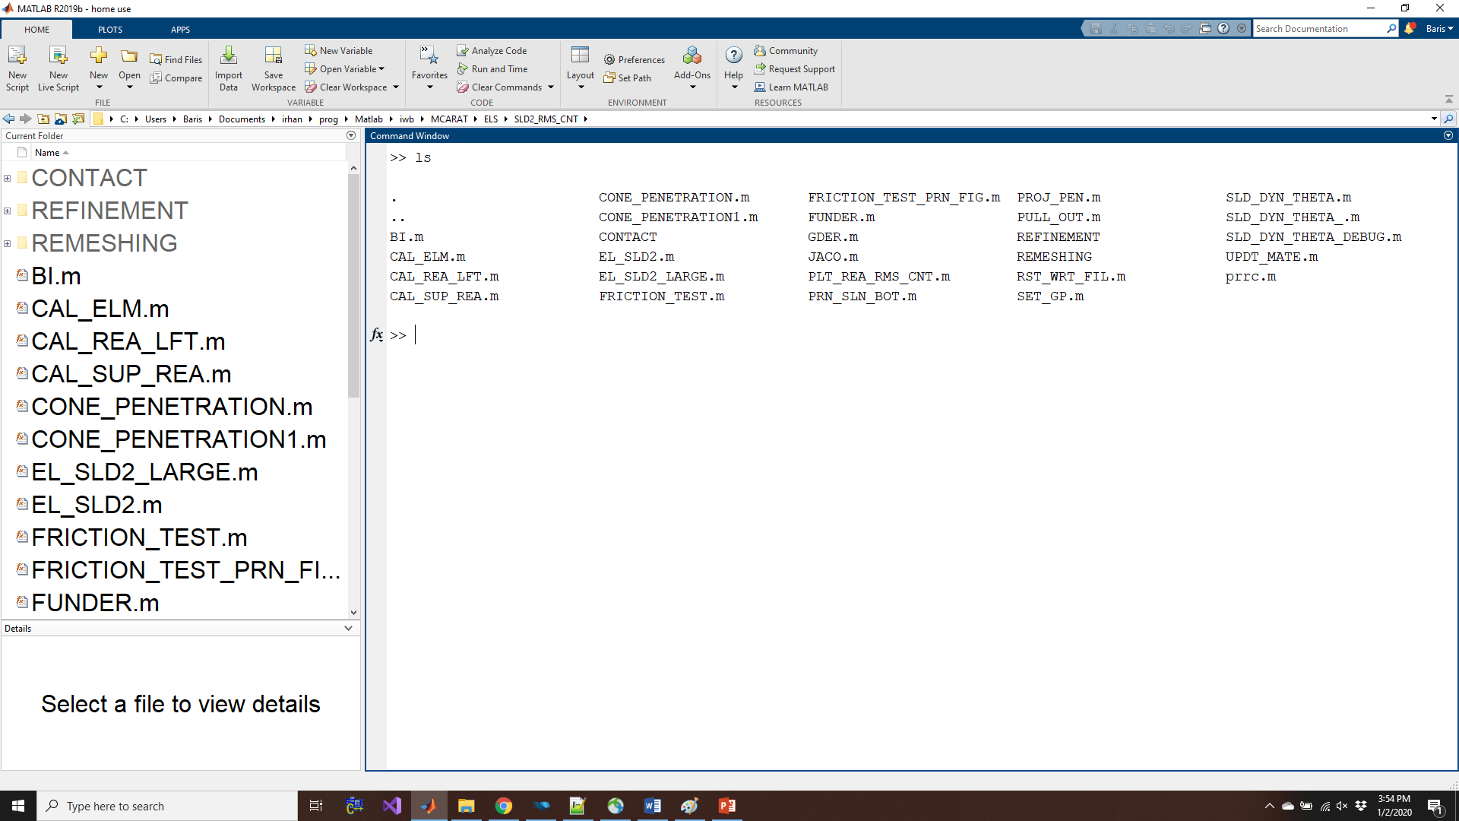
Example: SLD2_RMS_CNT Element

Slide 8
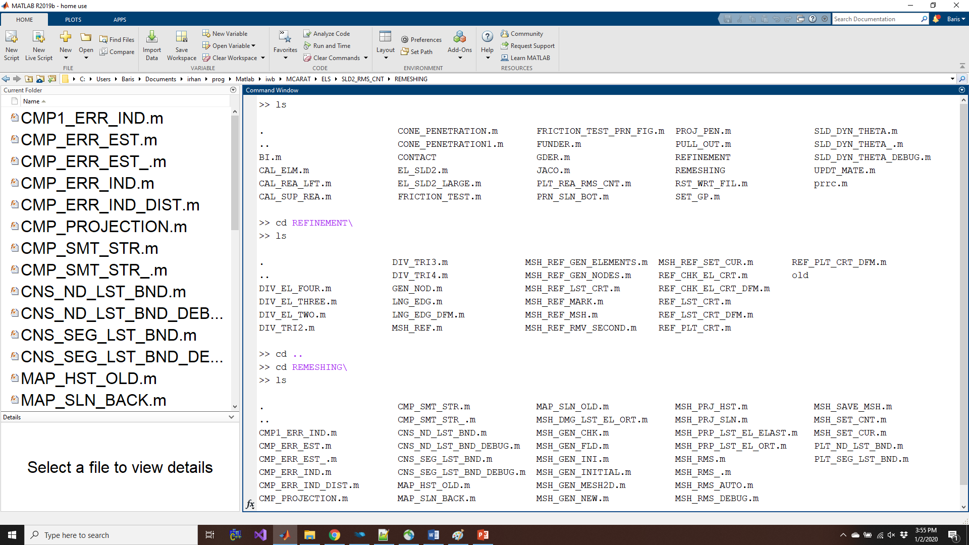
SLD2_RMS_CNT Element > Adaptivity

Slide 9
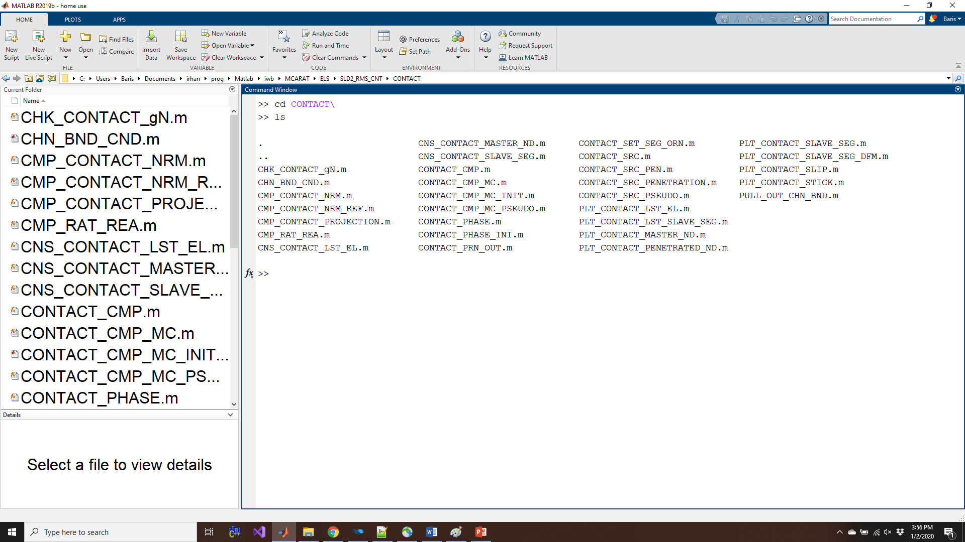
SLD2_RMS_CNT Element > Contact

Slide 10
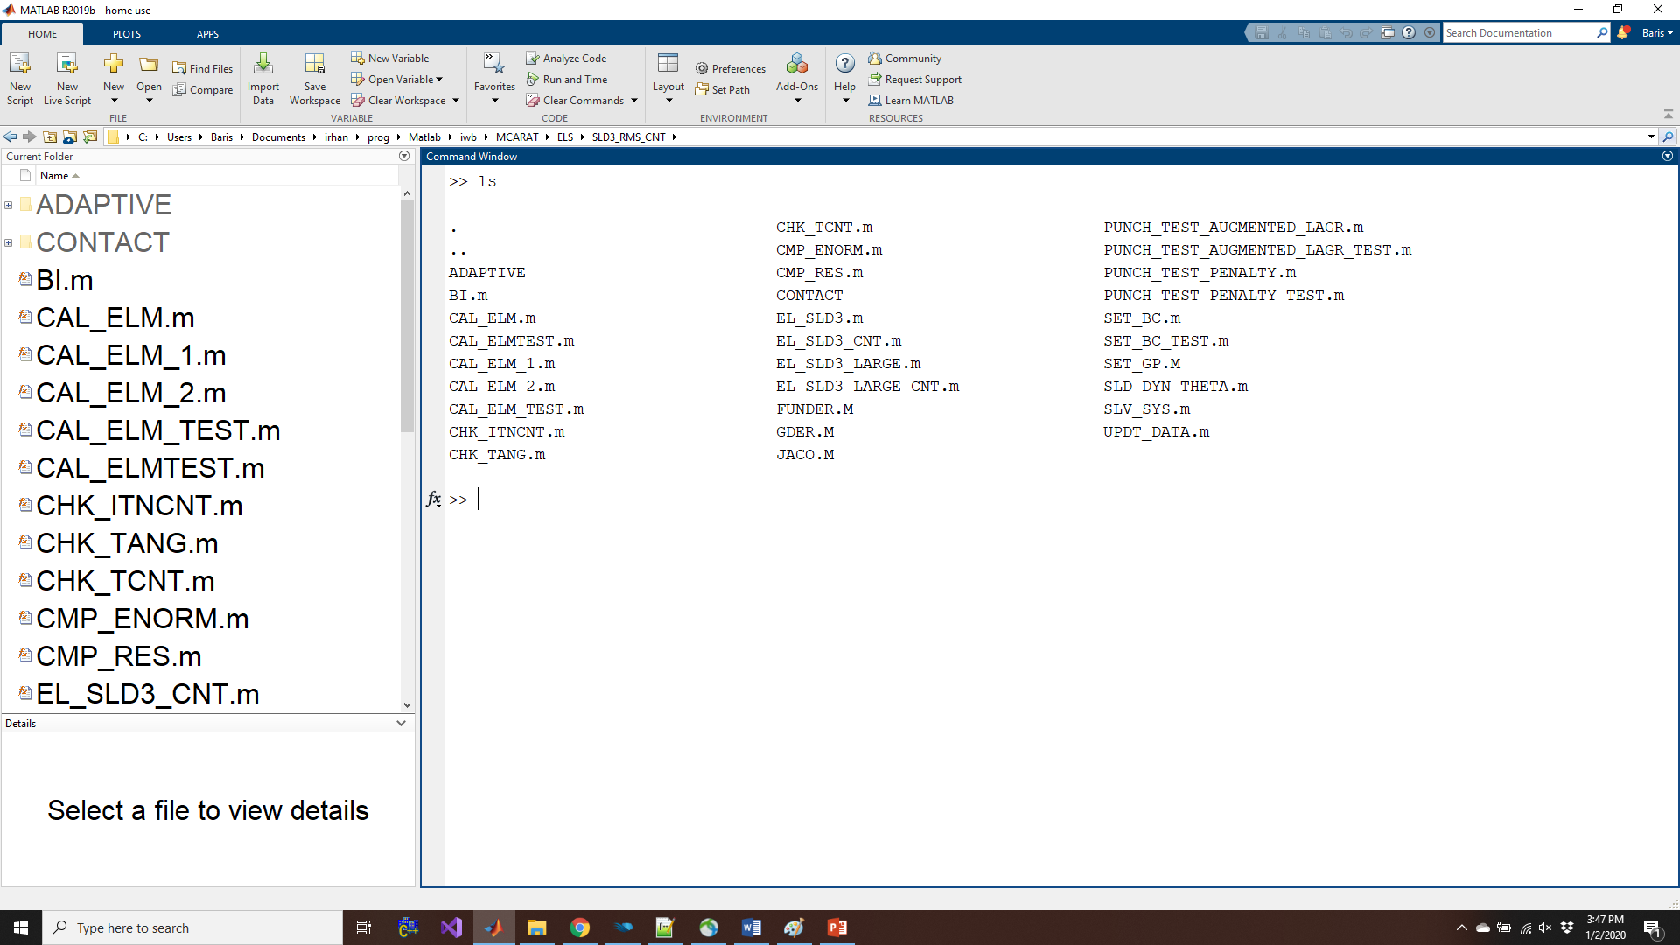
Example: SLD3_RMS_CNT Element

Slide 11
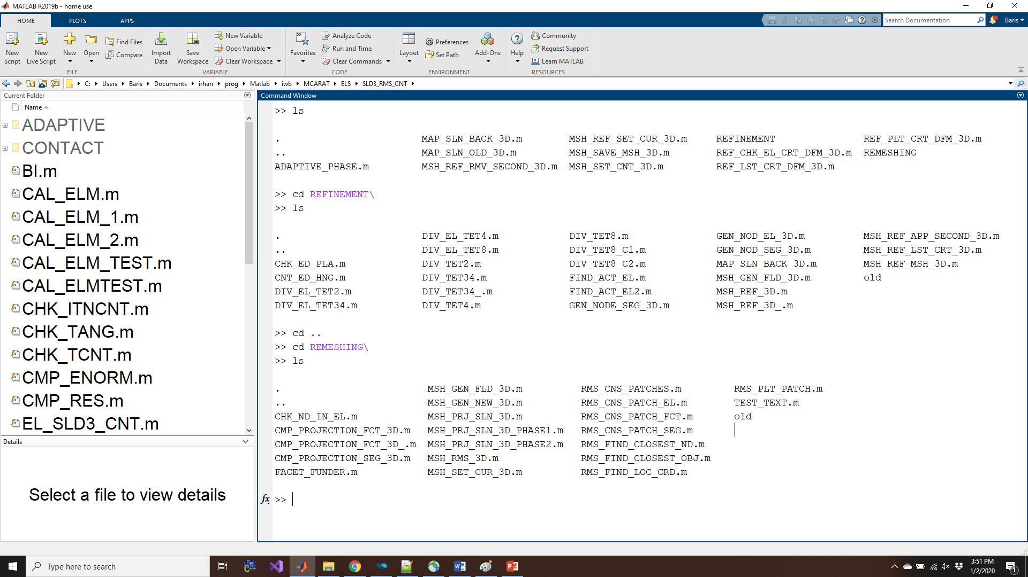
SLD3_RMS_CNT Element > Adaptivity

Slide 12
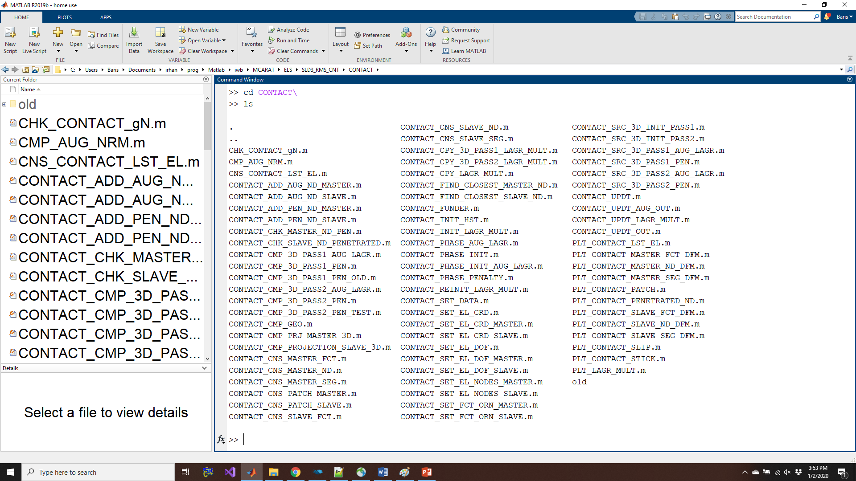
SLD3_RMS_CNT Element > Contact

Slide 13
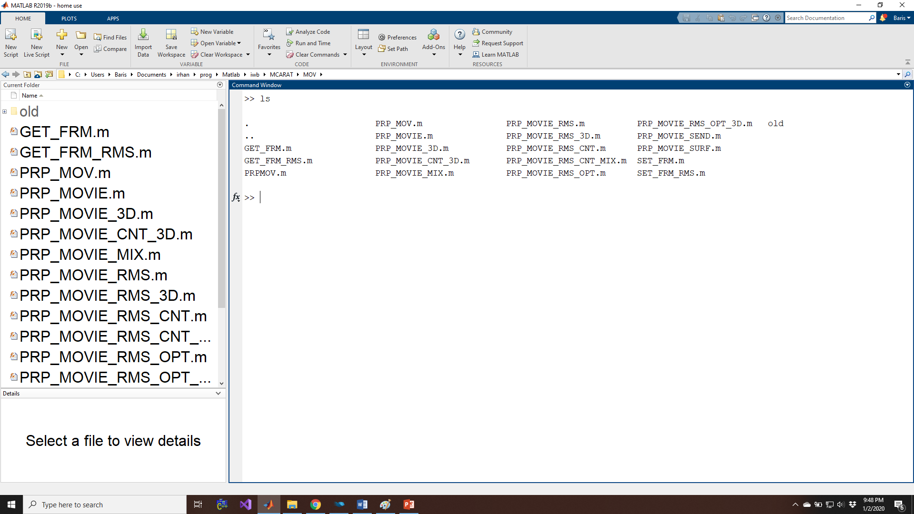
MOV Folder

Slide 14
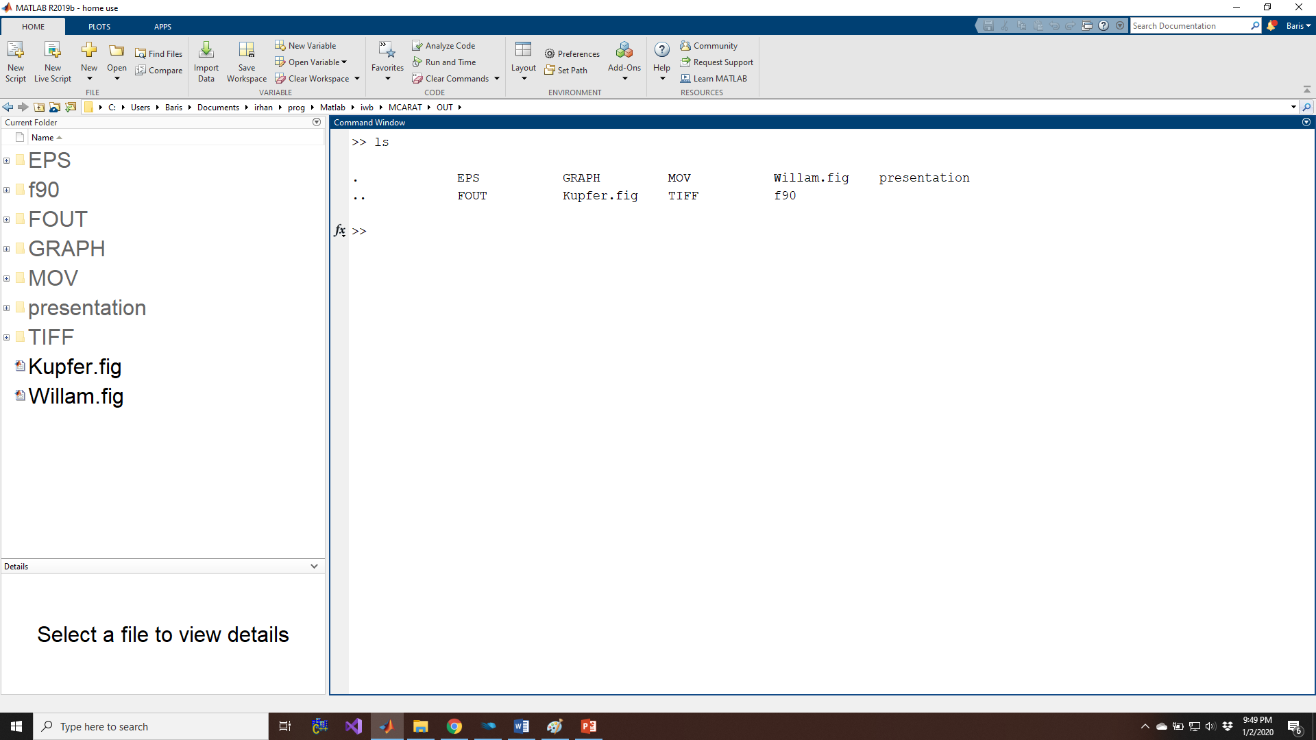
OUT Folder

Slide 15
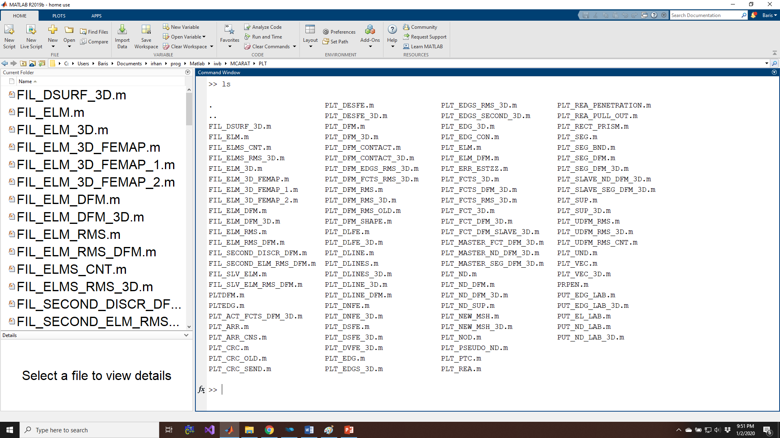
PLT Folder

Slide 16
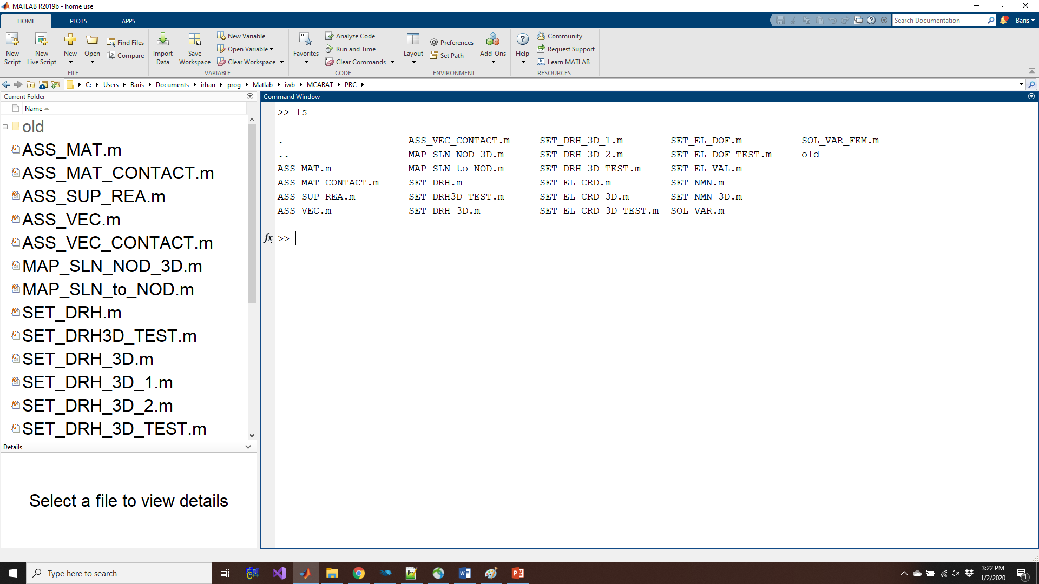
PRC Folder

Slide 17
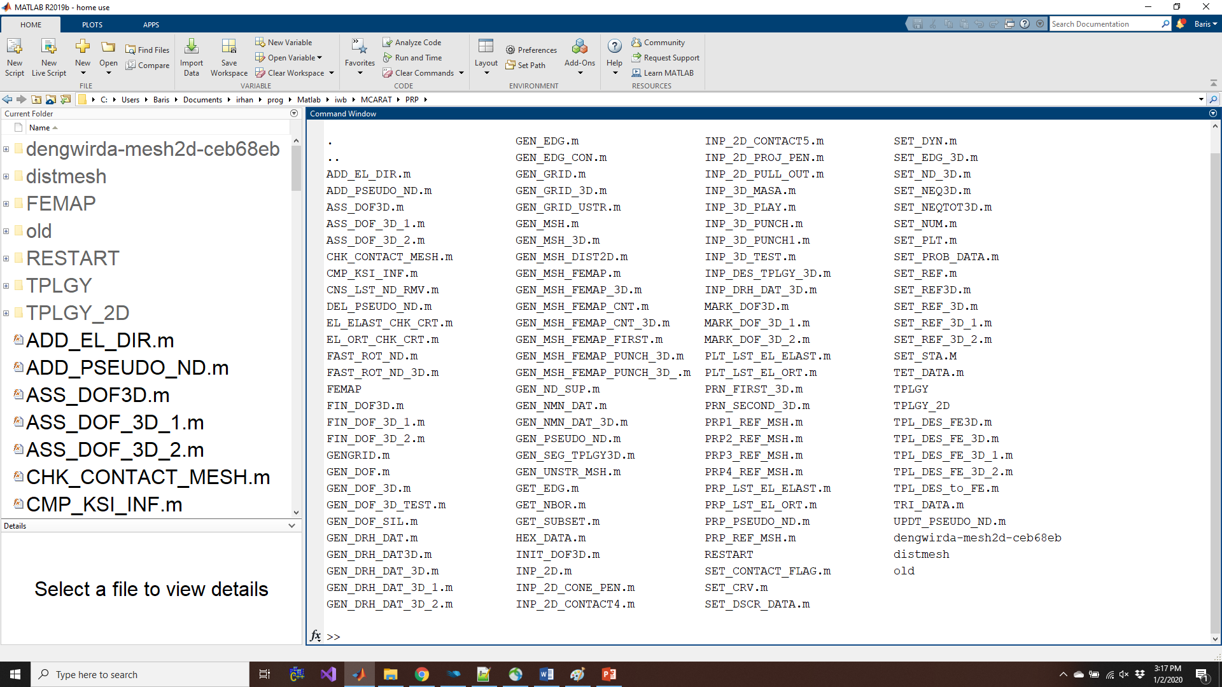
PRP Folder

Slide 18
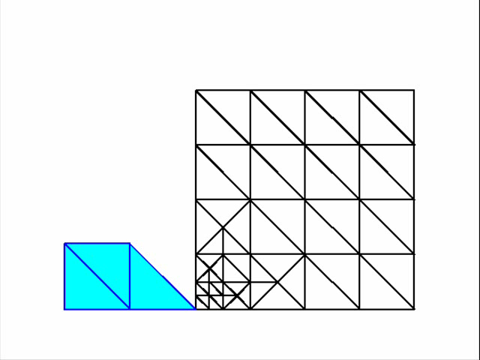
Movie: 2D projectile penetration simulation

Slide 19
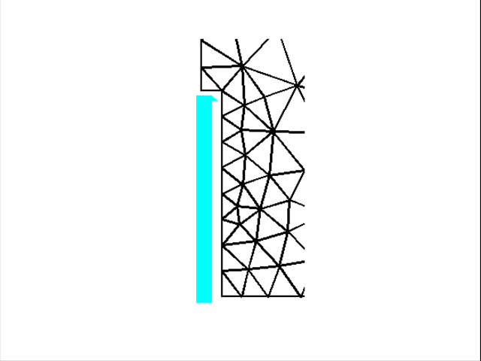
Movie: 2D pull-out test simulation

Slide 20
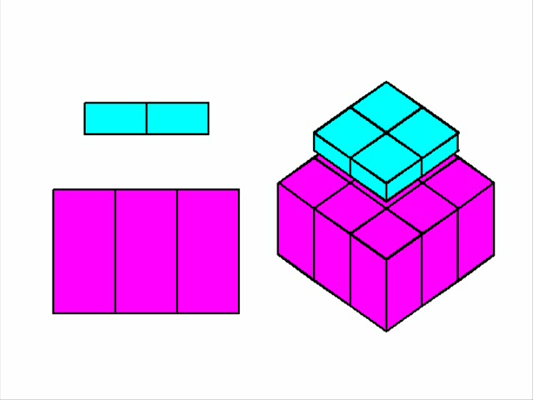
Movie: 3D punch test simulation

Slide 21
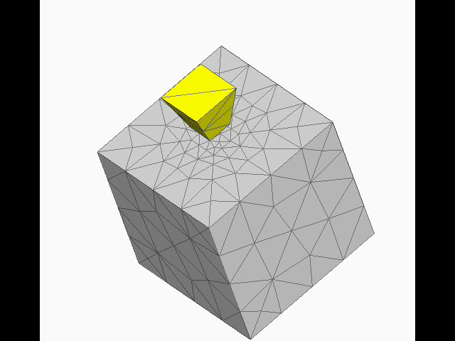
Movie: 3D cone penetration

