Slide 1
ADAPTIVE FINITE ELEMENT METHODS FOR CONTACT SIMULATIONS
MSc Barış İRHAN
IWB - University of Stuttgart

Slide 2

CONTENTS:
MOTIVATION: PENETRATION PROBLEM
CONTACT PROBLEM
ADAPTIVE FINITE ELEMENTS FOR CONTACT
NUMERICAL EXAMPLES
FUTURE ASPECTS
Institut für Werkstoffe im Bauwesen

Slide 3
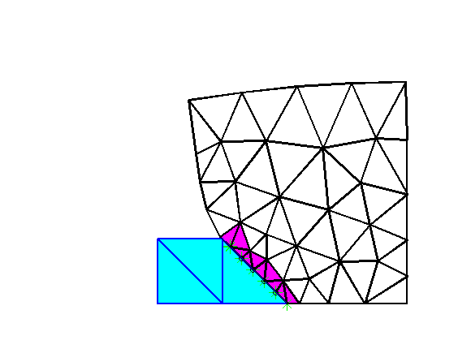
MOTIVATION: PENETRATION PROBLEM
NONLINEARITY ( MATERIAL and GEOMETRICAL )
INELASTICITY ( DAMAGE, PLASTICITY …)
CONTACT
NON-MECHANICAL EFFECTS ( HEAT … )
RATE EFFECTS
Institut für Werkstoffe im Bauwesen

Slide 4
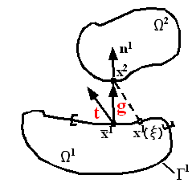
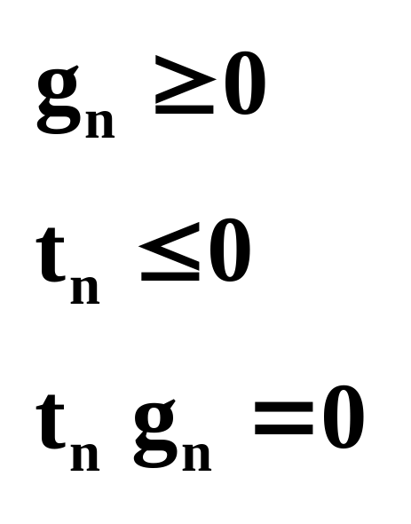
CONTACT PROBLEM
Contact Constraints: Karush-Kuhn-Tucker Conditions
Institut für Werkstoffe im Bauwesen

Slide 5
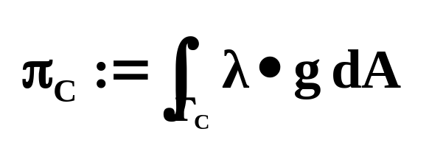

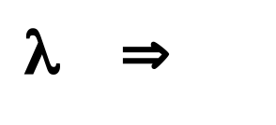
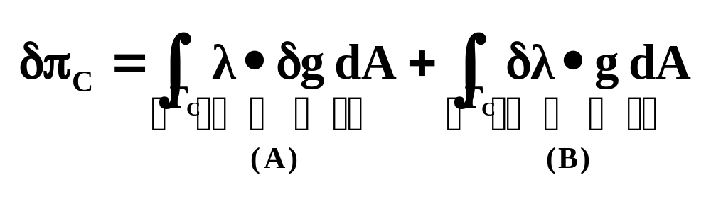
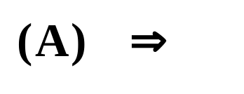

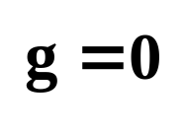
CONTACT PROBLEM
Lagrange Multiplier Method:
Penetration vector
Lagrange Multipliers ( ‚Contact Tractions‘ )
Contribution to the virtual work
Weak form of impenetrability constraint:
Institut für Werkstoffe im Bauwesen

Slide 6
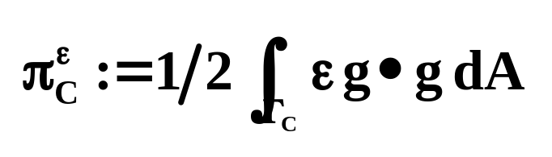

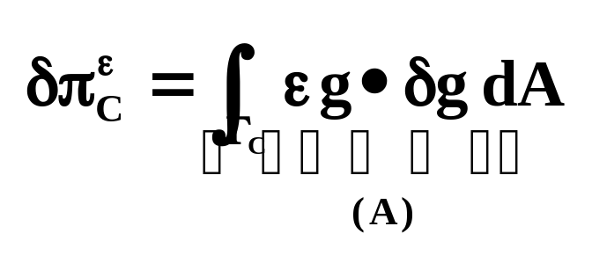
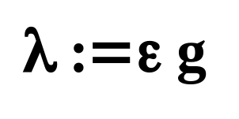
CONTACT PROBLEM
Penalty Method:
Penetration vector
Penalty parameter. A large number
Contribution to the virtual work
Institut für Werkstoffe im Bauwesen

Slide 7
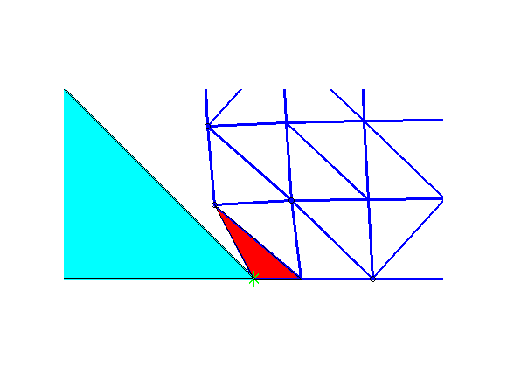
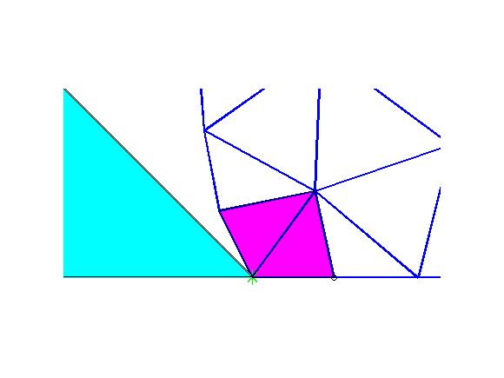
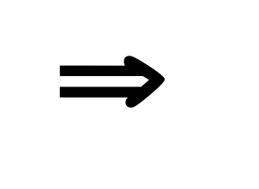
ADAPTIVE FINITE ELEMENTS FOR CONTACT
MOTIVATION: WHY a new FE discretization?
1) To remove highly distorted elements
Institut für Werkstoffe im Bauwesen

Slide 8
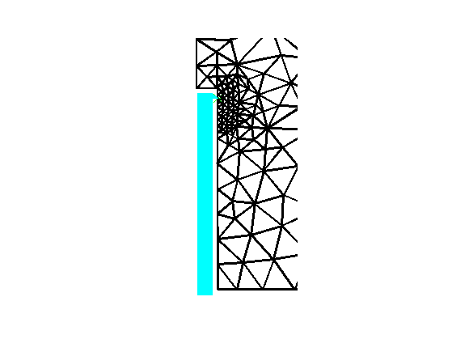
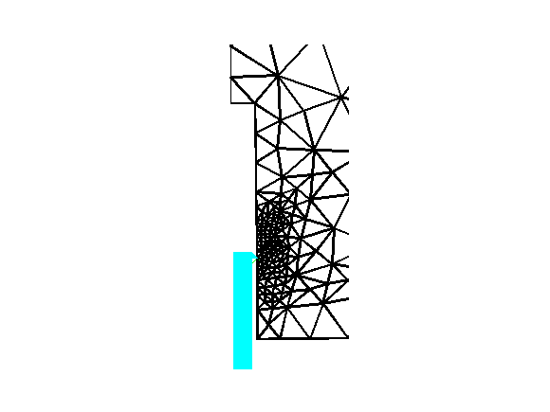
ADAPTIVE FINITE ELEMENTS FOR CONTACT
MOTIVATION: WHY new FE discretization?
2) To increase accuracy around the contact interface
Institut für Werkstoffe im Bauwesen

Slide 9
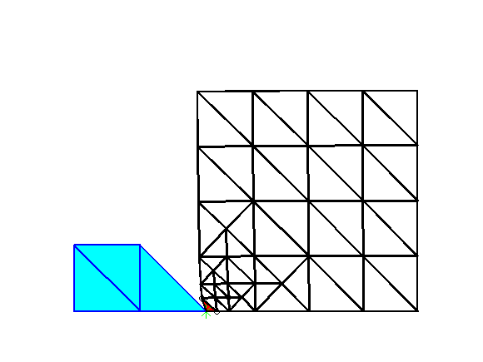
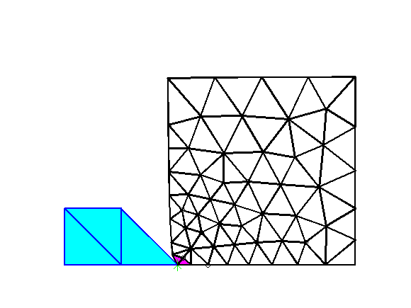
ADAPTIVE FINITE ELEMENTS FOR CONTACT
REMESHING:
FE discretization with a completely new topology is generated.
Time demanding due to projection of primary and secondary variables.
Smearing of data during projection.
Elements of good aspect ratio and density can be generated.
Institut für Werkstoffe im Bauwesen

Slide 10
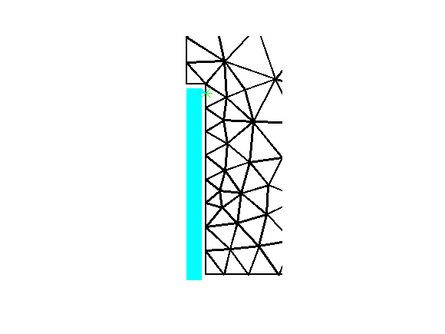
ADAPTIVE FINITE ELEMENTS FOR CONTACT
MESH REFINEMENT:
Old FE topology is respected.
Time efficient. No search algorithm is required during projection phase.
Accurate transfer of primary and secondary variables is achieved.
No improvement in the element quality. Can not be used alone as a adaptive strategy.
Institut für Werkstoffe im Bauwesen

Slide 11
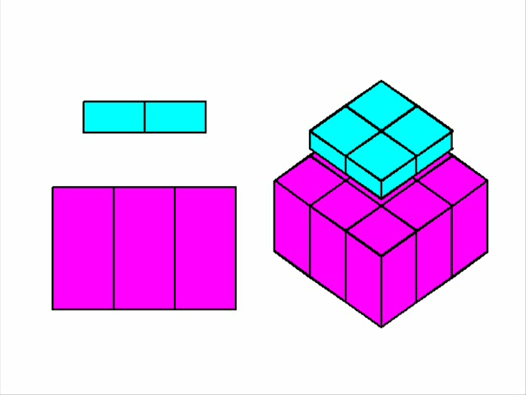
NUMERICAL EXAMPLES
EXAMPLE1: PUNCH TEST (*)
(*) H. Parisch, 1989. “A consistent tangent stiffness matrix for threedimensional non-linear contact analysis”, International Journal for Numerical Methods in Engineering, 28, pp. 1803-1812
Institut für Werkstoffe im Bauwesen

Slide 12
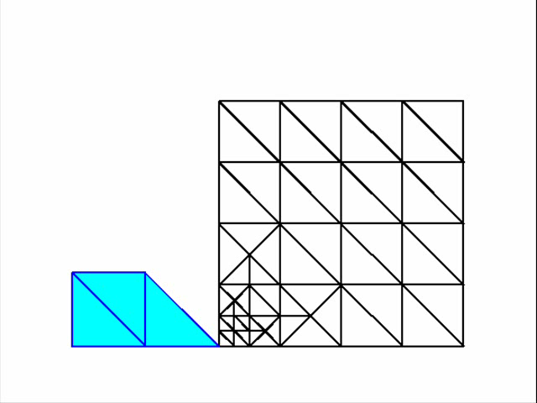
NUMERICAL EXAMPLES
EXAMPLE2: PENETRATION TEST
Institut für Werkstoffe im Bauwesen

Slide 13

NUMERICAL EXAMPLES
EXAMPLE3: PULL-OUT TEST
Institut für Werkstoffe im Bauwesen

Slide 14
FUTURE ASPECTS
3D remeshing+contact
A material model for quasi-brittle materials
Loading-rate sensitivity
Inertial effects
Implementation into MASA3
Institut für Werkstoffe im Bauwesen

