Slide 1
Perceived Touristic Attractiveness in the Porto Metropolitan Area Based on Google Places Reviews: Introduction and Database
Authors: Beatriz Santos, Bruno Rocha, Joana Guerreiro

Slide 2
🎯Main Objective
To build a Global Index of Perceived Touristic Attractiveness (IGPTA) using user ratings and reviews.
To explore spatial patterns of perceived attractiveness in the Porto Metropolitan Area.

Slide 3
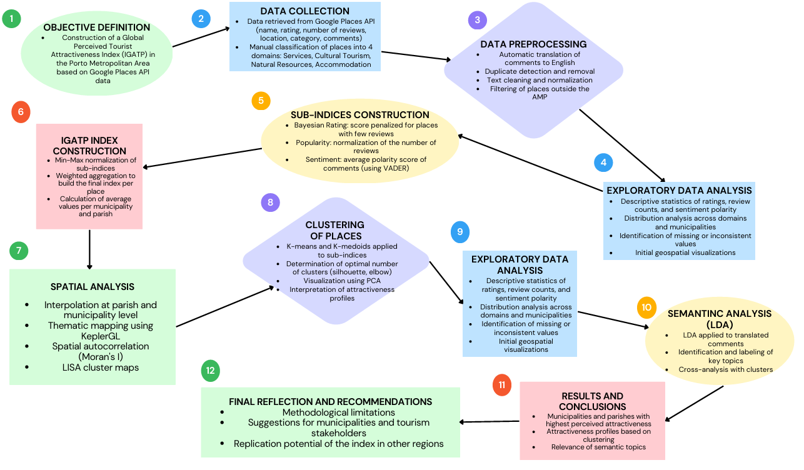
Flowchart

Slide 4
What is Touristic Attractiveness?
🧭 Definition (project-specific): "Touristic attractiveness refers to the degree to which a location captures visitors’ interest and preference, based on online perception, shared experiences, and qualitative evaluation."
💬 Note:
The index focuses on perceived attractiveness, not actual tourist flows.

Slide 5
Data Overview
📌 Source: Google Places API
📍 Study Area: 17 municipalities in the Porto Metropolitan Area (AMP)
📂 Datasets:
google_places_AMP_with_coordinates.csv: place information + average rating
comments_google_maps_AMP.csv: up to 5 reviews per place

Slide 6
Data Overview
📊 Variable Dictionary – Ratings (google_places_AMP_with_coordinates.csv)
📊 Variable Dictionary – Comments (comments_google_maps_AMP.csv)
Variable | Description
City | Municipality where the point of interest is located
Category | Category assigned to the place (restaurant, museum, hotel, bar, tourist attraction, cafe, church, park, natural feature, viewpoint, trail, lodging)
Name | Name of the establishment or point of interest
Rating | Average rating given by users for the place
Address | Full address of the place
Types | List of categories assigned by the Google API
Latitude | Geographic latitude coordinate of the place
Longitude | Geographic longitude coordinate of the place
Total Reviews | Total number of reviews received by the place
Variable | Description
City | Municipality where the point of interest is located
Category | Category assigned to the place (e.g., restaurant, hotel, park)
Place Name | Name of the establishment or point of interest
Author | Name of the user who wrote the comment
Text | Original text of the comment published by the user
Date | Relative date of the comment (e.g., 'a year ago')
Rating | Rating assigned in the comment (1 to 5 stars)

Slide 7
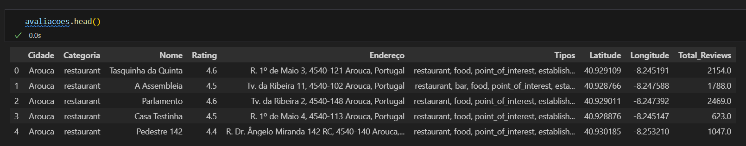
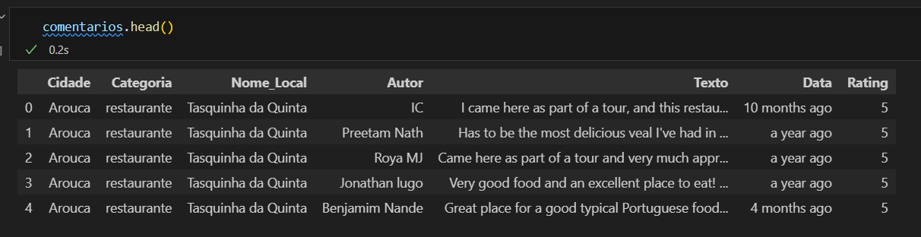
Database Structure
Ratings (google_places_AMP_with_coordinates.csv)
Comments (comments_google_maps_AMP.csv)

