Slide 1
Perceived Touristic Attractiveness in the Porto Metropolitan Area Based on Google Places Reviews: Exploratory Analysis
Authors: Beatriz Santos, Bruno Rocha, Joana Guerreiro

Slide 2
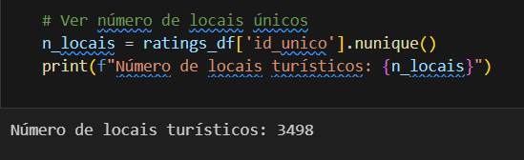
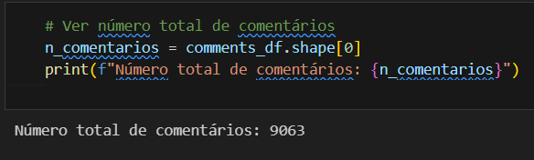
Descriptive Exploratory Analysis
Number of tourist locations: 3498
Total number of comments collected: 9063

Slide 3
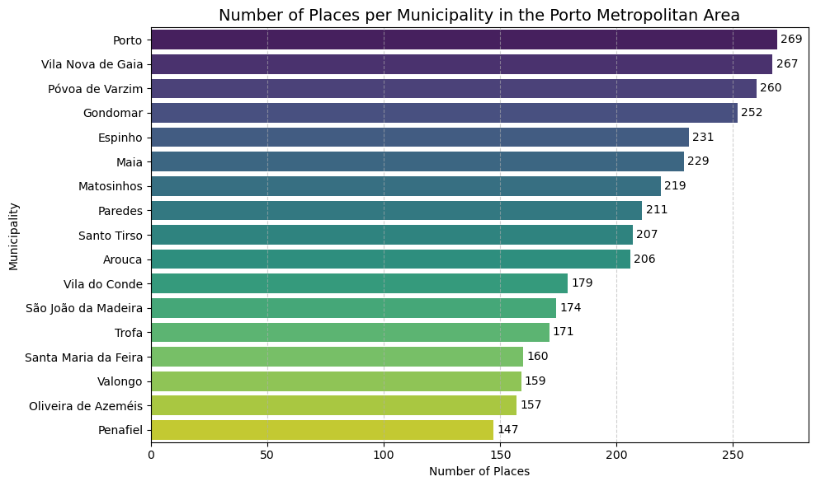
Descriptive Exploratory Analysis
Locations by Municipality:
The distribution of tourist sites across the Porto Metropolitan Area shows a notably higher concentration in the larger urban centres—Porto (269 sites) and Vila Nova de Gaia (267)—followed by Póvoa de Varzim (260), Gondomar (252) and Espinho (231). This pattern reflects not only population density and economic dynamism but also the digital visibility of these attractions on review platforms. Nonetheless, the gap between the municipality with the most sites (Porto) and the one with the fewest (Penafiel, with 147) remains relatively moderate, indicating a balanced territorial coverage well-suited for comparative analysis of perceived tourist attractiveness.

Slide 4
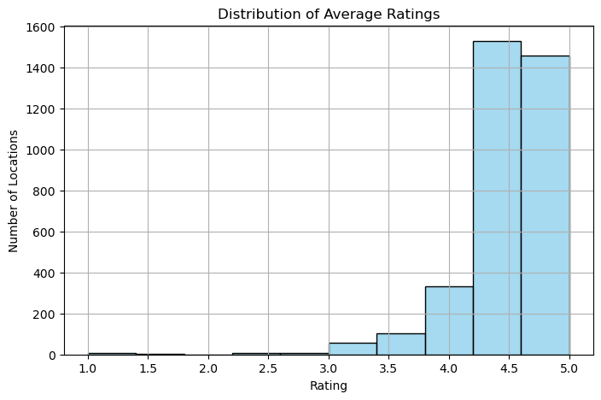
Descriptive Exploratory Analysis
Descriptive Statistics for “Rating”:
The Ratings exhibit a strongly positive overall perception of the assessed sites, with a mean of 4.46 on a 1–5 scale. The median is 4.5, and 75% of locations have ratings of 4.3 or higher, indicating a pronounced skew toward favorable evaluations. Nonetheless, there is some variability (standard deviation = 0.40), and the minimum value of 1.0 confirms the presence of a small number of negative experiences.

Slide 5
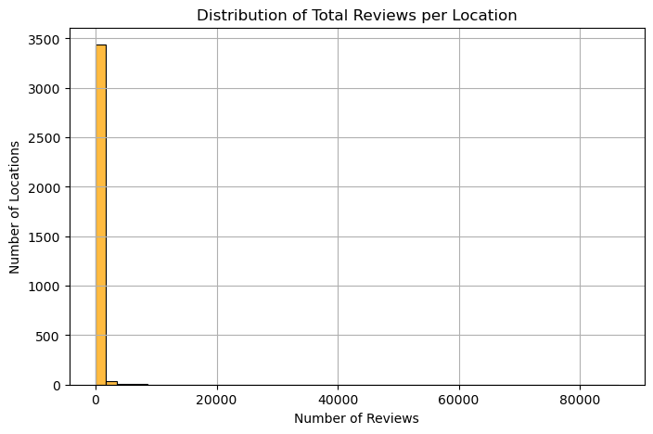
Descriptive Exploratory Analysis
Descriptive Statistics for “Total_Reviews”:
The Total_Reviews variable is highly skewed: among 3,498 sites, the median is 0 (half of all POIs have received no reviews, and this remains true up to the 75th percentile), whereas the mean (≈166) and standard deviation (≈1,780) are driven upward by a handful of extremely popular locations. Indeed, the maximum value of 86,331 reviews underlines a long right tail, where few sites concentrate the vast majority of feedback. Consequently, when constructing the Popularity sub‐index, it is advisable to apply an appropriate transformation (e.g., logarithm) or robust normalization technique to mitigate the influence of these outliers and enable fairer comparisons across all locations.

Slide 6
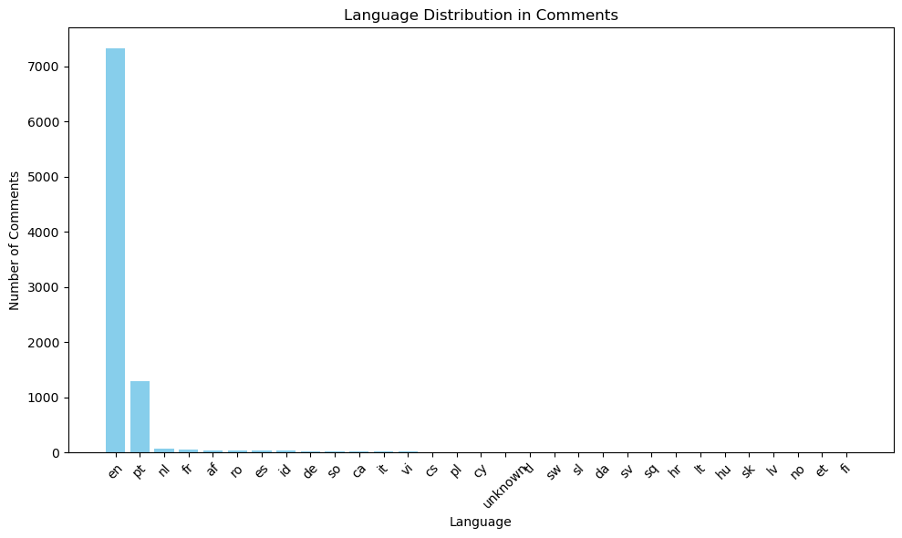
Descriptive Exploratory Analysis
Language Distribution in Comments
The analysis of comment languages (9,000 total) shows a strong dominance of English (≈7,332 entries), followed by Portuguese (≈1,298). The remaining languages form a “long tail”: Dutch (68), French (53), Afrikaans (40), Romanian (39), Spanish (35) and Indonesian (33) together account for only a few hundred comments, while German, Somali, Catalan, Italian and others appear even less frequently (5–20 occurrences). Dozens of additional languages (e.g., Vietnamese, Czech, Polish, Galician, Latvian) are represented sporadically, and five comments could not be identified. This pattern justifies our choice to auto-translate all comments into English and apply sentiment tools optimized for that language, while highlighting the need for broader multilingual approaches in future work to fully capture the corpus’s linguistic diversity.

Slide 7
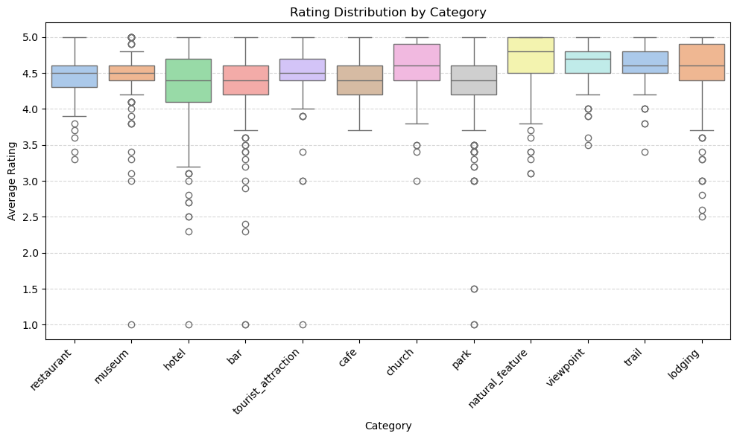
Descriptive Exploratory Analysis
Rating Distribution by Category
The category-wise rating distributions exhibit distinct patterns in both central tendency and variability. “Natural_feature,” “viewpoint,” and “church” show medians around 4.8–5.0★ with narrow interquartile ranges, indicating uniformly high and consistent ratings. In contrast, “hotel,” “bar,” and “park” have lower medians (approximately 4.2–4.4★) and wider boxes, reflecting more diverse visitor experiences; these categories also include a noticeable number of low-end outliers (1.0–2.0★). “Cafe” and “tourist_attraction” share similar medians (≈4.4–4.5★) with moderate spread, while “restaurant” and “museum” occupy intermediate positions, featuring medians near 4.5★ and relatively compact distributions. Overall, natural sites and viewpoints enjoy the strongest consensus of positive ratings, whereas accommodations, bars, and parks display more polarized feedback.

Slide 8
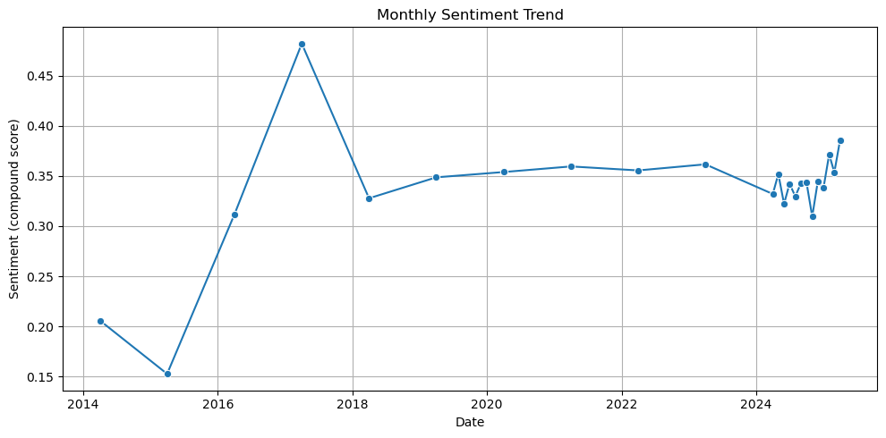
Descriptive Exploratory Analysis
Monthly Trend of Average Polarity
The monthly average polarity trend chart displays several notable peaks and troughs—most prominently a sharp rise between 2017 and 2018—which may reflect specific events (such as attraction renovations, promotional campaigns, or seasonal factors). From 2019 through mid-2024, polarity stabilizes around 0.33–0.36, with a modest uptick toward the end of 2024 and early 2025, indicating a slight increase in positivity in the most recent comments. Although based on up to five reviews per location and relative-date conversions, this longitudinal pattern underscores a generally consistent positive perception over time, warranting future validation with more comprehensive historical data.

Slide 9
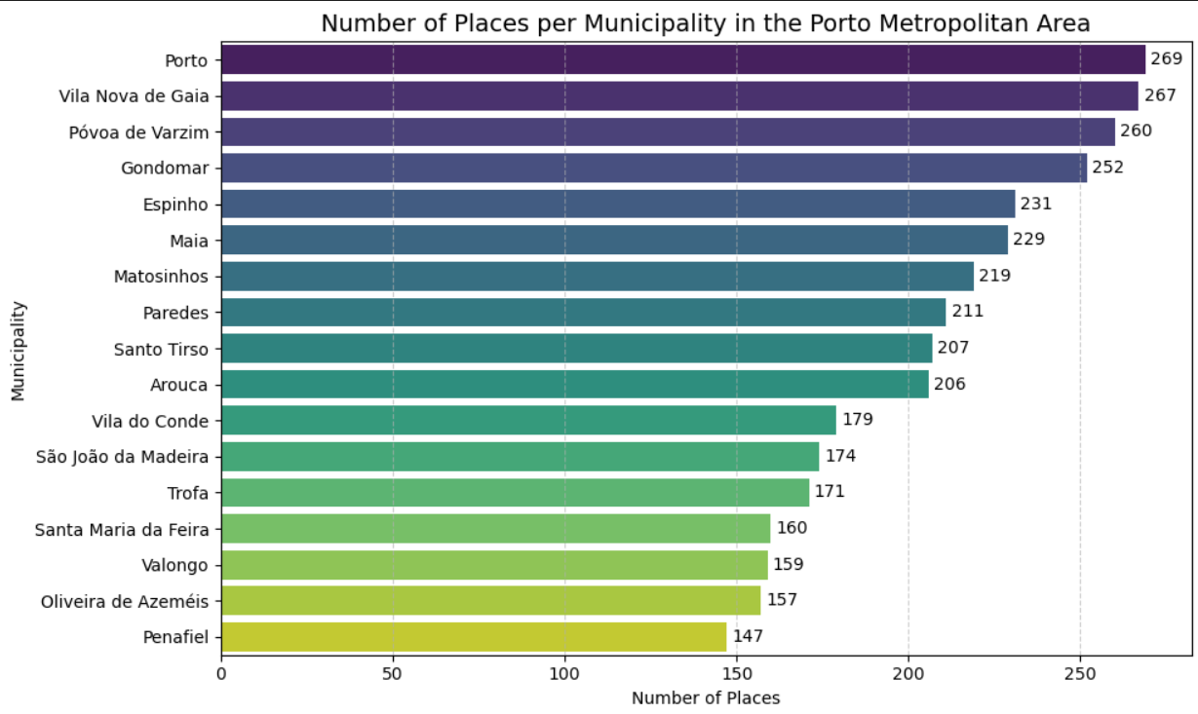
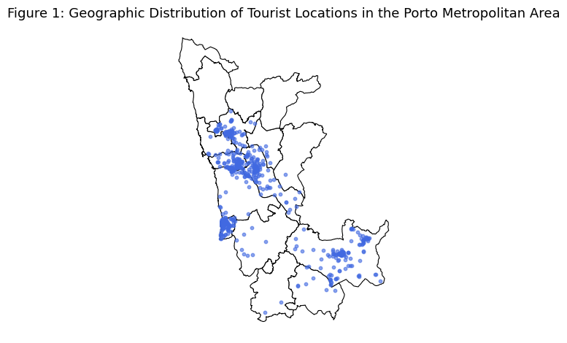
Spatial Exploratory Analysis
However, when we plot the spatial distribution using the geographic coordinates, there are several gaps in coverage, indicating that the coordinates obtained from the Google Places API are not fully reliable.
Based on the CSV data:

Slide 10
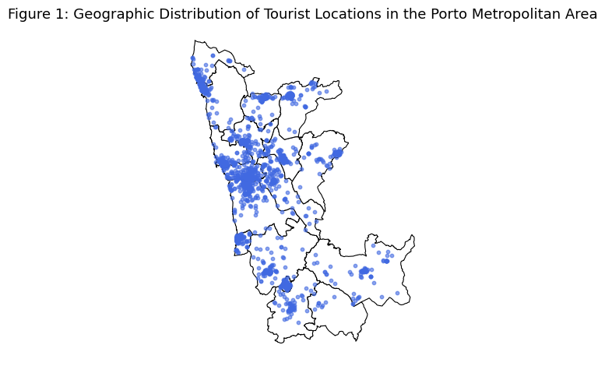
Spatial Exploratory Analysis
Given that we had the address column, we attempted geocoding to retrieve missing coordinates. The result improved overall coverage, although some gaps remain due to addresses that could not be resolved via geocoding.
The outcome was as follows:

Slide 11
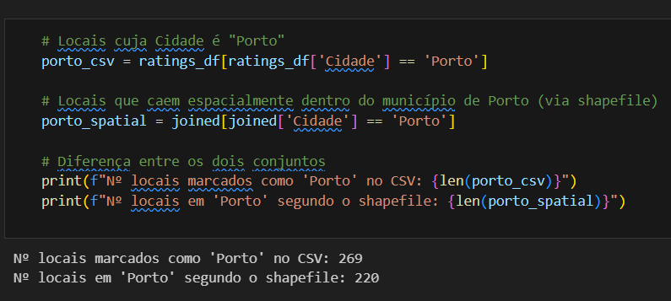
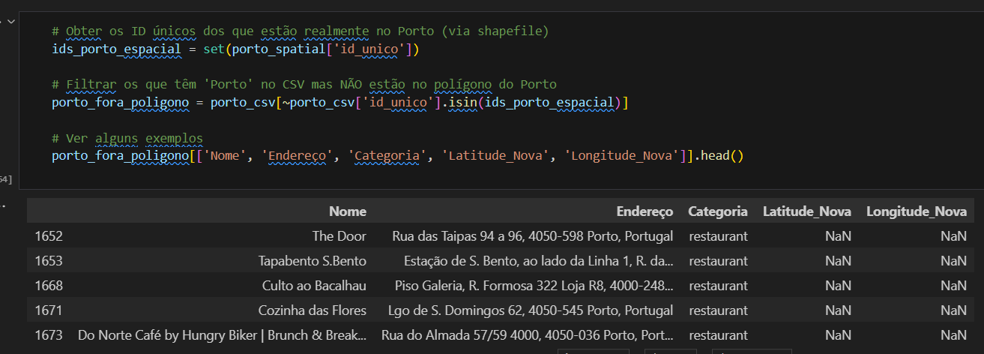
Spatial Exploratory Analysis
Nonetheless, even after geocoding some locations still lack coordinates, but this gap has been substantially reduced.

Slide 12
Spatial Exploratory Analysis
The geographic distribution of points of interest shows a strong concentration in the urban core of the Porto Metropolitan Area, particularly along the coastal corridor encompassing Porto, Vila Nova de Gaia, and Matosinhos. Secondary clusters appear in Póvoa de Varzim and Vila do Conde, as well as more scattered groups in inland municipalities such as Penafiel and Santa Maria da Feira. Despite gaps in coordinates for some records—which may underrepresent the most central areas—it is evident that perceived attractiveness is not confined to a single hub: there are both densely reviewed historic centers and coastal tourism poles, along with occasional clusters in peripheral municipalities. This pattern suggests a complementarity between established urban areas and natural or cultural destinations in the surrounding region.

Slide 13
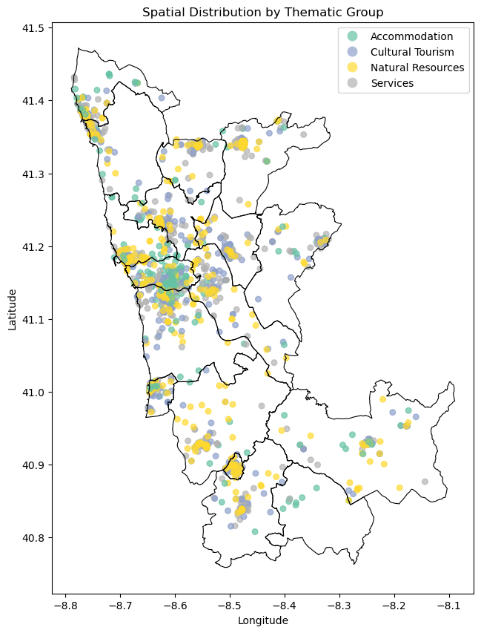
Spatial Analysis
Spatial Distribution of Tourist Locations by Thematic Group
This map displays the spatial distribution of tourist-related locations in the Porto Metropolitan Area (AMP), classified by thematic group.
Thematic categories shown:
🟢 Accommodation: hotels, hostels, guesthouses.
🟡 Cultural Tourism: museums, historical sites, churches.
🔵 Natural Resources: parks, viewpoints, nature trails.
⚪ Services: cafés, restaurants, bars.
A higher concentration of diverse locations is observed in urban centers such as Porto, Vila Nova de Gaia, and Matosinhos.
In more peripheral municipalities, natural and cultural points of interest tend to dominate the landscape.
This spatial breakdown confirms the territorial reach and thematic diversity of the data, serving as a baseline for further spatial or cluster-based analysis.

