Slide 1
Perceived Touristic Attractiveness in the Porto Metropolitan Area Based on Google Places Reviews: Bayesian Rating Ajustment
Authors: Beatriz Santos, Bruno Rocha, Joana Guerreiro

Slide 2
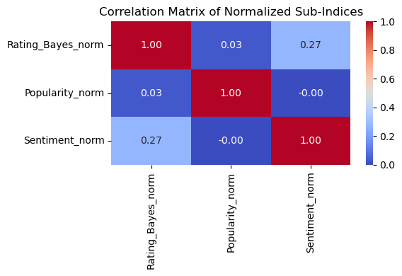
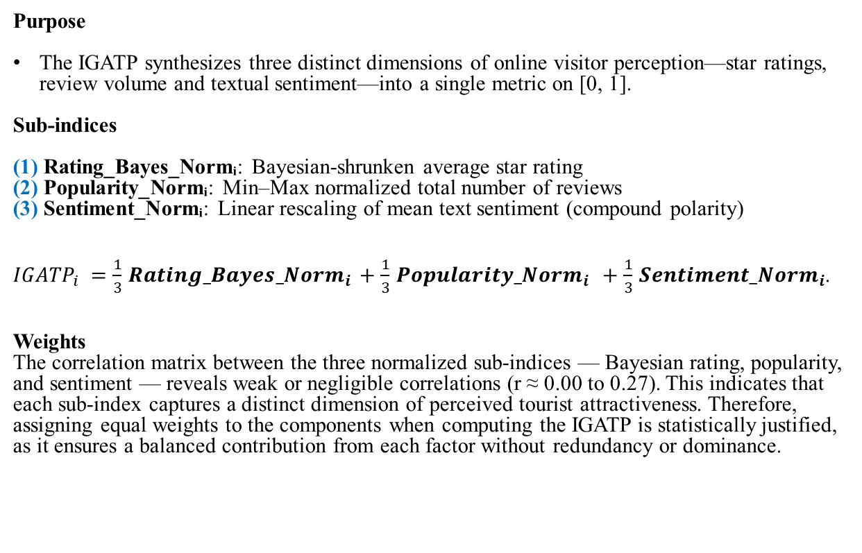
Global Index of Perceived Tourist Attractiveness
Purpose
The IGATP synthesizes three distinct dimensions of online visitor perception—star ratings, review volume and textual sentiment—into a single metric on [0, 1].
Sub-indices
(1) Rating_Bayes_Normᵢ: Bayesian-shrunken average star rating
(2) Popularity_Normᵢ: Min–Max normalized total number of reviews
(3) Sentiment_Normᵢ: Linear rescaling of mean text sentiment (compound polarity)
$IGATP_{i}=\frac{1}{3}Ratin{g_Bayes_Norm}_{i}+\frac{1}{3}{Popularity_Norm}_{i} +\frac{1}{3}{Sentiment_Norm}_{i}$.
Weights
The correlation matrix between the three normalized sub-indices — Bayesian rating, popularity, and sentiment — reveals weak or negligible correlations (r ≈ 0.00 to 0.27). This indicates that each sub-index captures a distinct dimension of perceived tourist attractiveness. Therefore, assigning equal weights to the components when computing the IGATP is statistically justified, as it ensures a balanced contribution from each factor without redundancy or dominance.

Slide 3
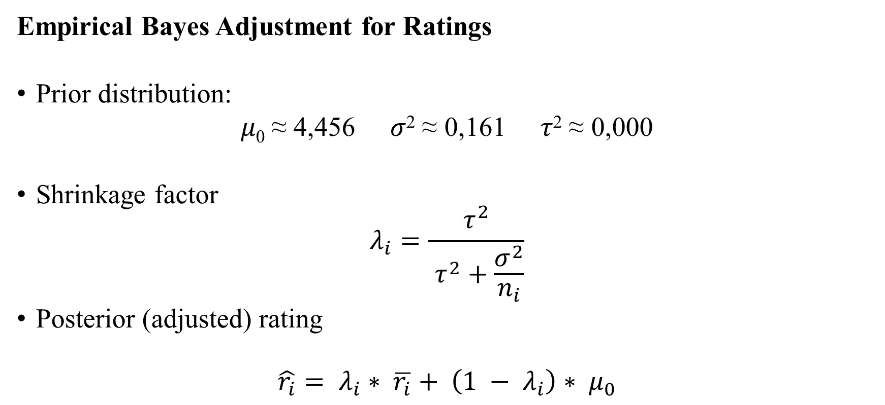
Global Index of Perceived Tourist Attractiveness
Empirical Bayes Adjustment for Ratings
Prior distribution:
𝜇₀ ≈ 4,456 𝜎² ≈ 0,161 𝜏² ≈ 0,000
Shrinkage factor
$$λ_{i}=\frac{τ^{2}}{ τ^{2}+\frac{σ^{2}}{n_{i}}}$$
Posterior (adjusted) rating
$$\hat{r_{i}}= λ_{i}∗ \overline{r_{i}}+ \left(1 − λ_{i}\right)∗ μ_{0}$$

Slide 4

Global Index of Perceived Tourist Attractiveness
Empirical Bayes Adjustment for Ratings
Interpretation:
If 𝑛_{𝑖} (number of reviews) is small ⇒ 𝜆_{𝑖​} ≈ 0 ⇒ $\hat{r_{i}}$ → 𝜇₀.
If 𝑛_{𝑖}​ is large ⇒ 𝜆_{𝑖} ≈ 1 ⇒ $\hat{r_{i}}$ ≈ $\overline{r_{i}}$

Slide 5
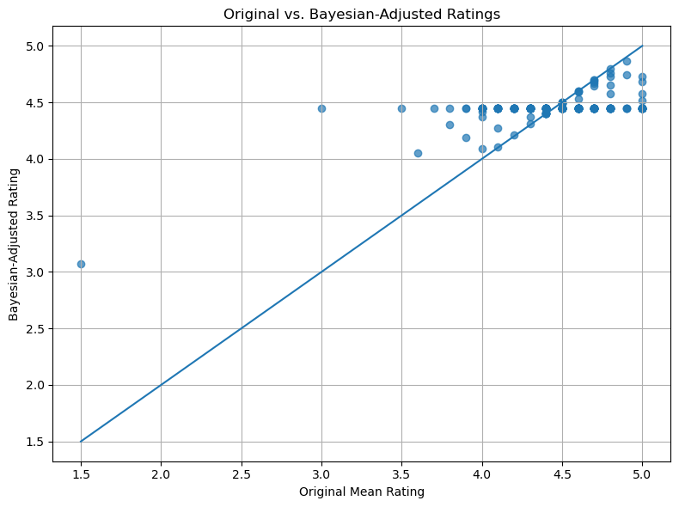
Global Index of Perceived Tourist Attractiveness
Empirical Bayes Adjustment for Ratings
The scatter-and-identity-line plot clearly illustrates the “shrinkage” effect of the Bayesian adjustment. Venues with unusually low original ratings tend to have their adjusted scores pulled upward toward the global mean, appearing above the diagonal line. Conversely, venues with very high original ratings see their adjusted scores pulled downward, falling below the identity line.Points closer to the diagonal correspond to venues with more stable and well-supported ratings, which are only minimally adjusted. Overall, the Empirical Bayes adjustment works to compress extreme values, stabilizing ratings and offering a more reliable and comparable measure of perceived attractiveness across venues.

Slide 6
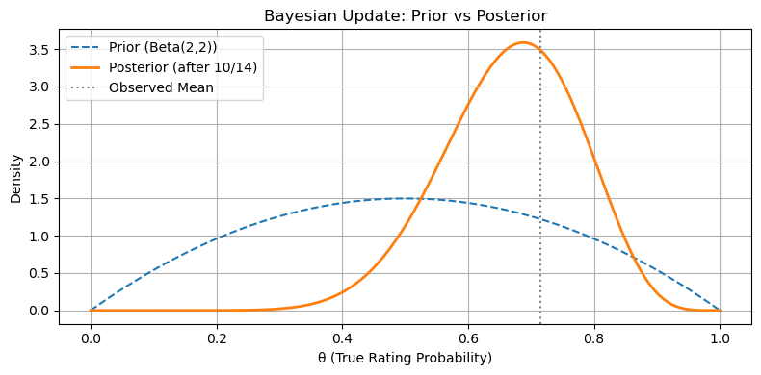
Global Index of Perceived Tourist Attractiveness
Empirical Bayes Adjustment for Ratings
Interpretation of the Bayesian Update Plot:
Prior Distribution (Beta(2,2))
Represents initial belief before seeing any data.
It is symmetric around 0.5, reflecting neutral expectations (neither optimistic nor pessimistic).
Equivalent to imagining 2 positive and 2 negative ratings (weak prior).
Observed Data
10 out of 14 reviews are positive → empirical mean ≈ 0.714.
This provides the evidence to update the prior.

Slide 7
Global Index of Perceived Tourist Attractiveness
Empirical Bayes Adjustment for Ratings
Interpretation of the Bayesian Update Plot:
Posterior Distribution (Beta(12,6))
Combines the prior with the observed data.
The curve shifts right toward the observed mean, but does not fully reach it.
Reflects increased confidence in higher true rating probability, while still incorporating uncertainty.
Vertical Line (Observed Mean)
Marks the empirical proportion of positive reviews.
The posterior centers close to this line, but is smoothed due to the prior.
Key Insight
Bayesian updating balances prior knowledge and new data.
It avoids overconfidence in small samples and stabilizes comparisons across locations with different numbers of reviews.

