Slide 1
Perceived Touristic Attractiveness in the Porto Metropolitan Area Based on Google Places Reviews: Composite Index
Authors: Beatriz Santos, Bruno Rocha, Joana Guerreiro

Slide 2
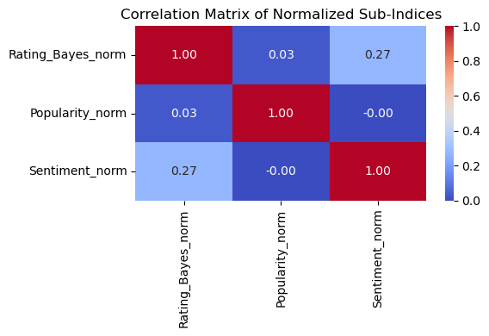
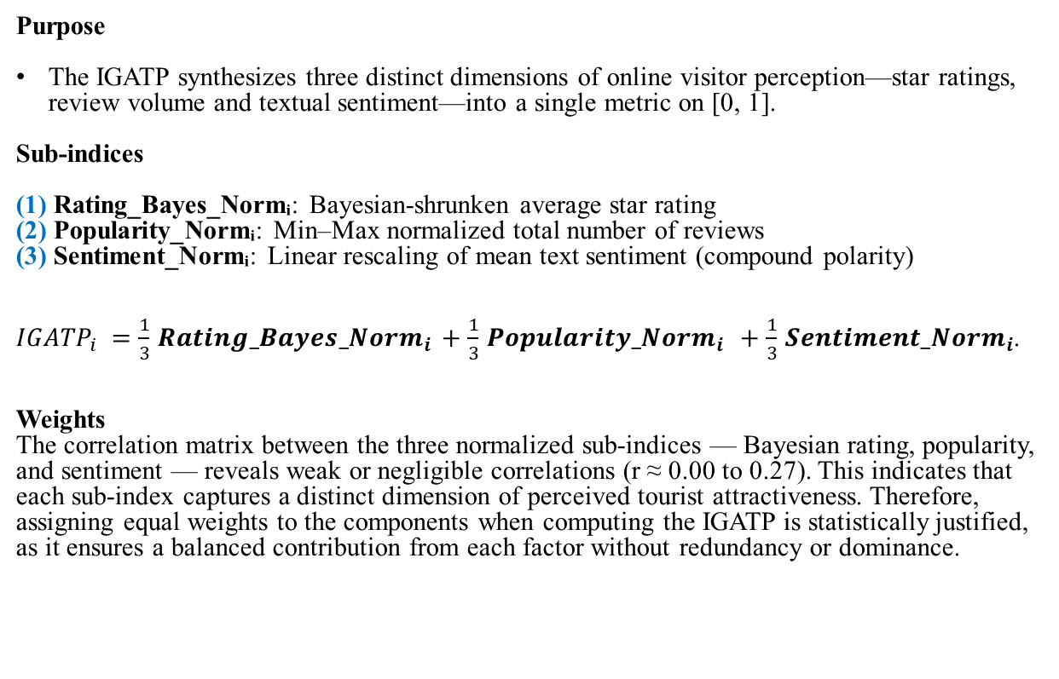
Global Index of Perceived Tourist Attractiveness
Purpose
The IGATP synthesizes three distinct dimensions of online visitor perception—star ratings, review volume and textual sentiment—into a single metric on [0, 1].
Sub-indices
(1) Rating_Bayes_Normᵢ: Bayesian-shrunken average star rating
(2) Popularity_Normᵢ: Min–Max normalized total number of reviews
(3) Sentiment_Normᵢ: Linear rescaling of mean text sentiment (compound polarity)
$IGATP_{i}=\frac{1}{3}Ratin{g_Bayes_Norm}_{i}+\frac{1}{3}{Popularity_Norm}_{i} +\frac{1}{3}{Sentiment_Norm}_{i}$.
Weights
The correlation matrix between the three normalized sub-indices — Bayesian rating, popularity, and sentiment — reveals weak or negligible correlations (r ≈ 0.00 to 0.27). This indicates that each sub-index captures a distinct dimension of perceived tourist attractiveness. Therefore, assigning equal weights to the components when computing the IGATP is statistically justified, as it ensures a balanced contribution from each factor without redundancy or dominance.

Slide 3
Global Index of Perceived Tourist Attractiveness
Average sub-indices:
(1) Rating_Bayes_Norm ≈ 0.81
(2) Popularity_Norm ≈ 0.0022
(3) Sentiment_Norm ≈ 0.6548
Global Index Range: [0.095, 0.873]

Slide 4
Global Index of Perceived Tourist Attractiveness
Top 5 locations by IGATP:
Rank | Location | IGATP
1 | Luís I Bridge | 0.873
2 | Jardim do Morro | 0.644
3 | Abadessa Restaurante e Petiscos | 0.635
4 | Parque Nascente Shopping | 0.622
5 | La Bocca Dolce | 0.613

Slide 5
Global Index of Perceived Tourist Attractiveness
Data was exported to composite_index.csv
Columns: 'Cidade', 'Categoria', 'Nome', 'Rating', 'Endereço', 'Tipos',
'Latitude', 'Longitude', 'Total_Reviews', 'id_unico', 'Grupo_Tematico',
'Locais_Semelhantes_Perto', 'Latitude_Nova', 'Longitude_Nova',
'Endereço_Limpo', 'shrinkage', 'Rating_Bayes', 'Nome_Local',
'Avg_Polarity', 'Rating_Bayes_norm', 'Popularity_norm',
'Sentiment_norm', 'IGATP'

