Slide 1
Perceived Touristic Attractiveness in the Porto Metropolitan Area Based on Google Places Reviews: Clustering
Authors: Beatriz Santos, Bruno Rocha, Joana Guerreiro

Slide 2
Clustering Methodology
Why we applied clustering techniques:
To better understand the diversity of touristic locations in the Porto Metropolitan Area (AMP), we applied clustering techniques as an unsupervised learning approach to group places based on similarities in their perceived attractiveness profiles. By combining normalized sub-indices—Bayesian-adjusted rating, popularity, and sentiment polarity—we aimed to uncover latent patterns and classify locations into distinct segments. This segmentation enables a more interpretable analysis of the territory, identifying, for example, "boutique gems" or "mainstream attractions", and supports more targeted insights for stakeholders interested in tourism planning, territorial marketing, or resource allocation.

Slide 3
Clustering Methodology
Silhouette Analysis (K-Means)
Loaded the composite index dataset (composite_index.csv) containing the three normalized sub-indices: • (1) Rating_Bayes_norm • (2) Popularity_norm • (3) Sentiment_norm
Extracted these three columns into a feature matrix for clustering.
Applied mean imputation to replace any missing values with the column mean.
Standardized each feature to zero mean and unit variance (z-score normalization).
Performed K-Means clustering for k = 2…10 and computed the silhouette score for each k.
Plotted the silhouette scores versus k to identify the optimal number of clusters.

Slide 4
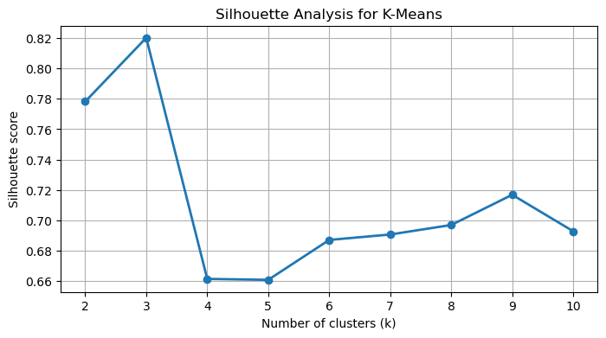
Clustering Methodology
Silhouette Analysis (K-Means)
The silhouette analysis reveals a clear peak at k = 3 (≈ 0.82), indicating strong cohesion and separation in a simplified segmentation. However, almost all observations fall into a single cluster, limiting interpretability.Beyond k = 3, scores decrease but stabilize, remaining in the 0.66–0.70 range. Among these, k = 6 offers a valuable compromise: it segments the data into multiple interpretable groups while maintaining a silhouette score close to the plateau.In practical terms, k = 6 is selected to balance segmentation richness and clustering quality.

Slide 5
Clustering Methodology
Imbalanced Cluster Sizes
At k = 6, K-Means yields a well-distributed segmentation:
One large cluster (n = 1983)
Three moderately sized clusters (n = 246, 145, 118)
One small but non-negligible group (n = 27)
One singleton (n = 1), likely an outlier
This configuration avoids the micro-cluster inflation observed at k = 8, while still enhancing granularity compared to k = 3.
With a silhouette score of 0.68, this structure offers improved interpretability without introducing excessive fragmentation.
Cluster Size Distribution at k=6:
Cluster | Count of Points
0 | 1983
4 | 246
3 | 145
5 | 118
2 | 27
1 | 1

Slide 6
Clustering Methodology
Imbalanced Cluster Sizes
We compared K-Means configurations for k = 3, 6, 7, and 8:
k = 3 yields strong silhouette but lacks segmentation (one cluster holds 97% of data).
k = 6 introduces three well-sized groups and a small meaningful segment, with minimal noise.
k = 7 and k = 8 bring micro-clusters (n = 1–2), suggesting over-fragmentation.
Decision: We proceed with k = 6, which balances structural insight, cluster size distribution, and silhouette stability. The singleton is treated as an outlier.
k | Cluster Sizes (descending)
3 | 2471, 48, 1
6 | 1983, 246, 145, 118, 27, 1
7 | 1983, 246, 145, 116, 27, 2, 1
8 | 1947, 243, 144, 140, 31, 12, 2, 1

Slide 7
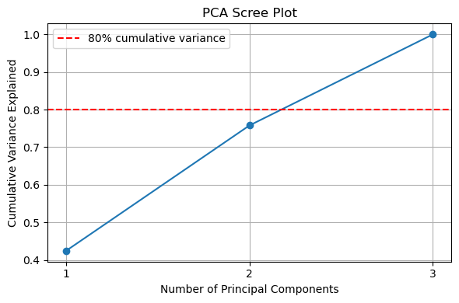
Clustering Methodology
PCA Visualization (K-Means): Choosing the Number of Principal Components
Cumulative Variance Criterion
PC1 explains 41.7 % of variance; PC1 + PC2 bring total to 75.0 %.
While 80 % is a common rule-of-thumb, 75 % already captures the majority of structure in our three-dimensional feature space.
Elbow Method & Parsimony
The scree curve shows a marked “elbow” after the second component, indicating diminishing returns from additional PCs.
Retaining only PC1 and PC2 balances model simplicity and information retention, avoiding overfitting or over-compression.

Slide 8
Clustering Methodology
PCA Visualization (K-Means): Choosing the Number of Principal Components
Interpretability & Visualization
Two components facilitate clear 2D visualizations (scatter plots, cluster overlays) for stakeholder communication.
Simplifies the interpretation of feature contributions (loadings) without substantial loss of explanatory power.
Practical Trade-Off
Using two components reduces computational complexity for downstream tasks (e.g. clustering, mapping) while preserving the core signal.
A third component could be added if > 80 % variance is strictly required; however, PC1–2 suffice for our exploratory and segmentation objectives.

Slide 9
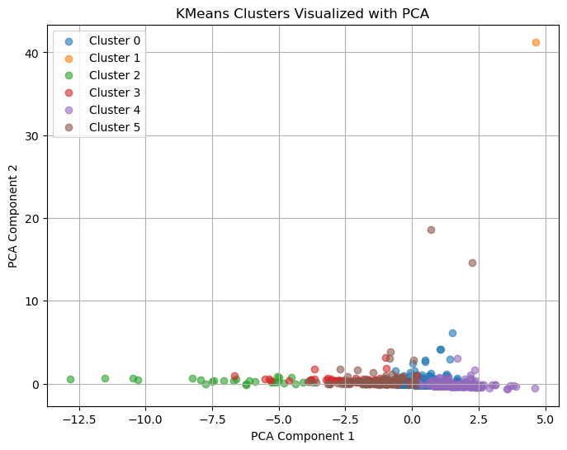
Clustering Methodology
PCA Visualization (K-Means)
Applied PCA to project scaled data into 2 dimensions (PC1, PC2)
Colored each point by its K-Means cluster label for visual inspection
Feature | PC1 Loading | PC2 Loading
Rating_Bayes_norm | 0.798 | 0.003
Popularity_norm | 0.081 | 0.995
Sentiment_norm | 0.794 | −0.105
PCA Interpretation:
PC1 (≈ 0.80 Rating + 0.79 Sentiment): captures combined “quality” and “emotional intensity”
PC2 (≈ 0.995 Popularity): isolates “visibility/popularity” dimension

Slide 10
Clustering Methodology
Clustering Results & Component Loadings (k=6)
Using the 6-cluster K-Means solution and the 2D PCA projection:
PC1 is interpreted as a proxy for quality/sentiment,
PC2 reflects popularity/visibility.
The PCA scatterplot reveals six distinguishable clusters:
Cluster 0 (Mainstream Core): The largest group, centered near the origin — reflects mid-tier, balanced locations.
Cluster 5 (Flagship Venues): High quality and visibility — prominent, top-rated points.
Cluster 4 (Boutique / Niche): High sentiment but low visibility — hidden gems or less-frequented highlights.
Cluster 2 (Underperformers): Low quality and low popularity — likely less attractive options.
Cluster 3 (Hidden Popular): Higher visibility despite below-average sentiment — potentially overrated or controversial spots.
Cluster 1 (Extreme Outlier): Isolated point with extreme values in both dimensions — possibly an anomaly or very unique venue.
Cluster | Size | PC1 | PC2 | Profile
0 | 1983 | ≈ 0 | ≈ 0 | Mainstream Core
5 | 118 | ↑ | ↑ | Flagship Venues
4 | 246 | ↑ | ↓ | Boutique / Niche
2 | 27 | ↓ | ↓ | Underperformers
3 | 145 | ↓ | ↑ | Hidden Popular
1 | 1 | ↑↑ | ↑↑ | Extreme Outlier

Slide 11
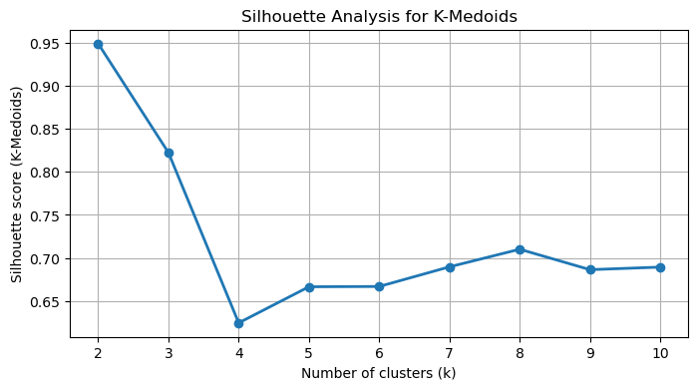
Clustering Methodology
Silhouette Analysis (K-Medoids)
Decision Rationale:
k = 2–3 shows high silhouette but overly broad segmentation.
k = 4 exhibits a sharp drop in silhouette, suggesting weak structure.
k = 5–8 yields stable silhouette scores (~0.66–0.71), with improved interpretability.
k = 6 offers a balance between cohesion and segmentation richness:
Clear structure without over-fragmentation.
Compatible with the K-Means solution for consistency.
→ We adopt k = 6 for our final K-Medoids clustering, as it:
Provides interpretable and balanced cluster sizes
Ensures robust cohesion and separation
Aligns with prior K-Means results to enable cross-method comparison

Slide 12
Clustering Methodology
Clustering Performance Comparison (K-Means vs K-Medoids)
Adjusted Rand Index (ARI)
ARI (KMeans vs KMedoids) for k=6: 0.861
⇒ Indicates very high agreement, with both algorithms recovering similar segmentations despite methodological differences.
Silhouette Scores
K-Means (k=6) 0.687
K-Medoids (k=7): 0.667
⇒ Both > 0.6 → strong cluster cohesion and separation
⇒ K-Means only marginally higher (+0.020)
Interpretation & Choice
Clusters are comparably well-defined (silhouette difference < 0.02).
K-Medoids preferred for practical interpretation:
Real-world exemplars: medoids correspond to actual POIs, enhancing interpretability.
Outlier resistance: more robust against extreme or noisy values.
➤ Despite the slight drop in silhouette, K-Medoids provides representative, actionable tourism clusters.

Slide 13
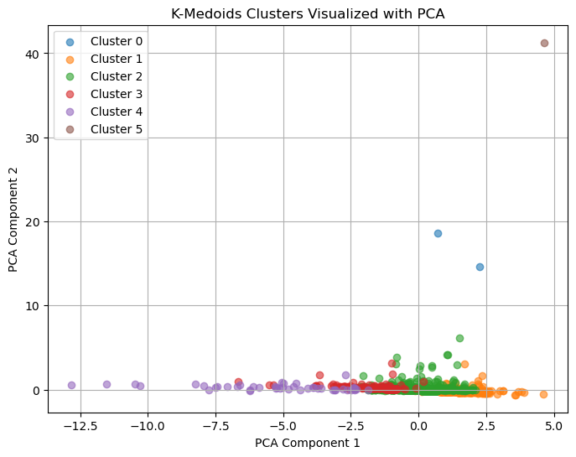
Clustering Methodology
PCA Visualization (K-Medoids)
Applied PCA to project scaled data into 2 dimensions (PC1, PC2)
Colored each point by its K-Medoids cluster label for visual inspection
Feature | PC1 Loading | PC2 Loading
Rating_Bayes_norm | 0.798 | 0.003
Popularity_norm | 0.081 | 0.995
Sentiment_norm | 0.794 | −0.105
PCA Interpretation:
PC1 (≈ 0.80 Rating + 0.79 Sentiment): captures combined “quality” and “emotional intensity”
PC2 (≈ 0.995 Popularity): isolates “visibility/popularity” dimension

Slide 14
Clustering Methodology
Clustering Results & Component Loadings (k=6)
Using the 6-cluster K-Medoids solution and the 2D PCA projection:
PC1 is interpreted as a proxy for quality/sentiment,
PC2 reflects popularity/visibility.
The PCA scatterplot reveals six distinguishable clusters:
Cluster 2 (Mainstream Core): The dominant segment (2070 points), positioned near the center — average locations with balanced sentiment and visibility.
Cluster 3 (Flagship Venues): Highly rated and popular locations (148 points), situated in the upper-right quadrant of the PCA space.
Cluster 1 (Hidden Popular): 254 points with low sentiment but higher popularity — possibly overrated or trending places.
Cluster 4 (Underperformers): Small cluster (45 points) with low quality and visibility — potentially weak or outdated attractions.
Cluster 0 (Boutique / Niche): Only 2 observations, high sentiment but limited exposure — hidden gems or specialized locations.
Cluster 5 (Extreme Outlier): A single observation with extreme values in both dimensions — likely an anomalous or unique spot.
Cluster | Size | PC1 | PC2 | Profile
2 | 2070 | ≈ 0 | ≈ 0 | Mainstream Core
3 | 148 | ↑ | ↑ | Flagship Venues
1 | 254 | ↓ | ↑ | Hidden Popular
4 | 45 | ↓ | ↓ | Underperformers
0 | 2 | ↑ | ↓ | Boutique / Niche
5 | 1 | ↑↑ | ↑↑ | Extreme Outlier

Slide 15
Clustering Methodology
Exporting Clustered Dataset
We exported the full composite index with all cluster assignments to a CSV file for reproducibility and downstream analysis.
File saved as composite_index_with_clusters.csv, containing:
Original POI attributes (ratings, sentiment, popularity, PCA scores, etc.)
K-Means labels for k=2,3,6, 7, 8 and 9 (cluster_k2, (…), cluster_k9)
K-Medoids labels for k=6 and k=7 (cluster_k6_pam, cluster_k7_pam)
This consolidated file ensures easy sharing and integration with mapping or spatial‐statistical tools.

Slide 16
Clustering Methodology
Data was exported to composite_index_with_clusters.csv
Columns: 'Cidade', 'Categoria', 'Nome', 'Rating', 'Endereço', 'Tipos',
'Latitude', 'Longitude', 'Total_Reviews', 'id_unico', 'Grupo_Tematico',
'Locais_Semelhantes_Perto', 'Latitude_Nova', 'Longitude_Nova',
'Endereço_Limpo', 'shrinkage', 'Rating_Bayes', 'Nome_Local',
'Avg_Polarity', 'Rating_Bayes_norm', 'Popularity_norm',
'Sentiment_norm', 'IGATP', 'cluster_k2', 'cluster_k3', 'cluster_k6',
'cluster_k7', 'cluster_k8', 'cluster_k9', 'cluster_k7_pam',
'cluster_k6_pam'

