Slide 1
Perceived Touristic Attractiveness in the Porto Metropolitan Area Based on Google Places Reviews: Validation
Authors: Beatriz Santos, Bruno Rocha, Joana Guerreiro

Slide 2
Validation
Correlation Between Sentiment and Bayesian Rating (Sub-Indices)
Method: Pearson Correlation (cleaned data)
Result: r = 0.27, p-value = 0.000
Interpretation:
Weak but significant positive correlation.
Suggests partial overlap, but each metric captures distinct aspects of perceived attractiveness.
Implication:
Justifies keeping both sub-indices in the global index (IGATP).
Enhances multidimensionality and avoids redundancy.

Slide 3
Validation
Sensitivity Analysis: IGATP Weighting Scenarios
Objective:
To evaluate the stability of the IGATP when adjusting the relative weight of its three components:
Rating_Bayes_norm
Popularity_norm
Sentiment_norm
Tested Scenarios:
Scenario | Weights (Rating / Popularity / Sentiment)
Equal Weights | 1/3 – 1/3 – 1/3 (reference)
Rating-Heavy | 0.50 – 0.25 – 0.25
Popularity-Heavy | 0.25 – 0.50 – 0.25
Sentiment-Heavy | 0.25 – 0.25 – 0.50

Slide 4
Validation
Sensitivity Analysis: IGATP Weighting Scenarios
Results (Pearson correlation with the equal-weight IGATP):
Rating-Heavy: r = 0.968
Popularity-Heavy: r = 0.980
Sentiment-Heavy: r = 0.968
Conclusion: All alternative weighting scenarios show very high correlation (r > 0.96) with the original IGATP. This indicates that the index is highly robust and not sensitive to moderate changes in weight distribution.

Slide 5
Validation
IGATP Consistency by Review Count
Comparison:
We tested whether the IGATP values change significantly when calculated on two review-count-based subsets:
Locations with ≥ 10 reviews
Locations with < 10 reviews
Pearson correlations with full dataset:
≥ 10 reviews: r = 1.000, p < 0.001
< 10 reviews: r = 1.000, p < 0.001
Conclusion:
The IGATP index is fully consistent across subsets, confirming its internal reliability regardless of the number of reviews per location.

Slide 6
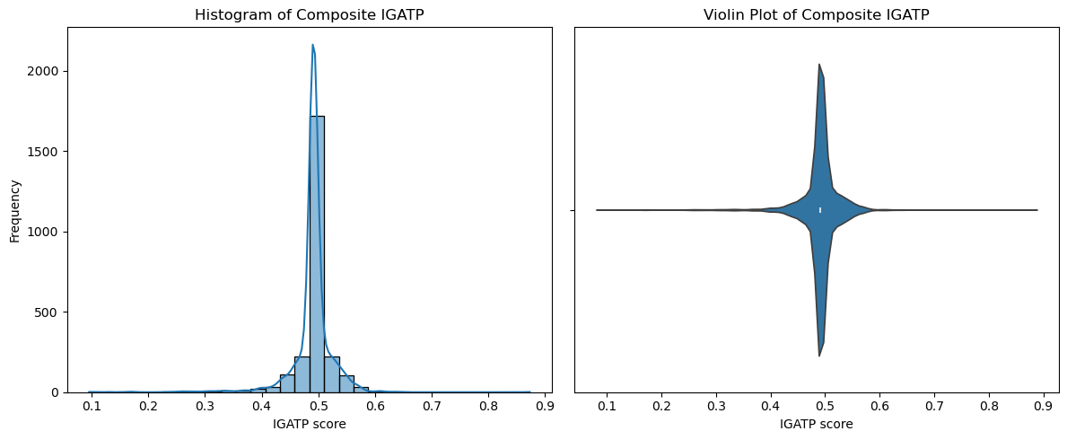
Validation
Distribution of Composite Index (IGATP)
Objective:
To examine the shape, central tendency, and dispersion of the IGATP scores.
Visualizations Used:
Histogram with KDE (left):
Shows a strongly peaked distribution, slightly right-skewed, with most values concentrated around 0.48–0.52.There are a few mild outliers above 0.6 and below 0.4, indicating limited tail behavior.
Violin Plot (right):
Reinforces the narrow concentration near the center and the low spread, confirming that the index is tightly centered with few extreme values.

Slide 7
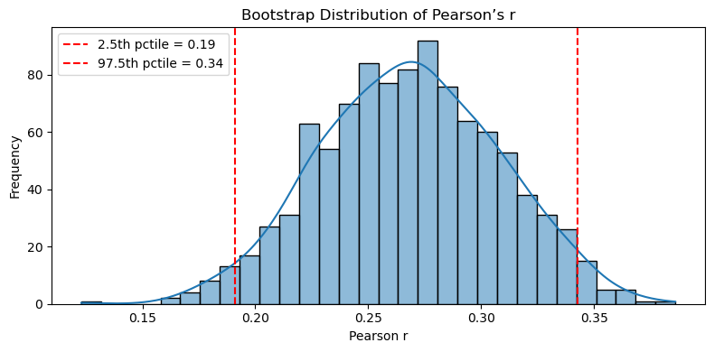
Validation
Bootstrap Confidence Interval for Pearson’s r
Objective: To quantify the uncertainty around the observed Pearson correlation between Rating_Bayes_norm and Sentiment_norm.
Methodology:
1,000 bootstrap resamples (with replacement)
Computed Pearson’s r in each resample
Extracted 2.5th and 97.5th percentiles as non-parametric CI
Results: Observed r: 0.2795% Bootstrap CI: [0.19, 0.34]
Conclusion: The correlation is statistically significant and robust,but remains moderate in strength.Confirms that the two sub-indices capture complementary dimensions of perceived attractiveness.

Slide 8
Validation
Validation of Clustering Structure
Objective:
To evaluate the quality of the clustering solution (k = 7, K-Medoids) based on the normalized sub-indices of the IGATP.
Methodology:
Used Silhouette Score on feature matrix: Rating_Bayes_norm, Popularity_norm, Sentiment_norm
Labels: cluster_k7_pam (K-Medoids, k = 7)
Result:
Silhouette Score = 0.667
Interpretation:
Score well above 0.6 → indicates strong cluster cohesion and separation.
Confirms the validity and interpretability of the 7-cluster K-Medoids structure.

Slide 9
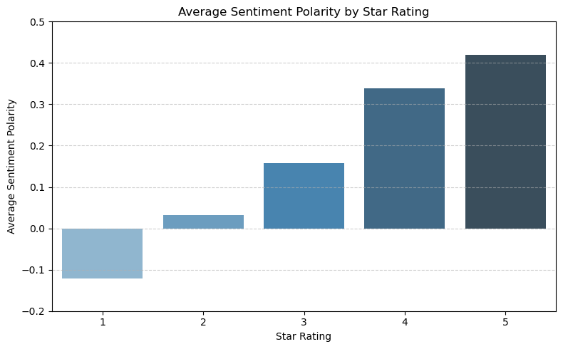
Validation
Objective:
To verify the alignment between NLP-based sentiment polarity and explicit user ratings (1★–5★).
Findings from the Plot:
1★ → clearly negative polarity (≈ -0.1)
2★ → near-neutral sentiment
3★ → moderate positivity
4★ → clearly positive
5★ → strongly positive (≈ +0.42)
Conclusion: The monotonic increase confirms that the sentiment polarity scale is consistent with user satisfaction.Validates sentiment polarity as a trustworthy component of the IGATP.

