Slide 1
Perceived Touristic Attractiveness in the Porto Metropolitan Area Based on Google Places Reviews: Spatial Analysis
Authors: Beatriz Santos, Bruno Rocha, Joana Guerreiro

Slide 2
Spatial Analysis
Spatial Analysis of Points of Interest – Methodology
Objective:
To visualise the spatial distribution of the IGATP and its sub-indices (Rating_Bayes, Popularity, and Sentiment) within the Porto Metropolitan Area (AMP), using georeferenced points of interest.
Procedures:
Removal of observations without coordinates (Latitude_Nova, Longitude_Nova).
Conversion to a GeoDataFrame with point geometries (EPSG:4326).
Application of a spatial join with the AMP municipal polygons to retain only valid points.
Individual visualisation of each indicator based on value-driven colour mapping (cmap = "viridis") over municipal boundaries.

Slide 3
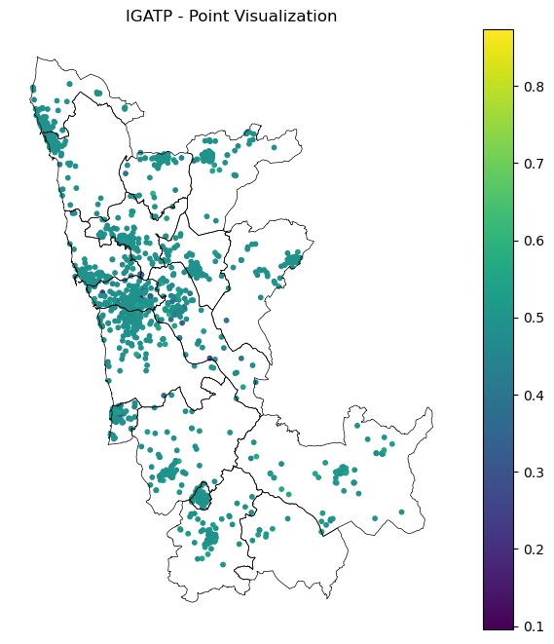
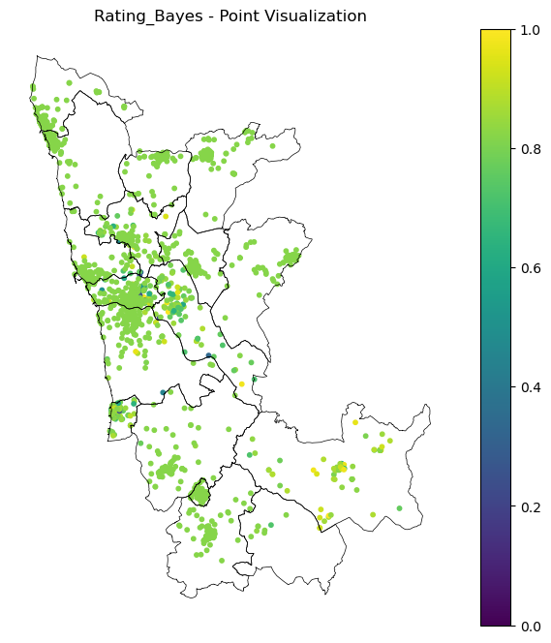
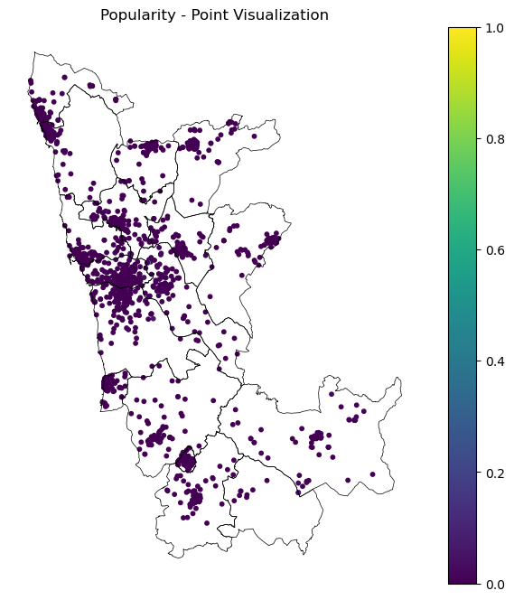
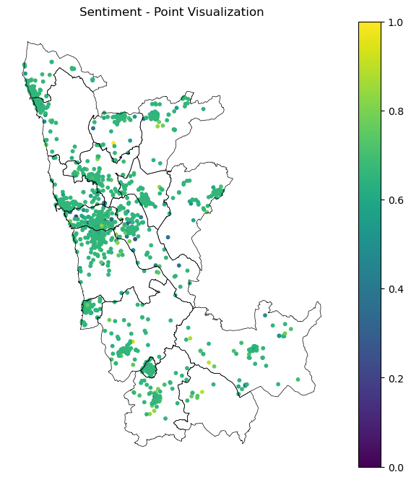
Spatial Analysis
Spatial Analysis of Points of Interest – Results
Limitations of Point-Based Visualization:
The high density of points in urban areas leads to visual overlap, making it difficult to perceive clear spatial patterns.Since many points are very close or nearly overlapping, point-based maps are not sufficiently informative to reveal significant territorial differences.

Slide 4
Spatial Analysis
Aggregated Spatial Analysis by Municipality – Methodology
Objective:
Evaluate the average distribution of the IGATP and its sub-indices (Rating_Bayes, Popularity, Sentiment) aggregated by municipality within the Porto Metropolitan Area (AMP).
Procedures:
Performed a spatial join between each point of interest and its corresponding municipality (DICO_right).
Calculated the mean score per municipality for each indicator.
Merged results with the municipal shapefile (gdf_mun) using a left join.
Created thematic maps with municipal-level averages, coloured using the viridis scale for visual contrast.

Slide 5
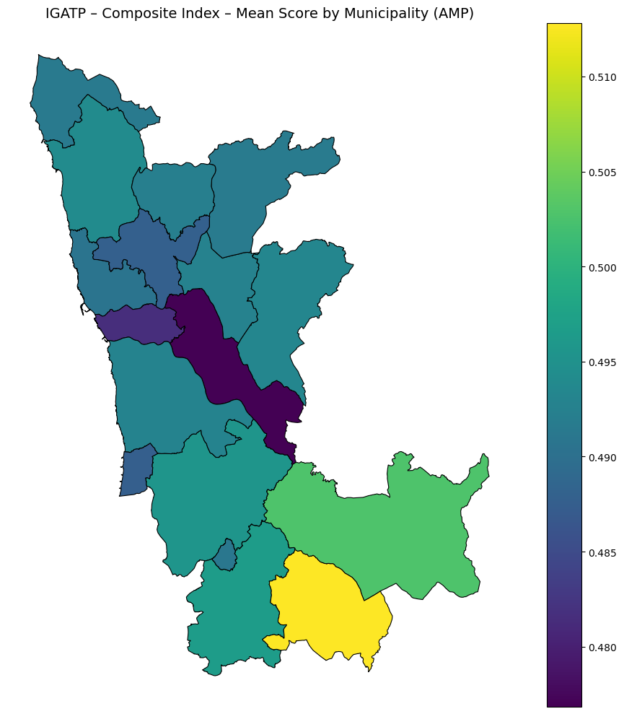
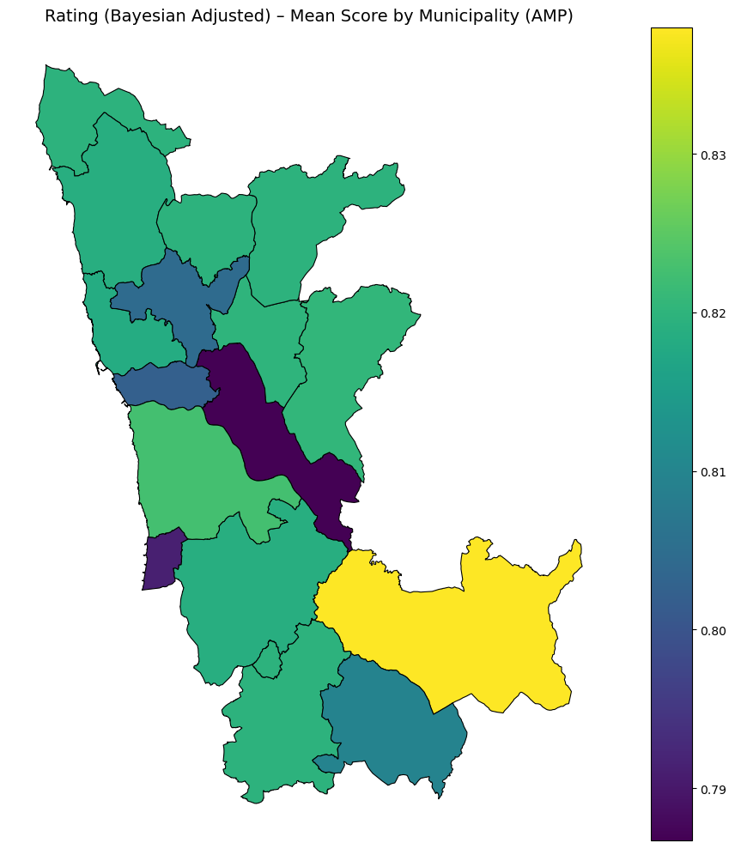
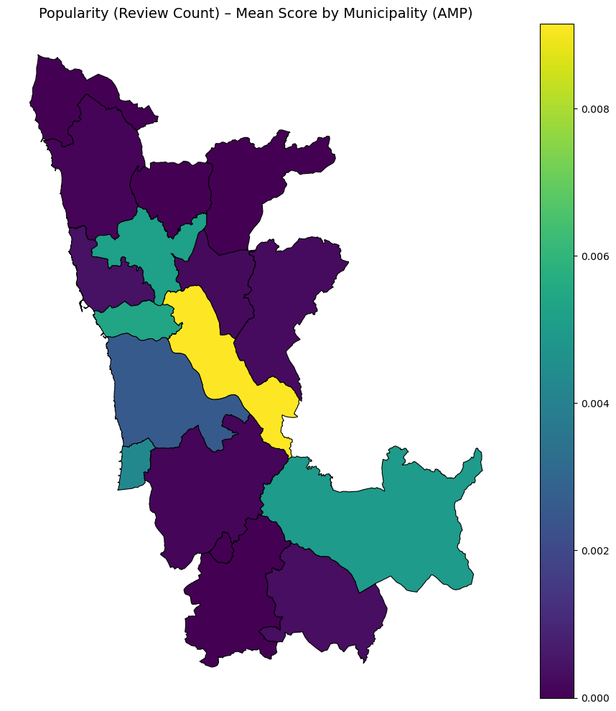
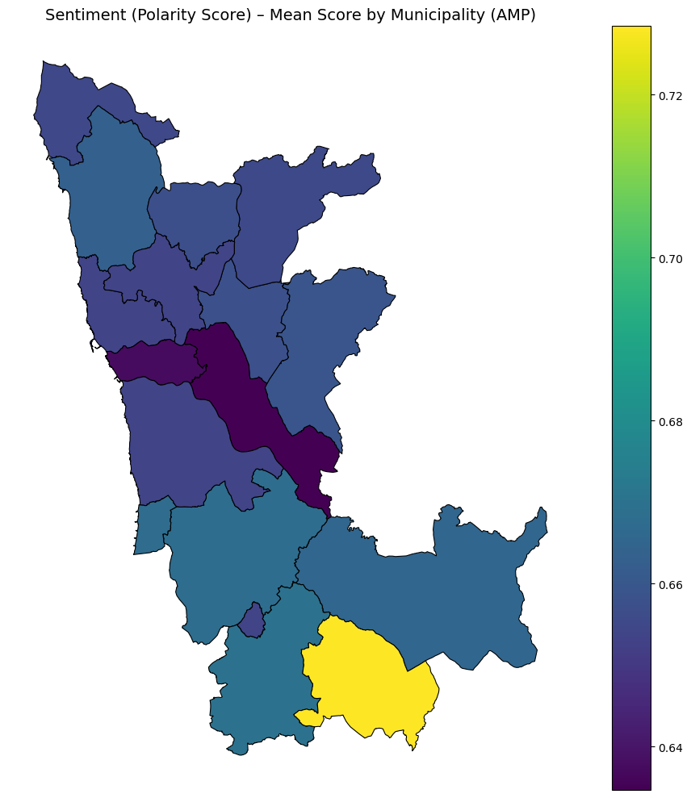
Spatial Analysis
Aggregated Spatial Analysis by Municipality – Results
IGATP – Composite Index:
Municipal averages show very little variation (≈0.48–0.51).
Suggests a regionally balanced level of perceived attractiveness, with minor peaks in Arouca and Vale de Cambra.
Rating (Bayesian Adjusted):
Also highly uniform across municipalities (≈0.79–0.83), reinforcing consistent user satisfaction.

Slide 6
Spatial Analysis
Aggregated Spatial Analysis by Municipality – Results
Popularity (Review Count):
Despite low absolute variation (≈0.000–0.009), the distribution is highly unequal:
A few central municipalities (e.g. Porto, Gaia) concentrate most reviews;
Many others show near-zero visibility.
The map accentuates this relative disparity due to colour scaling.
Sentiment (Average Polarity Score):
Slightly wider range than rating (≈0.64–0.72).
More positive sentiment observed in the southern and inland municipalities.
Conclusion:
While most indicators show limited absolute variation, the Popularity sub-index reveals substantial disparities in digital engagement.This municipal-level analysis provides a baseline for the upcoming finer-grained analysis at the parish level.

Slide 7
Spatial Analysis
Aggregated Spatial Analysis by Parish – Methodology
Objective:
To analyse the spatial distribution of the IGATP and its sub-indices (Rating_Bayes, Popularity, and Sentiment) at the parish level within the Porto Metropolitan Area (AMP), allowing for finer-grained detection of local patterns not visible at the municipal scale.
Procedures:
A spatial join was performed between the georeferenced points (gdf_points) and the parish polygons (gdf_freg) using the within predicate.
For each parish (DICOFRE_le), the mean value of each index was calculated.
These averages were then merged with the parish shapefile for spatial visualisation.
Thematic maps were generated using a continuous colour scale (viridis) to facilitate comparative interpretation across parishes.
Note: Some parishes do not contain any georeferenced points, resulting in missing values (NaNs) for one or more indices. These gaps reflect either low digital representation or absence of reviewed points of interest.

Slide 8
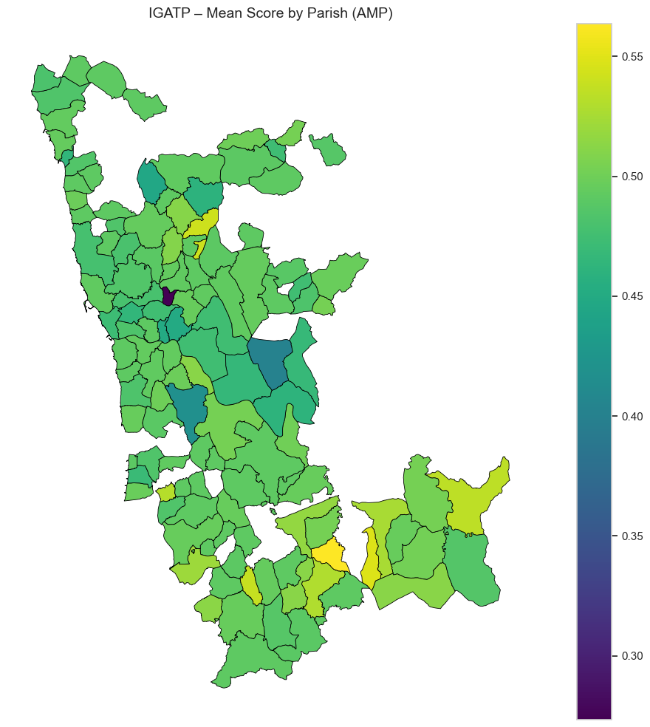
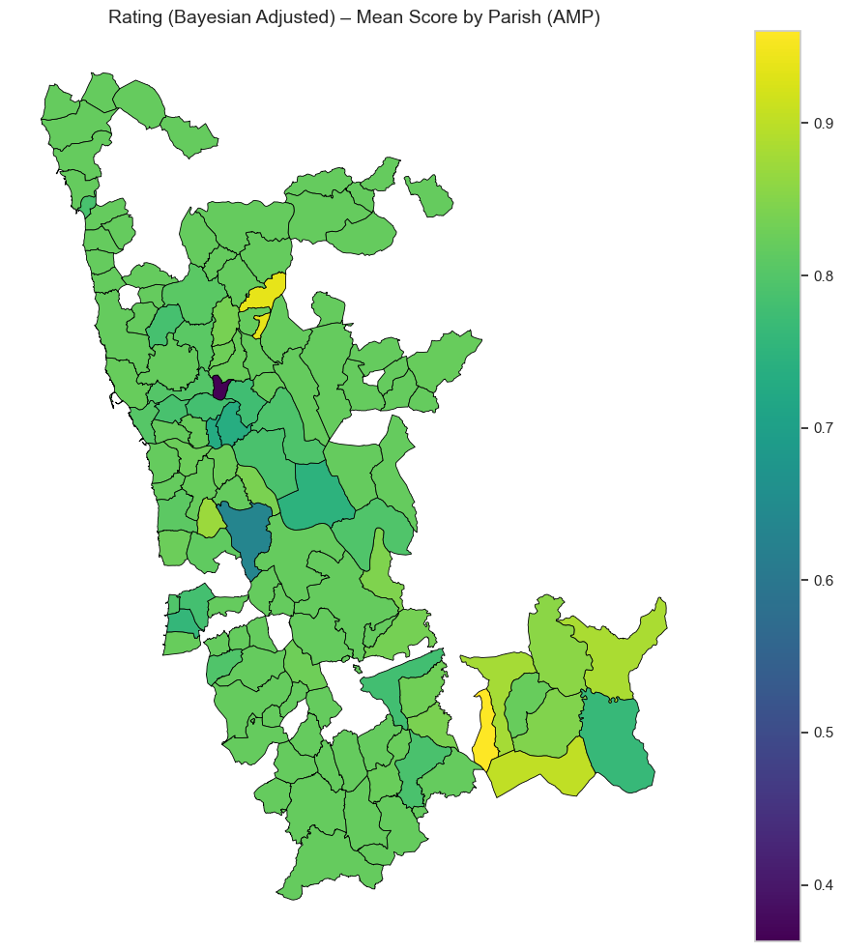
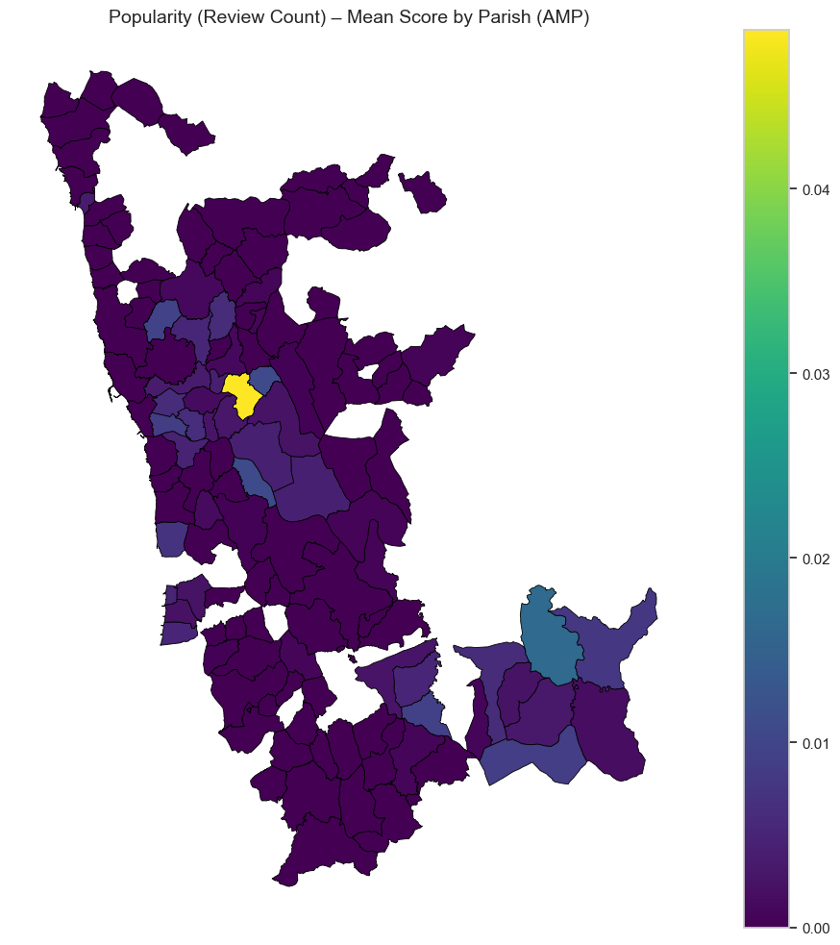
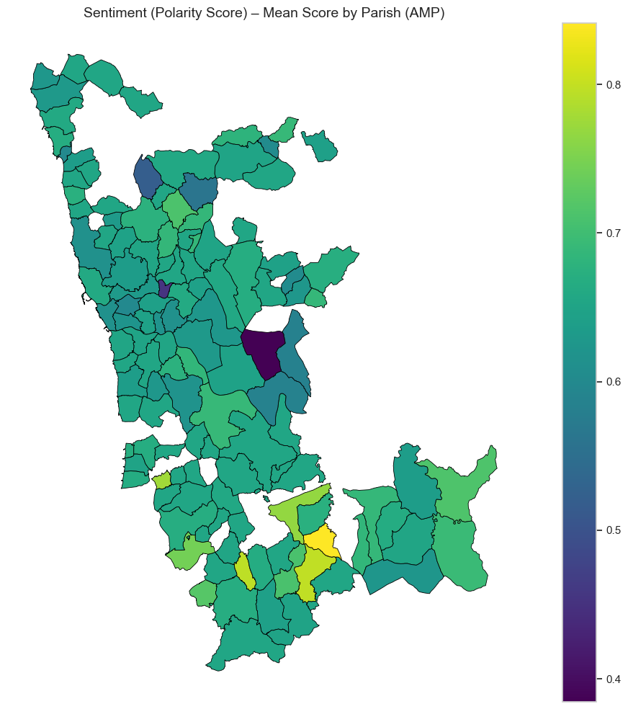
Spatial Analysis
Aggregated Spatial Analysis by Parich – Results
IGATP – Global Index:
Mean values range between ≈0.30 and 0.55.
Greater heterogeneity is observed compared to the municipal scale, with some inland parishes and those in southern Arouca standing out positively.
Rating (Bayesian Adjusted):
Generally positive distribution, with some more inland parishes showing average values above 0.90.
Two parishes exhibit atypically low values (below 0.60).

Slide 9
Spatial Analysis
Aggregated Spatial Analysis by Parich – Results
Popularity (Review Count):
Despite a narrow absolute range, the distribution is highly unequal:
A few parishes (notably in Porto and Vila Nova de Gaia) concentrate the majority of reviews.
Most parishes have near-zero values, reflecting very limited digital visibility.
Sentiment (Polarity Score):
Wider range (≈0.40 to 0.80), enabling the identification of more extreme perceptions.
Several southern parishes stand out for their positive emotional tone in reviews.
Conclusion:
Parish-level analysis allows for the detection of more detailed spatial patterns and highlights local inequalities in perceived attractiveness.The IGATP, when disaggregated, proves sensitive to intra-municipal diversity, which reinforces the relevance of using a finer-scale approach.

Slide 10
Spatial Analysis
Top Municipalities by Perceived Attractiveness (IGATP)
Interpretation:
The highest-ranked municipalities are mostly peripheral within the AMP.
The strong performance of Vale de Cambra and Arouca likely reflects a combination of good ratings and more positive perceived sentiment.
These results suggest that perceived attractiveness is not concentrated in major urban centers, but may instead emerge in less central territories.
Top 5 Municipalities – Mean Global Attractiveness Index (IGATP):
Municipality | Global Index Mean
Vale de Cambra | 0.513
Arouca | 0.503
Oliveira de Azeméis | 0.497
Santa Maria da Feira | 0.496
Vila do Conde | 0.494

Slide 11
Spatial Analysis
Bottom Municipalities by Perceived Attractiveness
Interpretation:
Larger and denser municipalities like Porto, Gondomar, and Matosinhos appear among the lowest-ranked.
Despite hosting many points of interest, these areas may be affected by overexposure, lower sentiment, or greater rating variability.
The difference between top and bottom performers is modest (≈0.04), reinforcing the overall consistency of the index at the municipal level.
Bottom 5 Municipalities – Mean IGATP:
Municipality | Global Index Mean
Matosinhos | 0.491
Maia | 0.488
Espinho | 0.488
Porto | 0.482
Gondomar | 0.477

Slide 12
Spatial Analysis
Top 5 Parishes – Mean IGATP:
Parish | Global Index Mean
Chave | 0.564
Urrô | 0.549
Folgosa | 0.542
São Roque | 0.538
Alvarenga | 0.535
Parish-Level Ranking: Local Disparities
Interpretation:
Lower-scoring parishes include dense urban areas such as Bonfim (Porto) and suburban zones like Pedrouços (Maia).
Pedrouços, with the lowest index (0.273), represents an extreme case, possibly associated with a small number of reviews, poor sentiment, or low digital presence.
The intra-municipal disparities observed at the parish level highlight the importance of spatially disaggregated analysis, where more granular patterns of perceived attractiveness emerge.
Bottom 5 Parishes:
Parish | Global Index Mean
Bonfim | 0.450
União das Freguesias de Alvarelhos e Guidões | 0.446
União das Freguesias de Pedroso e Seixezelo | 0.418
Aguiar de Sousa | 0.401
Pedrouços | 0.273

Slide 13
Spatial Analysis
Global Spatial Autocorrelation – Moran’s I (Methodology)
Objective:
To evaluate the presence of global spatial autocorrelation patterns in the IGATP (Global Perceived Attractiveness Index), at both the parish and municipality levels.
Steps Performed:
Data Cleaning:
Observations with missing IGATP_mean values were removed.
Spatial Weights Matrix:
A Queen contiguity matrix was created (Queen.from_dataframe()), considering neighboring units that share either borders or vertices.
Moran’s I Calculation:
The global Moran’s I coefficient and significance (p-value) were computed using the Moran() function from the esda module, based on random permutations.
Variable Standardization:
IGATP values were standardized (z-scores) to allow scatterplot representation.
Visualization:
A Moran Scatterplot was built to visualize the relationship between standardized IGATP values and their spatial lag (average value among neighbors).
A red regression line indicates the strength and direction of the spatial autocorrelation.

Slide 14
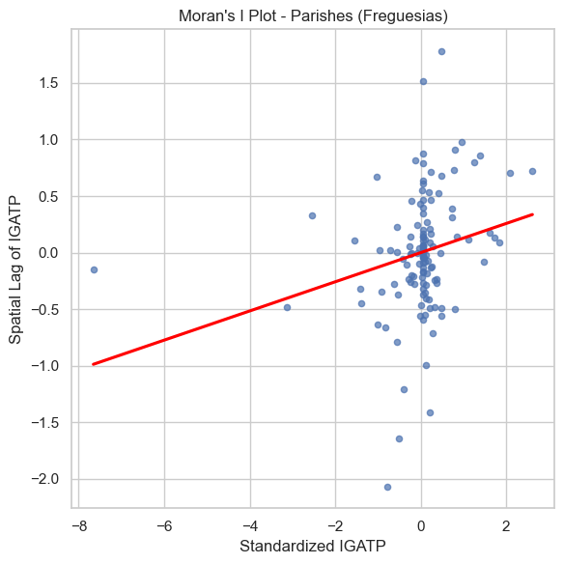
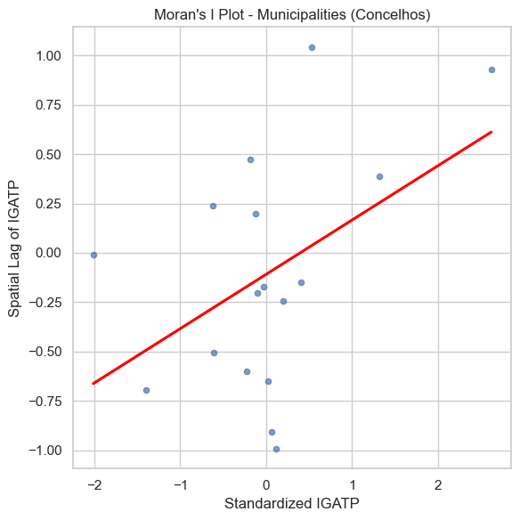
Spatial Analysis
Spatial Autocorrelation Analysis – Moran’s I
Interpretation:
The results confirm the presence of a spatial structure in the IGATP:
At the parish level, the spatial dependence is weaker, yet still statistically significant;
At the municipal level, the pattern is clearer and more pronounced.
This suggests that neighboring territories tend to share similar levels of perceived attractiveness, validating the use of spatial approaches in this type of analysis.
The upward trend in both Moran’s scatterplots (red line) visually confirms the presence of positive spatial dependence.
Spatial Autocorrelation Results:
Level | Moran’s I | p-value | Interpretation
Parishes | 0.1301 | 0.0200 | Weak but statistically significant positive spatial autocorrelation
Municipalities | 0.2751 | 0.0110 | Moderate positive spatial autocorrelation, also significant

Slide 15
Spatial Analysis
Spatial Cluster Mapping – LISA Methodology
Objective:
To identify significant local clusters of perceived attractiveness (IGATP) using Local Indicators of Spatial Association – Local Moran (LISA).
Procedures:
A Queen contiguity spatial weights matrix was created;
The Local Moran's I was applied to the average IGATP at the parish and municipality levels;
Statistical significance was assessed using 999 random permutations (α = 0.05);
Spatial units were classified into five categories:
Category | Description
High-High | High value surrounded by high values (positive cluster)
Low-Low | Low value surrounded by low values (negative cluster)
High-Low | High value surrounded by low values (positive spatial outlier)
Low-High | Low value surrounded by high values (negative spatial outlier)
Not Significant | No statistically significant spatial autocorrelation

Slide 16
Spatial Analysis
LISA Results – Interpretation of Clusters
Parishes:
High-High clusters are concentrated in the southern part of the AMP, indicating areas with consistently high attractiveness;
Low-Low clusters are found in more peripheral zones and some urban centers;
The presence of High-Low and Low-High configurations reveals spatial outliers, where attractiveness levels contrast with surrounding areas;
Most parishes show no significant spatial autocorrelation, reinforcing the intra-municipal heterogeneity of the index.
Municipalities:
High-High: detected in southern AMP, highlighting regions with spatially contiguous positive attractiveness;
High-Low: municipalities like Vila Nova de Gaia, where high IGATP values contrast with neighboring low values — suggesting local spatial polarization;
Low-High: municipalities with lower attractiveness surrounded by higher-scoring areas — indicating potential targets for policy intervention (Porto, Maia);
The presence of clear spatial patterns suggests that territorial promotion strategies should take into account regional dynamics rather than isolated contexts.
⚠️ Note: Some identified clusters, particularly in peripheral areas, may be partially influenced by limited data availability, especially due to the scarcity of user-generated reviews or content in those regions. Interpretation should therefore account for potential sampling bias.

