Slide 1
Perceived Touristic Attractiveness in the Porto Metropolitan Area Based on Google Places Reviews: Visualization
Authors: Beatriz Santos, Bruno Rocha, Joana Guerreiro

Slide 2
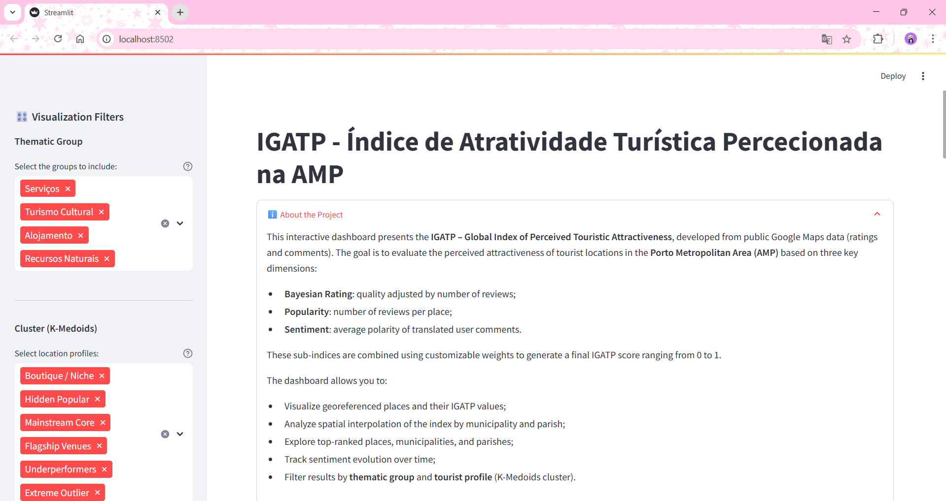
Visualization
Purpose and Technologies Used
What is IGATP?
We developed an interactive dashboard to compute and visualize the IGATP – Global Index of Perceived Touristic Attractiveness in the Porto Metropolitan Area (AMP).
The index combines three dimensions from Google Maps:
Bayesian Rating
Popularity (number of reviews)
Sentiment (review polarity)
Technologies used:
Python (pandas, geopandas, scikit-learn, Altair)
LDA Topic Modeling and PCA + K-Medoids clustering
Kepler.gl and Streamlit for geospatial visualization and interactive interface

Slide 3
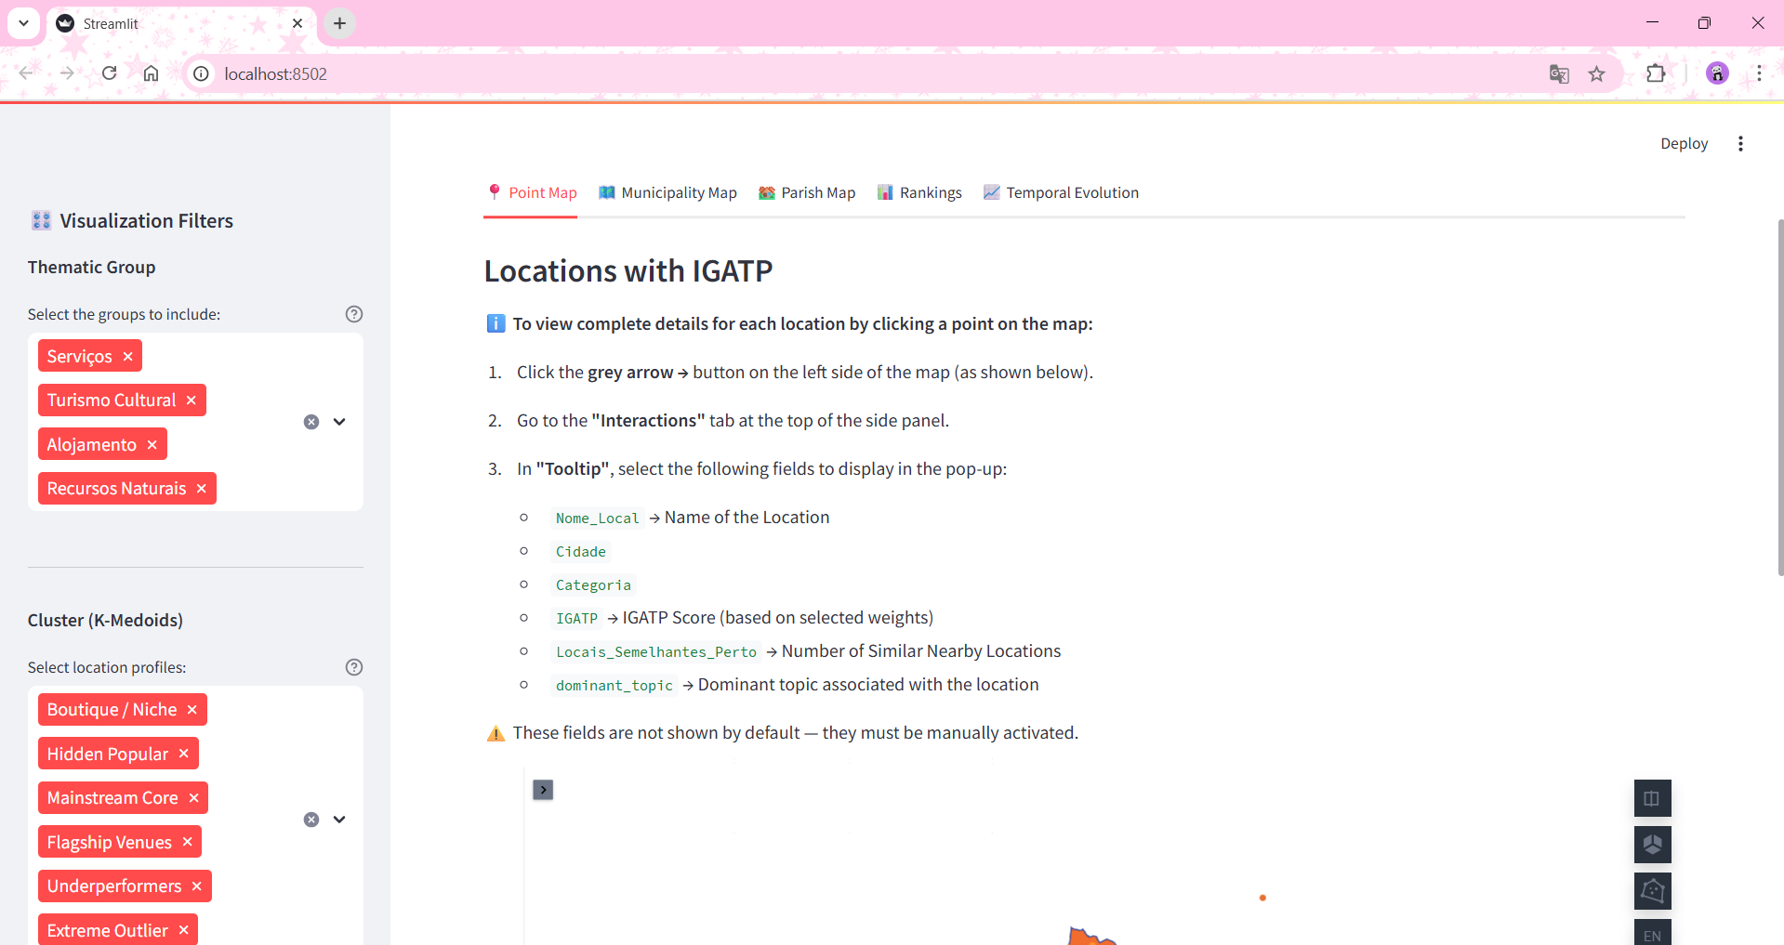
Visualization
Point Map – Locations with IGATP
Displays all georeferenced touristic locations in the AMP.
Points can be filtered by thematic group and tourist profile (cluster).
Users can click the left-side arrow on the map to activate pop-ups showing:
Name, category, city, IGATP score
Number of similar nearby locations
Dominant topic for each place
Filters and index weights are fully adjustable in the sidebar.

Slide 4
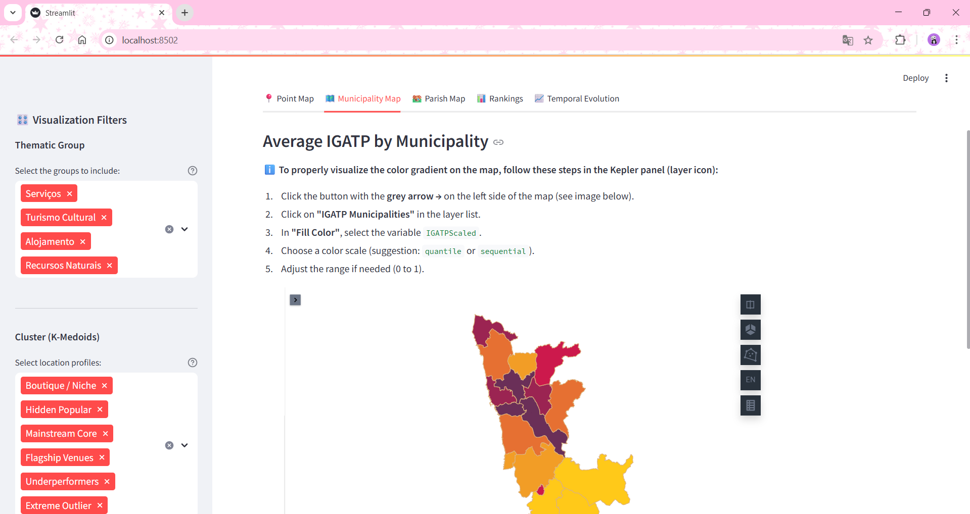
Visualization
Average IGATP by Municipality
Heatmap by municipality, showing the average IGATP based on the locations within each municipality.
Users can activate the layer in Kepler and customize the color gradient (e.g., quantile, sequential).
Helps identify municipalities with higher or lower perceived attractiveness.

Slide 5
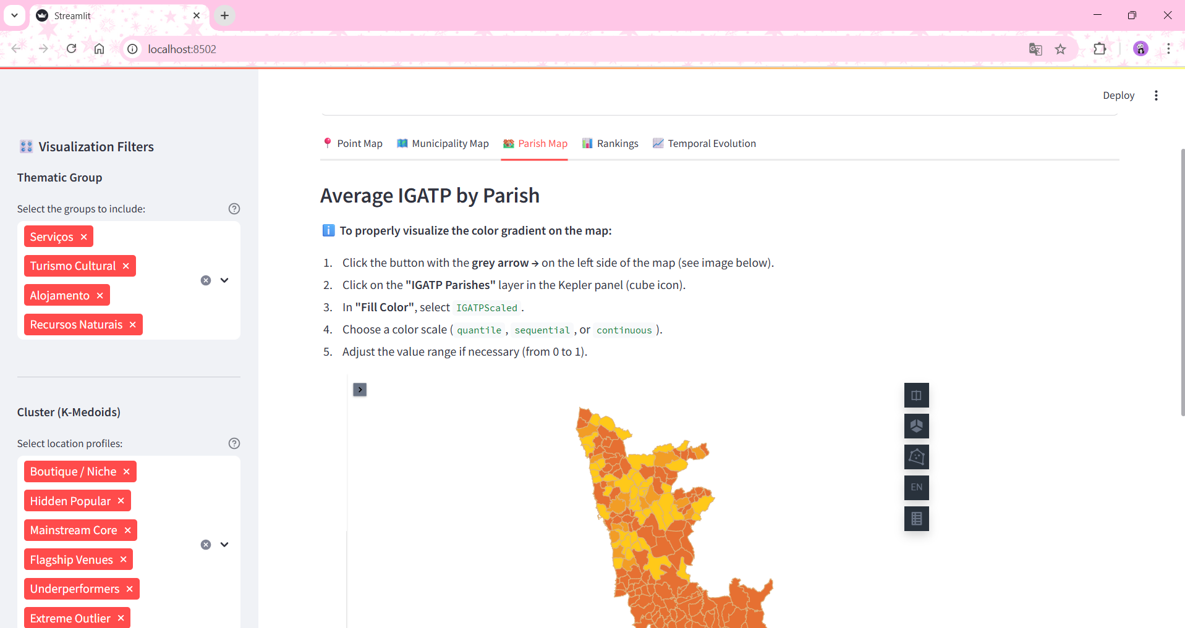
Visualization
Average IGATP by Parish
More detailed view of the index at the parish level.
Based on a pre-processed dataset with average IGATP values per parish.
Ideal for assessing the local variation in perceived attractiveness, relevant for local planning and public policy.

Slide 6
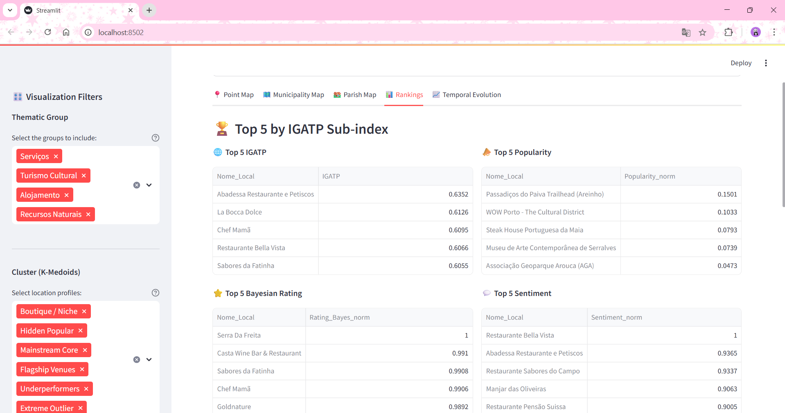
Visualization
Touristic Attractiveness Rankings
Displays the Top 5 locations for each sub-index and for the overall IGATP.
Also includes:
Municipalities with highest and lowest average IGATP
Parishes with highest and lowest average IGATP
Provides a quick overview of highlights and low-performing areas in the region.

Slide 7
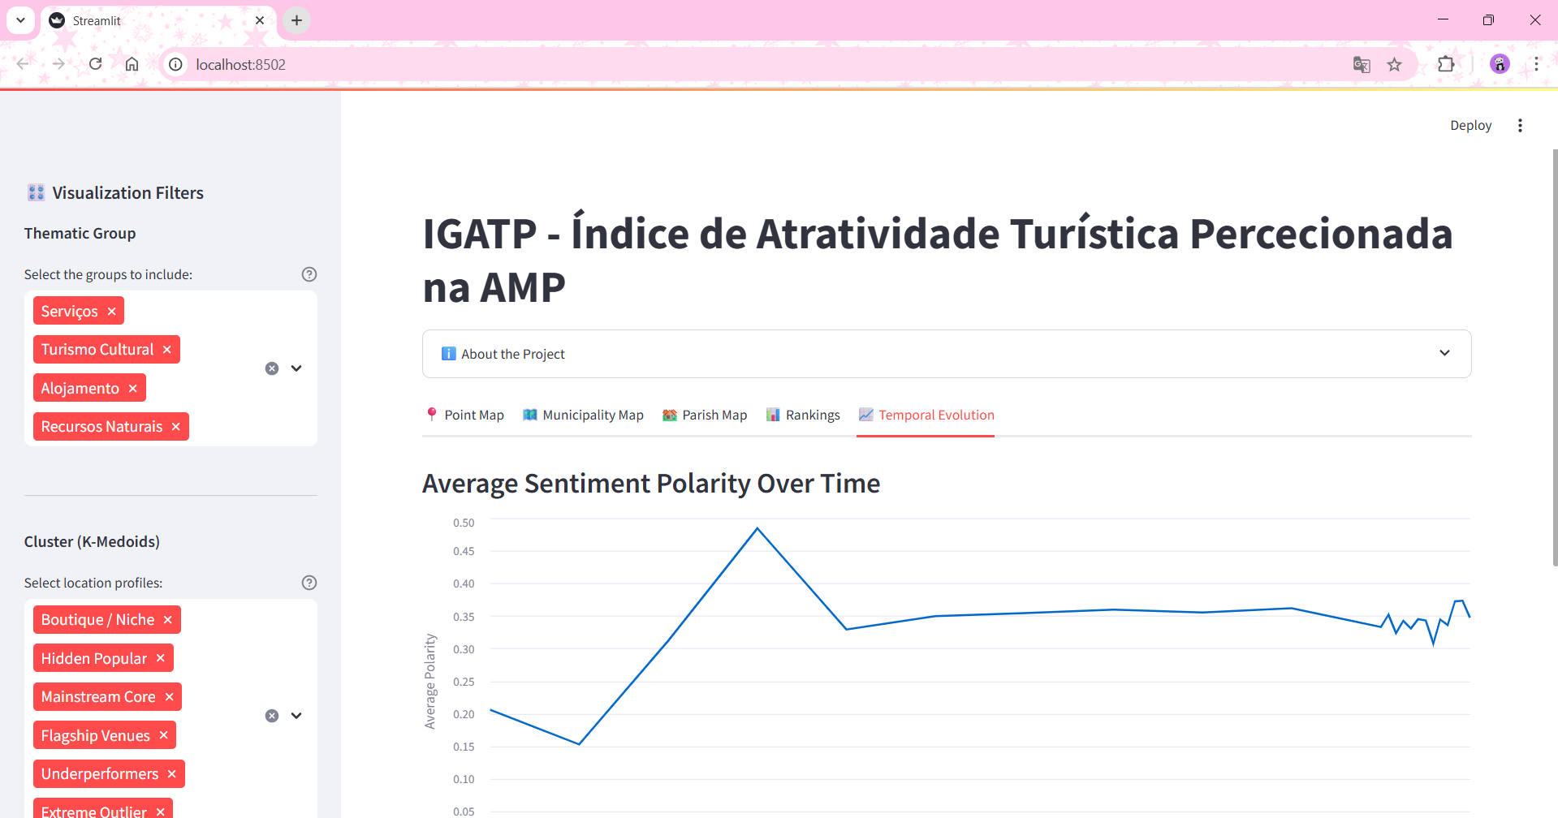
Visualization
Sentiment Trend Over Time
Line chart showing the monthly evolution of average review sentiment.
Helps identify:
Whether user perception is improving or worsening
Seasonal trends or event-related variations
Serves as a starting point for longitudinal analysis or strategic planning.

