Slide 1
Block or walk: Effects of time-varying selectivity options in stock assessments
Options across model frameworks:
Constant
Time blocks (subjective choices)
Random walk, autocorrelated, etc. (objective choices)
Stock assessment frameworks fit to data from 13 stocks:
Assessment for all (a4a)
State-space assessment model (SAM)
Stock Synthesis (SS)
Woods Hole assessment model (WHAM)

Slide 2
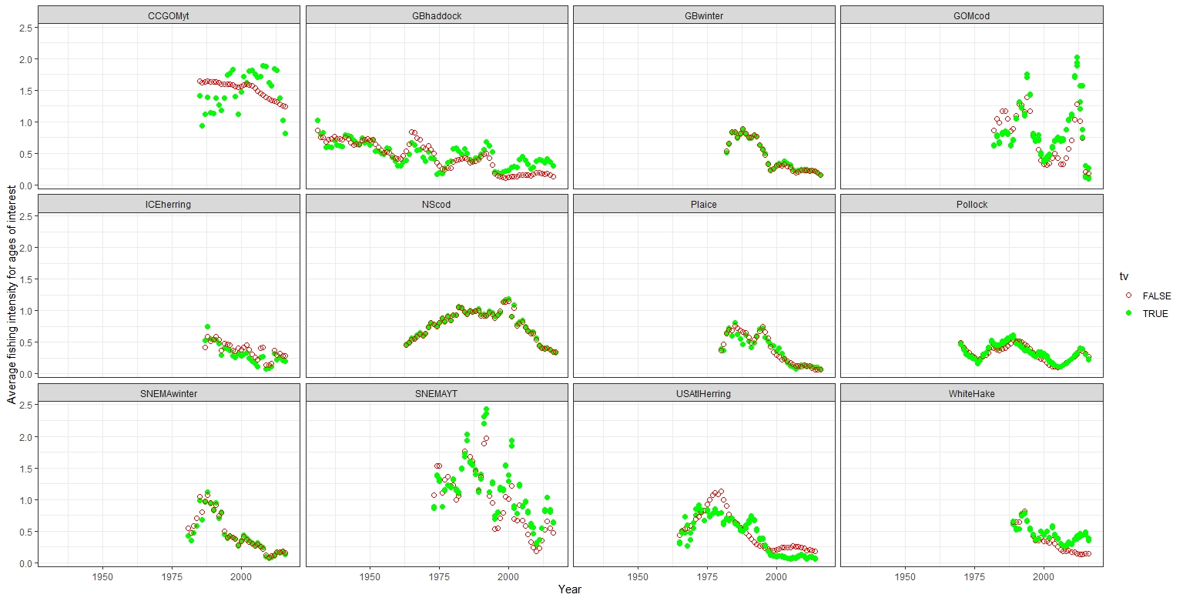
Constant vs. time-varying selectivity in SAM for 12 stocks
Constant
Time blocks (subjective choices)
Random walk, autocorrelated, etc. (objective choices)
Average fishing intensity for ages of interest

