Slide 1
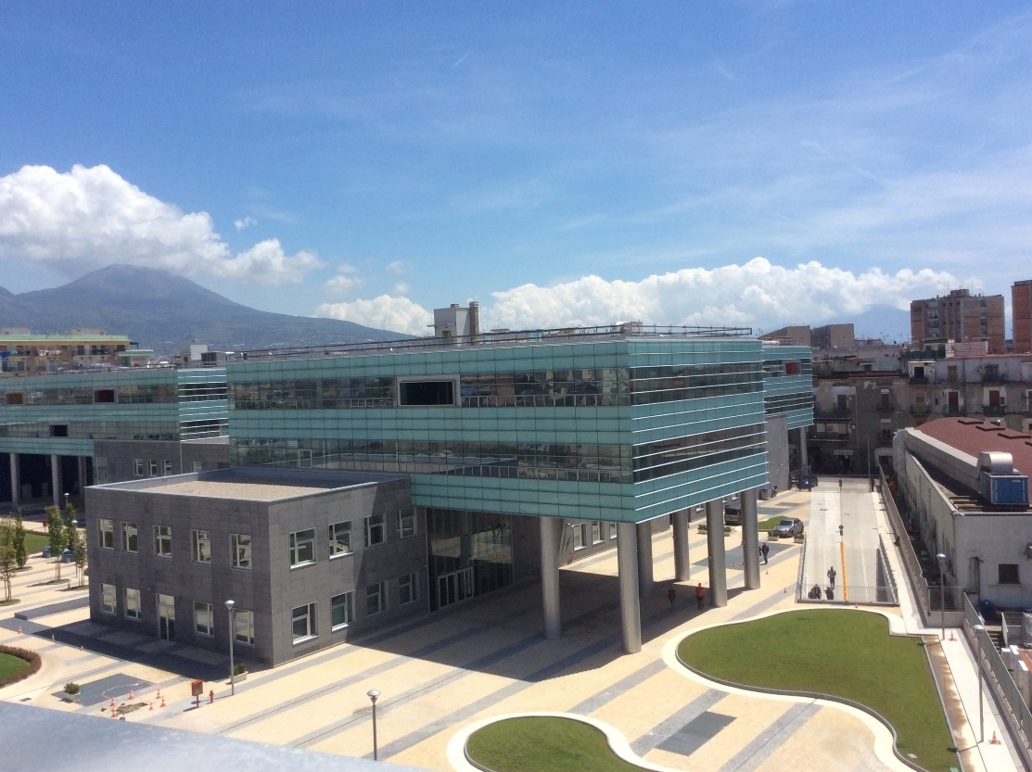


A Parking System Based on Priority Scheme
International Conference on Advanced Information Networking and Applications
Biagio Scotto di Covella - b.scottodicovella@studenti.unina.it
Erasmo Prosciutto – e.prosciutto@studenti.unina.it
Antonio Lanuto – an.lanuto@studenti.unina.it
Silvia Stranieri – silvia.stranieri@unina.it
Walter Balzano – wbalzano@unina.it
University of Naples: Federico II
DIETI - Department of Electrical Engineering and Information Technology
A Parking System Based on Priority Scheme, AINA Conference, March 2023 1/16

Slide 2

Key Words:
Introduction
The game of fifteen
Goal
Parking Model
Chequered Parking Algorithm
Running Example
Buffer Size Evaluation
Comparison with existing systems
Conclusions
Parking
Queue
Chequered parking
The game of fifteen
A Parking System Based on Priority Scheme, AINA Conference, March 2023 2/16

Slide 3
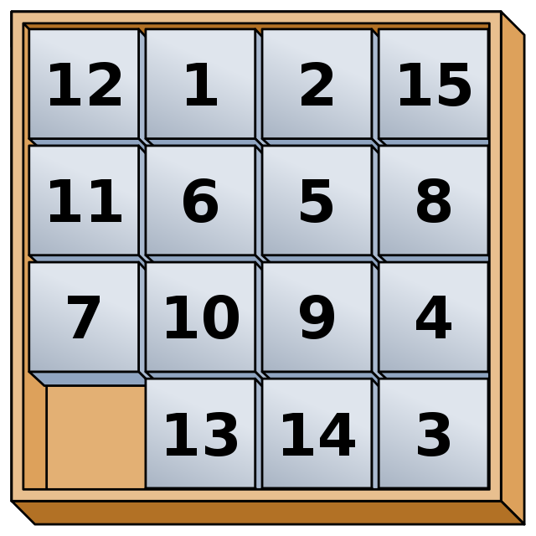
The game of fifteen
Introduction
The game of fifteen
Goal
Parking Model
Chequered Parking Algorithm
Running Example
Buffer Size Evaluation
Comparison with existing systems
Conclusions
Sorting out boxes by taking advantage of one free space
A Parking System Based on Priority Scheme, AINA Conference, March 2023 3/16

Slide 4
Goals
Introduction
The game of fifteen
Goal
Parking Model
Chequered Parking Algorithm
Running Example
Buffer Size Evaluation
Comparison with existing systems
Conclusions
Applying the basic idea of the game of fifteen to our case study
Demonstrate the efficiency of using a checkerboard parking lot with a buffer zone
Demonstrate the efficiency of checkerboard parking compared with normal parking systems
A Parking System Based on Priority Scheme, AINA Conference, March 2023 4/16

Slide 5
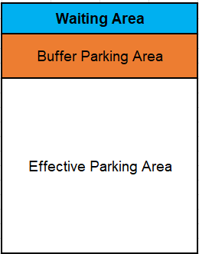
Parking Model
Introduction
The game of fifteen
Goal
Parking Model
Chequered Parking Algorithm
Running Example
Buffer Size Evaluation
Comparison with existing systems
Conclusions
Waiting Area: The area where cars communicate the required information
Buffer Parking Area: The area used to move cars and facilitate movements
Effective Parking Area: area designated for parking cars
A Parking System Based on Priority Scheme, AINA Conference, March 2023 5/16

Slide 6
Chequered Parking Algorithm: Phases
Introduction
The game of fifteen
Goal
Parking Model
Chequered Parking Algorithm
Running Example
Buffer Size Evaluation
Comparison with existing systems
Conclusions
Phase 1, Initialization: the system asks the user for information about the incoming cars and the algorithm creates a queue of them
Phase 2, Parking Arrangement: the system processes this priority queue and arranges the cars in the parking lot
Phase 3, New Car Insertion: this phase deals with the management of incoming new cars
Phase 4, Parking Rearrangement: the algorithm now knows which column to work on and through a series of car moves
A Parking System Based on Priority Scheme, AINA Conference, March 2023 6/16

Slide 7
Chequered Parking Algorithm: Phases 1 and 2
Introduction
The game of fifteen
Goal
Parking Model
Chequered Parking Algorithm
Running Example
Buffer Size Evaluation
Comparison with existing systems
Conclusions
Phase 2, Parking Arrangement
Phase 1, Initialization
A Parking System Based on Priority Scheme, AINA Conference, March 2023 7/16

Slide 8
Chequered Parking Algorithm: Phases 3 and 4
Introduction
The game of fifteen
Goal
Parking Model
Chequered Parking Algorithm
Running Example
Buffer Size Evaluation
Comparison with existing systems
Conclusions
Phase 4, Parking Rearrangement
Phase 3, New Car Insertion
A Parking System Based on Priority Scheme, AINA Conference, March 2023 8/16

Slide 9
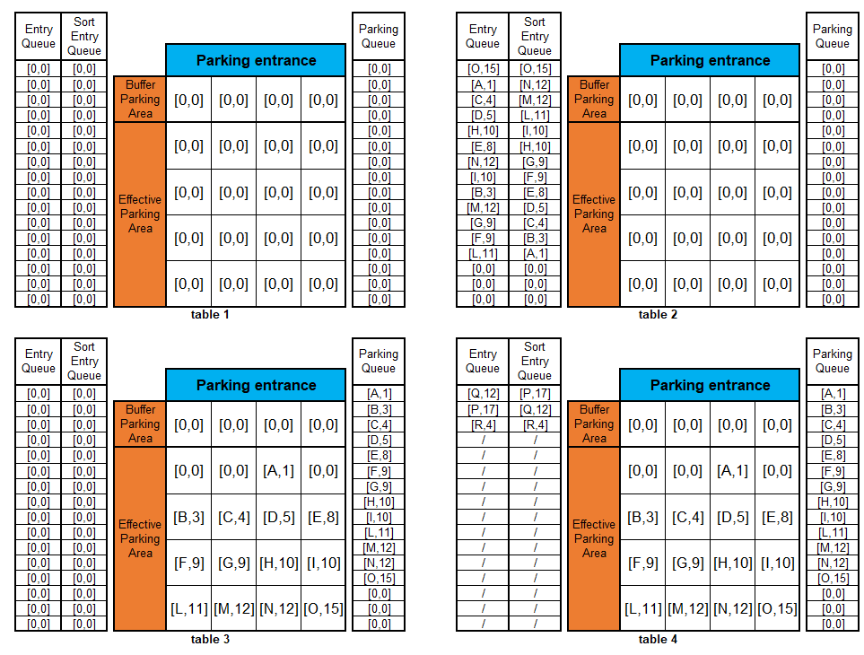
CPA: example phase 1,2,3
Introduction
The game of fifteen
Goal
Parking Model
Chequered Parking Algorithm
Running Example
Buffer Size Evaluation
Comparison with existing systems
Conclusions
Phase 1
Phase 2
Phase 3
A Parking System Based on Priority Scheme, AINA Conference, March 2023 9/16

Slide 10
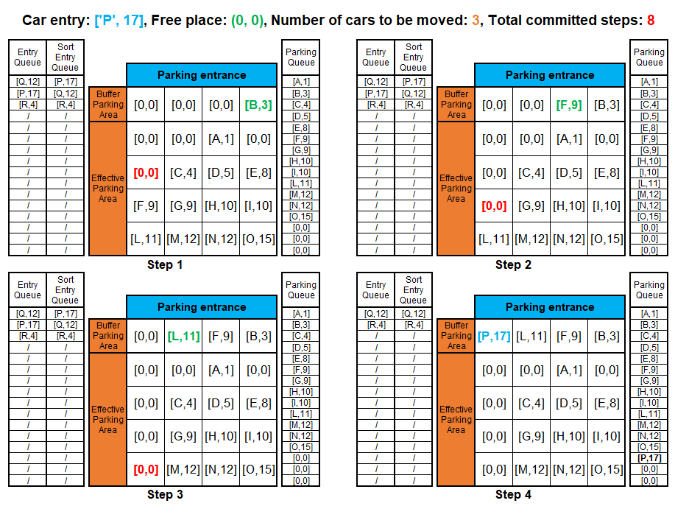
CPA: example phase 4
Introduction
The game of fifteen
Goal
Parking Model
Chequered Parking Algorithm
Running Example
Buffer Size Evaluation
Comparison with existing systems
Conclusions
A Parking System Based on Priority Scheme, AINA Conference, March 2023 10/16

Slide 11
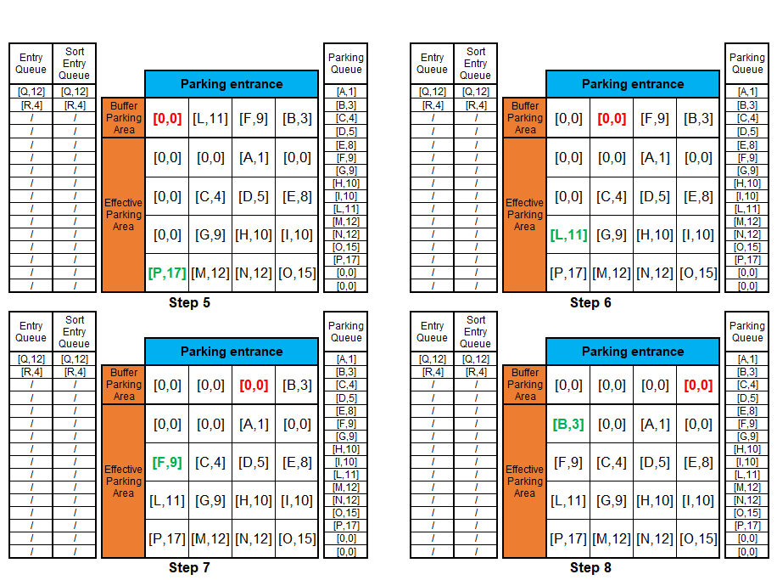
CPA: example phase 4
Introduction
The game of fifteen
Goal
Parking Model
Chequered Parking Algorithm
Running Example
Buffer Size Evaluation
Comparison with existing systems
Conclusions
A Parking System Based on Priority Scheme, AINA Conference, March 2023 11/16

Slide 12
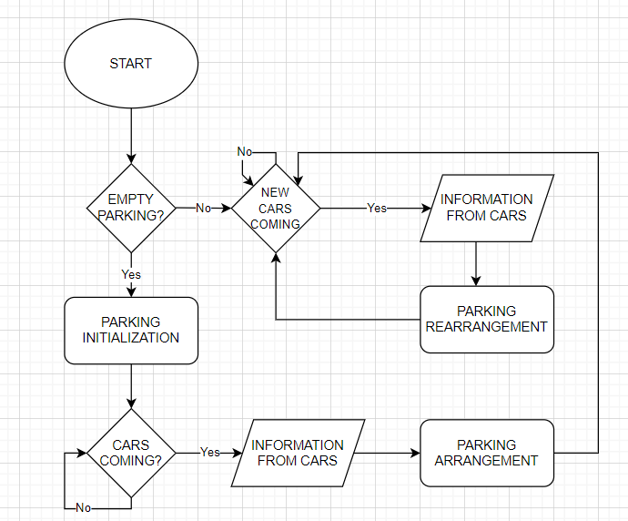
Chequered Parking Algorithm: Flowchart
Introduction
The game of fifteen
Goal
Parking Model
Chequered Parking Algorithm
Running Example
Buffer Size Evaluation
Comparison with existing systems
Conclusions
A Parking System Based on Priority Scheme, AINA Conference, March 2023 12/16

Slide 13
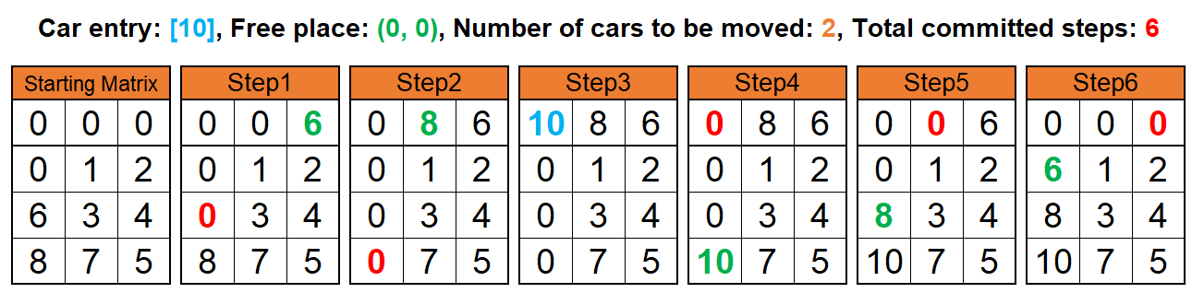
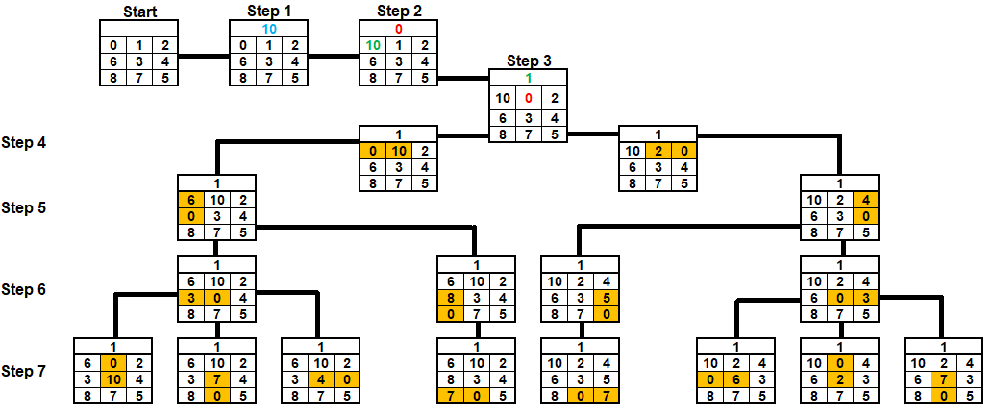
Buffer size evaluation
Introduction
The game of fifteen
Goal
Parking Model
Chequered Parking Algorithm
Running Example
Buffer Size Evaluation
Comparison with existing systems
Conclusions
A Parking System Based on Priority Scheme, AINA Conference, March 2023 13/16

Slide 14
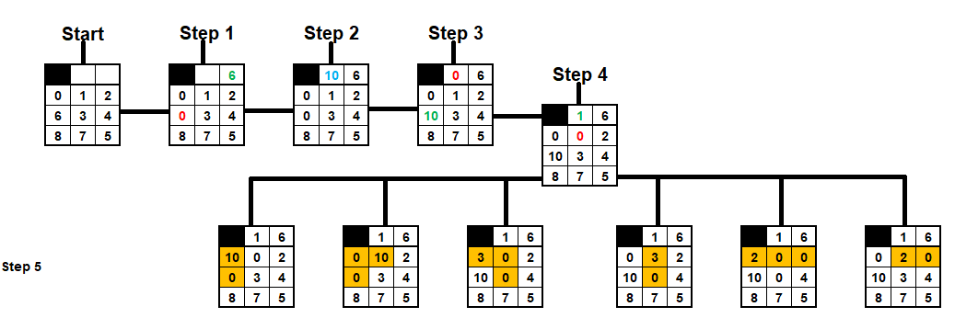
Buffer size evaluation
Introduction
The game of fifteen
Goal
Parking Model
Chequered Parking Algorithm
Running Example
Buffer Size Evaluation
Comparison with existing systems
Conclusions
A Parking System Based on Priority Scheme, AINA Conference, March 2023 14/16

Slide 15
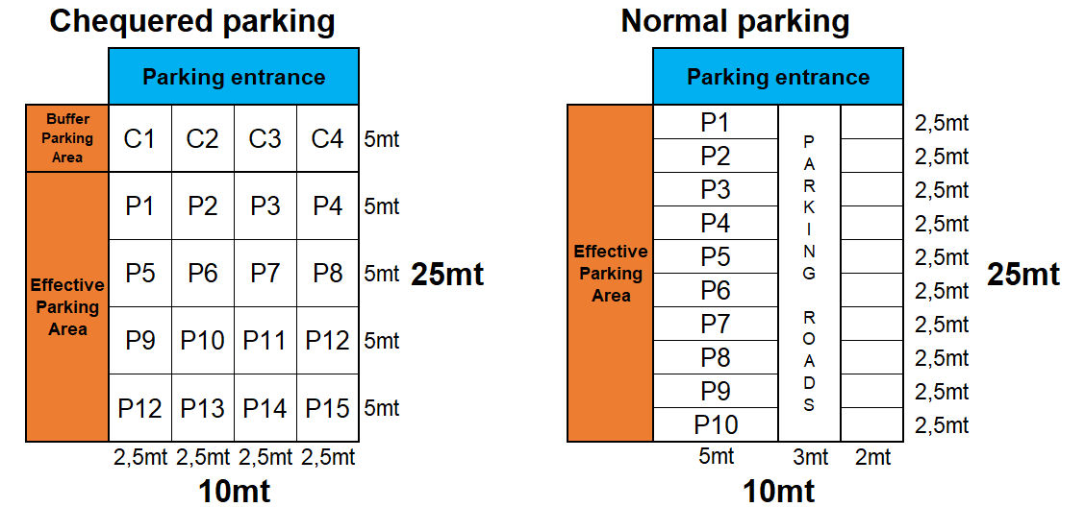
Chequered vs normal parking
Introduction
The game of fifteen
Goal
Parking Model
Chequered Parking Algorithm
Running Example
Buffer Size Evaluation
Comparison with existing systems
Conclusions
P13 P14 P15 P16
A Parking System Based on Priority Scheme, AINA Conference, March 2023 15/16

Slide 16
Thank you
Biagio Scotto di Covella - b.scottodicovella@studenti.unina.it
Erasmo Prosciutto – e.prosciutto@studenti.unina.it
Antonio Lanuto – an.lanuto@studenti.unina.it
Silvia Stranieri – silvia.stranieri@unina.it
Walter Balzano – wbalzano@unina.it
University of Naples Federico II
DIETI - Department of Electrical Engineering and Information Technology
A Parking System Based on Priority Scheme, AINA Conference, March 2023 16/16

