Slide 1
CONTAINERS 101
INTRODUCCION A CONTENEDORES

Slide 2
AGENDA
1
Background de Tecnologías Cloud Native - CNCF
2
Contenedores
3
Docker como herramienta más popular para el despliege de Containers
4
Workshop – Implementacion de Contenedores con Docker

Slide 3

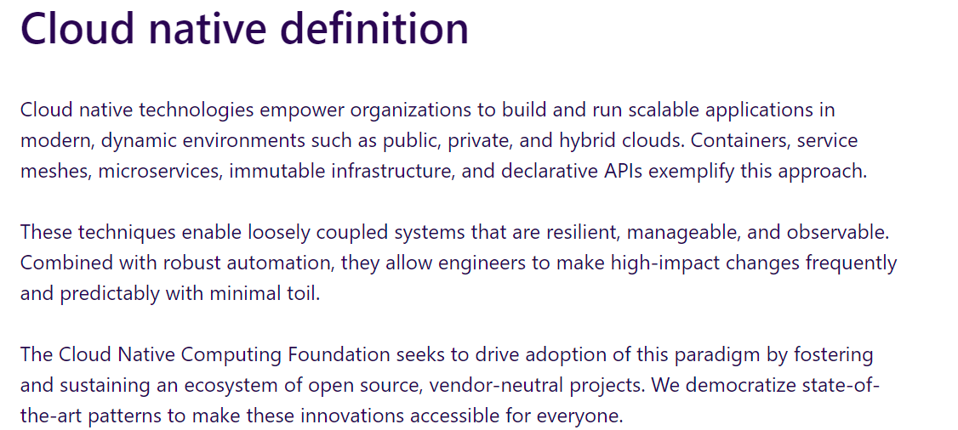
https://www.cncf.io/

Slide 4
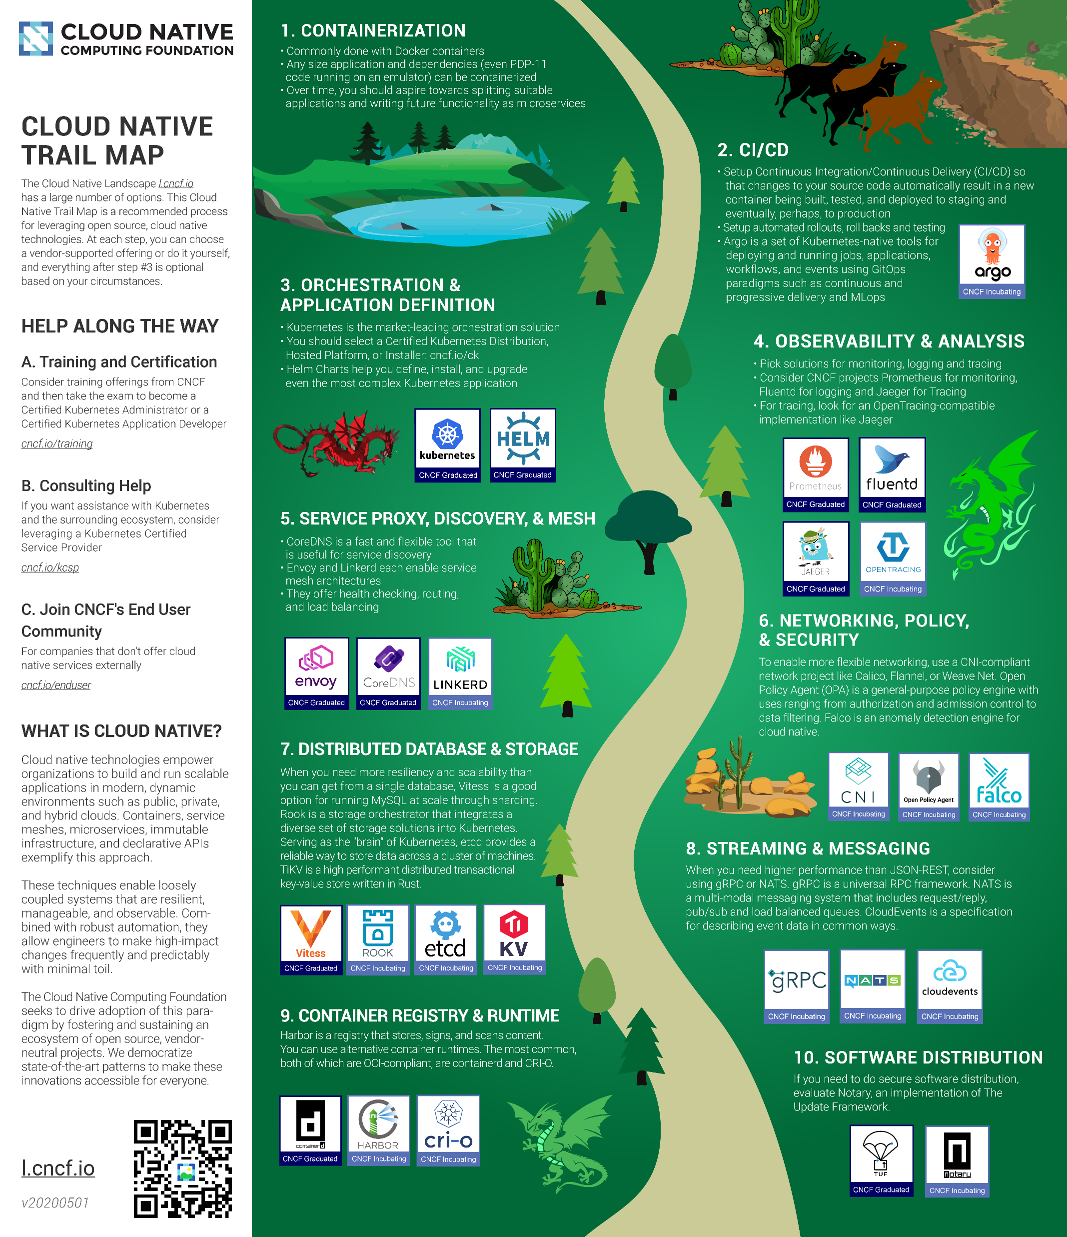

Slide 5
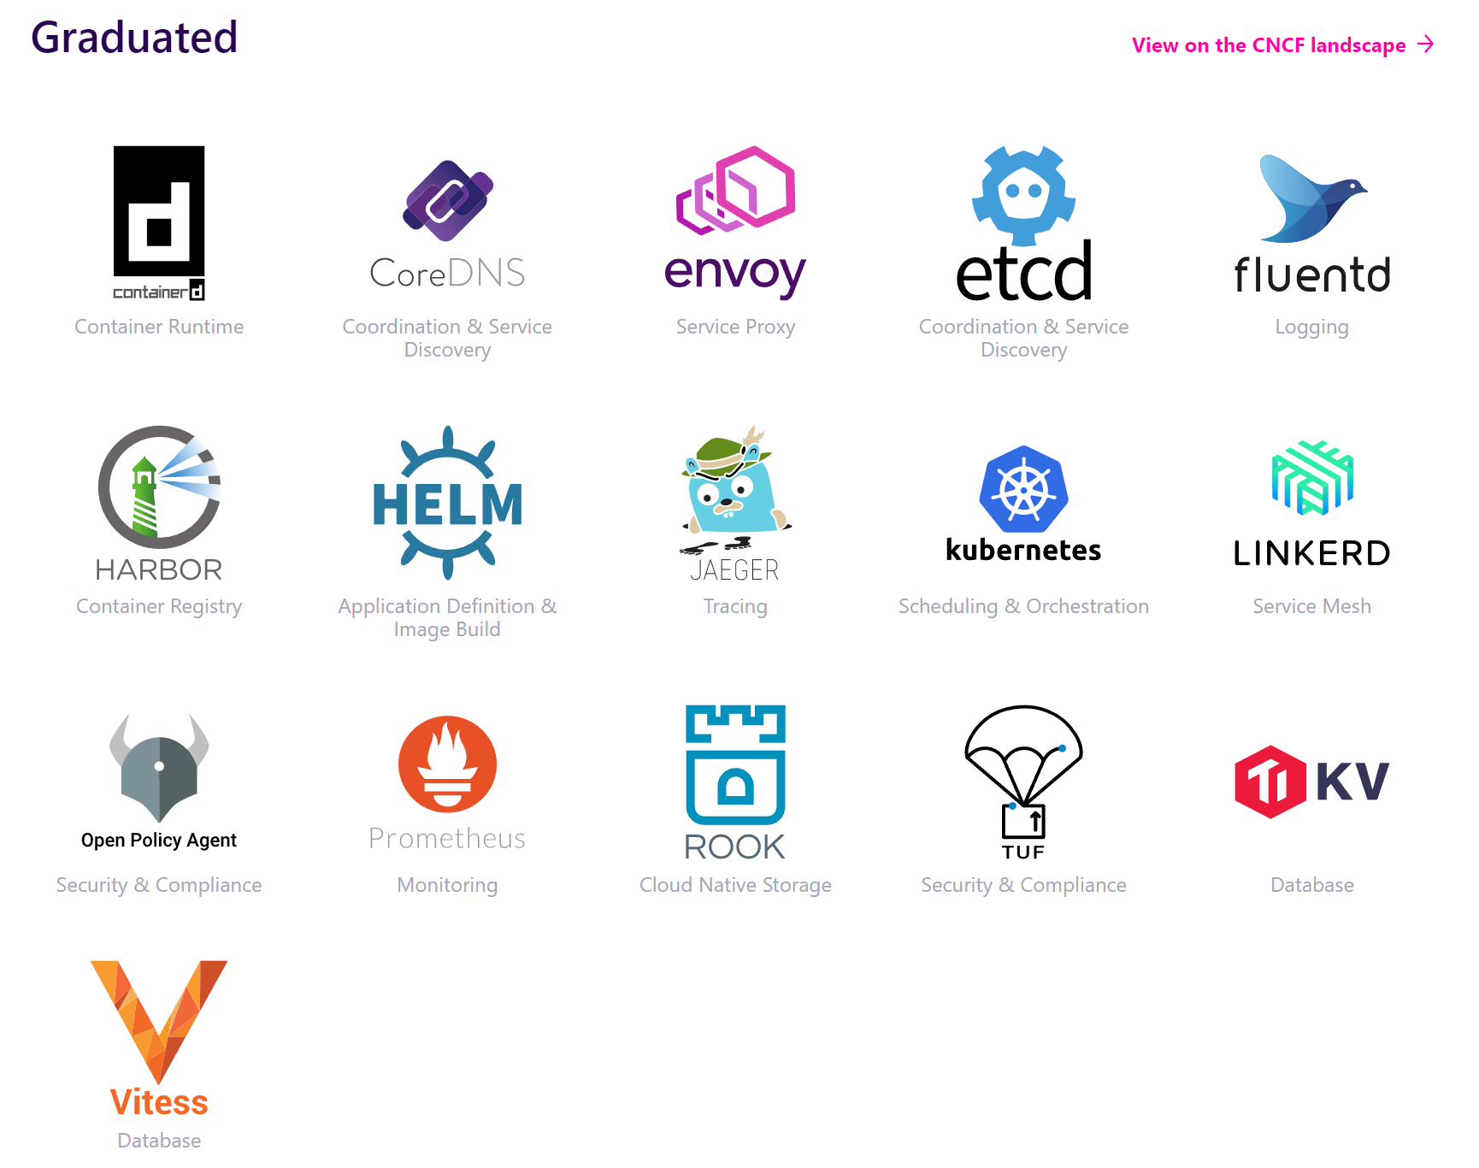
Proyectos de CNCF

Slide 6
What is a Container?
A container encapsulates an application in a form that’s portable and easy to deploy. Containers can run without changes on any compatible system—in any private cloud or public cloud—and they consume resources efficiently, enabling high density and resource utilization. Although containers can be used with almost any application, they’re frequently associated with microservices, in which multiple containers run separate application components or services. The containers that make up microservices are typically coordinated and managed using a container orchestration platform, such as Kubernetes.

Slide 7
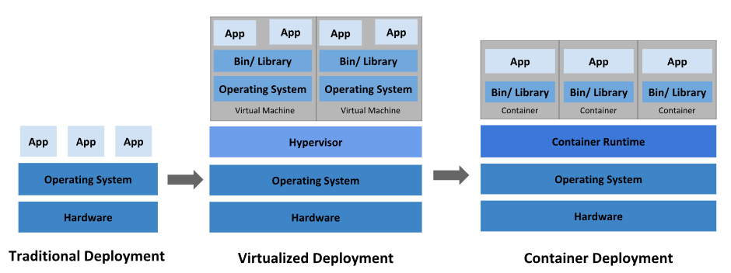
DEPLOYMENTS EVOLUTION

Slide 8
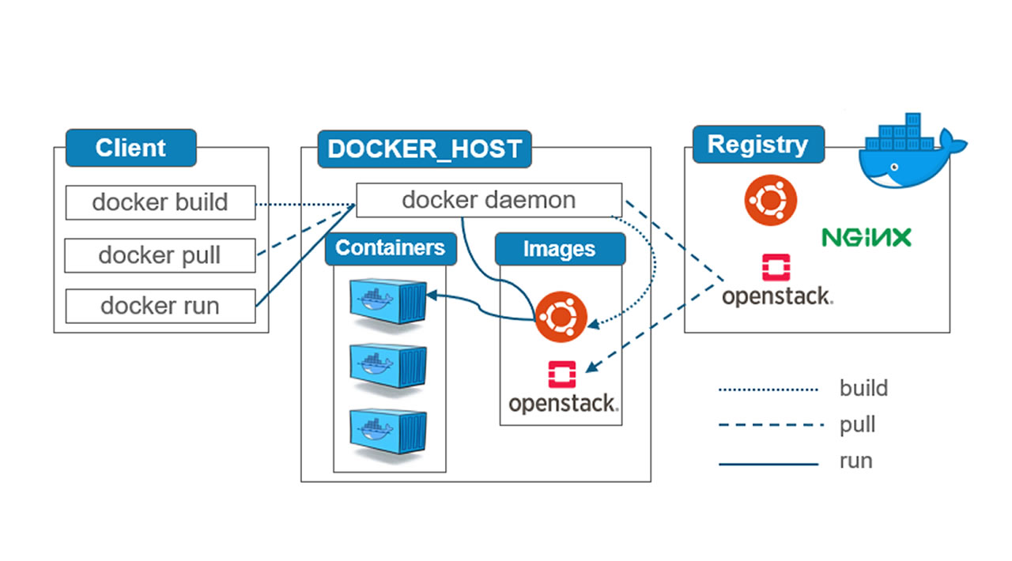
DOCKER ARCHITECTURE

Slide 9
