Slide 1
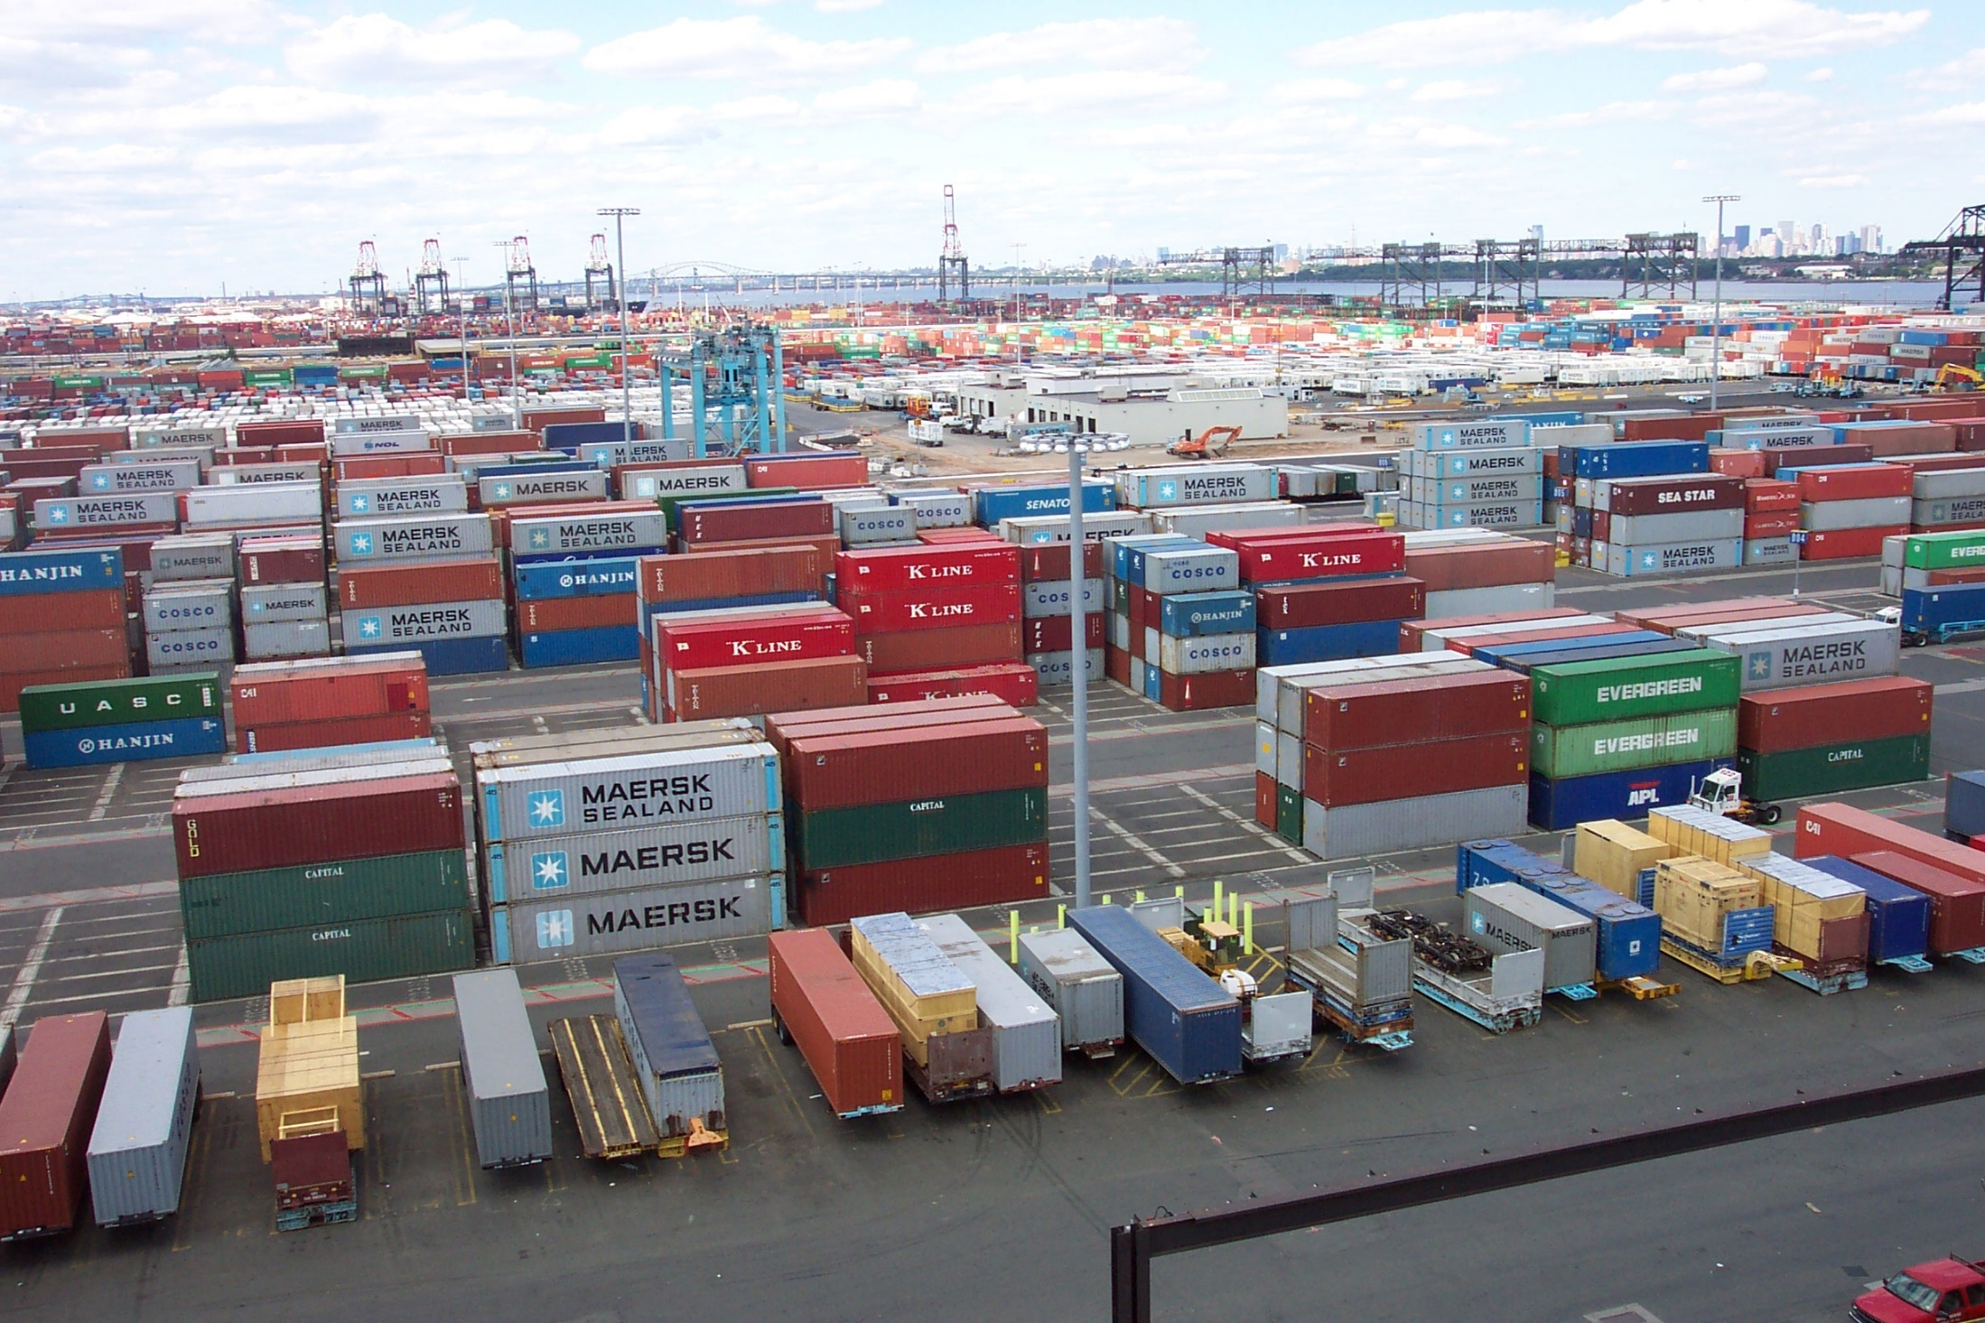
Containers 101
Welcome to cointainers world
Francisco Aroche
DBA – IT Enthusiast
26-01-2022

Slide 2
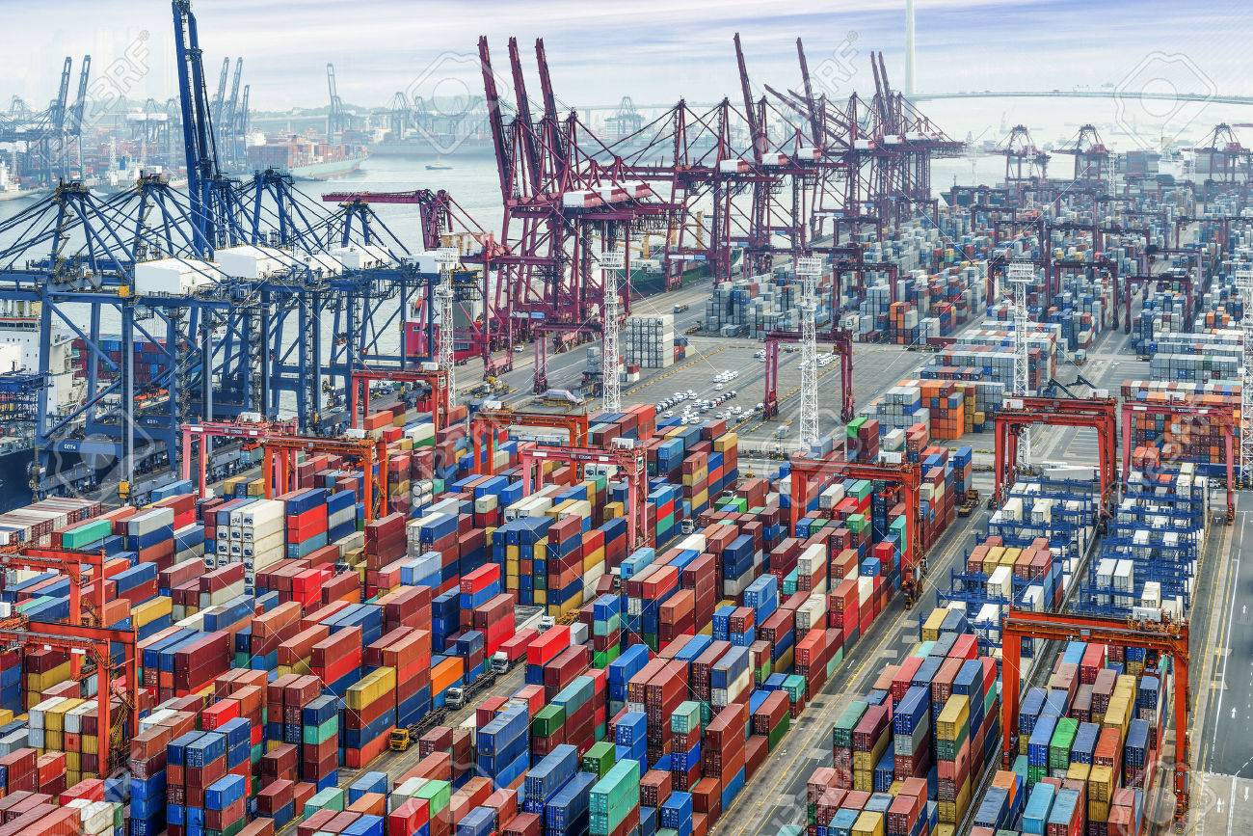
Content overview
01.
Background Cloud Native Technologies - CNCF
02.
What is a Container?
03.
Docker as popular tool to deploy containers
04.
Hands-on

Slide 3
01.
Cloud Native Technologies - CNCF

Slide 4

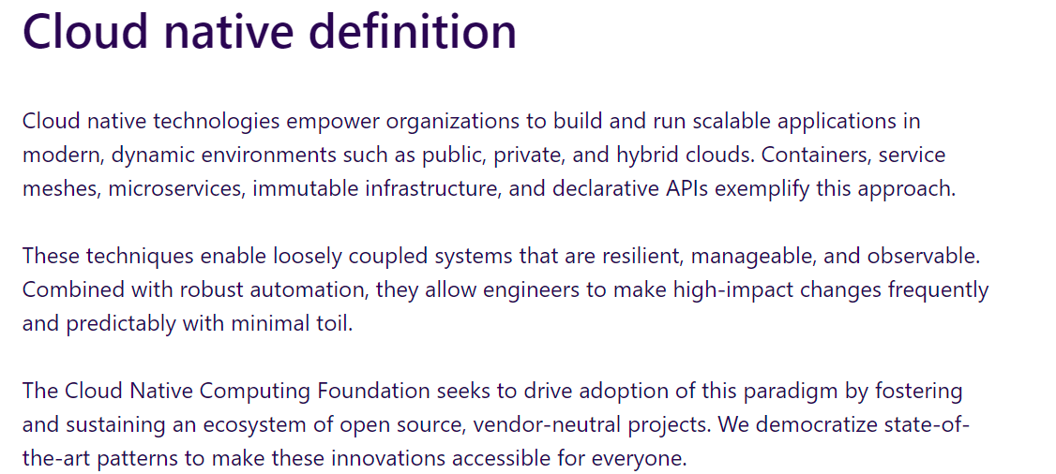
Cloud Native Technologies
https://www.cncf.io/

Slide 5
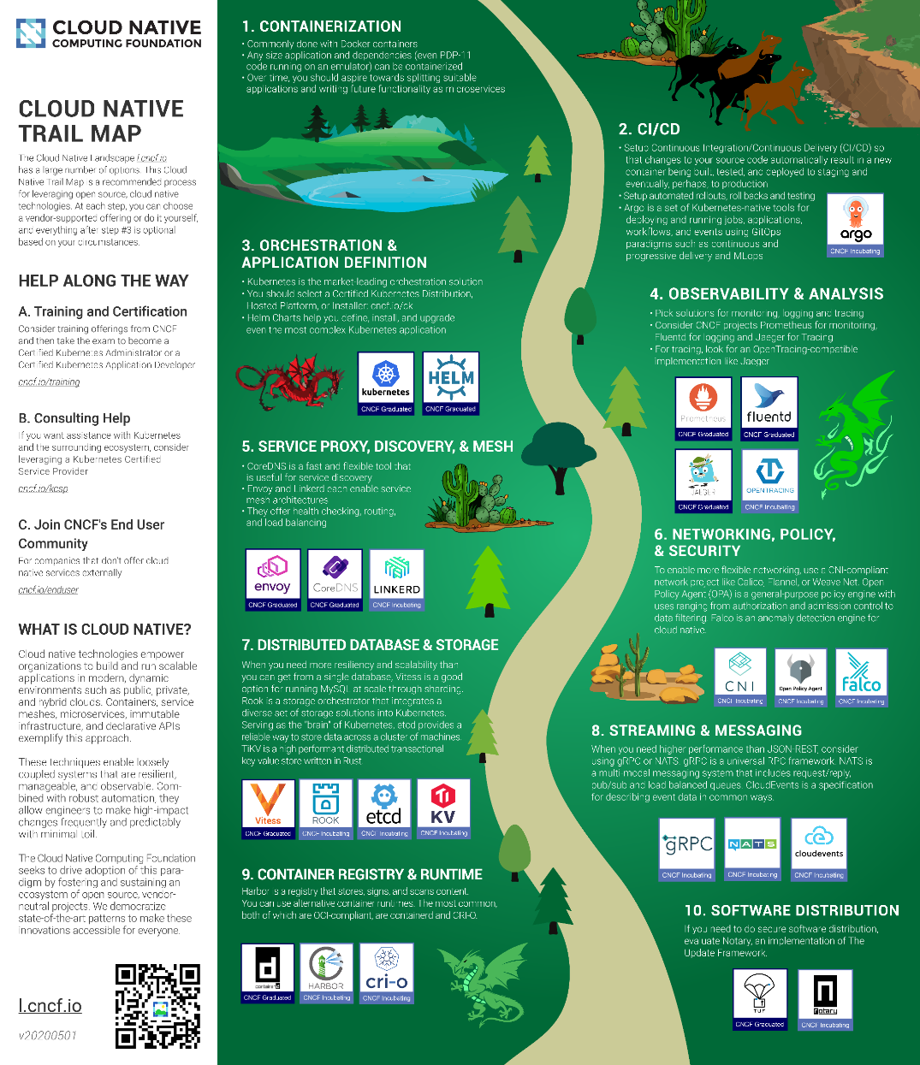
Tecnologías Cloud Native

Slide 6
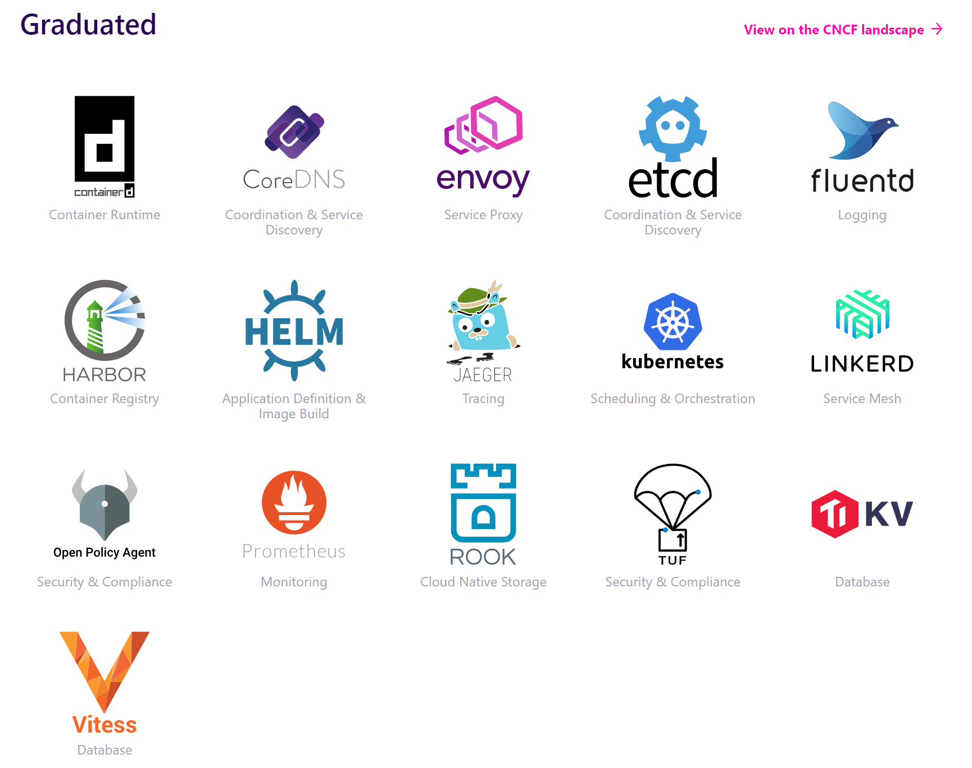
CNCF - Projects

Slide 7
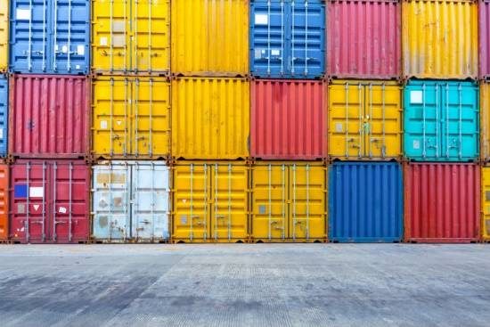
What is a container?

Slide 8
What is a Container?
A container encapsulates an application in a form that’s portable and easy to deploy. Containers can run without changes on any compatible system—in any private cloud or public cloud—and they consume resources efficiently, enabling high density and resource utilization. Although containers can be used with almost any application, they’re frequently associated with microservices, in which multiple containers run separate application components or services. The containers that make up microservices are typically coordinated and managed using a container orchestration platform, such as Kubernetes.

Slide 9
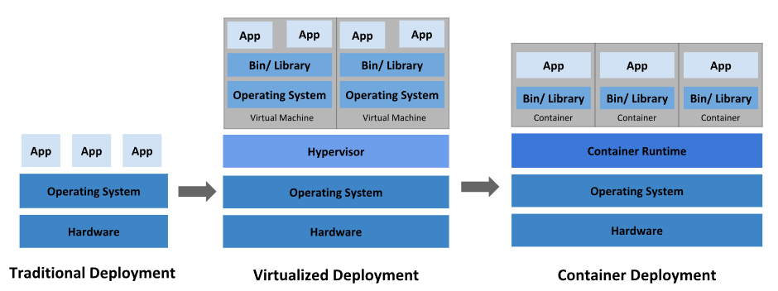
System deploy evolution

Slide 10
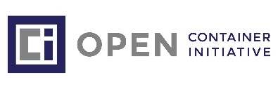
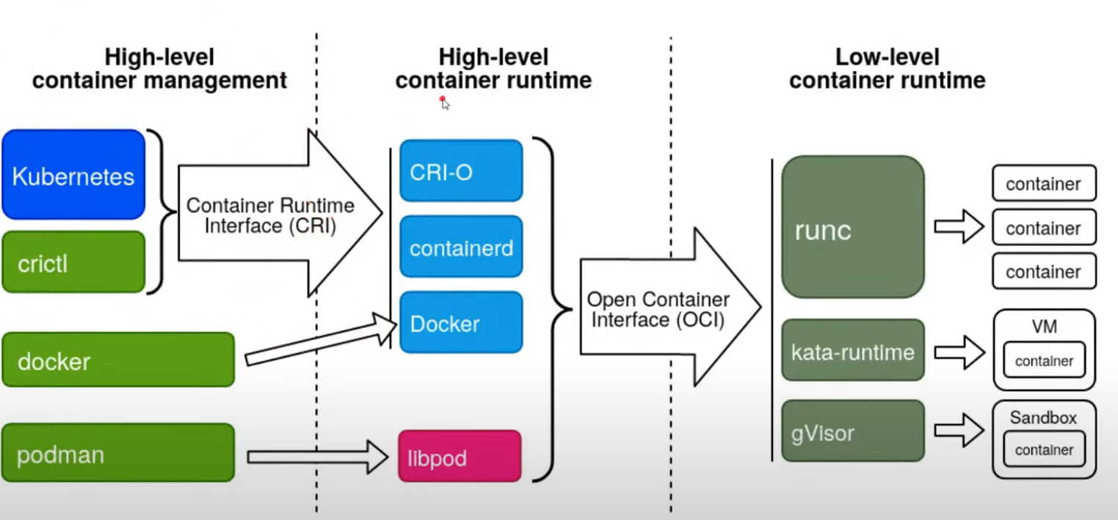
OCI Complaint

Slide 11
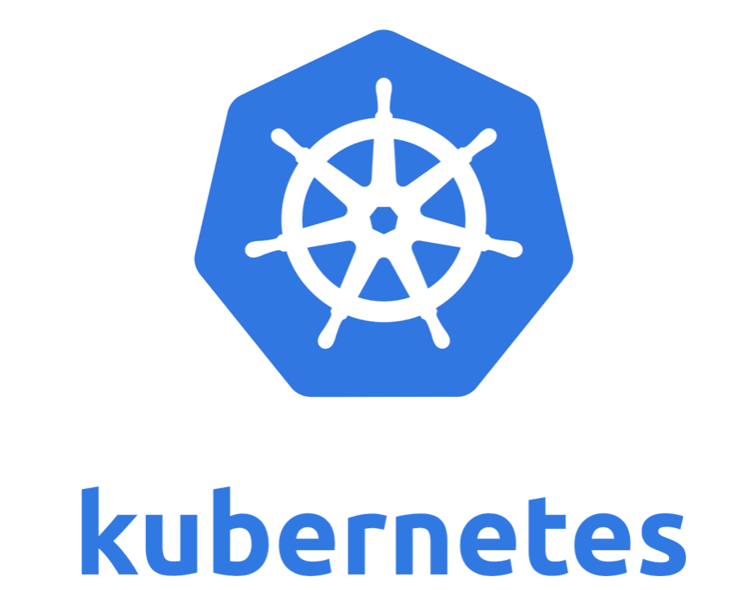

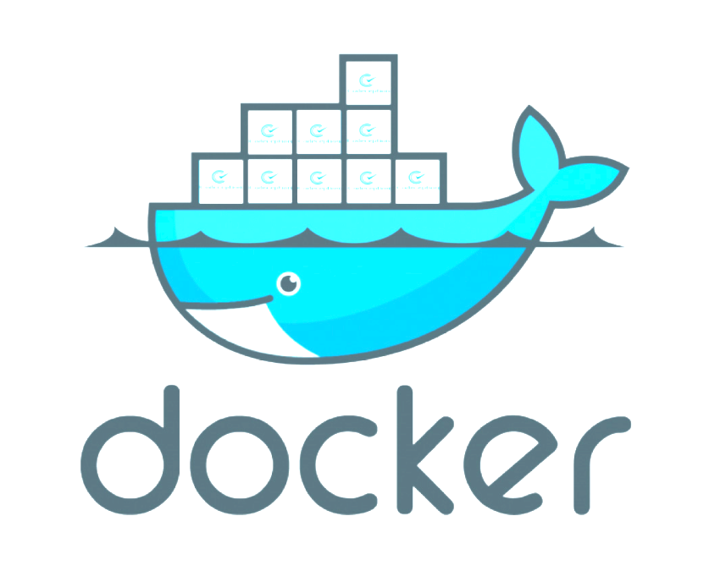
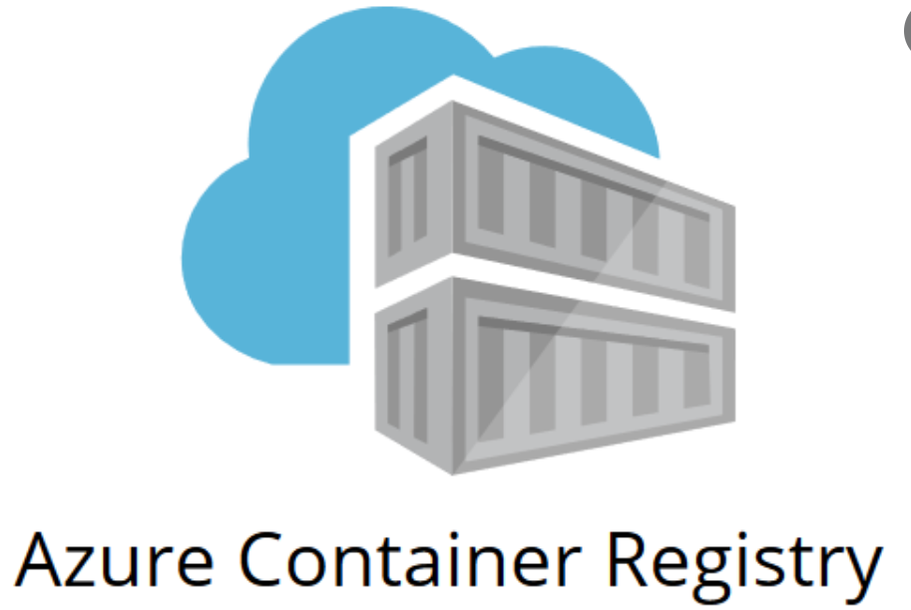

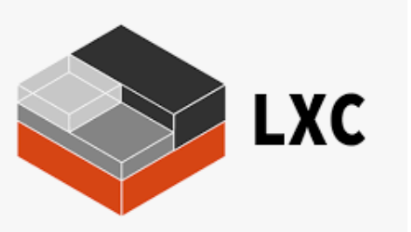


Containers Tools

Slide 12
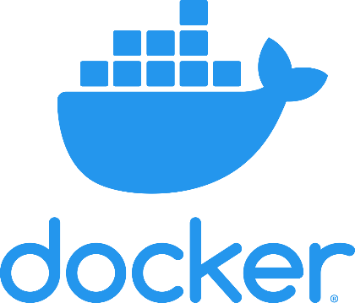
Docker as popular tool to deploy containers

Slide 13
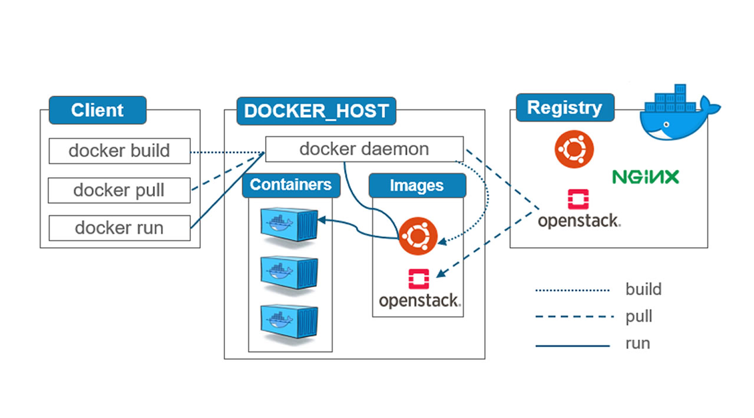
Docker architecture
How docker works?

Slide 14
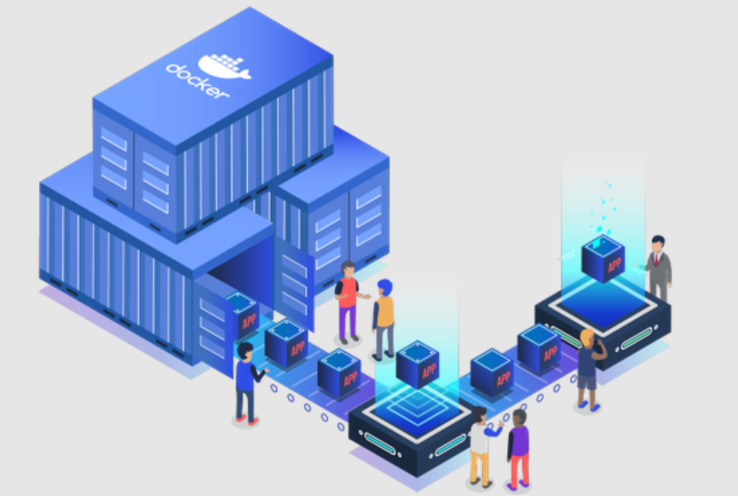
Hands on

Slide 15
Questions?

Slide 16
Thank you!
Email: faroche@gmail.com
Twitter: @faroche

