Slide 1
Neural controller for Unmanned Aerial Vehicle control
Jan Kostecki

Slide 2
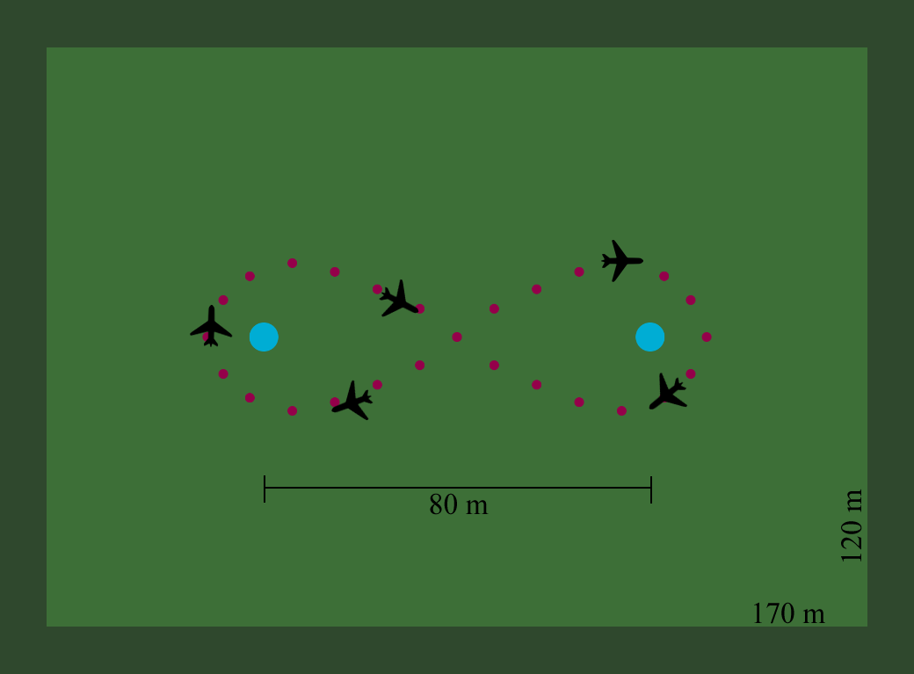
Objective

Slide 3
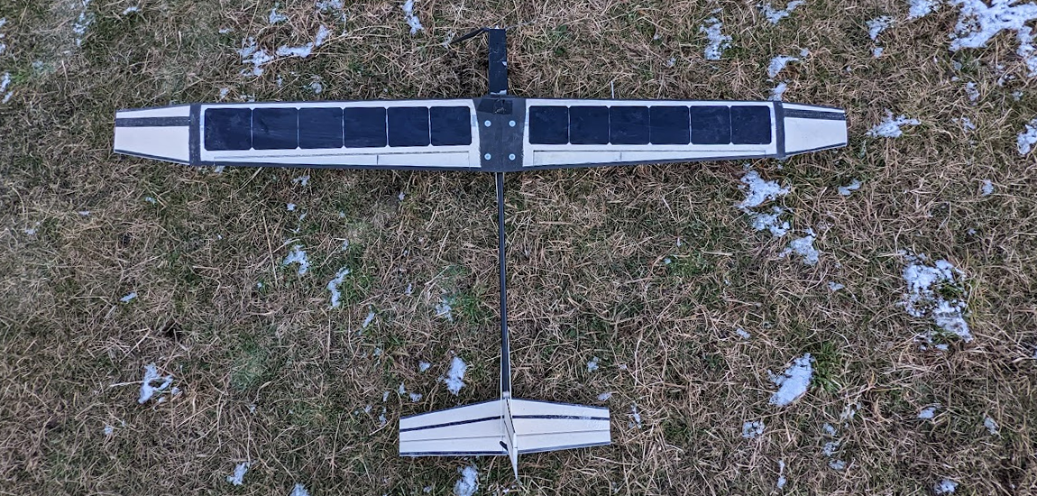
Model plane „Dodo”

Slide 4
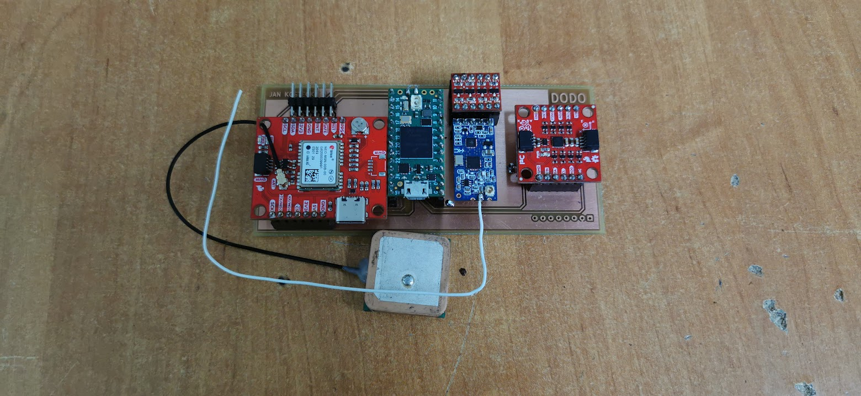
Electronic controller module

Slide 5
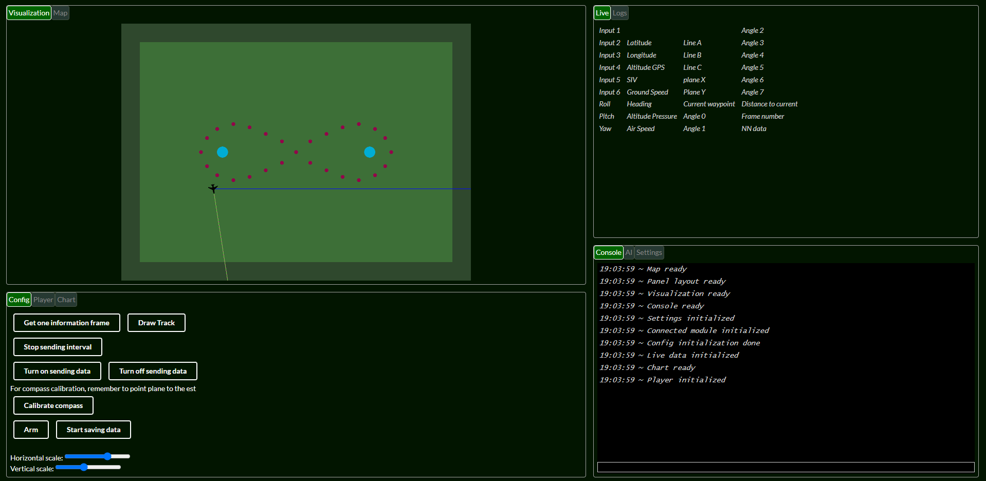
Web visualization app

Slide 6
Milestones
Prepare plane for flight (small repairs)
Test flight
Collect training data during flights
Fix importing TensorFlow Lite model to Teensy 4.0 microcontroller
Train few different networks (RNN, LSTM)
Test autonomous flight
Compare performance results

Slide 7
Bibliography
Mozammal Chowdhury and Shawn Keshmiri. Design and flight test validation of an ai-based longitudinal flight controller for fixed-wing uass. IEEE Computer Society, 2022
Mihai Lungu. Backstepping and dynamic inversion combined controller for auto-landing of fixed wing uavs. Aerospace Science and Technology, 2020
Ruijie Sun, Zhou Zhou, and Xiaoping Zhu. Stability control of a fixed full-wing layout uav under manipulation constraints. Aerospace Science and Technology, 2022

Slide 8
Thank you :)

