Slide 1

Predicting Heart Disease
by Bianca Orozco

Slide 2
Predicting Heart Disease
Data
Features
Model
Results
UC Irvine ML Repository
13 features; Target = 0 or 1
Random Forest
F1 Score

Slide 3
Features Target
Chest pain
Maximum heart rate
# of damaged major blood vessels
Score: 3 = normal, 6 = fixed defect,
7 = reversable defect
0 = No heart disease present
1 = Heart disease present

Slide 4
Random Forest
F1 Score: 0.772
Confusion Matrix:
Actual
 | No Heart Disease Present | Heart Disease Present
No Heart Disease Present | 25 | 3
Heart Disease Present | 10 | 22
Predicted

Slide 5
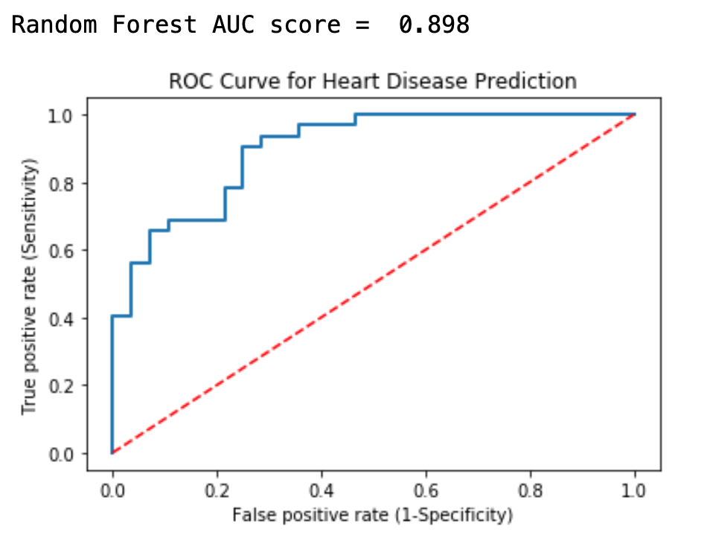
Random Forest
ROC Curve:
AUC Score: 0.898

Slide 6
Appendix

