Slide 1




By Bianca Orozco
Notes:
Good Morning,
My name is
Today I will be presenting to you a recommendation sys
predicts Medium Articles a user would be interested in
based on a search or a previously read Article

Slide 2

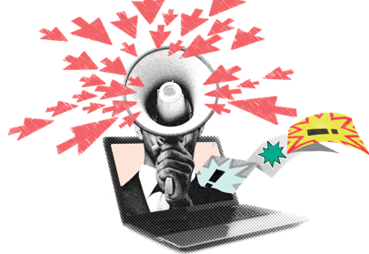

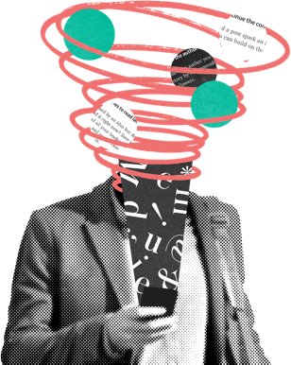

About Medium
Facts:
Online publishing platform (ad-free)
Started in 2012 by Evan Williams
150 million monthly readers
$5 per month/$50 yearly
Popular Tags as of 2019:
Startup
Life
Politics
Life Lessons
Travel
Notes:
Medium was launched in August 2012
an example of social journalism
hybrid collection of amateur & professional people and publications
Medium: Ideas and perspectives you won’t find anywhere else.

Slide 3


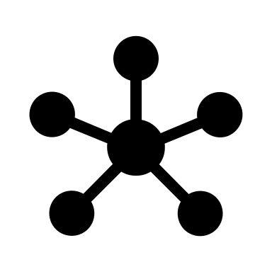

Methonds
Data
Cleaning/NLP
Clustering
Recommendations
Kaggle
1.4 Million Titles
2017-2018
95 Tags
Title + Subtitle
TF-IDF
Uni/Bigrams
LSA
K-Means
4 Clusters
Title Input
Most popular related articles

Slide 4


Recommendation System
“Can Neural
Networks Develop
Attention?
Google Thinks
They Can.
TF-IDF
LSA
K-Means
Top 3 Related Articles:
How I Fully Quit Google (And You Can, Too)
When They Leave
Popping The Bubble: Cryptocurrency vs. Dot Com

Slide 5
Future Work
Obtain full articles
Use Cosine Similarity to find the closest articles, then the most popular
Use a computer that can handle more data
Optimize parameters (GridSearchCV)
Update data (2019)
Produce better results than a search bar

Slide 6

Questions/Comments

Slide 7
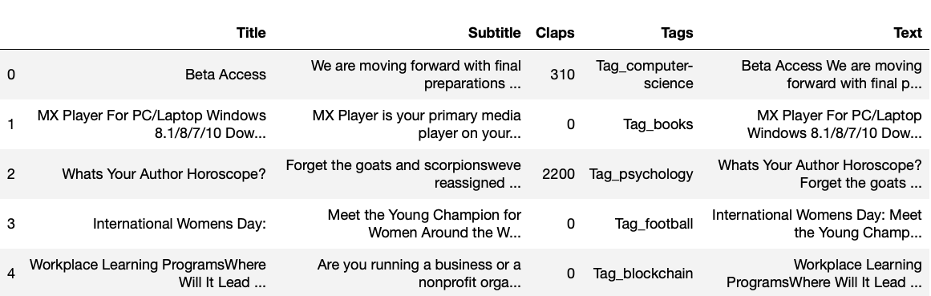
Appendix

Slide 8
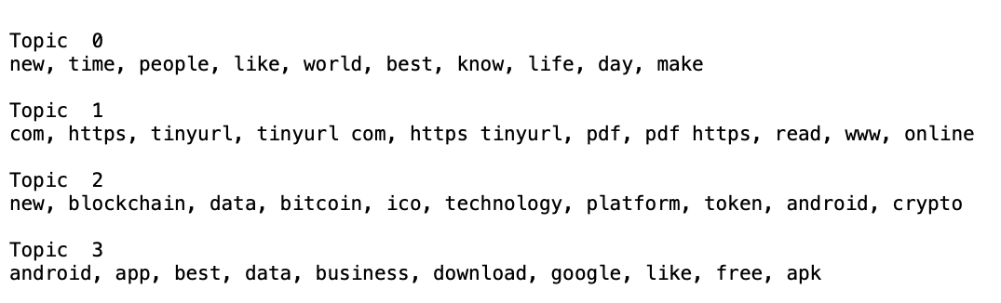
Appendix

Slide 9
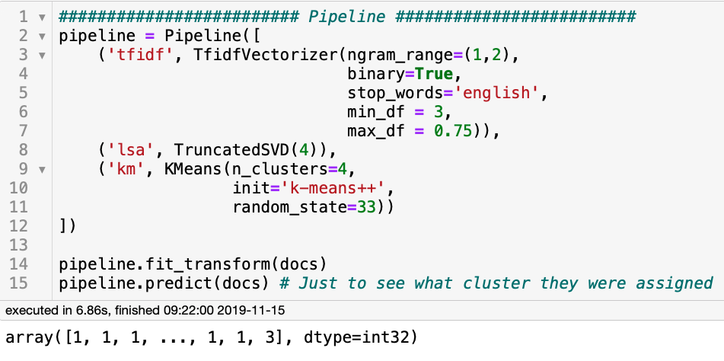
Appendix

Slide 10
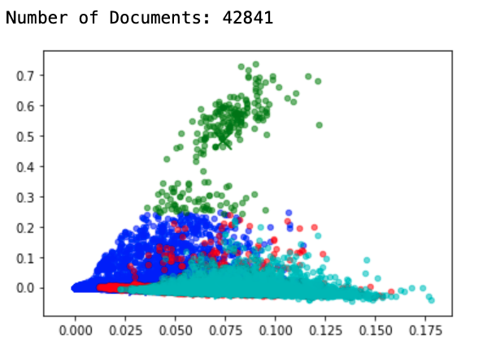
Appendix

