Slide 1
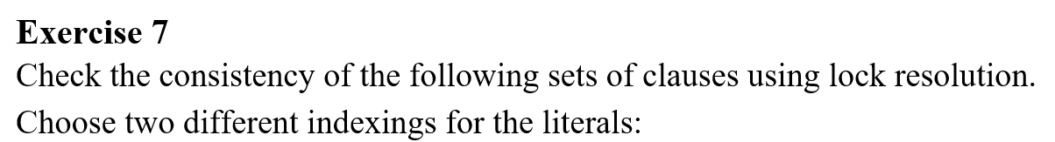
Problem statement

Slide 2
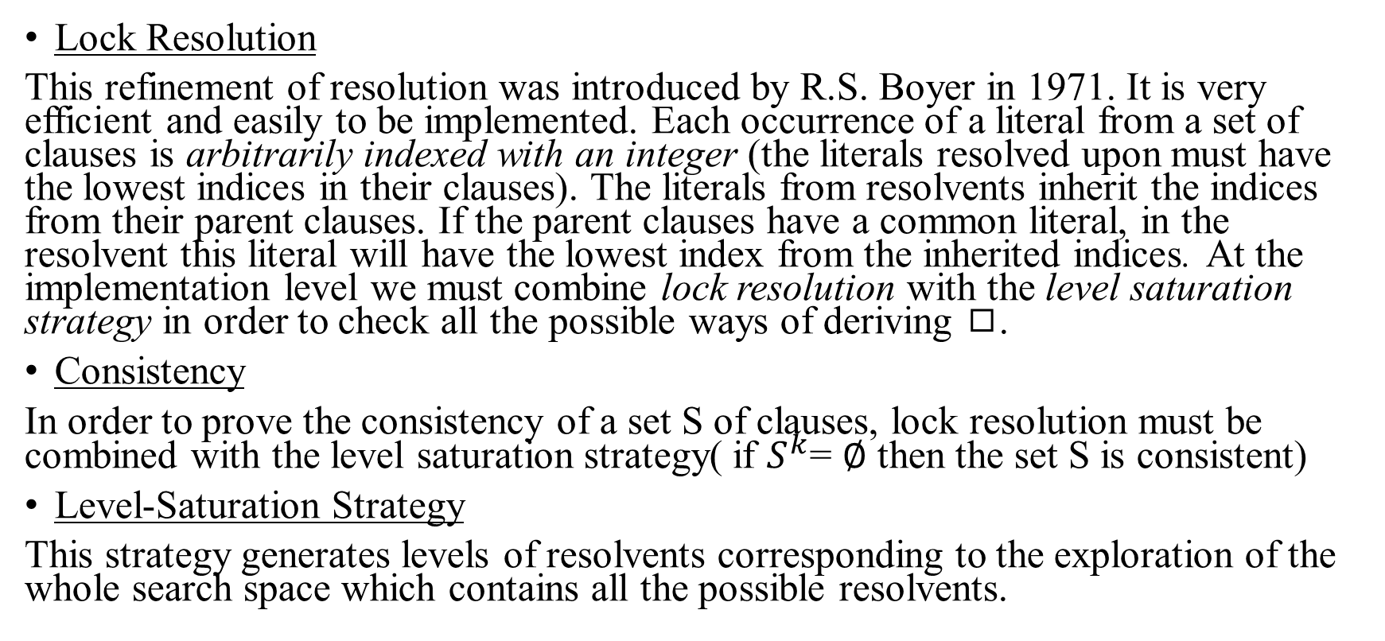
Theoretical results
Lock Resolution
This refinement of resolution was introduced by R.S. Boyer in 1971. It is very efficient and easily to be implemented. Each occurrence of a literal from a set of clauses is arbitrarily indexed with an integer (the literals resolved upon must have the lowest indices in their clauses). The literals from resolvents inherit the indices from their parent clauses. If the parent clauses have a common literal, in the resolvent this literal will have the lowest index from the inherited indices. At the implementation level we must combine lock resolution with the level saturation strategy in order to check all the possible ways of deriving ◻.
Consistency
In order to prove the consistency of a set S of clauses, lock resolution must be combined with the level saturation strategy( if $S^{k}$= ∅ then the set S is consistent)
Level-Saturation Strategy
This strategy generates levels of resolvents corresponding to the exploration of the whole search space which contains all the possible resolvents.

Slide 3
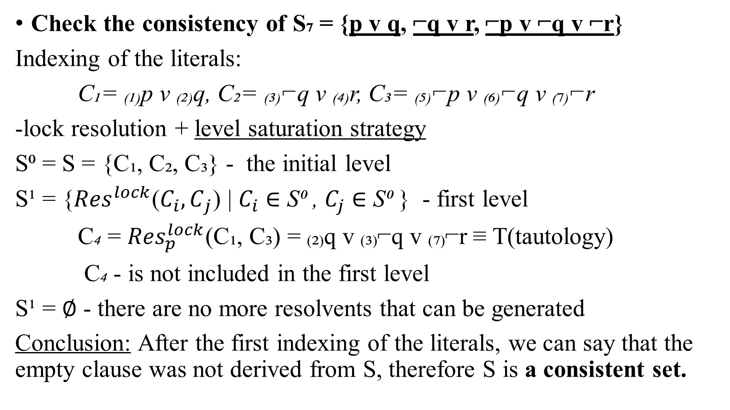
Check the consistency of S₇ = {p v q, ⌐q v r, ⌐p v ⌐q v ⌐r}
Indexing of the literals:
C₁= ₍₁₎p v ₍₂₎q, C₂= ₍₃₎⌐q v ₍₄₎r, C₃= ₍₅₎⌐p v ₍₆₎⌐q v ₍₇₎⌐r
-lock resolution + level saturation strategy
S⁰ = S = {C₁, C₂, C₃} - the initial level
S¹ = {${Res}^{lock}$($C_{i}{,C}_{j}$) | $C_{i}$ ∈ S⁰ , $C_{j}$ ∈ S⁰ } - first level
C₄ = ${Res}_{p}^{lock}$(C₁, C₃) = ₍₂₎q v ₍₃₎⌐q v ₍₇₎⌐r ≡ T(tautology)
C₄ - is not included in the first level
S¹ = ∅ - there are no more resolvents that can be generated
Conclusion: After the first indexing of the literals, we can say that the empty clause was not derived from S, therefore S is a consistent set.

Slide 4
Another indexing of the literals from clauses:
C₁= ₍₁₎p v ₍₂₎q, C₂= ₍₃₎⌐q v ₍₄₎r, C₃= ₍₅₎⌐r v ₍₆₎⌐p v ₍₇₎⌐q
-lock resolution + level saturation strategy
S⁰ = S = {C₁, C₂, C₃} – the initial set of clauses
S¹ = ∅
-the literals must have the lowest indices in their clauses
Conclusion: After the second indexing of the literals, we can say that no lock resolvents can be generated, the empty clause cannot be derived from S, therefore S is a consistent set.

