Slide 1

Welcome to the Life Science Data Management: Planning workshop
You are encouraged to turn your video on while speaking
Use the chat function for questions
Mute yourself while not speaking
Use the ‘hand up’ function if you want to contribute directly
Slides will be available on zenodo

Slide 2
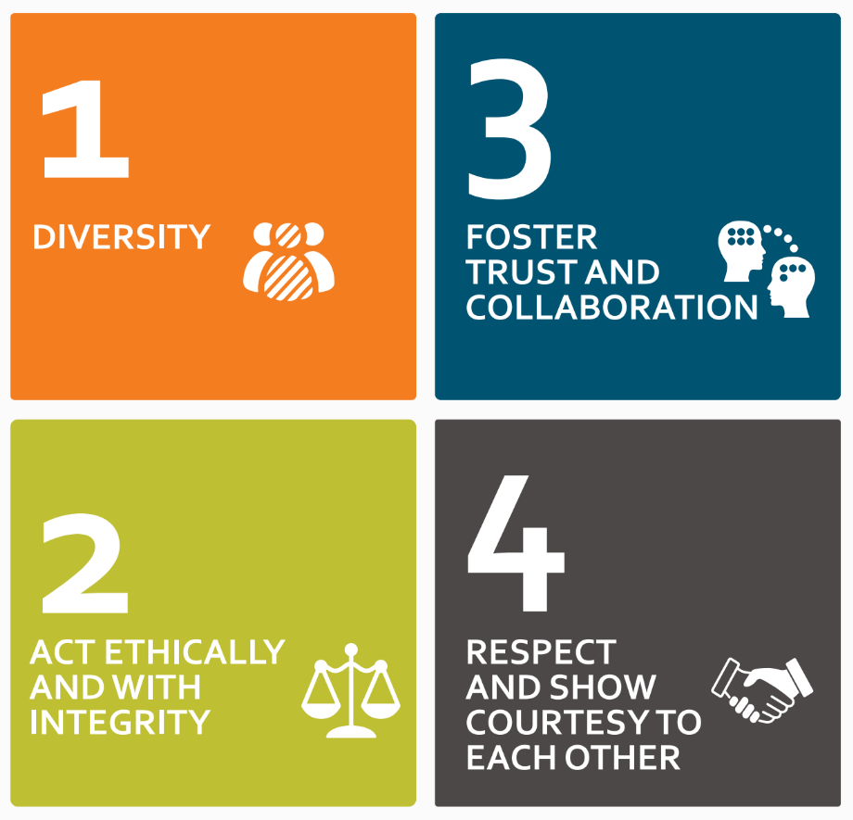
https://elixir-europe.org/events/code-of-conduct

Slide 3


Life Science Data Management: Planning workshop - Introduction
Korbinian Bösl
Data management coordinator
ELIXIR Norway & Centre for Digital Life Norway
05 June 2024

Slide 4
Schedule
05.06.2024
0830 - 0900 Login support
0900 - 0915 Introduction & Requirements from the RCN
0930 - 1000 Parallel session: Local recommendations, storage infrastructures & DMP guidelines
1000 - 1015 Short break
1015 - 1100 Introduction DSW
1100 - 1120 Information on national storage infrastructures
1120 - 1135 Short break
1135 - 1230 Persistent identifiers, Controlled Vocabularies & Ontologies

Slide 5
Schedule
06.06.2024
0900 - 1000 Key legal requirements for research in the GDPR and Health research act
1000 - 1010 Short break
1010- 1050 Relevant deposition repositories/ data archives
1045 - 1100 Short break
1100 - 1115 Licensing of data, biological material and software
1115 - 1300 Hands on training and assistance to generate a data management plan

Slide 6
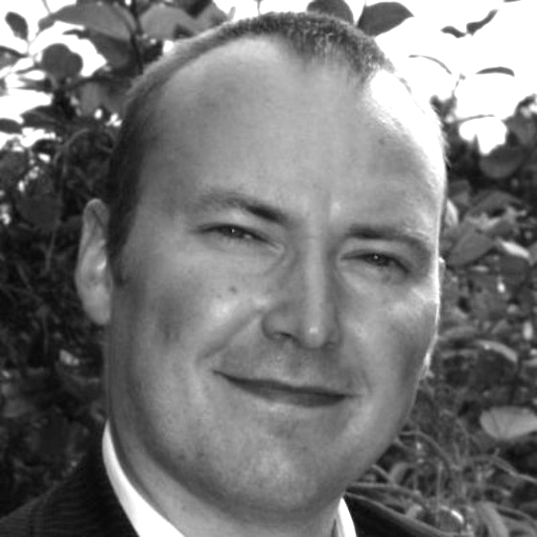

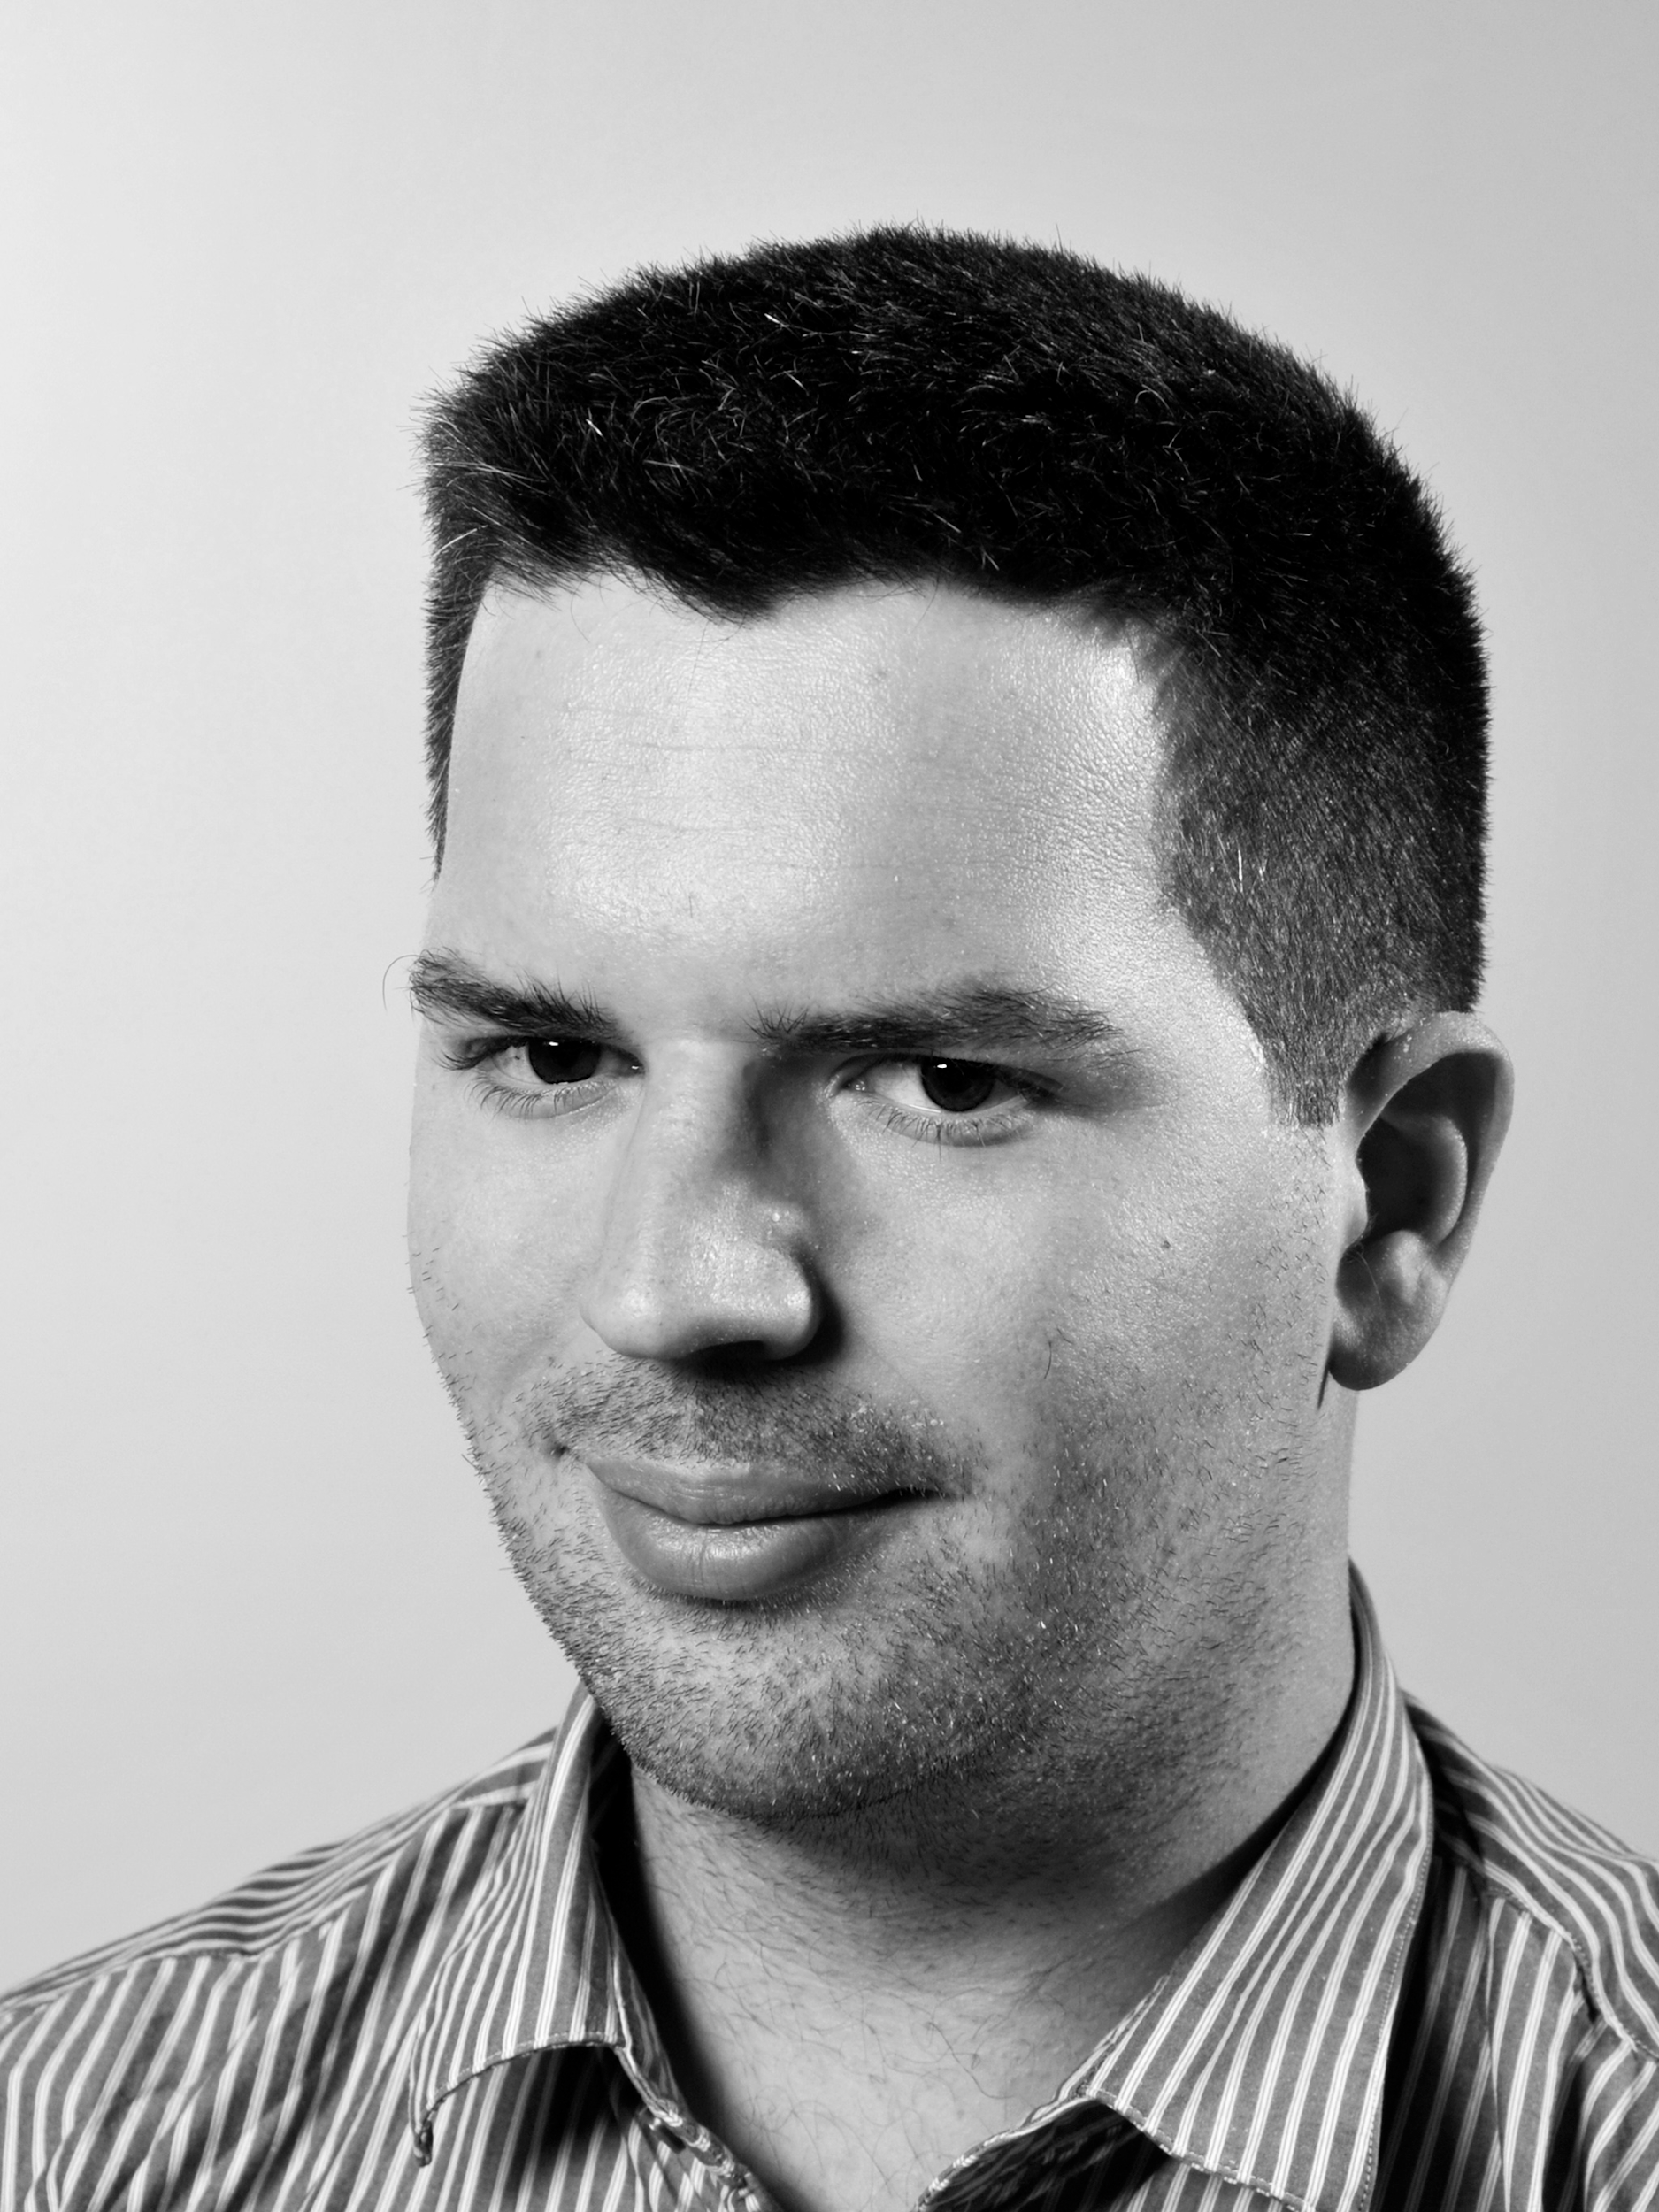
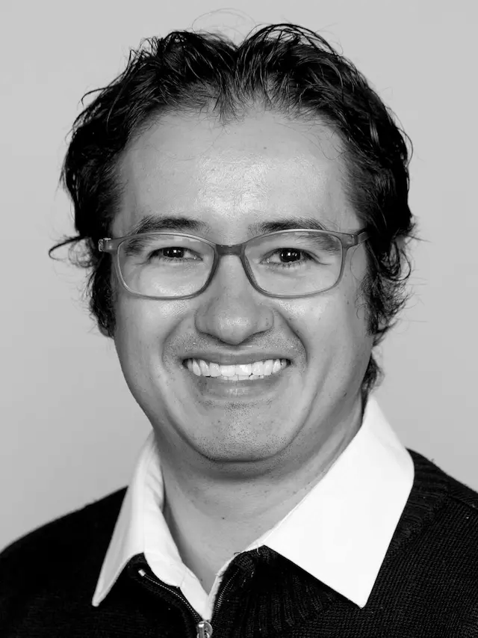
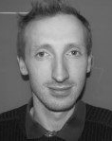
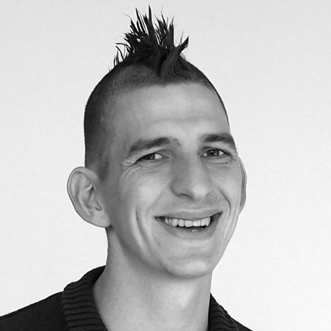





Espen Åberg
Nazeefa
Fatima
Federico Bianchini
Arturo Vera Ponce De Leon
David
Dolan
Korbinian Bösl

Slide 7
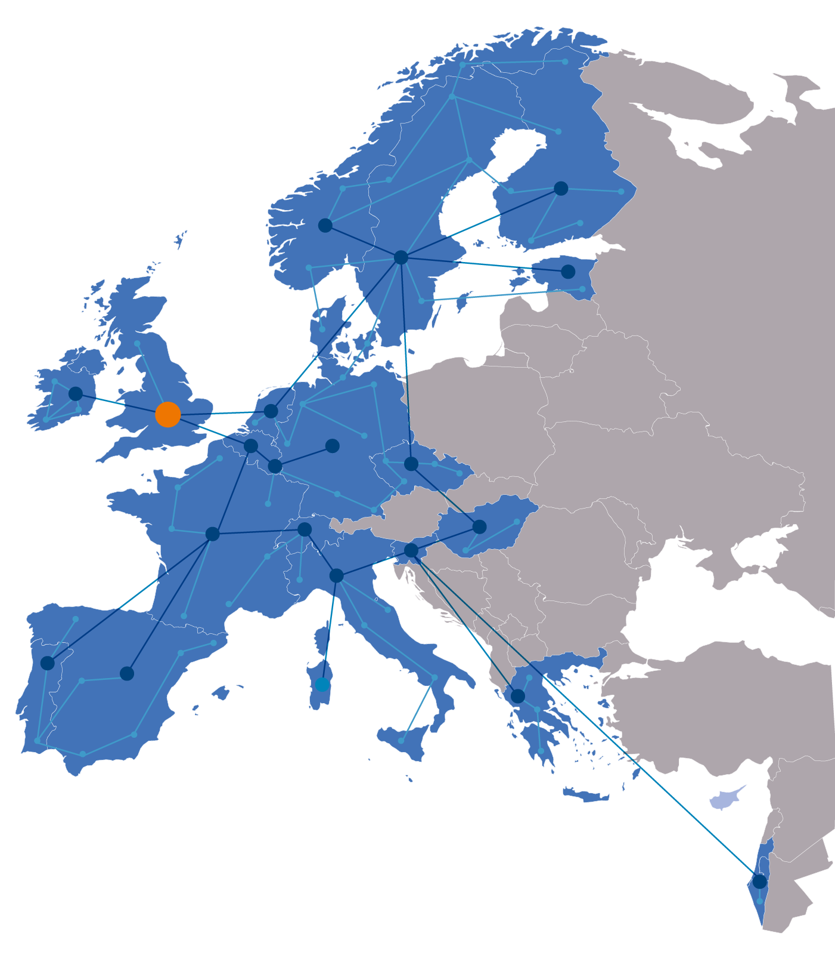

SINCE 2013
ELIXIR
ELIXIR is an intergovernmental organisation that brings together life science resources such as databases, software tools, training materials, standards and compute resources, from across Europe.
The goal of ELIXIR is to coordinate life science resources from across Europe so they form a single infrastructure.
This makes it easier for scientists to:
Find and share data
Exchange expertise
Agree on best practices in scientific research

Slide 8
ELIXIR Services
Data deposition:
ENA, EGA, PDBe, EuropePMC, …
Compute:
Secure data transfer, cloud computing, AAI
Data management:
Genome annotation
Data management plans
RDMkit
Bioinformatics tools:
Bio.tools, Benchmarking: OpenEBench
Industry:
Innovation and SME programme
Bespoke collaborations
Added value data:
UniProt, Ensembl, OrphaNet, …
Training:
TeSS, Data Carpentry, eLearning
Data Interoperability:
FAIRSharing, identifiers.org, OLS,
Bioschemas, …

Slide 9


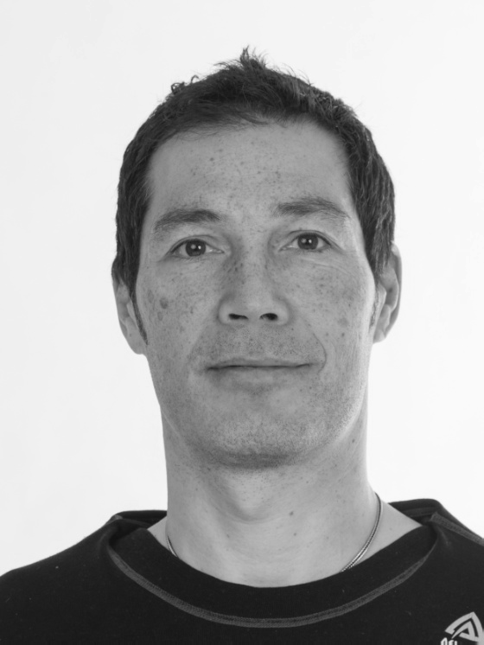

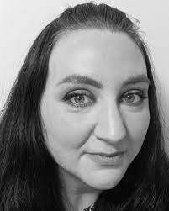
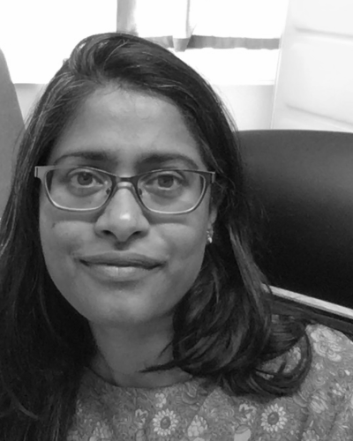
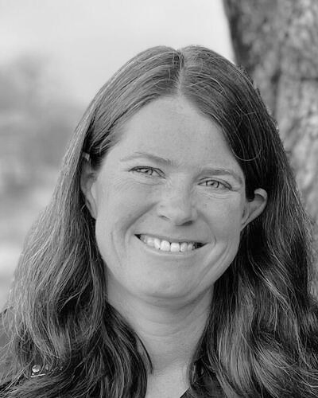
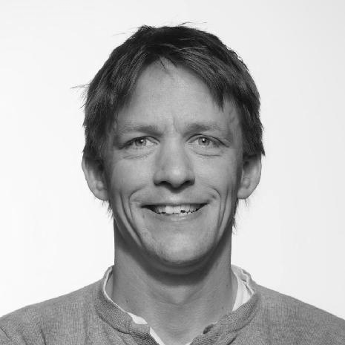

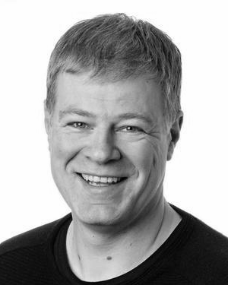
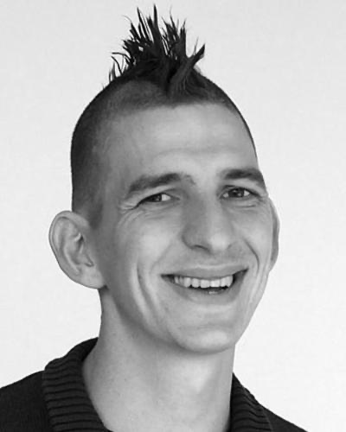
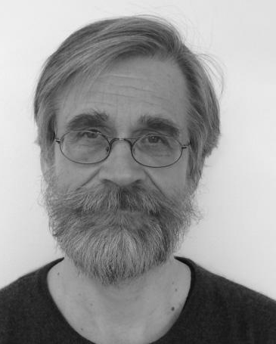
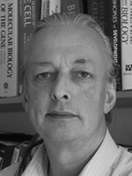
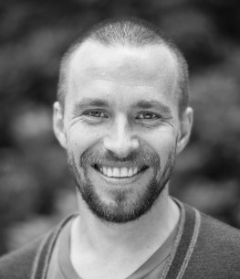
UiT node
Erik Hjerde
Node Leader
Espen Åberg
Service Coordinator
Erin Calhoon
Training Coordinator
NTNU node
Pål Sætrom
Node leader
UiB node
Sushma Grellscheid
Head of Node
Ingeborg Winge
Node coordinator
Kjell Petersen
Technical coordinator
Korbinian Bösl
Data Management
coordinator
David Dolan
Support lead
UiO node
Eivind Hovig
Rein Aasland
Node leaders
NMBU node
Simen Rød Sandve
Node leader

Slide 10
SINCE 2014
ELIXIR Structure
The Norwegian node of ELIXIR Europe
Currently funded by:
The Research Council of Norway
The involved institutions; UiB, UiO, NMBU, NTNU and UiT
Users
Services to national users
Infrastructure, support and training
National helpdesk
Deliverables to ELIXIR Europe
Tools and databases
https://elixir.no/

Slide 11






Centre for Digital Life Norway (DLN 2.0)
facilitates transdisciplinary research, innovation, and education in Life Science
Transdisciplinary collaborations
www.digitallifenorway.org
Education and career development
Responsible research and innovation
Innovation and commercialisation
Data management
Notes:
Korbinian and I are collegues in the Centre for Digital Life
DLN is an national initiative that includes the major instituations across the country. The centre aims to transform Norwegian biotechnology research and education. We offer guidance and support in the following focus areas:

Slide 12

>40 transdisciplinary biotechnology projects all over the country.
Biotechnology with digital technology: health, aquaculture, agriculture & industrial biotechnology.
Notes:
Currently, 35 projects are connected to the centre.
They all vary greatly in their research are and approaches, but share a digital biotechnology approach.

Slide 13
Join us!
Open call for Digital Life Norway project membership
contact@digitallifenorway.org
... and join the DLN Research School at any time
https://www.digitallifenorway.org/news/open-call-project-membership.html
https://www.digitallifenorway.org/research-school/membership/index.html
Notes:
Currently, 35 projects are connected to the centre.
They all vary greatly in their research are and approaches, but share a digital biotechnology approach.

Slide 14
Life cycle
RDM life cycle from RDMkit licensed under Creative Commons Attribution 4.0 International License

Slide 15
Requirements
Funder
Ethical & Legal
Project
& Domain specific
Institutional
RDM life cycle from RDMkit licensed under Creative Commons Attribution 4.0 International License

Slide 16
Requirements
Funder
Ethical & Legal
Project
& Domain specific
Institutional
RDM life cycle from RDMkit licensed under Creative Commons Attribution 4.0 International License

Slide 17


“National Strategy on access to and sharing of research data”
2017
Publicly funded research data refers to:
(i) data collected or generated for use for or as a result of publicly funded ­research, and
(ii) data underpinning publications that are the result of publicly funded ­research, regardless of the source of the data.
Basic principles:
Research data must be as open as possible, as closed as necessary.
Research data should be managed and curated to take full advantage of their potential.
Decisions concerning archiving and management of ­research data must be taken within the research community.
https://www.regjeringen.no/en/dokumenter/national-strategy-on-access-to-and-sharing-of-research-data/id2582412/
Notes:
The strategy focus on three basic principles:

Slide 18

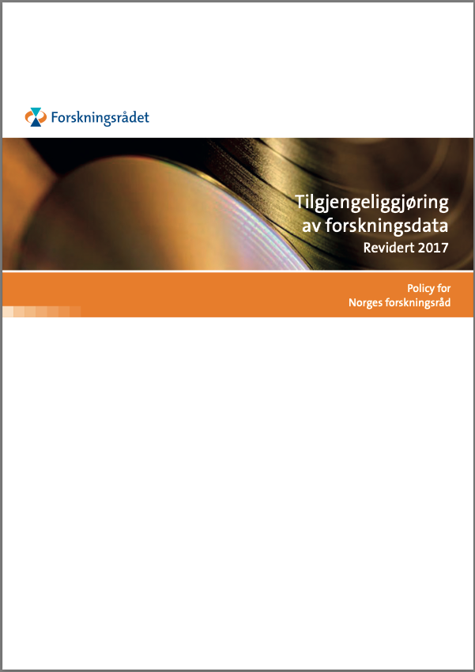
The Research Council of Norway’s Policy for Open Access to Research Data
Original 2014, updated 2017
“… requiring that R&D-performing institutions or companies should assess whether projects receiving funding from the Research Council must develop a data management plan.”
“The FAIR Guiding Principles for scientific data management and stewardship are included as a main principle in the Research Council’s policy”
https://www.forskningsradet.no/contentassets/e4cd6d2c23cf49d4989bb10c5eea087a/the-research-council-of-norways-policy-for-open-access-to-research-data.pdf
Notes:
following the new national strategy in 2017, RCN also updated their policy for open access.
Most were as before, but they also included that:
We will come back to this in a bit.

Slide 19
Research data...
… must be stored/archived in a safe and secure manner.
… must be made accessible for reuse.
… should be made accessible at an early stage [latest at publication]
… must be accompanied by standardised metadata.
… must be provided with a license for access, reuse and redistribution.
… should preferably be made accessible at no charge.
... must be described in a data management plan
https://www.forskningsradet.no/contentassets/e4cd6d2c23cf49d4989bb10c5eea087a/the-research-council-of-norways-policy-for-open-access-to-research-data.pdf
Illustrative Icons from VectorLab, Zulfahmi Al Ridhawi, Deemak Daksina & Vectorsmarket at Noun Project licensed under Creative Commons Attribution 4.0 International License
Notes:
Approved by the research-performing institution, and made available if possible.

Slide 20

Open Data
“As open as possible - as closed as necessary”

Slide 21

Illustrative Icons from VectorLab, Zulfahmi Al Ridhawi, Deemak Daksina & Vectorsmarket at Noun Project licensed under Creative Commons Attribution 4.0 International License

Slide 22
2023
Potential impact of the proposed research
The extent to which the planned outputs are openly accessible to ensure reusability of the research outputs and enhance reproducibility
FAIR, available and reusable data [software, algorithms, protocols, models, workflows, electronic notebooks, and other tools]
Early sharing through pre-registration and preprints, open access to software, workflows, tools, etc
https://www.forskningsradet.no/en/processing-grant-applications/processing-applications/assessment-open-science/
Illustrative Icons from VectorLab, Zulfahmi Al Ridhawi, Deemak Daksina & Vectorsmarket at Noun Project licensed under Creative Commons Attribution 4.0 International License

Slide 23
2023
Communication and exploitation
The extent to which the appropriate open science practices are implemented as an integral part of the proposed project to ensure open sharing and wide distribution of research outputs.
Early and open sharing (preprints or pre-registration and/or registration reports)
Full and immediate open access publication
https://www.forskningsradet.no/en/processing-grant-applications/processing-applications/assessment-open-science/
Illustrative Icons from VectorLab, Zulfahmi Al Ridhawi, Deemak Daksina & Vectorsmarket at Noun Project licensed under Creative Commons Attribution 4.0 International License

Slide 24
No full DMP required (- but helpful)
You should consider:
§§ Ethical and Legal issues
Storage and computing (budgeting?)
Budgeting for RDM-personnel & time effort
https://www.forskningsradet.no/en/research-policy-strategy/open-science/research-data/
Illustrative Icons from VectorLab, Zulfahmi Al Ridhawi, Deemak Daksina & Vectorsmarket at Noun Project licensed under Creative Commons Attribution 4.0 International License

Slide 25
§§Ethical and Legal issues
REK approval necessary (for sharing of data?)
GDPR considerations
IPR aspects
Which Research Ethical Guidelines apply for this project?
RRI
https://www.forskningsradet.no/en/research-policy-strategy/open-science/research-data/
Illustrative Icons from VectorLab, Zulfahmi Al Ridhawi, Deemak Daksina & Vectorsmarket at Noun Project licensed under Creative Commons Attribution 4.0 International License

Slide 26
Storage and Computing
Is access to computing/storage secured?
Will we have to pay for data storage (of sensitive data?)
How will data be accessed & transferred?
https://www.forskningsradet.no/en/research-policy-strategy/open-science/research-data/
Illustrative Icons from VectorLab, Zulfahmi Al Ridhawi, Deemak Daksina & Vectorsmarket at Noun Project licensed under Creative Commons Attribution 4.0 International License

Slide 27
Budgeting for RDM-personnel & time effort
Will we need help from a Data Steward (and budget for this)?
Will we need with data analysis, data warehousing or deposition?
https://www.forskningsradet.no/en/research-policy-strategy/open-science/research-data/
Illustrative Icons from VectorLab, Zulfahmi Al Ridhawi, Deemak Daksina & Vectorsmarket at Noun Project licensed under Creative Commons Attribution 4.0 International License

Slide 28
2018
When awarded funding
Full DMP required
If you decide that a data management plan is not needed, you must provide an explanation.
I don’t know of any - do you?
Even if you only reuse others data, you should describe where and how it is accessible & how your processed data can be accessed or reproduced?
https://www.forskningsradet.no/en/research-policy-strategy/open-science/research-data/
Illustrative Icons from VectorLab, Zulfahmi Al Ridhawi, Deemak Daksina & Vectorsmarket at Noun Project licensed under Creative Commons Attribution 4.0 International License

Slide 29
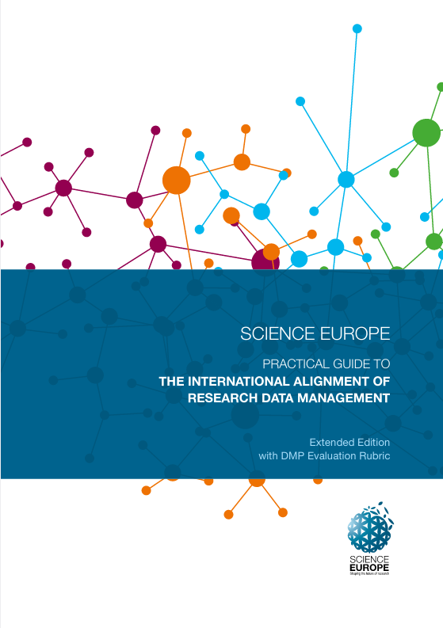
When awarded funding
Full DMP required
Documentation, formats, volume
Quality assurance including Metadata standards
Backup during project
Sharing & Preservation
Ethical and Legal aspects - including IPR
Who is responsible in the project?
To which trustworthy repository will the data be submitted?
https://www.forskningsradet.no/en/research-policy-strategy/open-science/research-data/ https://www.scienceeurope.org/our-resources/practical-guide-to-the-international-alignment-of-research-data-management/
Illustrative Icons from VectorLab, Zulfahmi Al Ridhawi, Deemak Daksina & Vectorsmarket at Noun Project licensed under Creative Commons Attribution 4.0 International License

Slide 30
When awarded funding
Full DMP required
The Research Council of Norway does not assess the content of submitted plans. It is the responsibility of the Project Owner to approve that the plan is in line with the institution's requirements and guidelines before it is submitted.
https://www.forskningsradet.no/en/research-policy-strategy/open-science/research-data/ https://www.scienceeurope.org/our-resources/practical-guide-to-the-international-alignment-of-research-data-management/
Illustrative Icons from VectorLab, Zulfahmi Al Ridhawi, Deemak Daksina & Vectorsmarket at Noun Project licensed under Creative Commons Attribution 4.0 International License

Slide 31


Full DMP required
Data management plans are to be made public and openly accessible.
Different possibilities:
https://www.forskningsradet.no/en/research-policy-strategy/open-science/research-data/ https://www.scienceeurope.org/our-resources/practical-guide-to-the-international-alignment-of-research-data-management/
Illustrative Icons from VectorLab, Zulfahmi Al Ridhawi, Deemak Daksina & Vectorsmarket at Noun Project licensed under Creative Commons Attribution 4.0 International License

Slide 32
DMP is constantly updated
Changes do not have to reported to RCN
Early deposition & sharing
https://www.forskningsradet.no/en/research-policy-strategy/open-science/research-data/ https://www.scienceeurope.org/our-resources/practical-guide-to-the-international-alignment-of-research-data-management/
Illustrative Icons from VectorLab, Zulfahmi Al Ridhawi, Deemak Daksina & Vectorsmarket at Noun Project licensed under Creative Commons Attribution 4.0 International License

Slide 33
Final version of the data management plan in connection with the final report of the project.
Data is deposited to trustworthy repository
https://www.forskningsradet.no/en/research-policy-strategy/open-science/research-data/ https://www.scienceeurope.org/our-resources/practical-guide-to-the-international-alignment-of-research-data-management/
Illustrative Icons from VectorLab, Zulfahmi Al Ridhawi, Deemak Daksina & Vectorsmarket at Noun Project licensed under Creative Commons Attribution 4.0 International License

Slide 34
A user-oriented guide to the FAIR RDM practices in life sciences
increase
self-sufficiency
support researchers to know and utilise RDM services
build capacity and skills in every research institute
pool the expertise of the community for the community
To support the data needs of Europe’s estimated 500,000 life scientists
https://rdmkit.elixir-europe.org
Notes:
Bridge the gap between ELIXIR and real researcher/data stewards in projects in our countries and nodes.

Slide 35
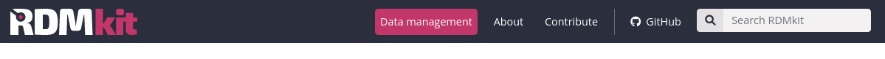
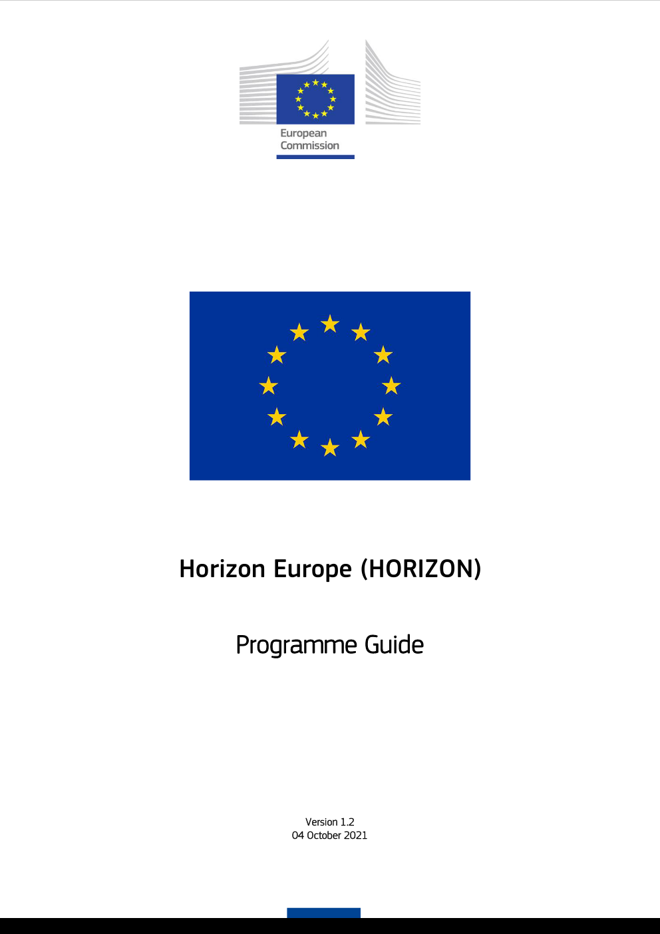
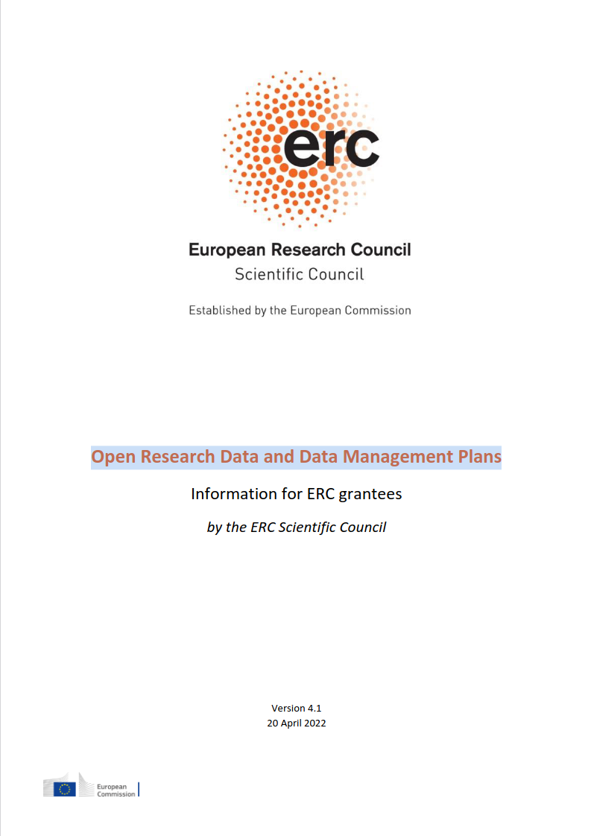
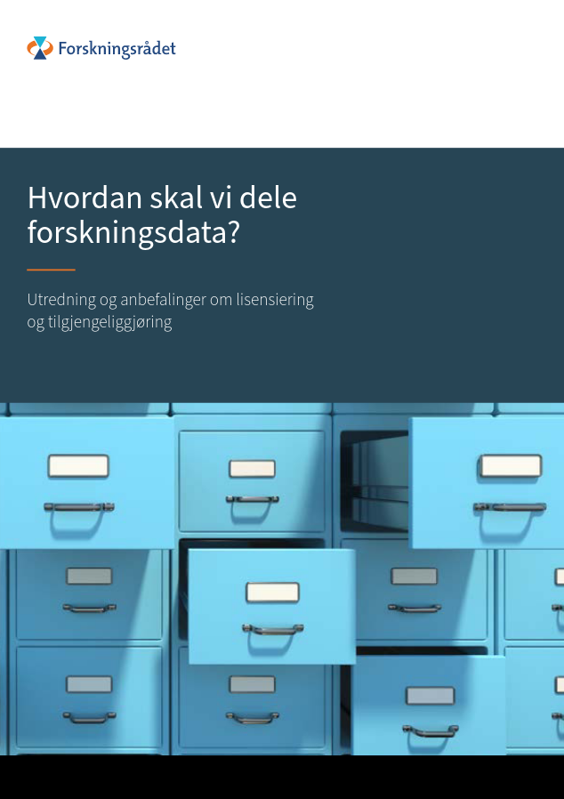

Recommended by:
EC: Horizon Europe Program Guide
ERC: Research Data and Data Management Plans
Research Council of Norway

Slide 36


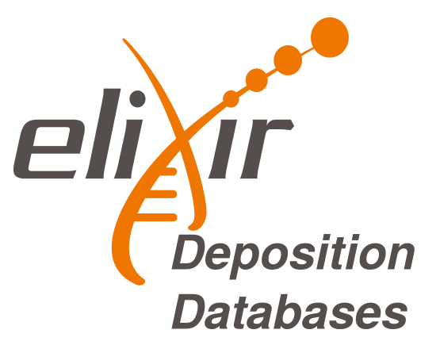



Norwegian RDM tool assembly
featured in:
Illustrative Icons from VectorLab, Zulfahmi Al Ridhawi, Deemak Daksina & Vectorsmarket at Noun Project licensed under Creative Commons Attribution 4.0 International License

Slide 37






For sensitive data
featured in:
ELSI
HuntCloud

Slide 38

Please contact us!
Horizon Europe
Open Science (OA, RDM, citizens engagement etc.) embedded throughout HE
14. Dissemination and exploitation of research results &
16. Open science
  “Open science practices are addressed and evaluated under ‘excellence’ as they are considered a part of the methodology.”
  “Data management plans are mandatory for all projects generating or reusing data and should be aligned with the D&E plan.”
https://ec.europa.eu/info/funding-tenders/opportunities/docs/2021-2027/horizon/guidance/programme-guide_horizon_en.pdf
https://ec.europa.eu/info/funding-tenders/opportunities/docs/2021-2027/common/agr-contr/general-mga_horizon-euratom_en.pdf
Notes:
We can also look to the international requirements, like from Horizon Europe program
As part of the European Commission’s goal to advance Open Science policy and practices – it is a mandatory component in Horizon Europe that all projects involving data include a DMP. Practically speaking, an initial DMP should be presented in the proposal. Later on, funded projects are required to provide a detailed DMP as a mandatory deliverable within 6 months from the grant signature date.

Slide 39
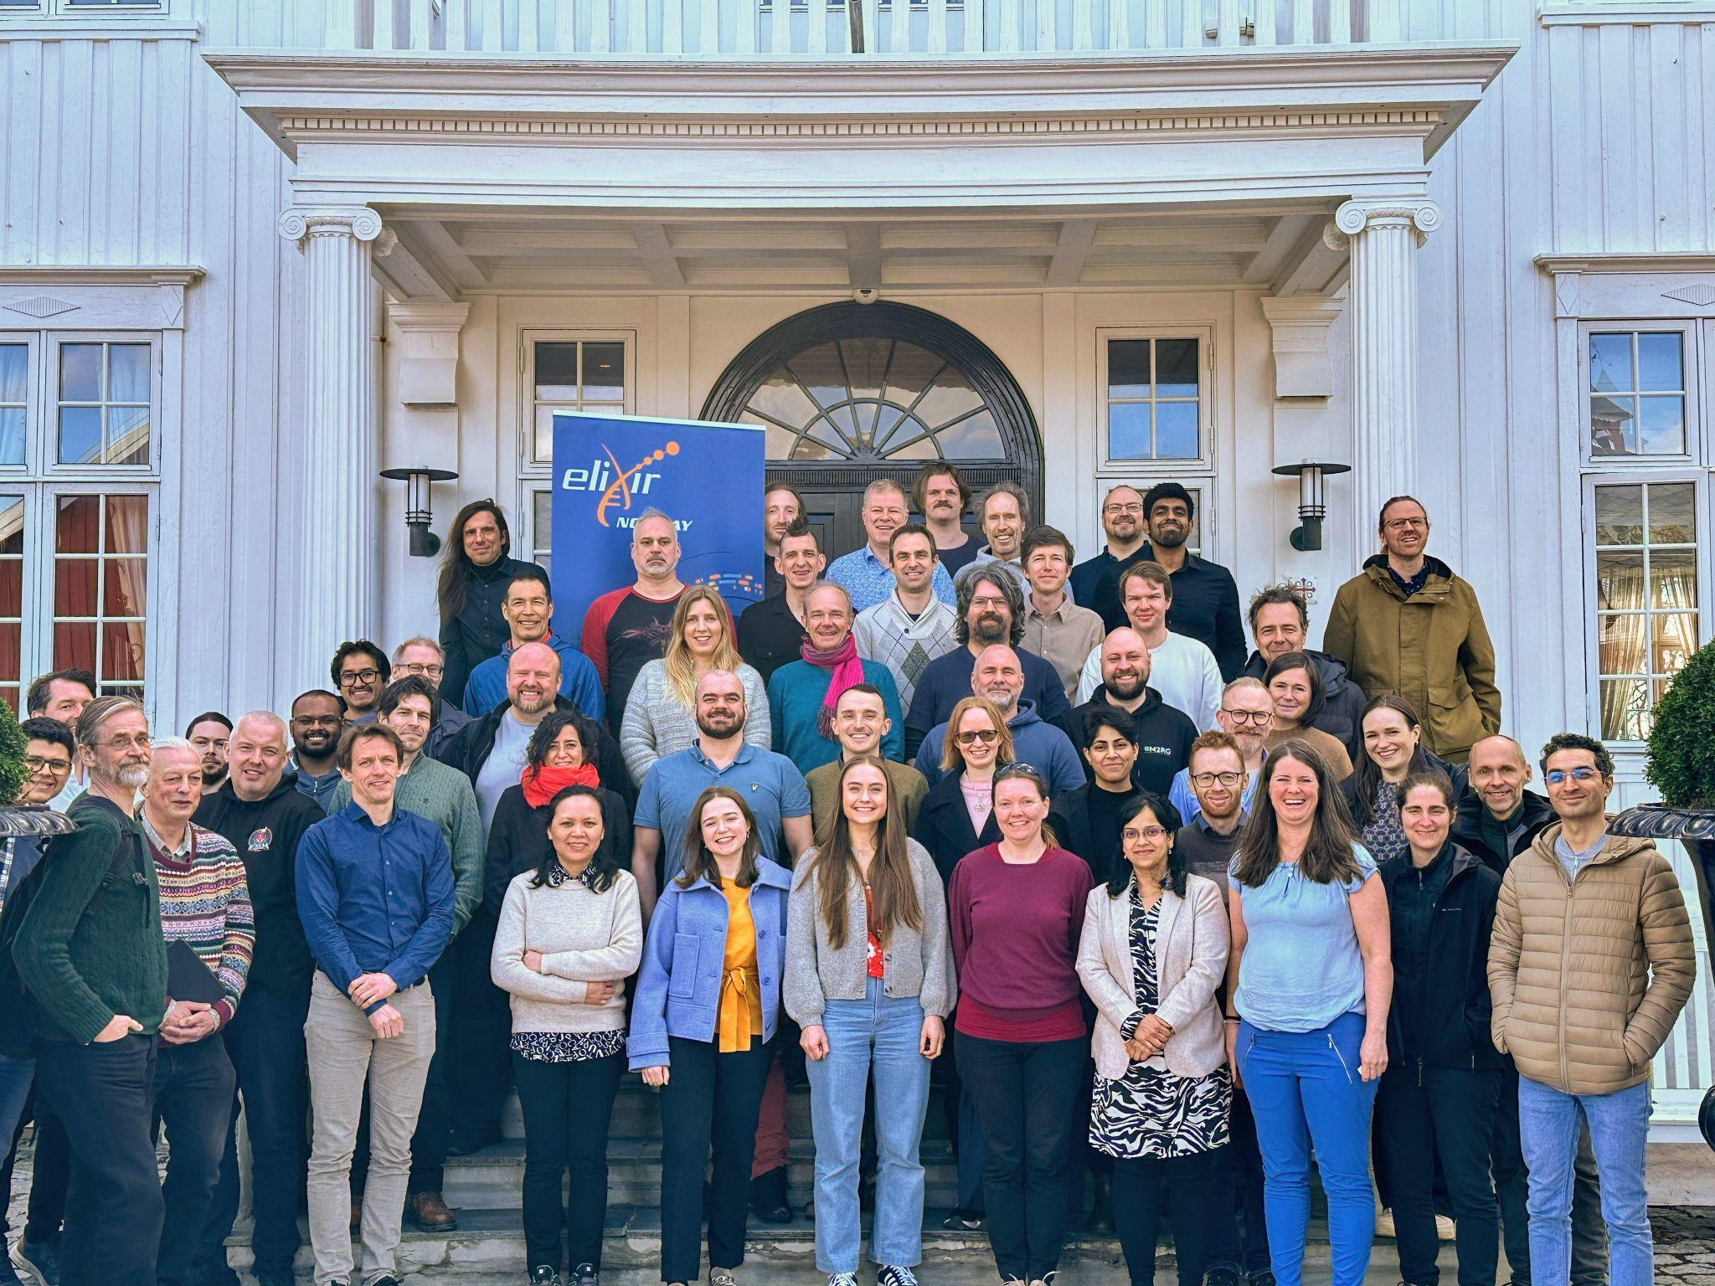










Joint effort across 5 institutions
More than 50 people involved:
Software developers
Bioinformaticians
Coordinators
Researchers
elixir.no contact@elixir.no
elixir-norway
@elixirnorway

