Slide 1
National storage infrastructures
NeLS/StoreBioInfo, NIRD, TSD
David Dolan
Research Support Lead
ELIXIR Norway

Slide 2






Data storage – from the researcher perspective
DATA
DATA STORAGE
EXPERIMENT
DATA DEPOSITION
METADATA
DATA ANALYSIS

Slide 3
Data storage – from the researcher perspective
DATA
DATA STORAGE
EXPERIMENT
DATA DEPOSITION
METADATA
DATA ANALYSIS

Slide 4
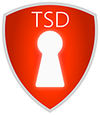



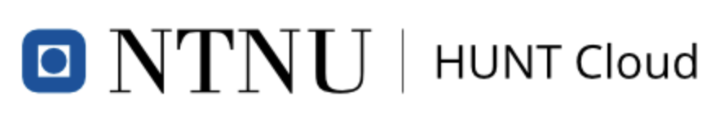
National storage infrastructures
Non-sensitive data
Sensitive data
DATA STORAGE
DATA ANALYSIS

Slide 5
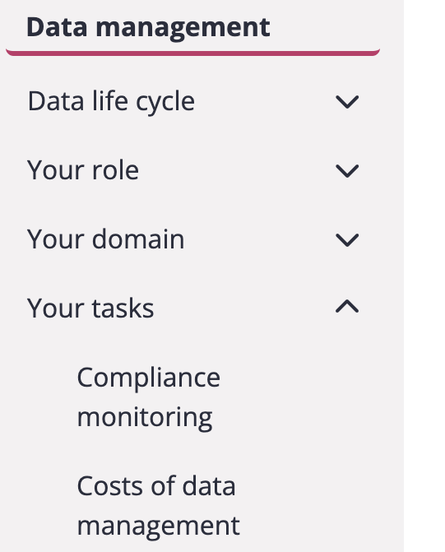
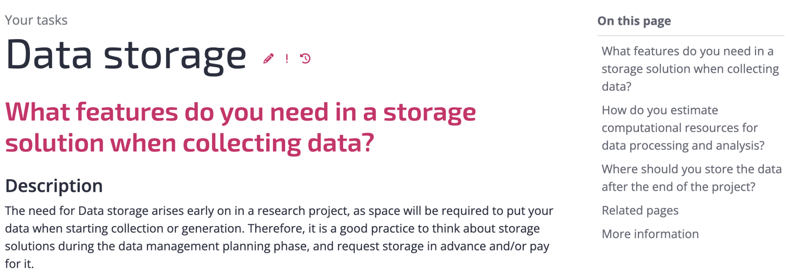


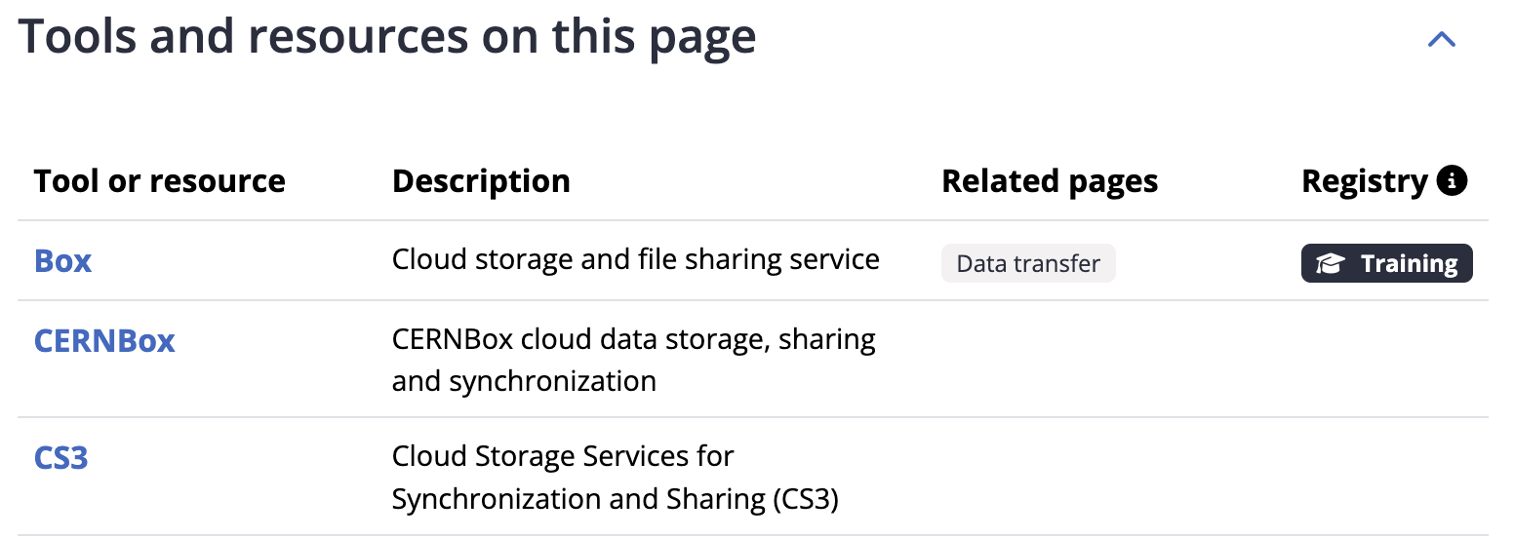
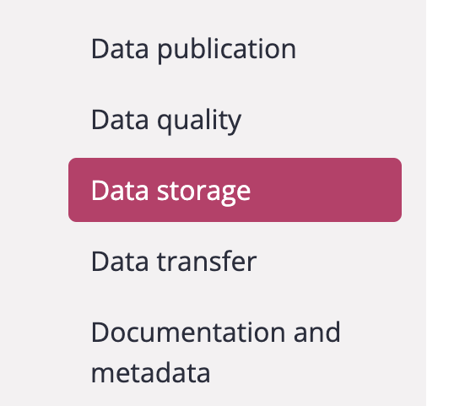
Data storage – General considerations
The ELIXIR Research Data Management kit
Link to RDMkit: https://rdmkit.elixir-europe.org/

Slide 6
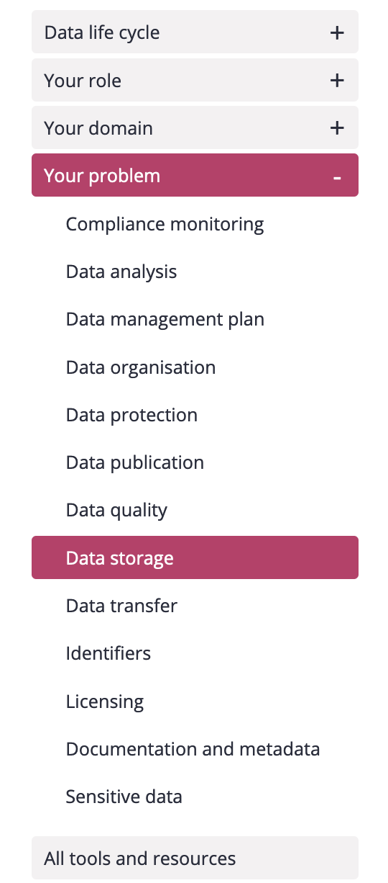
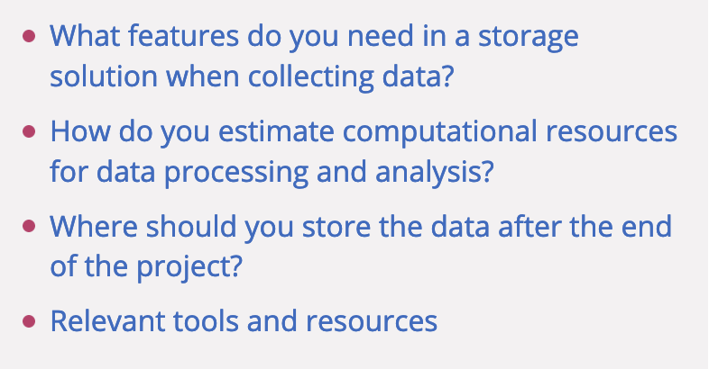
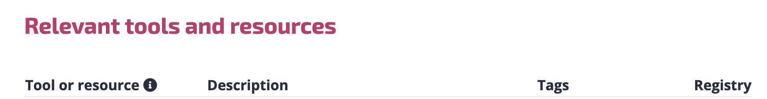
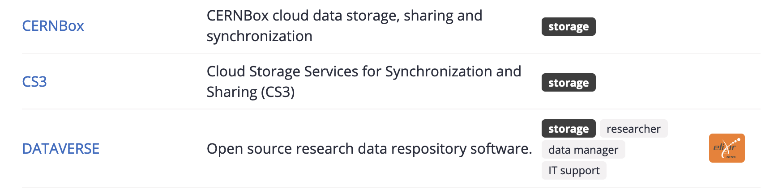
Data storage – General considerations
The ELIXIR Research Data Management kit
Link to RDMkit: https://rdmkit.elixir-europe.org/

Slide 7
Data storage – from the researcher perspective
DATA
DATA STORAGE
EXPERIMENT
DATA DEPOSITION
METADATA
DATA ANALYSIS

Slide 8
Data storage in NeLS and StoreBioInfo (SBI)
Norwegian e-infrastructure for Life Sciences - developed and operated by Elixir Norway
NeLS in general
Available to all Norwegian researchers
Enable collaborative projects
Multiple storage layers
Integrated with compute
Multiple permission roles - shared data
Free of charge*
Support for data deposition
User support: Elixir Norway helpdesk
Type of data
Non-sensitive data
Support multiple data types
SEEK integration for metadata
NeLS
DATA
DATA STORAGE
DATA DEPOSITION
METADATA
DATA ANALYSIS

Slide 9
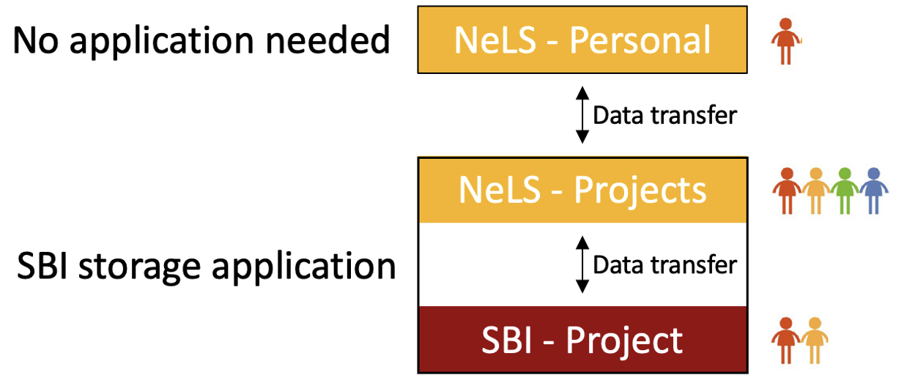
Data storage in NeLS/SBI – How to get access
Storage application needed for projects where data is shared by many users
Access via FEIDE user or NeLS idp can be made for non-FEIDE users
Free storage < 10 TB
Apply for storage: support@elixir.no
Wiki for usage: https://nels-docs.readthedocs.io/en/latest/

Slide 10
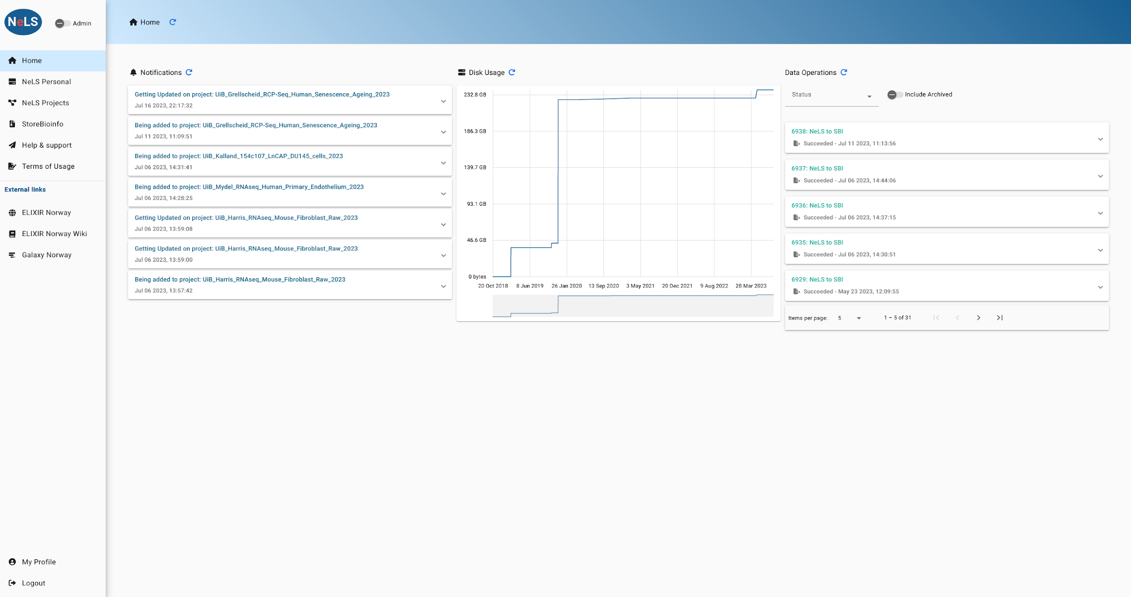
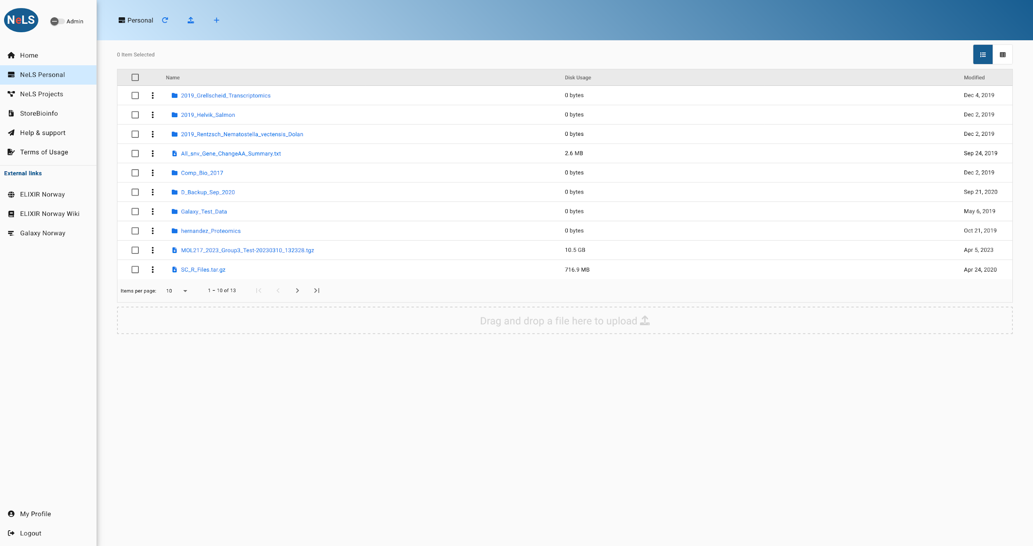
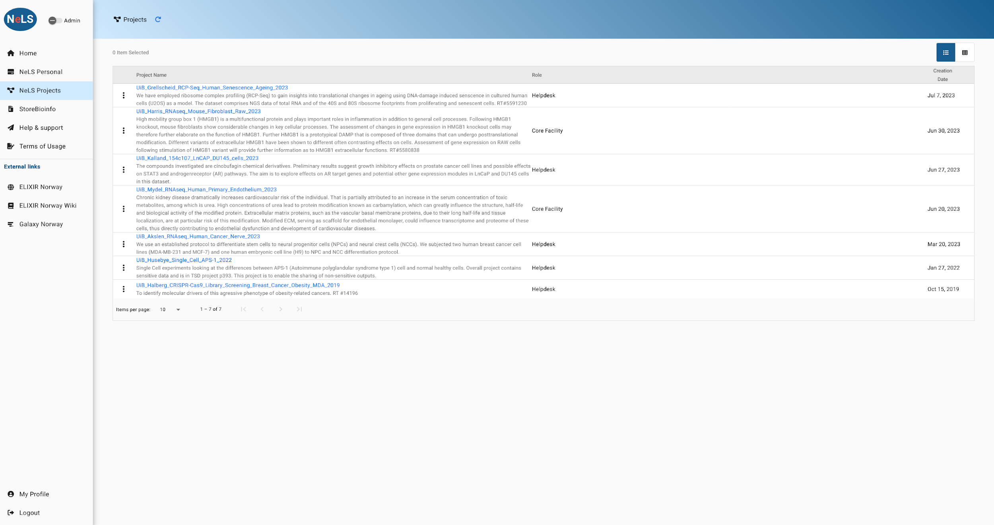
Access data storage in NeLS
The NeLS portal can be accessed via a web browser at https://nels.bioinfo.no/ or via a file transfer tool (e.g. Filezilla) or the command line SCP

Slide 11
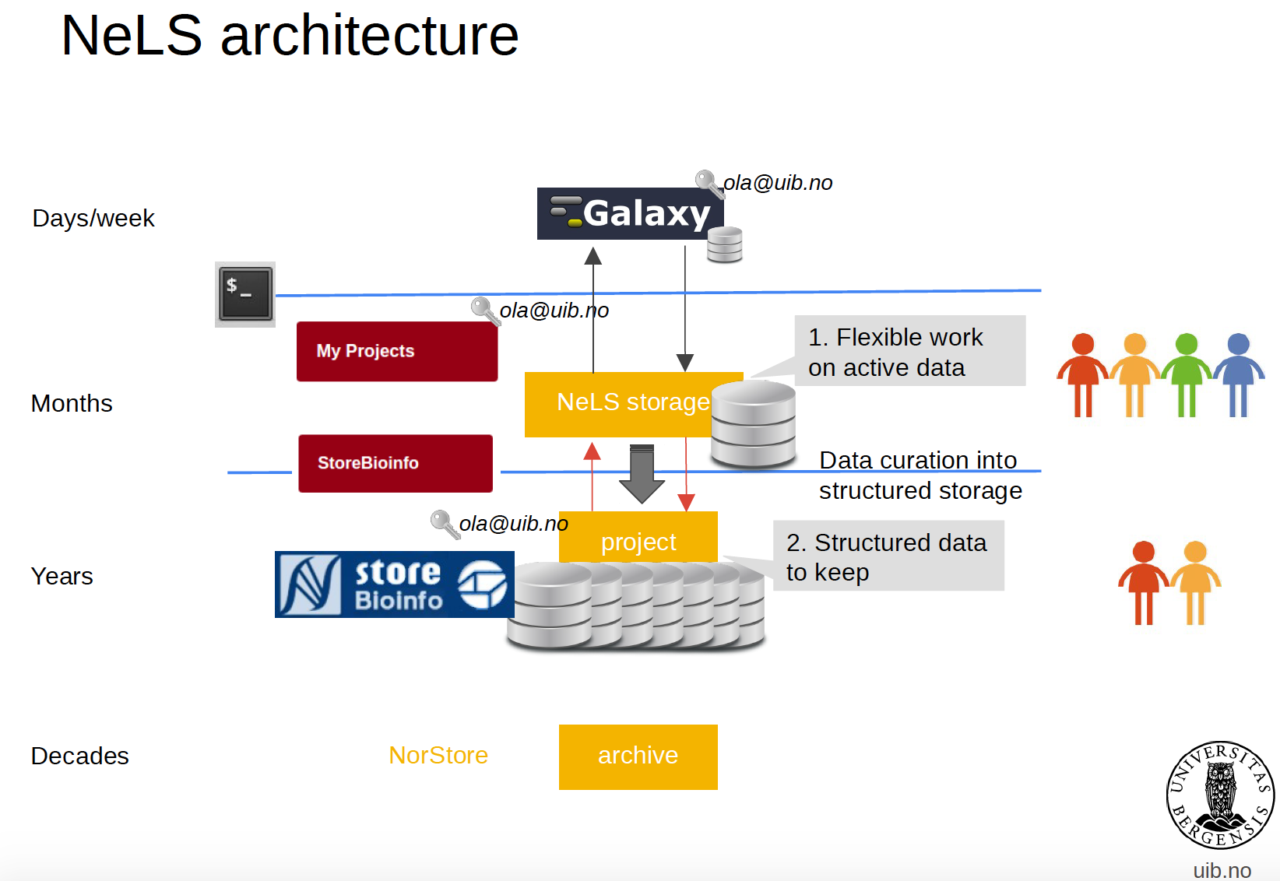






NeLS architecture
Research data archive

Slide 12



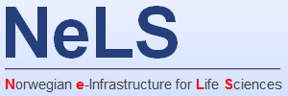
SEEK - sharing heterogeneous scientific research datasets, models or simulations, processes and research outcomes
The SEEK platform is a web-based tool for organising and storing data, and for exploring and annotating data
Norwegian users can link datasets stored in NeLS to a SEEK project using FAIRdom hub
Integrated
Datasets
eg. FASTQ fiiles
Metadata
(and datasets)
Notes:
Typically, organise the project with associated metadata (e.g. how sequencing libraries were prepared) in SEEK
Link datasets stored in NeLS to the SEEK project

Slide 13
Data storage in NIRD
National e-Infrastructure for Research Data - owned and operated by UNINETT Sigma2
NIRD in general
Available to all users with account
Enable collaborative projects
Integrated with compute
Multiple permission roles - shared data
Free of charge*
User support: Metacenter support
Type of data
Non-sensitive data
Support multiple data types
All type of scientific data*
NIRD
DATA STORAGE
DATA ANALYSIS
Notes:
Available to any scientific discipline

Slide 14
Data storage in NIRD – How to get access
Apply for a UNINETT SIGMA2 user.
Apply for a storage quota:
Category A: Non-commercial projects with resources allocated through the Resource Allocation Committee (RFK) must contribute to the operational expenses of the service. This category should be used in applications to the Norwegian Research Council and other funders, except the EU.
Category B: Non-commercial projects in need of Dedicated Resources, paying for capital and operational expenses.
Category C: Commercial research and industry which will pay market price.
Category D: For applications to the EU, as in-kind value.
Category 0: Smaller projects using less than 200 000 CPU core hours pr. year or using less than 7 TB storage pr. year. If any organisation outside BOTT has an aggregated use for smaller projects with a value of more than 50 000 NOK, the organisation needs to contribute given 6 months’ notice, for further future use of the infrastructure.
Apply for user account: https://www.metacenter.no/user/application/
Apply for storage: https://www.sigma2.no/apply-e-infrastructure-resources
Wiki for usage: https://documentation.sigma2.no/index.html
Contribution model: https://www.sigma2.no/user-contribution-model

Slide 15
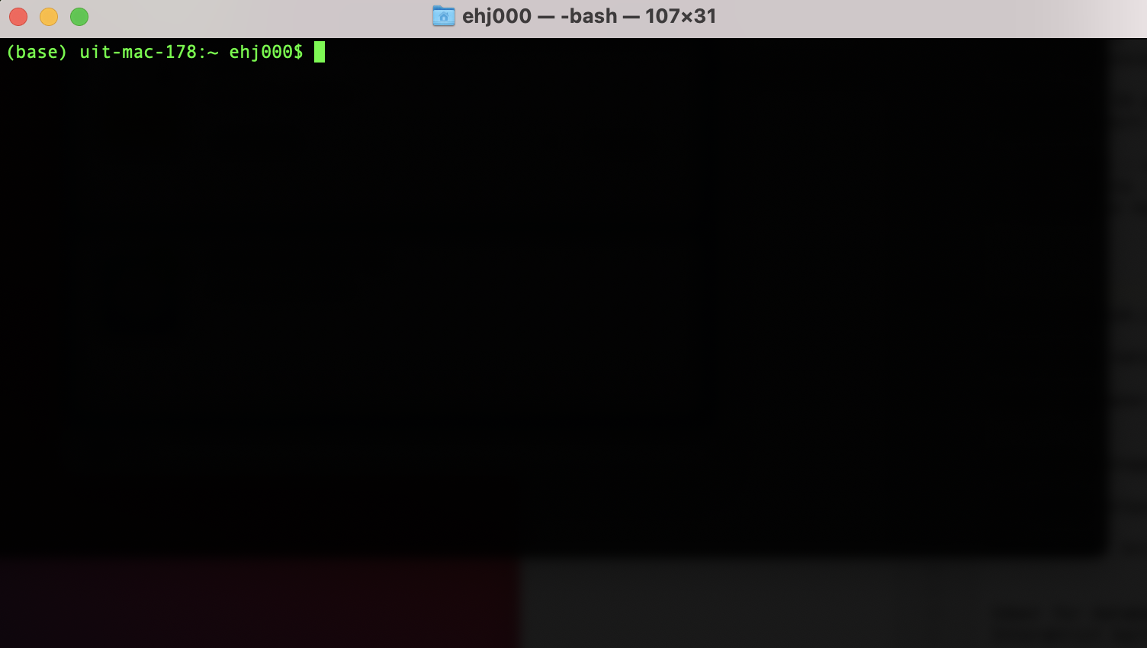
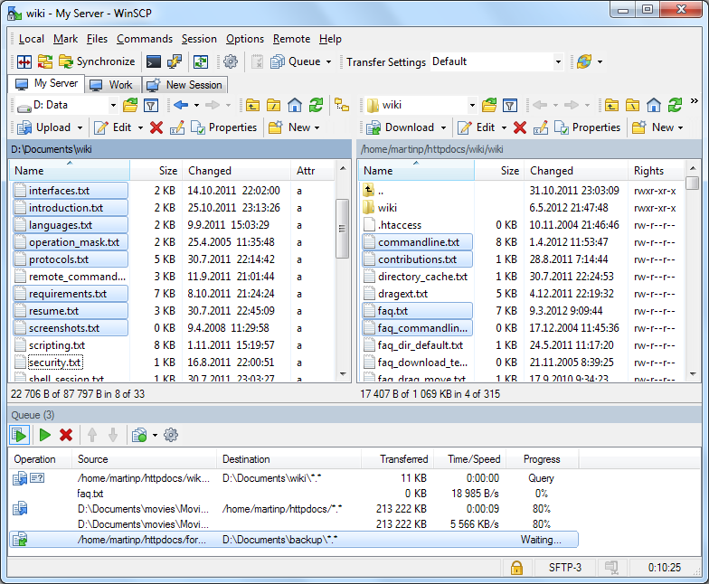
Access data storage in NIRD
The NIRD storage can be accessed via the command line using SSH
Data import/export via command line tools such as SCP or SFTP or other file transfer tools (e.g. WinSCP)

Slide 16
Sensitive data storage
Non-sensitive data
Sensitive data
DATA STORAGE

Slide 17
Data storage in TSD
National service for sensitive data - developed and operated by UiO
TSD in general
Available to all users with account
Enable collaborative projects
Integrated with compute
Multiple permission roles - shared data
User support: Tech and admin support
Type of data
Sensitive data
Support multiple data types
DATA STORAGE
DATA ANALYSIS
Notes:
Available to any scientific discipline

Slide 18
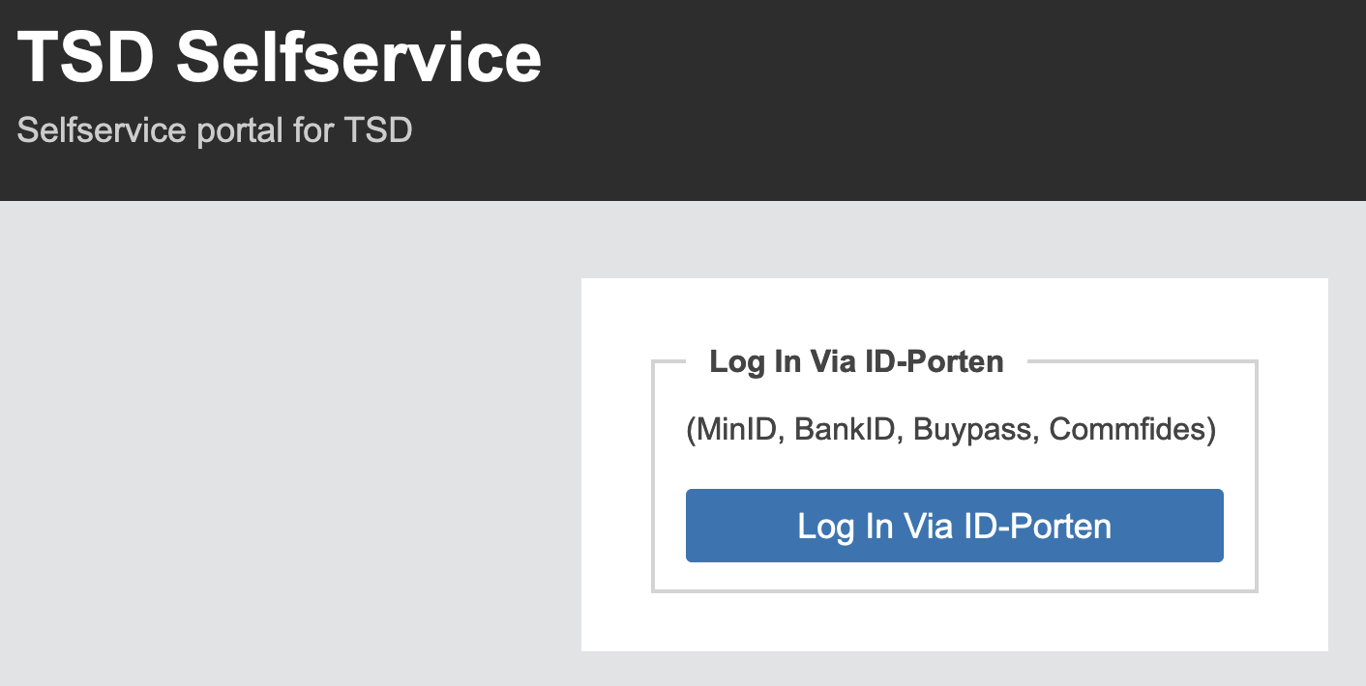
Data storage in TSD – How to get access
Apply for a project – need to document ethical approval (e.g. from REC)
Generate a TSD user – require 2-factor authentication
Payment models for storage
Apply for a TSD project through ELIXIR.NO:
ELIXIR Norway has a quota in TSD that, and users can get subsidised quota through ELIXIR in TSD
Generate user account: https://selfservice.tsd.usit.no/
Apply for project: https://www.uio.no/tjenester/it/forskning/sensitiv/hjelp/start/registrer.html
Wiki for usage: https://www.uio.no/tjenester/it/forskning/sensitiv/hjelp/start/index.html

Slide 19
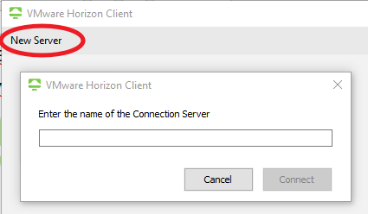
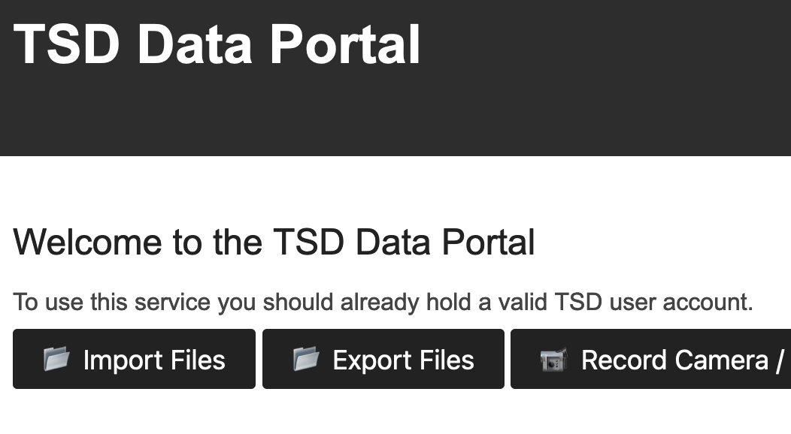
Access to data storage in TSD
The TSD storage can be accessed via VMware Horizon + 2-factor authentication
Import/export data via the web file upload service

Slide 20


Where should I store and share my life science data?
 | Sensitive data | Direct transfer from data producer | Web portal access* | Command line access | Shared projects | Integration for metadata | Support for data deposition | Free of charge
NeLS/SBI
NIRD
TSD
*Direct access to the data and project management through the web browser

Slide 21


Example - Data flow/handle using ELIXIR Norway
DATA
DATA STORAGE
EXPERIMENT
DATA DEPOSITION
METADATA
DATA ANALYSIS

Slide 22

Thank you!
elixir-norway.org
support@elixir.no
@elixirnorway
Except where otherwise noted, this work is licensed under a
Creative Commons Attribution 4.0 International License
https://creativecommons.org/licenses/by/4.0/

