Slide 1

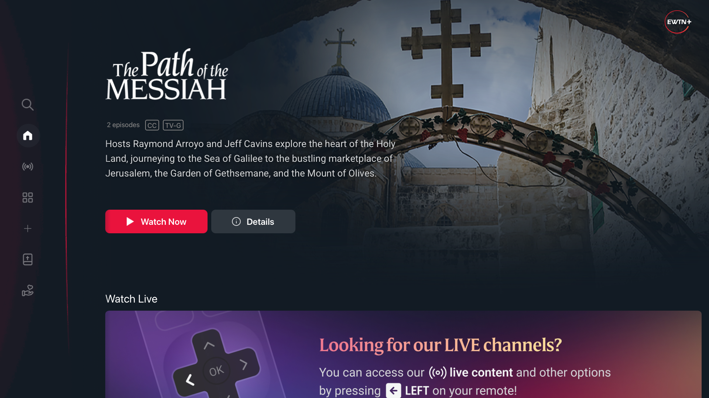
A streaming app for three platforms with a single codebase
EWTN+ for TV
How we built it with React Native, what problems we ran into, and how we solved them.
Stores
Devices
Timeline
Apple App Store · Google Play · Amazon Appstore
Apple TV · Android TV / Google TV · Fire TV
July 2025 to January 2026
Zaelot · EWTN+ for TV
01 / 13

Slide 2

CONTEXT
TV hardware limitations
On TV it is React, and it looks like a normal app. The machine underneath is not.
Low RAM
Slower CPUs
1 or 2 GB
More limited GPU capabilities
Constrained storage
Network handling
Isn't always reliable
Zaelot · EWTN+ for TV
02 / 13

Slide 3
01 · THE CLIENT
EWTN: a global Catholic media network
Television, radio, news and digital platforms.
What EWTN+ ships
At a glance
Global live multi-lingual channels, 24/7
Multi-lingual on-demand catalog
The Bible
Profiles
Program guide (EPG)
Search
Donation
Rollout
English and Spanish. US only in the first stage, then worldwide.
Previous app
A legacy TV app with fewer features, rebuilt from scratch.
Destinations
Apple App Store (tvOS) · Google Play (Android TV / Google TV) · Amazon Appstore (Fire TV)
Zaelot · EWTN+ for TV
03 / 13

Slide 4
02
The bet
A single codebase: the bright side
Zaelot · EWTN+ for TV
04 / 13

Slide 5
One codebase, three platforms
React Native on the react-native-tvos fork, plus Expo, in TypeScript. The same code produces every artifact the three stores accept, and Expo Application Services runs the builds and the submissions in the cloud.
.ipa
Apple App Store
production
tvOS, via TestFlight
One codebase
EAS Build
Google Play
.aab
React Native tvOS + Expo, TypeScript
Cloud builds and store submissions
production
Android TV, Google TV
.aab / .apk
Amazon Appstore
amazon-production
Fire TV, Amazon variant
Zaelot · EWTN+ for TV
05 / 13

Slide 6
03 · CHALLENGES
Where the cost went
Focus handling
No mouse or touch screen. The remote's D-pad drives focus, and each OS's native engine decides where it lands.
1
Screen readers
VoiceOver, TalkBack and VoiceView increase the test matrix and fail in opposite ways.
2
A single codebase for three platforms
tvOS, Android Amazon devices and Android Google devices differ.
3
Poor documentation
Far less material on TV apps than on mobile or web, on top of a fork that is little known.
4
Emulators vs physical devices
Focus, accessibility and performance behave differently on real hardware.
5
Zaelot · EWTN+ for TV
06 / 13

Slide 7
Challenge 1
Focus handling
On TV there is no mouse or touch screen: focus moves with the remote's D-pad, and the native engine decides where it goes from the layout's geometry.
Recurring symptoms
How we handled it
Focus escaping to the side menu during transitions
Focus lost after asynchronous loads
Initial focus on the wrong element
Overlapping elements
Custom reusable solutions (hooks and wrappers)
Preventing focus on the side menu during navigation
The decision: trust the native engine, supported by react-native-tvos APIs.
Zaelot · EWTN+ for TV
07 / 13

Slide 8
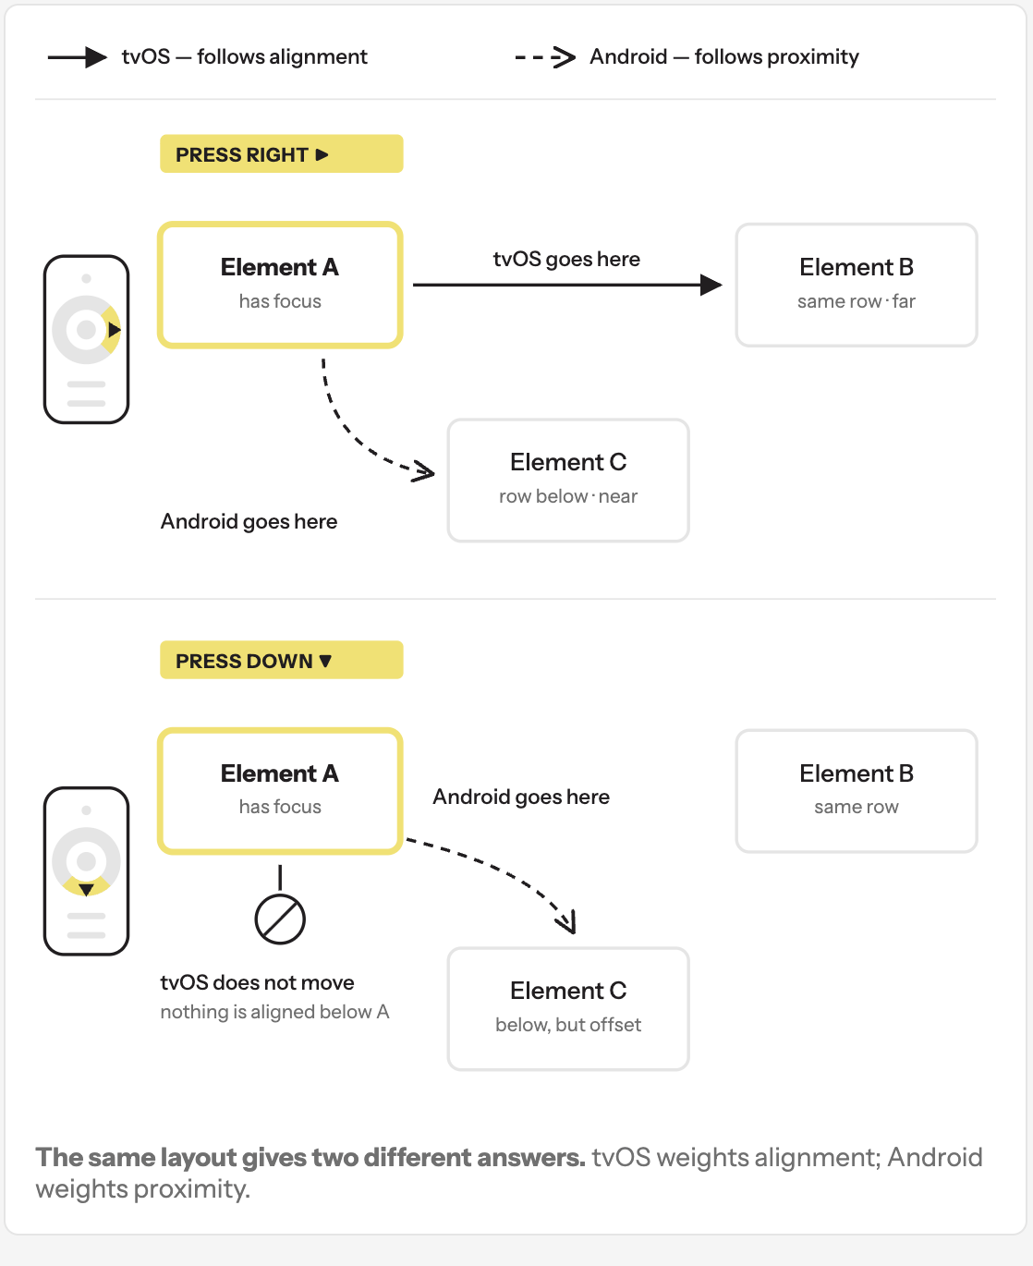
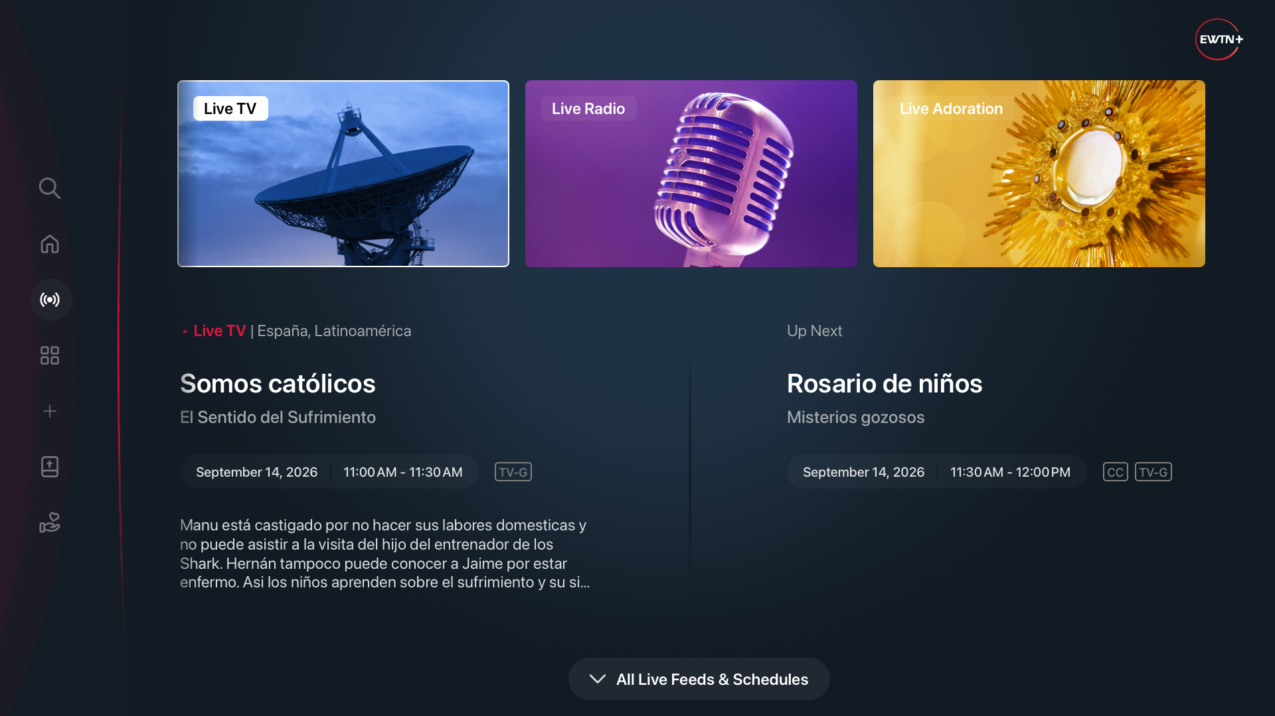
Zaelot · EWTN+ for TV
08 / 13

Slide 9
Challenge 2
Screen readers
~1%
of traffic — and still a big part of the work, because the client asks for a strong emphasis on accessibility.
Focus differentiation
Recurring symptoms
How we handled it
On TV, accessibility-focus differs from interaction focus. The reader announces the element with accessibility-focus.The two platforms fail in opposite ways.
Elements not targeted by accessibility-focus
Announced element not matching the focused one
Announcements cut off when the UI updates
Nothing announced on programmatic focus moves
An AccessibleContainer wrapper, reused everywhere
Every focus request paired with an accessibility-focus request
PR policy: evidence videos with the reader on and off
Explicit announcements on complex views
Why it matters
Nonprofits that are public accommodations or take federal funding are expected to meet the Americans with Disabilities Act, or face litigation.
Zaelot · EWTN+ for TV
09 / 13

Slide 10
Challenge 3
One codebase, three behaviors
Aspect | tvOS (Apple TV) | Android TV / Google TV | Fire TV
Focus engine | Infers targets by position and alignment. Diagonals and swipe supported. | Closest element in the pressed direction. No diagonals. | Same as Android
Event order | Blur of the previous element, then focus of the new one. | Focus of the new element before blur of the previous one. | Same as Android
Screen reader | VoiceOver cannot land on a Text component. | TalkBack lands on a Text component. | VoiceView: similar to Android
Video player | react-native-video does not report bitrate changes. | react-native-video reports bitrate changes. | Same as Android
Divergences between the applications are isolated in defensive config plugins: they inject native code without keeping ios / android folders around.
Zaelot · EWTN+ for TV
10 / 13

Slide 11
The bet, weighed
Fixing one platform was prone to breaking another — and the codebase can fill up with platform conditionals if nobody watches it.
Advantages
Disadvantages
One codebase and a single UI for three stores.
Expo Router for navigation, EAS for builds and submissions: no local Xcode or Gradle.
Usable React Native ecosystem (player, state, validation), fast iteration with hot reload.
The whole team had prior React experience.
Room to reuse business logic for the future mobile app.
The fork lags behind React Native and Expo. TV support is fragile.
Scarce documentation.
The native focus engine forces platform conditionals throughout the UI.
Complex end-to-end testing.
Zaelot · EWTN+ for TV
11 / 13

Slide 12
CHALLENGES 4 AND 5
Documentation and devices
Lack of documentation
Emulators vs physical devices
react-native-tvos is a fork maintained by few people, with scarce documentation — and far less material on TV apps, and on TV accessibility, than on mobile or web.
Focus, accessibility and performance behave differently on real hardware.
AI tools did not contribute much at first
They became useful once a solid base of custom solutions existed to use as reference
Apple TV's VoiceOver can only be tested on a physical device
Fire TV has no official emulator: testing runs over adb against physical sticks
Focus timing and the system keyboard differ between the Android TV emulator and a real Google TV
D-pad lag and screen-transition delays only show up on hardware
Zaelot · EWTN+ for TV
12 / 13

Slide 13
04 · Closing
What to take home
The assessment is still positive: the app is in production, in three stores, built by a small team.
01
One app, three stores, a small team.
The bet works, with the cost concentrated in focus and accessibility.
02
The native focus engine and screen readers are the real TV problem.
The rest is conventional React Native development.
03
What upstream does not document, the team documents.
In code and in guides.
04
End-to-end testing with Suitest.
To catch any kind of instability in time.
Zaelot · EWTN+ for TV
13 / 13

