Slide 1
GIT Tutorial

Slide 2
Cygwin/Gitbash & Git
Command line strongly recommended

Slide 3
Design Goals
Speed
Simple design
Strong support for non-linear development (thousands of parallel branches)
Fully distributed
Able to handle large projects like the Linux kernel efficiently (speed and data size)

Slide 4
A real distributed system
John
Andy
John
Andy
Local
Repo
Local
Repo
Central Repo
Central
Repo
Jack
Local
Repo
Conventional VCS
Jack
GIT

Slide 5
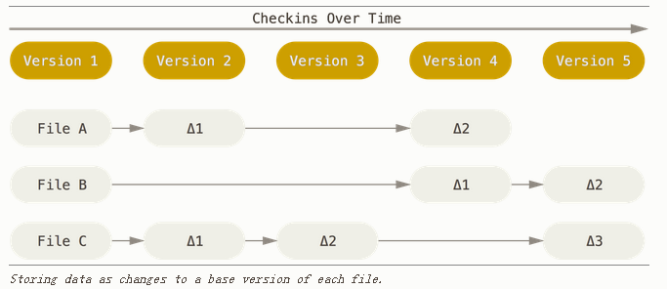
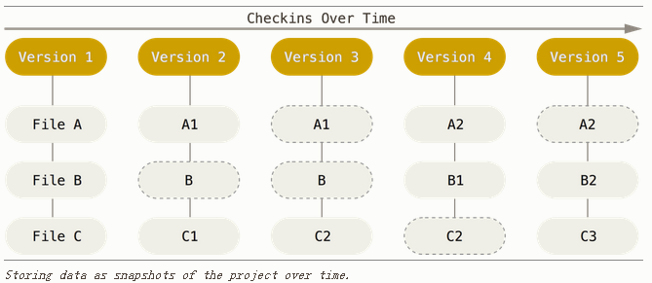

Data model
Other VCS
GIT
Integrity – SHA-1

Slide 6
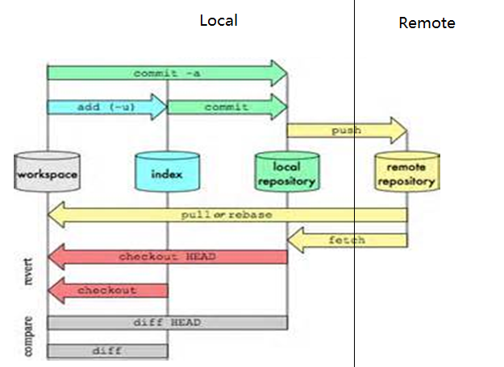
Three-step check-in
To stage area
git add
To local repo
git commit
To remote repo
git push

Slide 7
Normal work flow
Remote repo
A
B
C
1. git clone
Local repo
A
D
E
2. git add
3. git commit
Remote repo
A
B
C
D
E
5. git push
Local repo
A
B
C
D
E
4. git rebase

Slide 8
Gerrit review and submit
Central
Repo
submit
gerrit
push
Pending changes
review
approve

Slide 9
Commands
git add : add to stage
git reset HEAD -- <filename> : remove from stage
git status
git diff : compare against files in local repo
git diff --cached : compare against staged files
git diff <commit1>..<commit2>
git diff HEAD^
git diff HEAD~3
git commit : commit to local repo
git commit --amend
git commit -a
git rebase <branch> : rebase on top of <branch>
git push
“git push origin HEAD:refs/for/master” : push to gerrit for review
“git push origin HEAD:<remote branch> “: push current local branch to remote branch on origin.
“git push origin :<remote branch>” : delete remote branch

Slide 10
Branch and Merge
Remote repo
A
B
C
git clone
git pull
master
A
B
C
Local repo
git checkout –t origin –b topic
topic
A
D
E
Remote repo
A
B
C
git merge topic
master
A
B
C
D
E
Local repo
topic
A
B
C
D
E
git rebase master

Slide 11
Commands
git checkout –t <remote> -b <branch> : create a branch that tracks a remote branch
git checkout <branch> : switch branch
git branch : show branches
git branch –D <branch>: delete branch
git remote : list remote branches
git remote show <branch name> : show details
git fetch : sync meta info with remote, does not really update code.
git pull : merge remote branch, only use it to pull fast-forward changes
git fetch + git merge
git merge : only use it to merge fast-forward changes
git rebase + git merge : this is the way to merge cleanly

Slide 12
Release flow
Release
A
…
X
Remote repo
master
A
B
C
master
A
B
C
X
Local repo
git cherry-pick
topic
…
X

Slide 13
Config
.gitignore
.gitconfig
Aliases
Editor
Git diff
.git/hooks/pre-commit

Slide 14
MISC Commands
Find out who touched which lines
git blame
Save changes temporarily
git stash
git stash list
git stash pop
Remote
git remote
git remote show origin
Push a branch to a remote branch: git push origin HEAD:<branch name>
Delete a remote branch: git push origin :<branch name>
Reset
Unstage file: git reset HEAD --
Reset all changes: git reset --hard HEAD
Show changes
git show <commit>
git show –name-status <commit>
Show history
git log
Patch
git format-patch --stdout
git apply

Slide 15
How to migrate your dev branch?
Get a local copy of your tfs dev branch
Get a mainline repo: git clone
Create a branch
git checkout -b <name> -t origin
Copy all files in your tfs dev directory to git repo
Check modified files
git status
git diff
Make changes as needed
Commit modified files
git add
git commit
Push to gerrit, review and submit

Slide 16
Resources
Git pro: http://www.git-scm.com/book
Rebase workflow: http://www.randyfay.com/node/91
Gerrit internal: http://stackoverflow.com/questions/10461214/why-do-git-push-gerrit-headrefs-for-master-instead-of-git-push-origin-master

