Slide 1
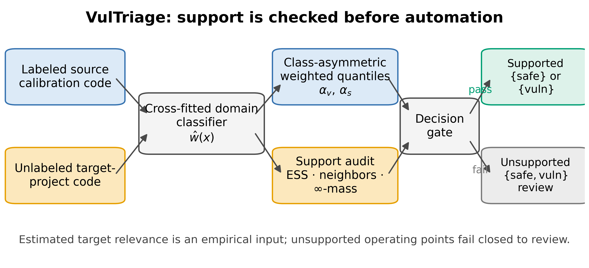
FRONTIERS OF COMPUTER SCIENCE | HIGHLIGHTS 1/3
VulTriage makes cross-project automation auditable
Separate class budgets + target-support audit -> automate when qualified, review otherwise
Source: manuscript Fig. 1; frozen PrimeVul project-shift protocol
Bian & Wang | VulTriage

Slide 2
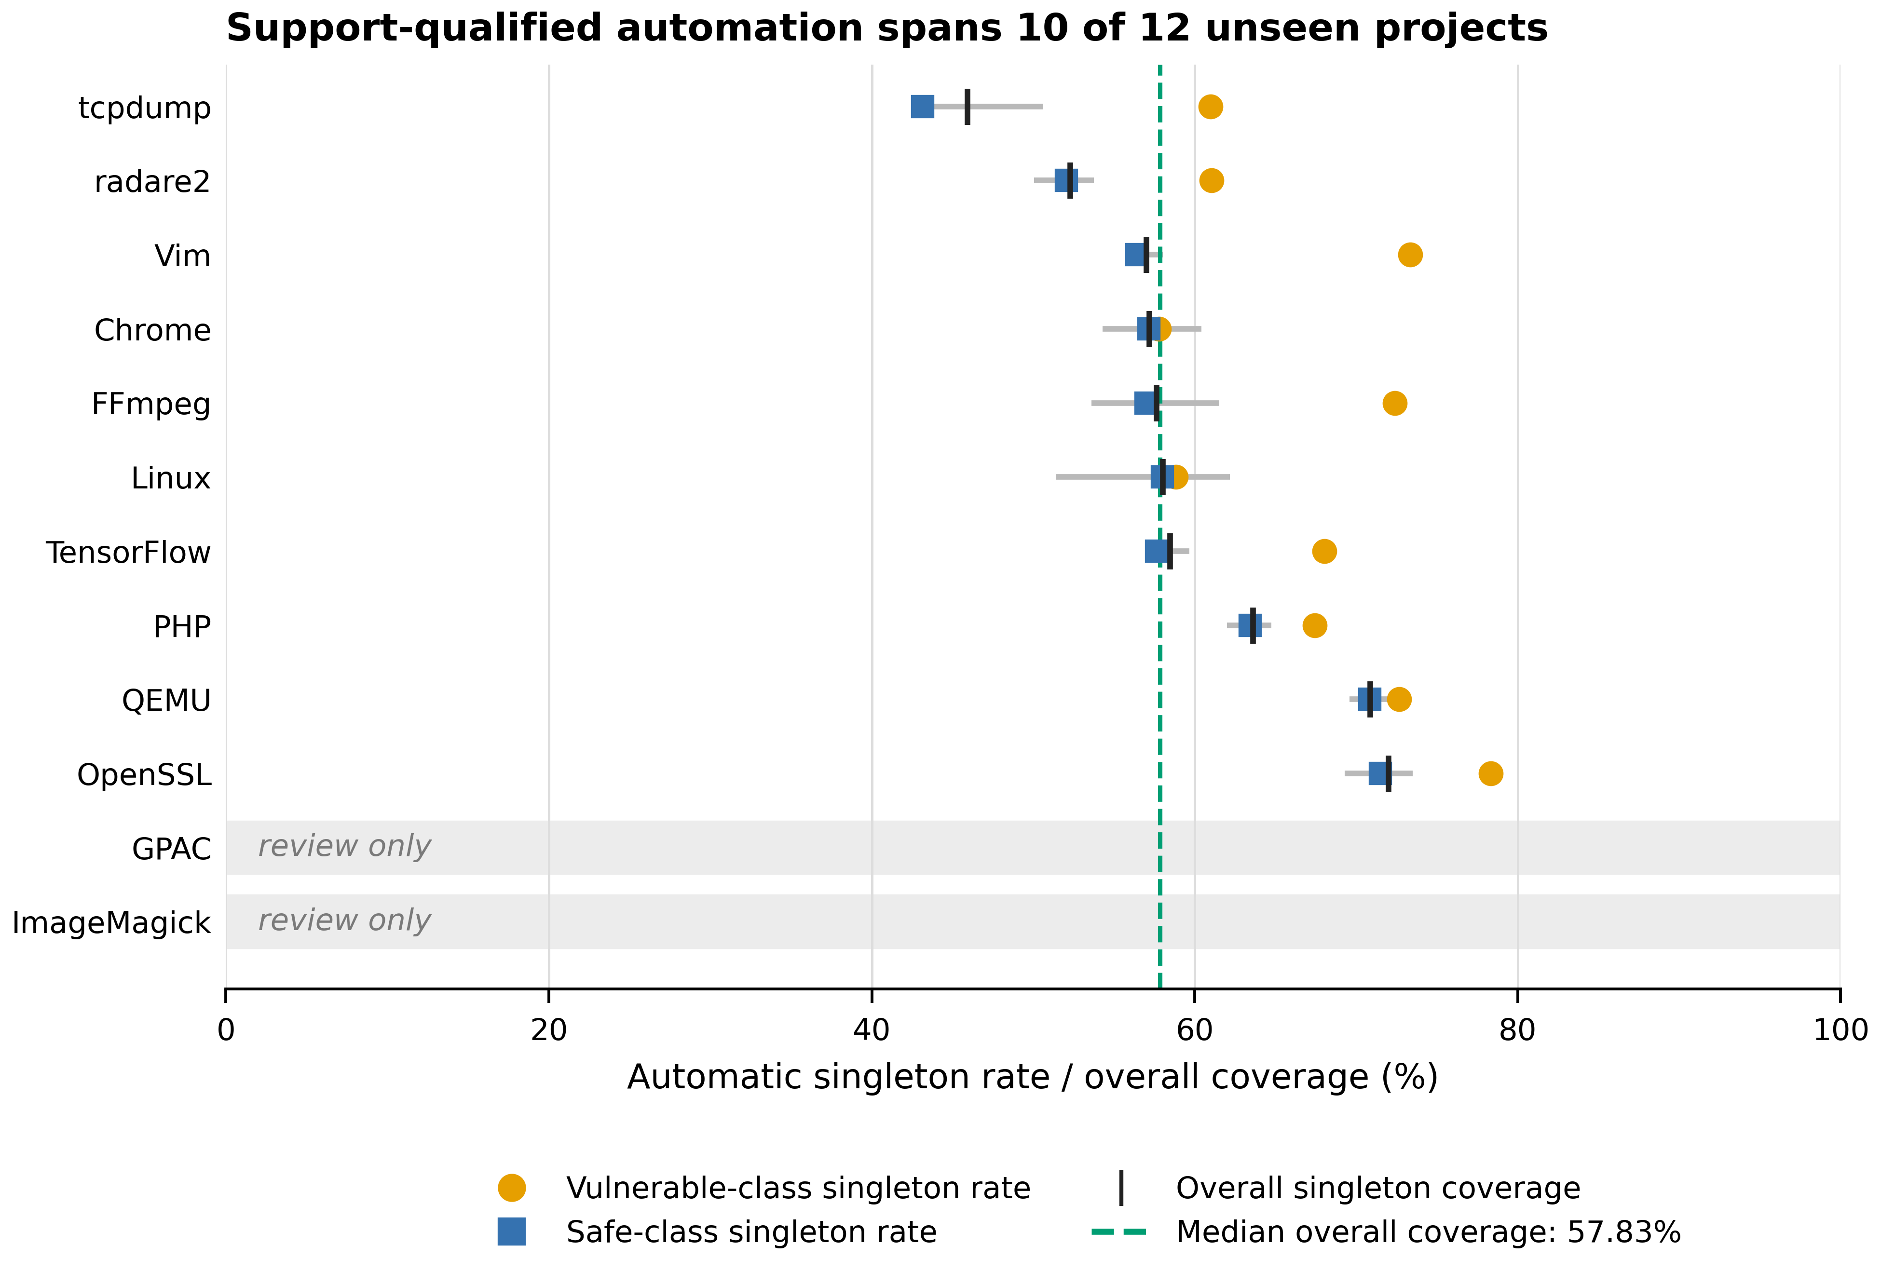
FRONTIERS OF COMPUTER SCIENCE | HIGHLIGHTS 2/3
Support-qualified automation covers 10 of 12 unseen projects
10 / 12
projects pass the label-free support audit
57.83%
median singleton coverage among supported projects
2 refused
ImageMagick and GPAC route entirely to review
Operating point: 10% vulnerable-class budget; 20% safe-class budget.
The system preserves useful automation while making unsupported targets explicit
Source: manuscript Fig. 3; seed-averaged results across five technical seeds
Bian & Wang | VulTriage

Slide 3
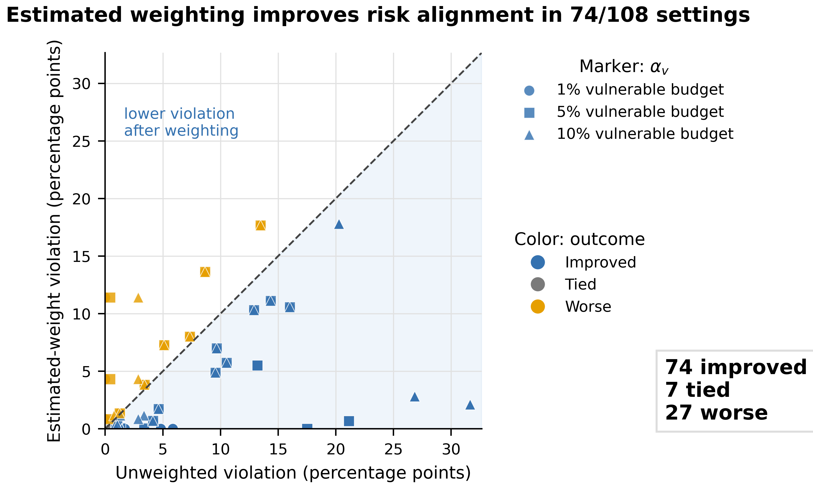
FRONTIERS OF COMPUTER SCIENCE | HIGHLIGHTS 3/3
Estimated weighting improves risk alignment in 74/108 settings
74 improved
lower worst-class budget violation
7 tied
no change at the evaluated setting
27 worse
kept visible in the full 108-setting audit
Public artifact
github.com/bianyanbo44-afk/vultriage-fcs
Evidence scope: PrimeVul, 12 target projects, one hashing/SGD detector.
Positive but bounded conclusion: auditable partial automation is attainable under project shift
Source: manuscript Fig. 4; descriptive frozen 12-project x 9-operating-point grid
Bian & Wang | VulTriage

