Slide 1
SUSTechMajiang
卞证 向昕昊 徐天元 林傲 孙斌贤

Slide 2
Motivation
With the development of the number of students in SUSTech, there is an urgent needs to develop more kinds of recreational activities for SUSTech students to relax and have fun.
If there is a recreation game where the background and some game elements comes from SUSTech, not only can it enrich students’ campus life, but also it enhance students’ campus identity pretty well.

Slide 3
Product Our Majiang Group will make
Our group is devoted to develop an Online Mahjong game with SUSTech elements and try to fulfil this mission.
An online game combined with the basic Mahjong rules and SUSTech background.
Download the client-side (.exe file) first and play with other users on the platform

Slide 4
Target customers of our products
This product is mainly target for the faculties and students in SUSTech and those who are interested in SUSTech.
Since SUSTech is a rapidly developing university with increasing ranking and popularity, it should have huge potential market.

Slide 5
Core Competence of our Products
How to combine the mahjong rules with SUSTech elements
Big events we will implement in the project:
(1) All the background imagines of the game (game hall, front and back of cards, buttons, etc.) will be in SUSTech element.
(2) Our background music will combine mahjong and SUSTech style.
(3) Besides the 144 basic cards in mahjong, we have 8 extra cards as special function cards.

Slide 6
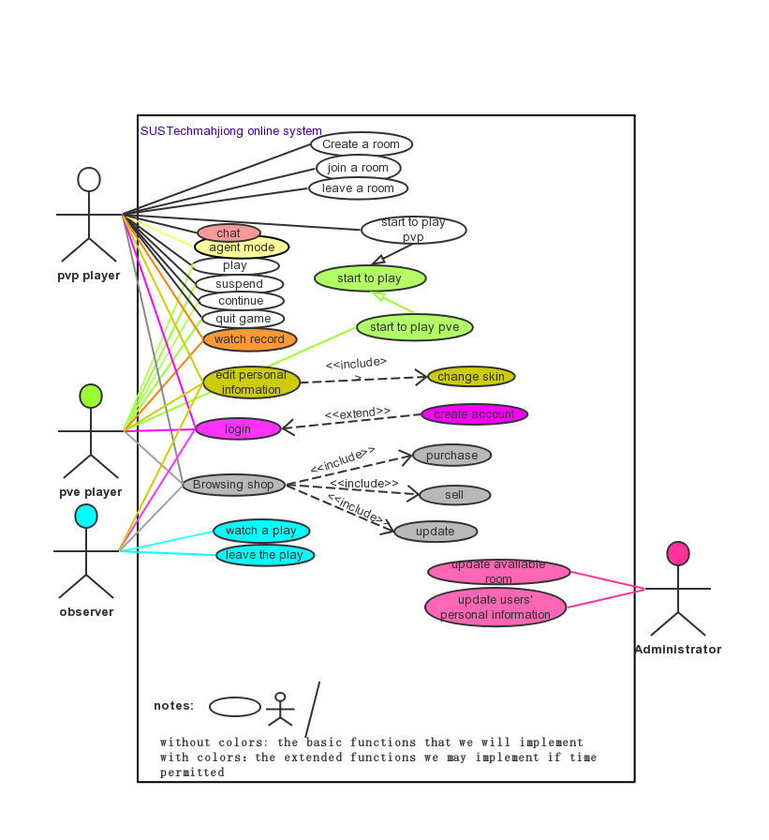
Product feature description
Case diagram

Slide 7
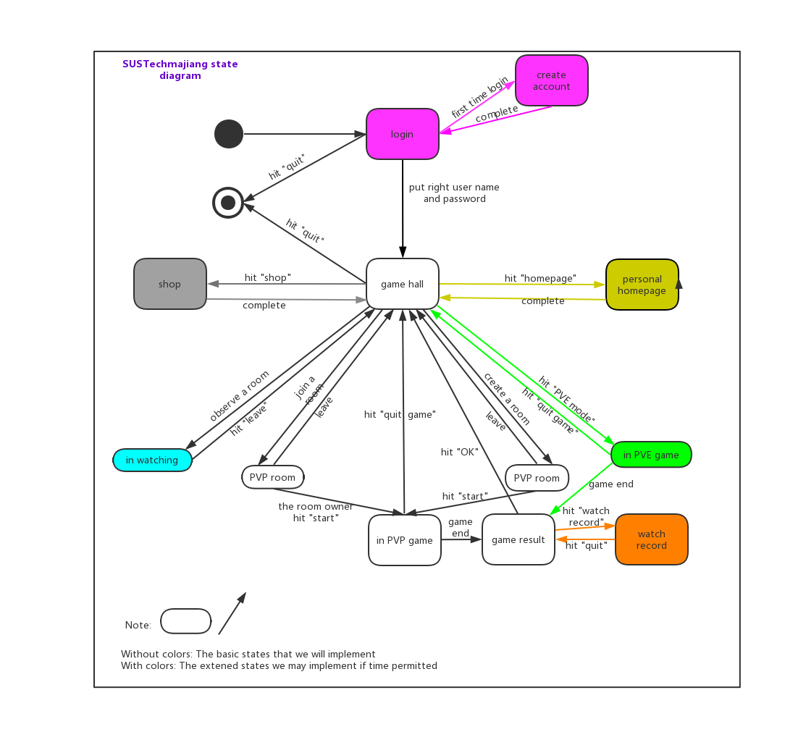
State diagram

Slide 8
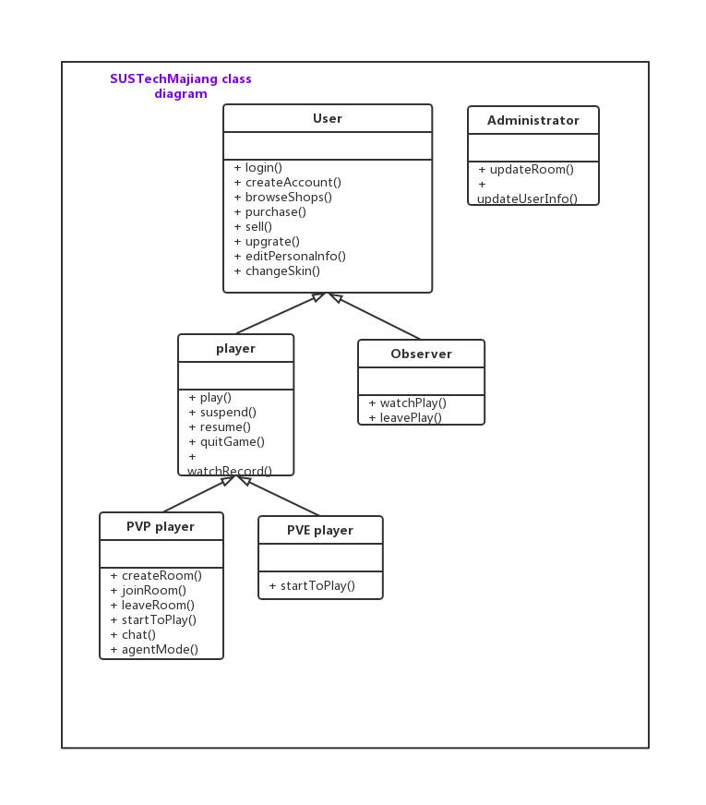
Class diagram

Slide 9
Tasks for which team members are primarily responsible
林傲（Lin Ao）: Project Master planning
Design the rules of the game
卞证（Bian Zheng）：Chief programmer
Implement the code
孙斌贤（Sun Binxian）: Project Deputy Planning and Associated programmer
Solving technical problems
Help Implement the code
徐天元（Xu Tianyuan）: Art Designer
Provide art resource
Make cards with SUSTech element
Design UI in the anaphase
向昕昊（Xiang Xinhao）：Communicator (I/O)
Keep in touch with “customers” (professor Zhang, teacher Zhu and SA)
Collect the latest information about the project and do manage (UML).
Write project report and do presentation
Help implement the code

Slide 10
Timeline
preparatory phase:
(before the opening report 2019.10.9)
Develop game rule, search and collect Art materials, learn the basic knowledge of APIs we will use and be familiar with them.
prophase:
(before 11.11)
Develop game logic, combine them with these art materials. Implement the server-side and client-side of game so that the whole game can run.
anaphase:
(before 12.11）
Testing and maintaining

Slide 11
•Some functions that can extend in the anaphase:
develop PVE mahjong game
develop the account system (insert some database in it)
develop shop system
develop section level system
develop skin system
develop “agent mode” in pvp play
develop “watch record” after a play
develop “chat” in pvp play
develop “observer” mode

Slide 12
APIs we will use
Unity, .Net socket, UGUI

Slide 13
Feasibility
Things that may lead us to fail
Lack of familiarity with APIs
Unable to deliver on performance
Cost excessive
Too many features (prioritize)
Third party APIs/service may not be reliable

Slide 14
However, we are still confident that we can complete the project, for the reason that:
1.Have clear division of every member’s responsibility and scientific management system.
2. Have completed in time and have master the basic knowledge of the tools and APIs we will use.
3.There are no much cost, maybe the only cost is our time!
4.performaence
5.We will first develop the basic version and make sure it can run well, then will we consider developing other extensive function
6. All the APIs we used are sophisticated and legal software

Slide 15
References
中国麻将竞赛规则
http://www.xqbase.com/other/mahjongg.htm
麻将基本术语中英文对照http://www.xqbase.com/other/mahjongg_english.htm

Slide 16
Thank you!

