Slide 1
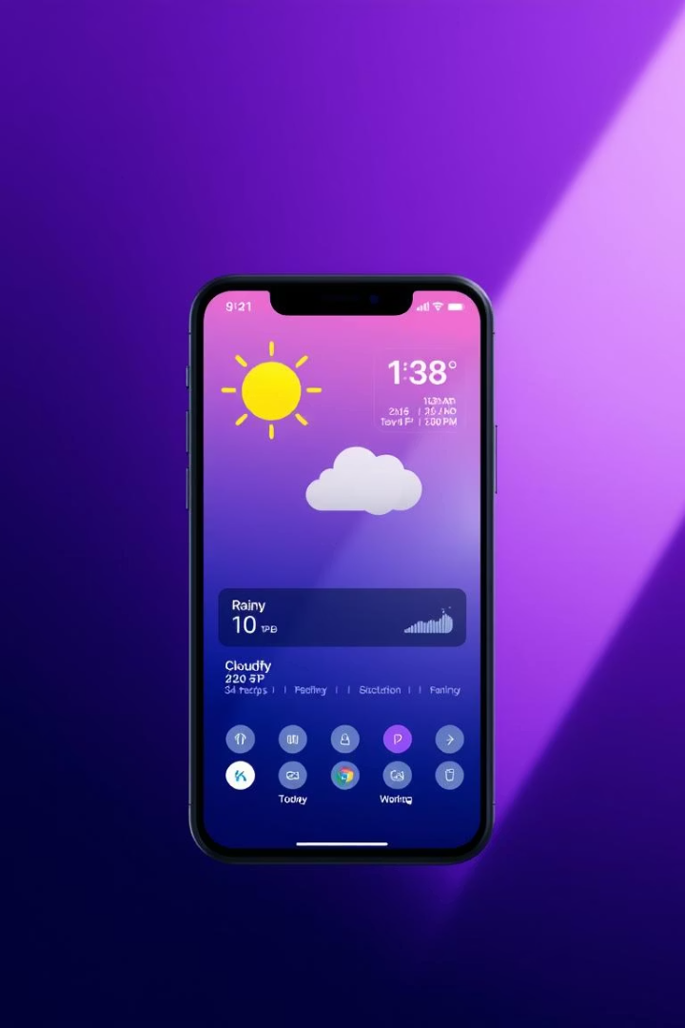

WeatherWise: Your 4-Day Forecast App
By [Your Name]
A comprehensive weather forecasting solution for better planning
by Shivein Pise

Slide 2

Project Motivation
Gaps in Current Apps
Forecast Accuracy
Lack key features users need daily
Need reliable 4-day weather predictions
Personalization
Custom insights improve user experience

Slide 3
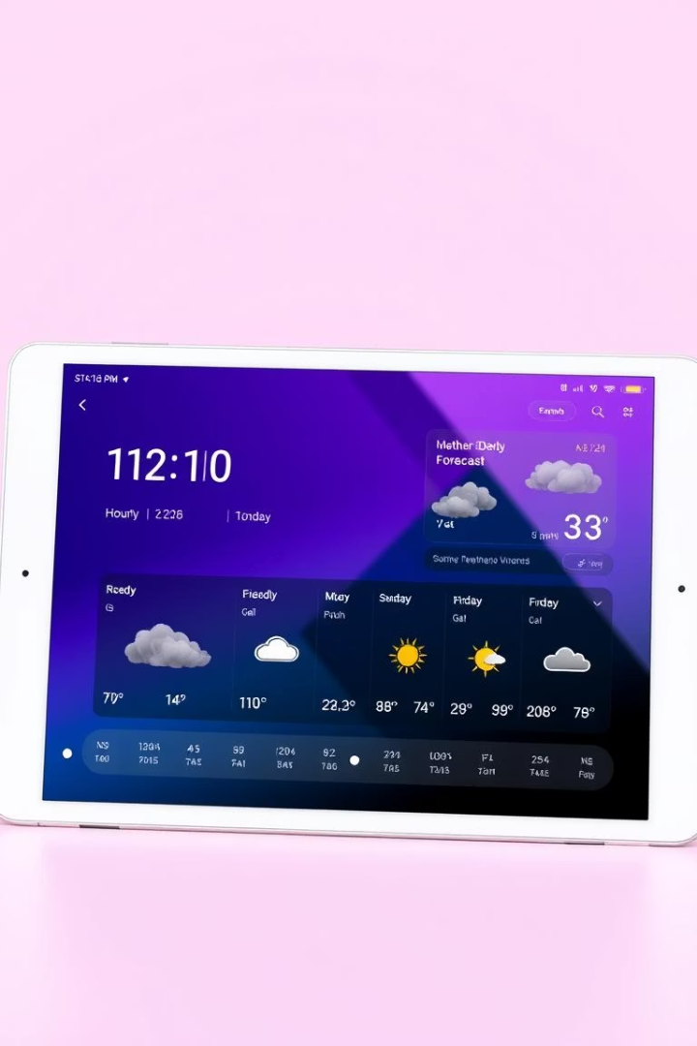
WeatherWise: Key Features
Current Conditions
Hourly weather updates
4-Day Forecast
Detailed temperature and precipitation info
User Interface
Intuitive navigation for all users
Custom Alerts
Notifications for specific weather events

Slide 4
Literature Review
Weather APIs
Forecast Models
UI/UX Practices
Competitor Comparison
Strengths and limitations analyzed
GFS, NAM model accuracy evaluated
Design trends for weather apps reviewed
Weather Channel, AccuWeather, Weather Underground

Slide 5
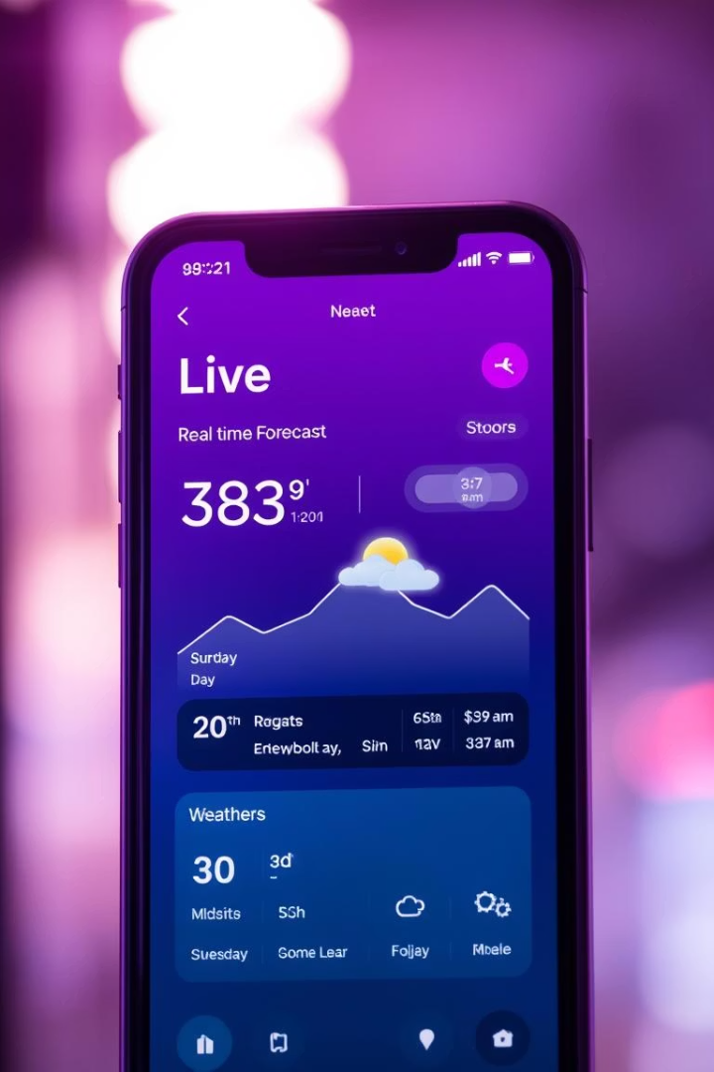



WeatherWise: App Demo
Live View
Show current weather conditions
Forecast Preview
4-day detailed forecast demonstration
Interactive Features
Custom alerts and navigation showcase

Slide 6
Technology Stack
Frontend
Backend
Database
Weather API
React Native for cross-platform apps
Python with Flask framework
MongoDB for flexible storage
OpenWeatherMap for reliable data

Slide 7

Conclusion
User-Centric Design
Accurate Forecasts
Focus on intuitive, accessible experience
Reliable 4-day weather updates
Market Gaps Addressed
Fills key shortcomings of current apps

Slide 8

Future Prospects
Smart Device Integration
Connect with home automation
Extended Forecast
Aim for 7-day detailed outlooks
AI Personalization
Custom forecasts using AI
Hyperlocal Data
Predict microclimate variations

