Slide 1

Probabilistic numerics at scale by distributed inference
Alex Ledbetter, Mykola Lukashchuk & Wouter Kouw
International Conference on Probabilistic Numerics 2026

Slide 2



https://github.com/biaslab/ProbNum2026-Tutorial
Pluto notebook (julia)
Marimo notebook (python)
installation instructions

Slide 3
Outline
1
Problem statement
2
Classical numerical approach
3
Probabilistic numerical approach
4
Message passing approach
5
Stacking modular components

Slide 4
1. Problem specification
A
Problem statement
B
Heat transfer on a silicon die
C
A system of linear equations

Slide 5
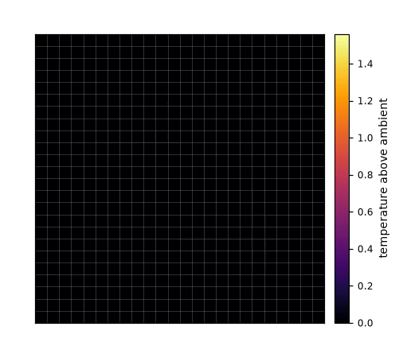
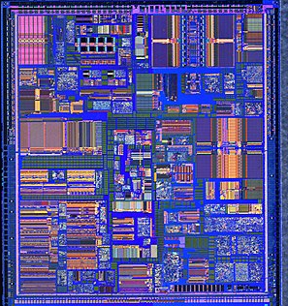
Keeping chips cool
This is a silicon die, specifically a Pentium II.
It contains a complete electronic circuit that performs a specific function (this one computes).
Each tile (region) draws power and heats up.
Heat spreads through the silicon material.
We want to keep the die cool, which we can do by "throttling" power consumption.
To decide which to "throttle", the control system needs the steady-state temperature of every tile.

Slide 6
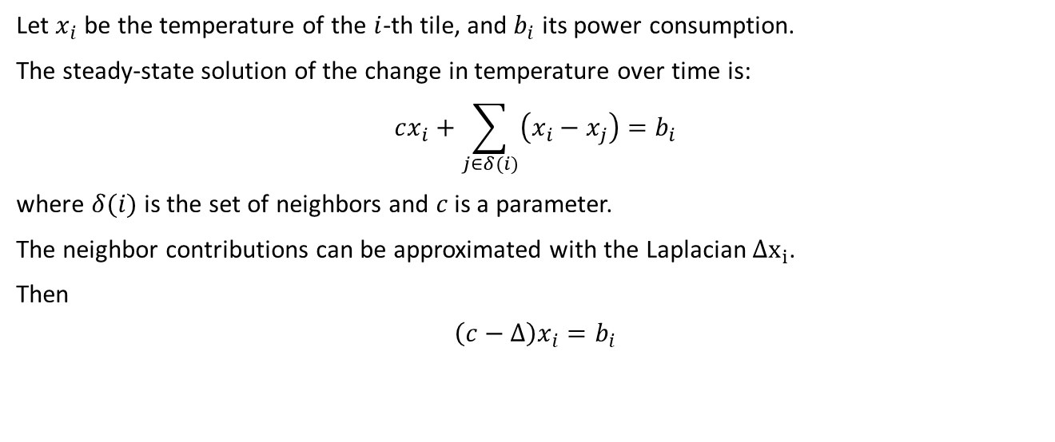
Heat transfer on a silicon die
Let $x_{i}$ be the temperature of the $i$-th tile, and $b_{i}$ its power consumption.
The steady-state solution of the change in temperature over time is:
$$cx_{i}+\sum_{j∈δ(i)}{\left(x_{i}−x_{j}\right)}=b_{i}$$
where $δ(i)$ is the set of neighbors and $c$ is a parameter.
The neighbor contributions can be approximated with the Laplacian $Δx_{i}$.
Then
$$\left(c−Δ\right)x_{i}=b_{i}$$

Slide 7
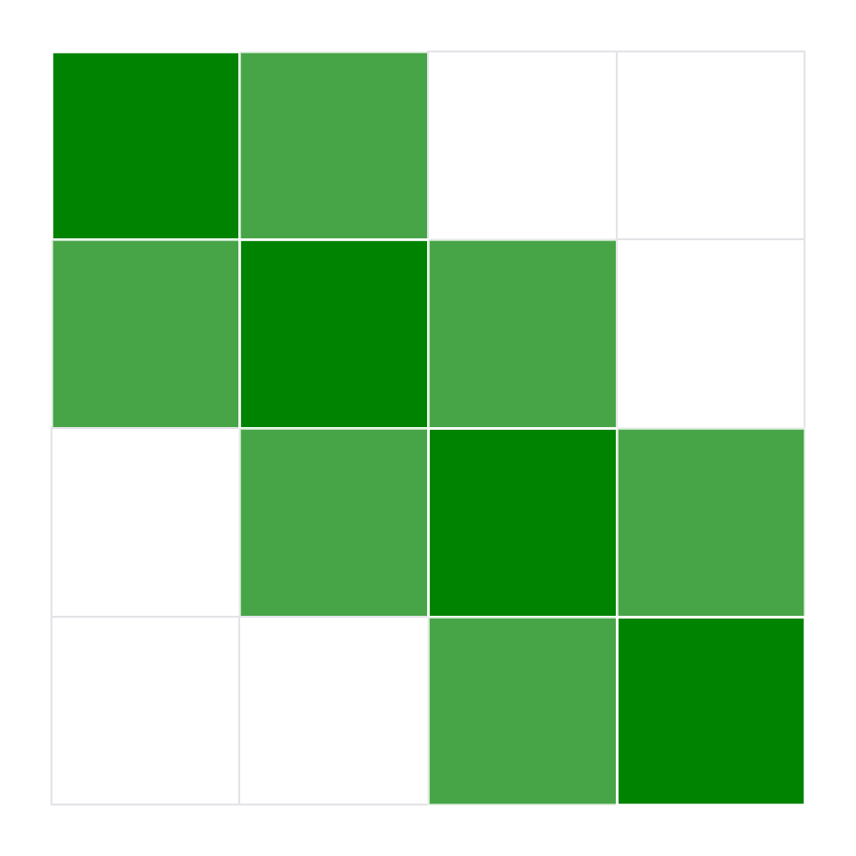
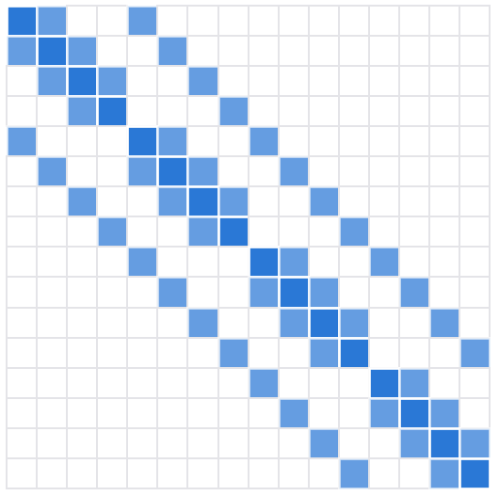
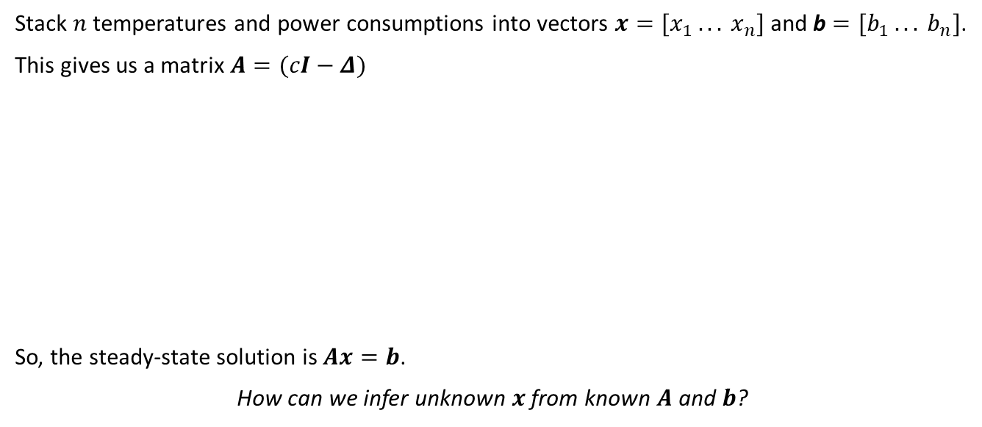
System of linear equations
Stack $n$ temperatures and power consumptions into vectors $x=[x_{1} ... x_{n}]$ and b $=[b_{1} ... b_{n}]$.
This gives us a matrix $A=(cI−Δ)$
So, the steady-state solution is $Ax=b$.
How can we infer unknown $x$ from known $A$ and $b$?

Slide 8
2. Classical numerical approaches
A
Jacobi method
B
Gauss–Seidel method
C
Conjugate gradient method

Slide 9
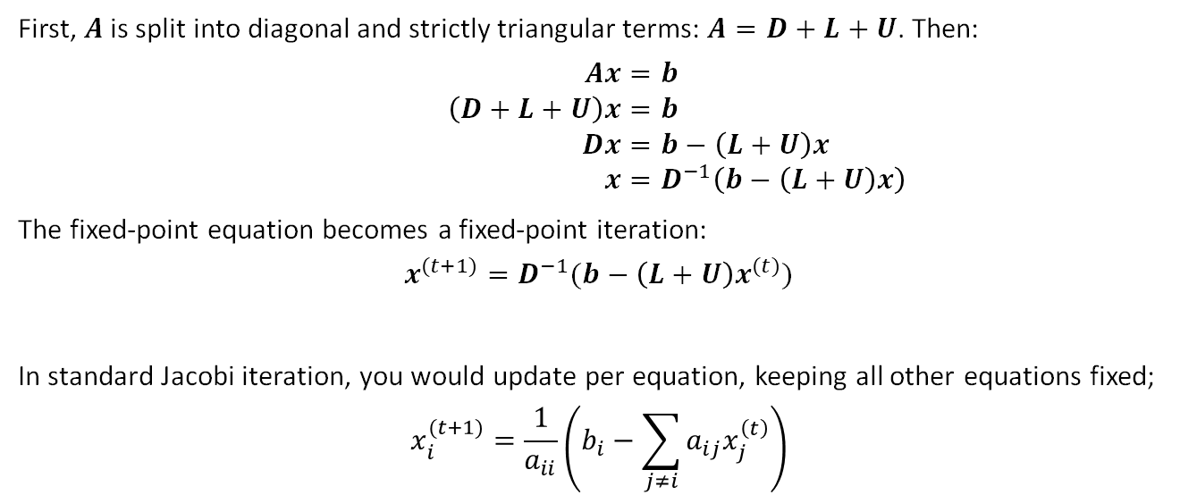
Jacobi method
First, $A$ is split into diagonal and strictly triangular terms: $A=D+L+U$. Then:
$$Ax=b \\ \left(D+L+U\right)x=b \\ Dx=b−\left(L+U\right)x \\ x=D^{−1}\left(b−\left(L+U\right)x\right)$$
The fixed-point equation becomes a fixed-point iteration:
$$x^{(t+1)}=D^{−1}(b−\left(L+U\right)x^{(t)})$$
In standard Jacobi iteration, you would update per equation, keeping all other equations fixed;
$$x_{i}^{(t+1)}=\frac{1}{a_{ii}}\left(b_{i}−\sum_{j≠i}{a_{ij}x_{j}^{\left(t\right)}}\right)$$

Slide 10
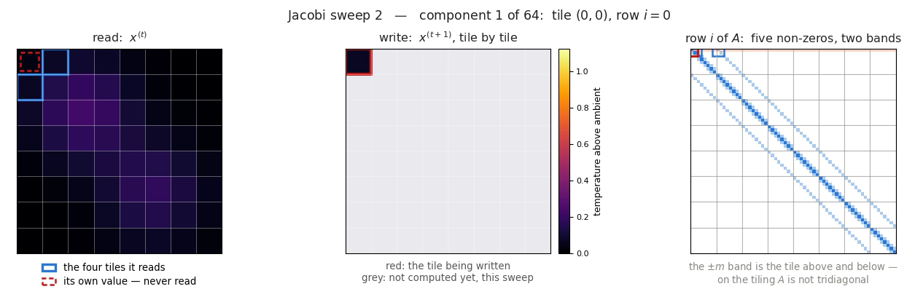
Jacobi method

Slide 11
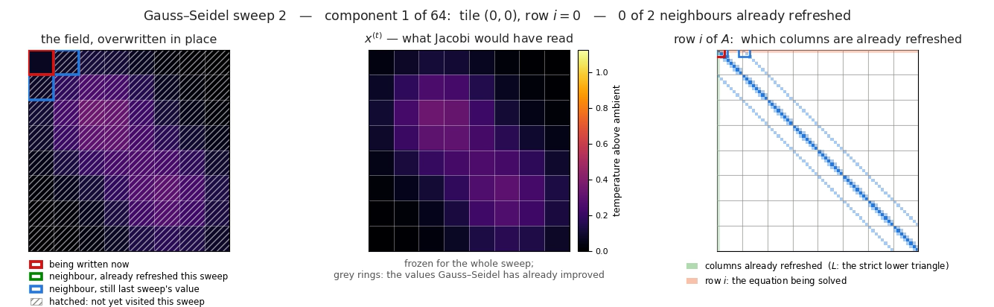

Gauss-Seidel method
Gauss-Seidel is essentially the same but now you use the already computed values;
$$x^{(t+1)}={\left(D+L\right)}^{−1}(b−{Ux}^{(t)})$$

Slide 12
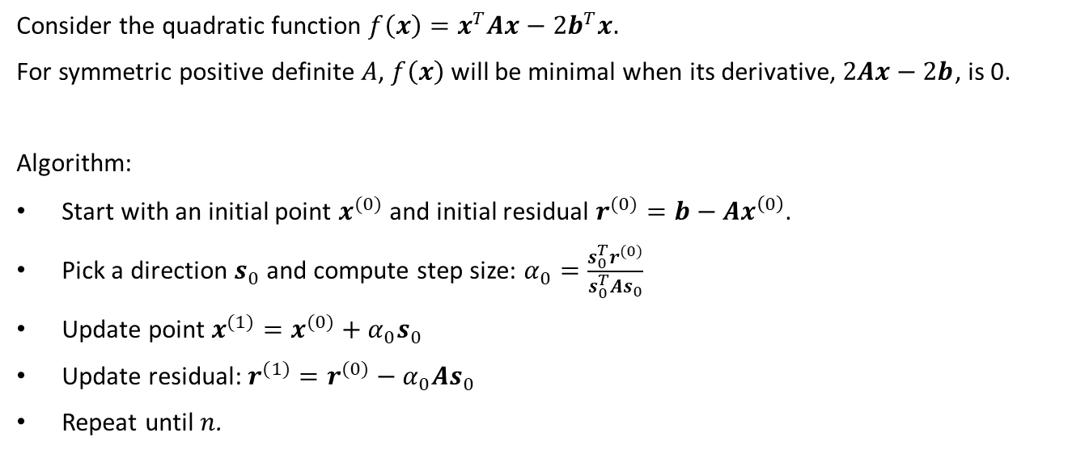
Conjugate gradient method
Consider the quadratic function $f\left(x\right)=x^{T}Ax−2b^{T}x.$
For symmetric positive definite $A$, $f\left(x\right)$ will be minimal when its derivative, $2Ax−2b$, is 0.
Algorithm:
Start with an initial point $x^{(0)}$ and initial residual $r^{(0)}=b−Ax^{\left(0\right)}$.
Pick a direction $s_{0}$ and compute step size: $α_{0}=\frac{s_{0}^{T}r^{(0)}}{s_{0}^{T}As_{0}}$
Update point $x^{(1)}=x^{(0)}+α_{0}s_{0}$
Update residual: $r^{(1)}=r^{(0)}−α_{0}As_{0}$
Repeat until $n$.

Slide 13
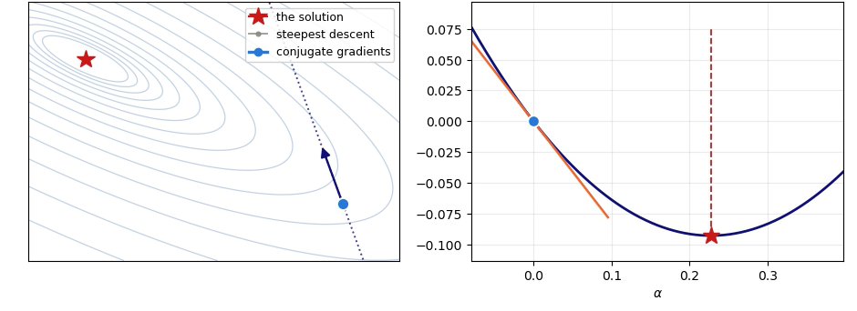

Conjugate gradient method
The directions are chosen to be conjugate with respect to $A$, i.e., $s_{i}^{T}As_{j}=0$ for $i≠j$.

Slide 14
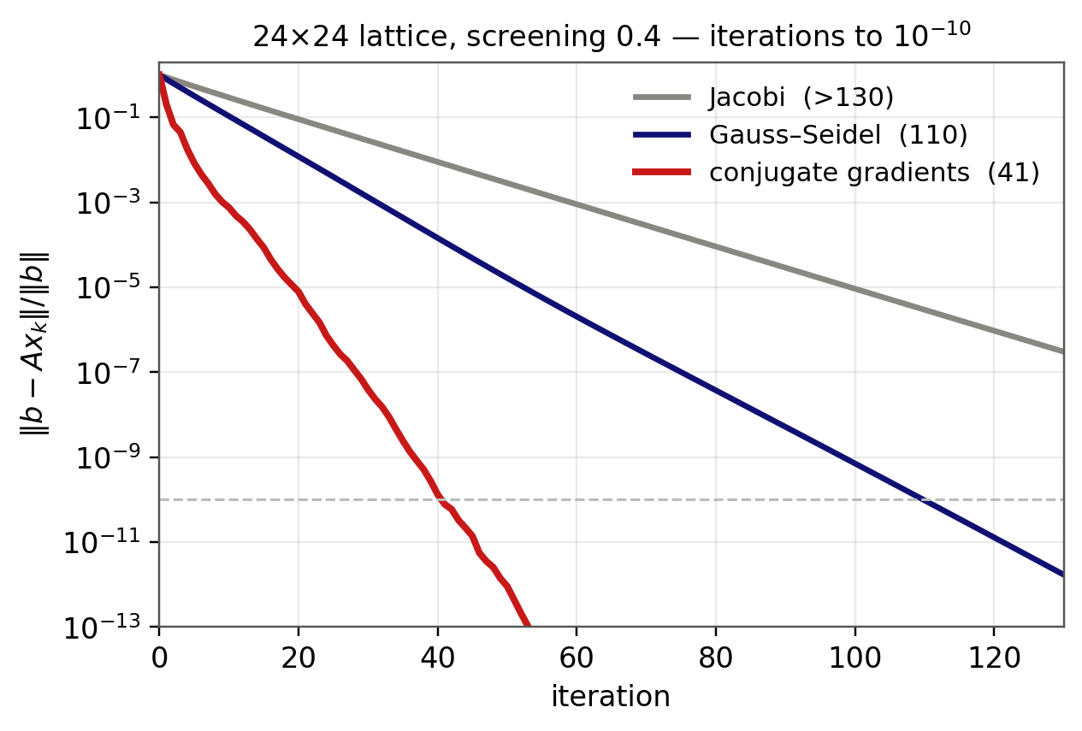

Experiment
Consider a 24 x 24 grid tiling ($n=576$) with $c=0.4$.

Slide 15
3. Probabilistic numerical approach
A
BayesCG
B
Uncertainty

Slide 16
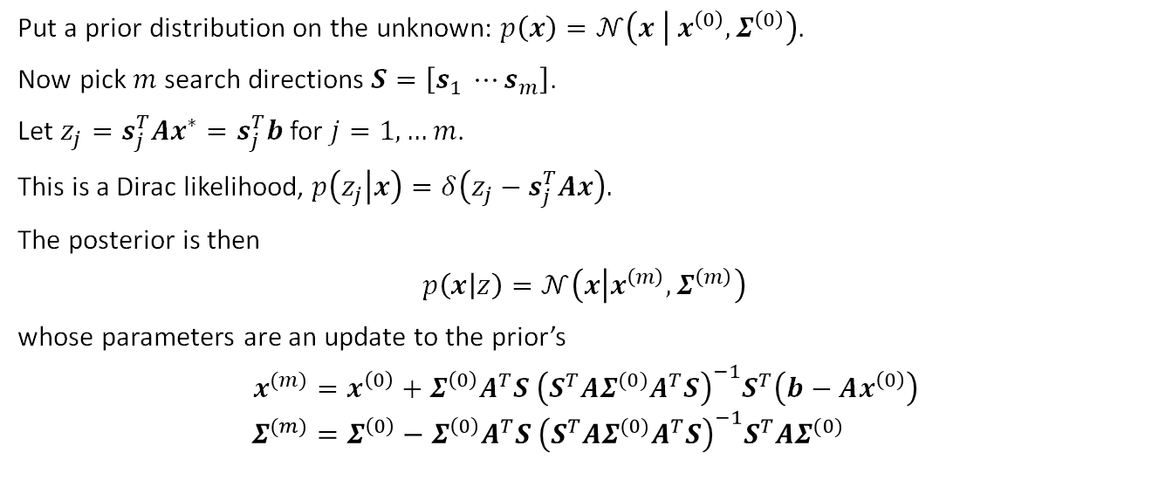
BayesCG
Put a prior distribution on the unknown: $p\left(x\right)=𝒩\left(x | x^{\left(0\right)},Σ^{\left(0\right)}\right)$.
Now pick $m$ search directions $S=\left[s_{1} ⋯s_{m}\right]$.
Let $z_{j}=s_{j}^{T}Ax^{∗}=s_{j}^{T}b$ for $j=1,…m$.
This is a Dirac likelihood, $p\left(z_{j} | x\right)=δ\left(z_{j}−s_{j}^{T}Ax\right).$
The posterior is then
$$p\left(x | z\right)=𝒩\left(x | x^{\left(m\right)},Σ^{\left(m\right)}\right)$$
whose parameters are an update to the prior’s
$$x^{(m)}=x^{\left(0\right)}+Σ^{\left(0\right)}A^{T}S {\left(S^{T}AΣ^{(0)}A^{T}S\right)}^{−1}S^{T}\left(b−Ax^{\left(0\right)}\right) \\ Σ^{(m)}=Σ^{\left(0\right)}−Σ^{\left(0\right)}A^{T}S {\left(S^{T}AΣ^{(0)}A^{T}S\right)}^{−1}S^{T}AΣ^{(0)}$$

Slide 17
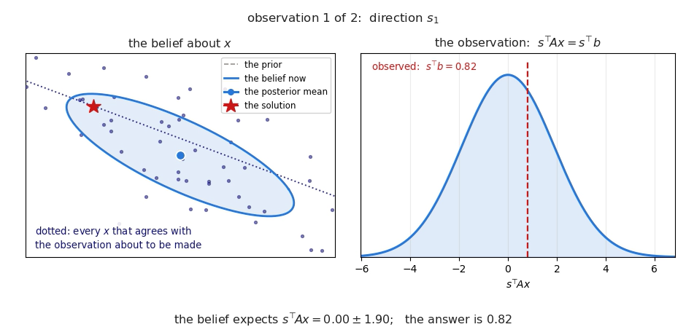
BayesCG

Slide 18
4. Message passing approach to $Ax=b$
A
Setup
B
Forney-style Factor Graphs
C
Belief propagation
D
Solving $Ax=b$ by Message-Passing on a Factor-Graph
Notes:
Outline

Slide 19
4. Message passing approach to $Ax=b$
A
Setup
B
Forney-style Factor Graphs
C
Belief propagation
D
Solving $Ax=b$ by Message-Passing on a Factor-Graph
Notes:
Outline

Slide 20
Message-passing approach: Setup
Goal: Solve Linear System
Multivariate Gaussian
Mode
-configuration at mode
-configuration at mean
How to find the mode / mean?
Notes:
***Setup***
Restate the goal: Want to solve Ax=b for x for given matrix A and vector b. [show Ax=b]
Reference Shantal – “As shown by Shantal et al. there exists a quadratic energy function whose mode encodes the solution to Ax=b - the simple multivariate Gaussian” – [show p(x) ..]
This is shown because where the gradient of log p(x) w.r.t. x equals 0, we find the mode,
and evaluating this gradient, we find it to be equal to -Ax + b. [show grad log px = -Ax +b]
Therefore, the x-configuration at the mode of p(x) is x = A^{-1}b [show x = ..]
Similarly, we can identify the mean of a multivariate Gaussian to be, as a function of its natural parameters (precision-weighted mean and precision, or information vector/matrix), mu = Lambda^{-1} eta, and thus encoding A and b and Lambda and eta, we identify the mean of the Gaussian with our solution.
With this understanding, then, we seek a means to determine a mode/mean of a multivariate Gaussian without directly inverting the possibly very large precision matrix A.
“Shantal et al. then also show that the mode could be reliably found by message passing on a probabilistic graph. [Show generic grid graph]
Specifically, they encode the Gaussian in a specific type of probabilistic graph known as a Gaussian Markov Random Field. [Show the fancy one]
To do this, we note that a Gaussian is quadratic [show energy function and summation form]
and can be factorized into a product of unary and binary factors, phi and psi. [show product and phi and psi]
These factors are then what we find in the graph.
We instead take a more general, modern approach, and encode the same Gaussian in what is called a Forney-style Factor Graph, or FFG. [show Mykola’s FFG]
In either case, a method called message-passing is used to infer the solution. (Read and show) [Message-passing is a scalable, distributed approach to approximate marginal inference.]
This means we infer the marginal distributions for each latent variable in a probabilistic model, in this case, we infer [q(x_i) for each variable x_i in the state vector x.]
By then stacking the means of these marginals, we can recover the mode of the distribution and thus our solution x = A^{-1}b. [show the x=A^[-1]b=[…]]
Note that we do not recover the complete inverse matrix A^{-1}, only the matrix-vector product, A^{-1}b.
We will now review how to encode this multivariate Gaussian distribution as a factor-graph, and then how to perform message-passing to recover its mode and our solution.

Slide 21
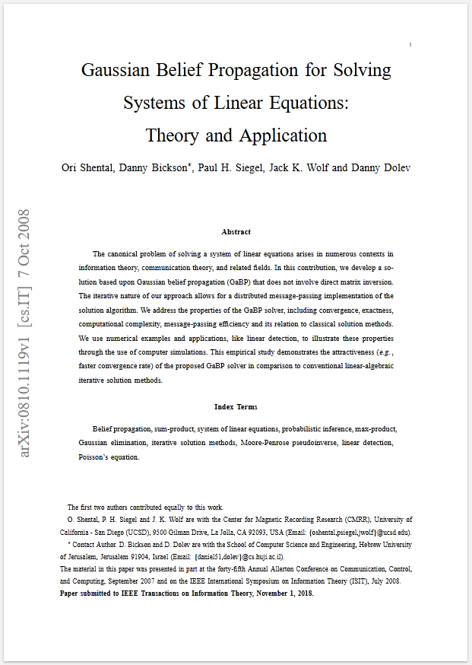
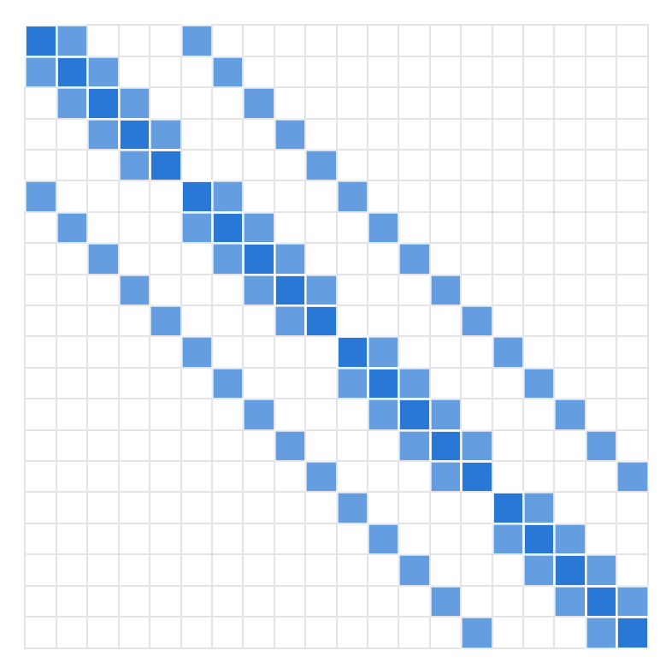

Message-passing approach: Setup
Unary
Binary
Structure of $A$
Notes:
***Setup***
Restate the goal: Want to solve Ax=b for x for given matrix A and vector b. [show Ax=b]
Reference Shantal – “As shown by Shantal et al. there exists a quadratic energy function whose mode encodes the solution to Ax=b - the simple multivariate Gaussian” – [show p(x) ..]
This is shown because where the gradient of log p(x) w.r.t. x equals 0, we find the mode,
and evaluating this gradient, we find it to be equal to -Ax + b. [show grad log px = -Ax +b]
Therefore, the x-configuration at the mode of p(x) is x = A^{-1}b [show x = ..]
Similarly, we can identify the mean of a multivariate Gaussian to be, as a function of its natural parameters (precision-weighted mean and precision, or information vector/matrix), mu = Lambda^{-1} eta, and thus encoding A and b and Lambda and eta, we identify the mean of the Gaussian with our solution.
With this understanding, then, we seek a means to determine a mode/mean of a multivariate Gaussian without directly inverting the possibly very large precision matrix A.
“Shantal et al. then also show that the mode could be reliably found by message passing on a probabilistic graph. [Show generic grid graph]
Specifically, they encode the Gaussian in a specific type of probabilistic graph known as a Gaussian Markov Random Field. [Show the fancy one]
To do this, we note that a Gaussian is quadratic [show energy function and summation form]
and can be factorized into a product of unary and binary factors, phi and psi. [show product and phi and psi]
These factors are then what we find in the graph.
We instead take a more general, modern approach, and encode the same Gaussian in what is called a Forney-style Factor Graph, or FFG. [show Mykola’s FFG]
In either case, a method called message-passing is used to infer the solution. (Read and show) [Message-passing is a scalable, distributed approach to approximate marginal inference.]
This means we infer the marginal distributions for each latent variable in a probabilistic model, in this case, we infer [q(x_i) for each variable x_i in the state vector x.]
By then stacking the means of these marginals, we can recover the mode of the distribution and thus our solution x = A^{-1}b. [show the x=A^[-1]b=[…]]
Note that we do not recover the complete inverse matrix A^{-1}, only the matrix-vector product, A^{-1}b.
We will now review how to encode this multivariate Gaussian distribution as a factor-graph, and then how to perform message-passing to recover its mode and our solution.

Slide 22
Message-passing approach: Setup
Forney-style Factor Graph
Notes:
***Setup***
Restate the goal: Want to solve Ax=b for x for given matrix A and vector b. [show Ax=b]
Reference Shantal – “As shown by Shantal et al. there exists a quadratic energy function whose mode encodes the solution to Ax=b - the simple multivariate Gaussian” – [show p(x) ..]
This is shown because where the gradient of log p(x) w.r.t. x equals 0, we find the mode,
and evaluating this gradient, we find it to be equal to -Ax + b. [show grad log px = -Ax +b]
Therefore, the x-configuration at the mode of p(x) is x = A^{-1}b [show x = ..]
Similarly, we can identify the mean of a multivariate Gaussian to be, as a function of its natural parameters (precision-weighted mean and precision, or information vector/matrix), mu = Lambda^{-1} eta, and thus encoding A and b and Lambda and eta, we identify the mean of the Gaussian with our solution.
With this understanding, then, we seek a means to determine a mode/mean of a multivariate Gaussian without directly inverting the possibly very large precision matrix A.
“Shantal et al. then also show that the mode could be reliably found by message passing on a probabilistic graph. [Show generic grid graph]
Specifically, they encode the Gaussian in a specific type of probabilistic graph known as a Gaussian Markov Random Field. [Show the fancy one]
To do this, we note that a Gaussian is quadratic [show energy function and summation form]
and can be factorized into a product of unary and binary factors, phi and psi. [show product and phi and psi]
These factors are then what we find in the graph.
We instead take a more general, modern approach, and encode the same Gaussian in what is called a Forney-style Factor Graph, or FFG. [show Mykola’s FFG]
In either case, a method called message-passing is used to infer the solution. (Read and show) [Message-passing is a scalable, distributed approach to approximate marginal inference.]
This means we infer the marginal distributions for each latent variable in a probabilistic model, in this case, we infer [q(x_i) for each variable x_i in the state vector x.]
By then stacking the means of these marginals, we can recover the mode of the distribution and thus our solution x = A^{-1}b. [show the x=A^[-1]b=[…]]
Note that we do not recover the complete inverse matrix A^{-1}, only the matrix-vector product, A^{-1}b.
We will now review how to encode this multivariate Gaussian distribution as a factor-graph, and then how to perform message-passing to recover its mode and our solution.

Slide 23
Message-passing approach: Setup
Message-passing is a scalable, distributed approach to approximate marginal inference.
We infer for each variable in state vector .
We then stack the means to obtain:
Forney-style Factor Graph
Notes:
***Setup***
Restate the goal: Want to solve Ax=b for x for given matrix A and vector b. [show Ax=b]
Reference Shantal – “As shown by Shantal et al. there exists a quadratic energy function whose mode encodes the solution to Ax=b - the simple multivariate Gaussian” – [show p(x) ..]
This is shown because where the gradient of log p(x) w.r.t. x equals 0, we find the mode,
and evaluating this gradient, we find it to be equal to -Ax + b. [show grad log px = -Ax +b]
Therefore, the x-configuration at the mode of p(x) is x = A^{-1}b [show x = ..]
Similarly, we can identify the mean of a multivariate Gaussian to be, as a function of its natural parameters (precision-weighted mean and precision, or information vector/matrix), mu = Lambda^{-1} eta, and thus encoding A and b and Lambda and eta, we identify the mean of the Gaussian with our solution.
With this understanding, then, we seek a means to determine a mode/mean of a multivariate Gaussian without directly inverting the possibly very large precision matrix A.
“Shantal et al. then also show that the mode could be reliably found by message passing on a probabilistic graph. [Show generic grid graph]
Specifically, they encode the Gaussian in a specific type of probabilistic graph known as a Gaussian Markov Random Field. [Show the fancy one]
To do this, we note that a Gaussian is quadratic [show energy function and summation form]
and can be factorized into a product of unary and binary factors, phi and psi. [show product and phi and psi]
These factors are then what we find in the graph.
We instead take a more general, modern approach, and encode the same Gaussian in what is called a Forney-style Factor Graph, or FFG. [show Mykola’s FFG]
In either case, a method called message-passing is used to infer the solution. (Read and show) [Message-passing is a scalable, distributed approach to approximate marginal inference.]
This means we infer the marginal distributions for each latent variable in a probabilistic model, in this case, we infer [q(x_i) for each variable x_i in the state vector x.]
By then stacking the means of these marginals, we can recover the mode of the distribution and thus our solution x = A^{-1}b. [show the x=A^[-1]b=[…]]
Note that we do not recover the complete inverse matrix A^{-1}, only the matrix-vector product, A^{-1}b.
We will now review how to encode this multivariate Gaussian distribution as a factor-graph, and then how to perform message-passing to recover its mode and our solution.

Slide 24
4. Message passing approach to $Ax=b$
A
Setup
B
Forney-style Factor Graphs
C
Belief propagation
D
Solving $Ax=b$ by Message-Passing on a Factor-Graph
Notes:
Outline

Slide 25
Message-passing approach: Forney-style Factor-graphs
Factor Graph: Insightful visual representation of $p(...)$
Notes:
***Factor Graphs***
Factor graphs are easy to understand, and highly useful when it comes to model design.
In short, any arbitrary factorized probabilistic model can be encoded exactly as a factor graph. Consider the model p(a,b,c) = p(a)p(b|a)p(c|b)
This model has a representation as this Forney-style factor-graph, where the nodes denote the factors and the edges denote the variables. The conditional independencies are made vividly clear. This is a simple model and you may argue the algebraic form is just as clear.
However, when we consider a loopy model with arbitrary non-negative factors/potentials f such as p(a,b,c,d) propto 1/Z f_1(a,b) f_2(b,c) f_3(c,d) f_4(d,a) and this corresponding factor graph, and we see that the loop is readily apparent, whereas in the algebraic form, it is less so, and in more complicated models, model structure can be quite difficult to understand.
And so a [factor-graph is a convenient visual representation of a probabilistic model], useful for understanding model structure and formulating message-passing algorithms.
(pass) Its use becomes even more apparent as we begin to utilize hybrid message-passing approaches, where we apply variational constraints to the variables around specific nodes [highlight a node and show a variational factorization]
(pass) , and in cases of non-conjugacies, where we may need to apply form-constraints to certain variables that perform projections into conjugate families [highlight an edge and write “ProjectTo Gamma”].
(pass) For now, we use Gaussian-conjugate factors without variational or form constraints.
We can also encode linear probabilistic models described algebraically, such as y = Hx + w, where y, x, and w are random variables, and A is a constant matrix, transpose vector, or scalar [ show equation, arrow, FFG ]
This highlights the presence of multiplication and summation nodes, where inverse and negated terms provide division and subtraction via the same factors.
Here we pause to review a few more factors that show up frequently in linear Gaussian models. Each have closed-form message rules.
When a variable connects to more than two factors, it gets duplicated via an equality node like this with these rules
Then we have point-mass factors used commonly for measured data, and encode dirac
We have multiplication nodes for multiplication of a variable by a vector or matrix…
We have summation nodes to add or subtract two variables…
And we have a Normal distribution node that forms a Gaussian potential for the output from an input random mean and variance …

Slide 26
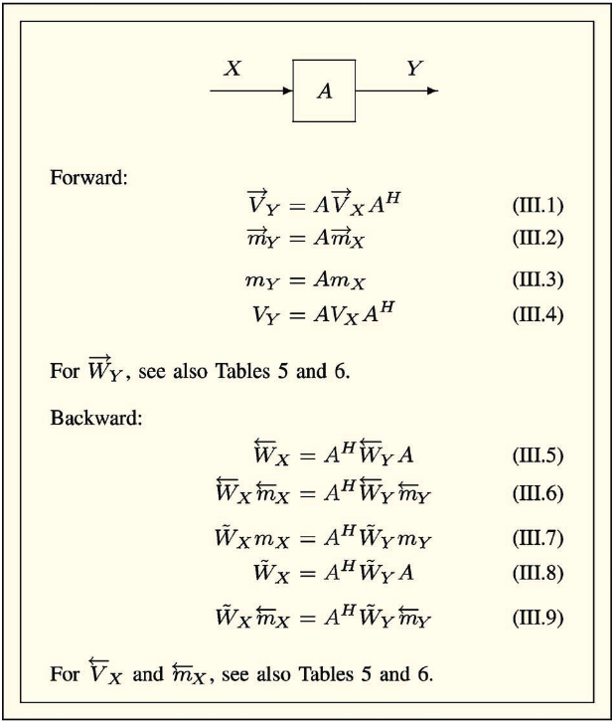
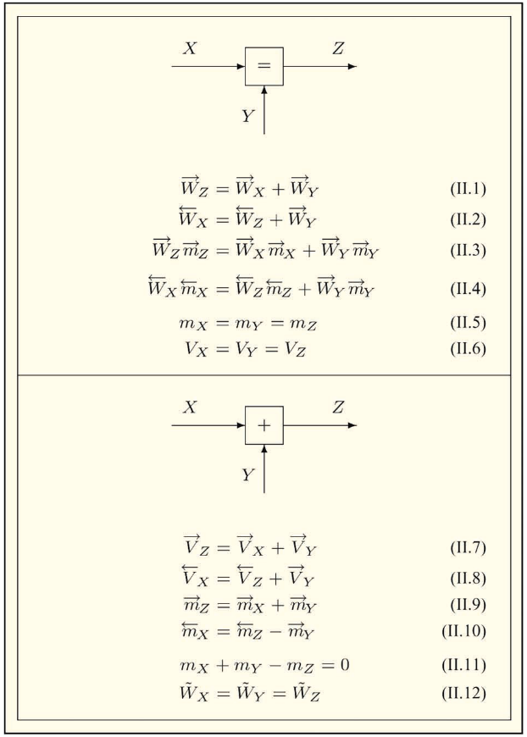
Message-passing approach: Forney-style Factor-graphs
Linear factors
Multiplication node
Summation node
Notes:
***Factor Graphs***
Factor graphs are easy to understand, and highly useful when it comes to model design.
In short, any arbitrary factorized probabilistic model can be encoded exactly as a factor graph. Consider the model p(a,b,c) = p(a)p(b|a)p(c|b)
This model has a representation as this Forney-style factor-graph, where the nodes denote the factors and the edges denote the variables. The conditional independencies are made vividly clear. This is a simple model and you may argue the algebraic form is just as clear.
However, when we consider a loopy model with arbitrary non-negative factors/potentials f such as p(a,b,c,d) propto 1/Z f_1(a,b) f_2(b,c) f_3(c,d) f_4(d,a) and this corresponding factor graph, and we see that the loop is readily apparent, whereas in the algebraic form, it is less so, and in more complicated models, model structure can be quite difficult to understand.
And so a [factor-graph is a convenient visual representation of a probabilistic model], useful for understanding model structure and formulating message-passing algorithms.
(pass) Its use becomes even more apparent as we begin to utilize hybrid message-passing approaches, where we apply variational constraints to the variables around specific nodes [highlight a node and show a variational factorization]
(pass) , and in cases of non-conjugacies, where we may need to apply form-constraints to certain variables that perform projections into conjugate families [highlight an edge and write “ProjectTo Gamma”].
(pass) For now, we use Gaussian-conjugate factors without variational or form constraints.
We can also encode linear probabilistic models described algebraically, such as y = Hx + w, where y, x, and w are random variables, and A is a constant matrix, transpose vector, or scalar [ show equation, arrow, FFG ]
This highlights the presence of multiplication and summation nodes, where inverse and negated terms provide division and subtraction via the same factors.
Here we pause to review a few more factors that show up frequently in linear Gaussian models. Each have closed-form message rules.
When a variable connects to more than two factors, it gets duplicated via an equality node like this with these rules
Then we have point-mass factors used commonly for measured data, and encode dirac
We have multiplication nodes for multiplication of a variable by a vector or matrix…
We have summation nodes to add or subtract two variables…
And we have a Normal distribution node that forms a Gaussian potential for the output from an input random mean and variance …

Slide 27
Message-passing approach: Forney-style Factor-graphs
Other common factors
Equality node
Point-mass node
Notes:
***Factor Graphs***
Factor graphs are easy to understand, and highly useful when it comes to model design.
In short, any arbitrary factorized probabilistic model can be encoded exactly as a factor graph. Consider the model p(a,b,c) = p(a)p(b|a)p(c|b)
This model has a representation as this Forney-style factor-graph, where the nodes denote the factors and the edges denote the variables. The conditional independencies are made vividly clear. This is a simple model and you may argue the algebraic form is just as clear.
However, when we consider a loopy model with arbitrary non-negative factors/potentials f such as p(a,b,c,d) propto 1/Z f_1(a,b) f_2(b,c) f_3(c,d) f_4(d,a) and this corresponding factor graph, and we see that the loop is readily apparent, whereas in the algebraic form, it is less so, and in more complicated models, model structure can be quite difficult to understand.
And so a [factor-graph is a convenient visual representation of a probabilistic model], useful for understanding model structure and formulating message-passing algorithms.
(pass) Its use becomes even more apparent as we begin to utilize hybrid message-passing approaches, where we apply variational constraints to the variables around specific nodes [highlight a node and show a variational factorization]
(pass) , and in cases of non-conjugacies, where we may need to apply form-constraints to certain variables that perform projections into conjugate families [highlight an edge and write “ProjectTo Gamma”].
(pass) For now, we use Gaussian-conjugate factors without variational or form constraints.
We can also encode linear probabilistic models described algebraically, such as y = Hx + w, where y, x, and w are random variables, and A is a constant matrix, transpose vector, or scalar [ show equation, arrow, FFG ]
This highlights the presence of multiplication and summation nodes, where inverse and negated terms provide division and subtraction via the same factors.
Here we pause to review a few more factors that show up frequently in linear Gaussian models. Each have closed-form message rules.
When a variable connects to more than two factors, it gets duplicated via an equality node like this with these rules
Then we have point-mass factors used commonly for measured data, and encode dirac
We have multiplication nodes for multiplication of a variable by a vector or matrix…
We have summation nodes to add or subtract two variables…
And we have a Normal distribution node that forms a Gaussian potential for the output from an input random mean and variance …

Slide 28
Message-passing approach: Forney-style Factor-graphs
Other common factors
Normal node
Notes:
***Factor Graphs***
Factor graphs are easy to understand, and highly useful when it comes to model design.
In short, any arbitrary factorized probabilistic model can be encoded exactly as a factor graph. Consider the model p(a,b,c) = p(a)p(b|a)p(c|b)
This model has a representation as this Forney-style factor-graph, where the nodes denote the factors and the edges denote the variables. The conditional independencies are made vividly clear. This is a simple model and you may argue the algebraic form is just as clear.
However, when we consider a loopy model with arbitrary non-negative factors/potentials f such as p(a,b,c,d) propto 1/Z f_1(a,b) f_2(b,c) f_3(c,d) f_4(d,a) and this corresponding factor graph, and we see that the loop is readily apparent, whereas in the algebraic form, it is less so, and in more complicated models, model structure can be quite difficult to understand.
And so a [factor-graph is a convenient visual representation of a probabilistic model], useful for understanding model structure and formulating message-passing algorithms.
(pass) Its use becomes even more apparent as we begin to utilize hybrid message-passing approaches, where we apply variational constraints to the variables around specific nodes [highlight a node and show a variational factorization]
(pass) , and in cases of non-conjugacies, where we may need to apply form-constraints to certain variables that perform projections into conjugate families [highlight an edge and write “ProjectTo Gamma”].
(pass) For now, we use Gaussian-conjugate factors without variational or form constraints.
We can also encode linear probabilistic models described algebraically, such as y = Hx + w, where y, x, and w are random variables, and A is a constant matrix, transpose vector, or scalar [ show equation, arrow, FFG ]
This highlights the presence of multiplication and summation nodes, where inverse and negated terms provide division and subtraction via the same factors.
Here we pause to review a few more factors that show up frequently in linear Gaussian models. Each have closed-form message rules.
When a variable connects to more than two factors, it gets duplicated via an equality node like this with these rules
Then we have point-mass factors used commonly for measured data, and encode dirac
We have multiplication nodes for multiplication of a variable by a vector or matrix…
We have summation nodes to add or subtract two variables…
And we have a Normal distribution node that forms a Gaussian potential for the output from an input random mean and variance …

Slide 29
Message-passing approach: Forney-style Factor-graphs
Other common factors
Normal node
Notes:
***Factor Graphs***
Factor graphs are easy to understand, and highly useful when it comes to model design.
In short, any arbitrary factorized probabilistic model can be encoded exactly as a factor graph. Consider the model p(a,b,c) = p(a)p(b|a)p(c|b)
This model has a representation as this Forney-style factor-graph, where the nodes denote the factors and the edges denote the variables. The conditional independencies are made vividly clear. This is a simple model and you may argue the algebraic form is just as clear.
However, when we consider a loopy model with arbitrary non-negative factors/potentials f such as p(a,b,c,d) propto 1/Z f_1(a,b) f_2(b,c) f_3(c,d) f_4(d,a) and this corresponding factor graph, and we see that the loop is readily apparent, whereas in the algebraic form, it is less so, and in more complicated models, model structure can be quite difficult to understand.
And so a [factor-graph is a convenient visual representation of a probabilistic model], useful for understanding model structure and formulating message-passing algorithms.
(pass) Its use becomes even more apparent as we begin to utilize hybrid message-passing approaches, where we apply variational constraints to the variables around specific nodes [highlight a node and show a variational factorization]
(pass) , and in cases of non-conjugacies, where we may need to apply form-constraints to certain variables that perform projections into conjugate families [highlight an edge and write “ProjectTo Gamma”].
(pass) For now, we use Gaussian-conjugate factors without variational or form constraints.
We can also encode linear probabilistic models described algebraically, such as y = Hx + w, where y, x, and w are random variables, and A is a constant matrix, transpose vector, or scalar [ show equation, arrow, FFG ]
This highlights the presence of multiplication and summation nodes, where inverse and negated terms provide division and subtraction via the same factors.
Here we pause to review a few more factors that show up frequently in linear Gaussian models. Each have closed-form message rules.
When a variable connects to more than two factors, it gets duplicated via an equality node like this with these rules
Then we have point-mass factors used commonly for measured data, and encode dirac
We have multiplication nodes for multiplication of a variable by a vector or matrix…
We have summation nodes to add or subtract two variables…
And we have a Normal distribution node that forms a Gaussian potential for the output from an input random mean and variance …

Slide 30
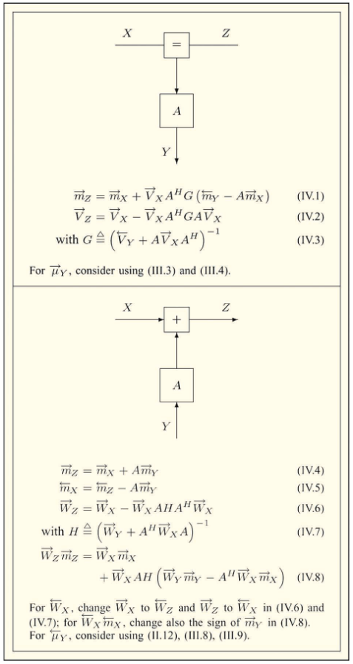
Message-passing approach: Forney-style Factor-graphs
Node composition
We can combine nodes into “composite nodes”
Notes:
***Factor Graphs***
Factor graphs are easy to understand, and highly useful when it comes to model design.
In short, any arbitrary factorized probabilistic model can be encoded exactly as a factor graph. Consider the model p(a,b,c) = p(a)p(b|a)p(c|b)
This model has a representation as this Forney-style factor-graph, where the nodes denote the factors and the edges denote the variables. The conditional independencies are made vividly clear. This is a simple model and you may argue the algebraic form is just as clear.
However, when we consider a loopy model with arbitrary non-negative factors/potentials f such as p(a,b,c,d) propto 1/Z f_1(a,b) f_2(b,c) f_3(c,d) f_4(d,a) and this corresponding factor graph, and we see that the loop is readily apparent, whereas in the algebraic form, it is less so, and in more complicated models, model structure can be quite difficult to understand.
And so a [factor-graph is a convenient visual representation of a probabilistic model], useful for understanding model structure and formulating message-passing algorithms.
(pass) Its use becomes even more apparent as we begin to utilize hybrid message-passing approaches, where we apply variational constraints to the variables around specific nodes [highlight a node and show a variational factorization]
(pass) , and in cases of non-conjugacies, where we may need to apply form-constraints to certain variables that perform projections into conjugate families [highlight an edge and write “ProjectTo Gamma”].
(pass) For now, we use Gaussian-conjugate factors without variational or form constraints.
We can also encode linear probabilistic models described algebraically, such as y = Hx + w, where y, x, and w are random variables, and A is a constant matrix, transpose vector, or scalar [ show equation, arrow, FFG ]
This highlights the presence of multiplication and summation nodes, where inverse and negated terms provide division and subtraction via the same factors.
Here we pause to review a few more factors that show up frequently in linear Gaussian models. Each have closed-form message rules.
When a variable connects to more than two factors, it gets duplicated via an equality node like this with these rules
Then we have point-mass factors used commonly for measured data, and encode dirac
We have multiplication nodes for multiplication of a variable by a vector or matrix…
We have summation nodes to add or subtract two variables…
And we have a Normal distribution node that forms a Gaussian potential for the output from an input random mean and variance …

Slide 31
4. Message passing approach to $Ax=b$
A
Setup
B
Forney-style Factor Graphs
C
Belief propagation
D
Solving $Ax=b$ by Message-Passing on a Factor-Graph
Notes:
Outline

Slide 32
Message-passing approach: Belief-propagation
Great! So how do we perform message-passing inference?
We consider only Belief Propagation
aka Sum-Product message-passing
Three steps:
(1) Messages
(2) Products
(3) Iteration
Notes:
***Belief Propagation***
In addition to considering a simple factor graph, we also consider the simplest message-passing formulation, called alternatively Belief-propagation and Sum-product message-passing. Additionally, we perform simple asynchronous message-passing, and I’ll explain what that means.
There are really just two steps to belief propagation that we repeat iteratively until convergence.
The first step is computation of messages, and the second is computation of marginals.
Messages are the local information content about a variable that is sent out from a factor along the edge for that variable, considering that factor’s inputs and factor function. They are functions or potentials of the output variable and need not be normalized, though they often are.
For belief-propagation, the an output message is computed as the integral of the factor function multiplied by all input messages, from variables besides the one for whom we are computing the message. This is shown as so… For Gaussian-conjugate factors and Gaussian messages, these message computations are available in closed-form.
These messages then serve as input to the other factor along that edge.
Asynchronous message-passing then implies that when a factors inputs have changed, it sends out a new message. That’s it.
Second, we compute marginals. We note that the two connected factors both send messages along a variable’s edge. The current iteration’s approximate marginal belief for that variable is the normalized product of those two messages. This is shown as so…
So, factors send messages whenever inputs change, and marginals are computed whenever messages along an edge change.
In a probabilistic model with loops, convergence is not guaranteed, but when it does as it often does in practice, means correspond to the exact posterior marginal means, while covariances are found to be in general, not exact, and often over-confident.
Now we return to our factorized Gaussian model and we showcase the message computation rules for both factors.
For Phi(x_i), only a single message is computed, and as it has no other inputs that might change, it’s outgoing message is computed only once. Evaluating this integral, we find the message to be so…
For Psi(x_i, x_j), the factor is symmetric about x_i and x_j, and so the same message rule is used in either case. It takes the form of this integral, with this closed-form solution… It gets recomputed for x_j whenever the incoming message for x_i changes, and vice-versa.
Finally, for completeness, we display the closed-form product of the two messages along any of these edges that computes the current iterative marginal. That is simply the sum of precision-weighted means and precisions, also known as information vectors and matrices, respectively.

Slide 33
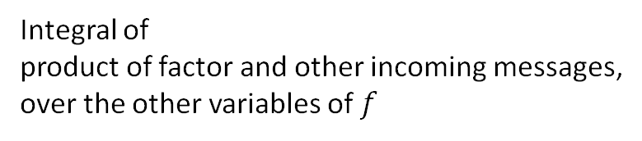

Message-passing approach: Belief-propagation
(1) Messages
BP message from $f$ to $x$
Integral of
product of factor and other incoming messages,
over the other variables of $f$
Incoming messages
Notes:
***Belief Propagation***
In addition to considering a simple factor graph, we also consider the simplest message-passing formulation, called alternatively Belief-propagation and Sum-product message-passing. Additionally, we perform simple asynchronous message-passing, and I’ll explain what that means.
There are really just two steps to belief propagation that we repeat iteratively until convergence.
The first step is computation of messages, and the second is computation of marginals.
Messages are the local information content about a variable that is sent out from a factor along the edge for that variable, considering that factor’s inputs and factor function. They are functions or potentials of the output variable and need not be normalized, though they often are.
For belief-propagation, the an output message is computed as the integral of the factor function multiplied by all input messages, from variables besides the one for whom we are computing the message. This is shown as so… For Gaussian-conjugate factors and Gaussian messages, these message computations are available in closed-form.
These messages then serve as input to the other factor along that edge.
Asynchronous message-passing then implies that when a factors inputs have changed, it sends out a new message. That’s it.
Second, we compute marginals. We note that the two connected factors both send messages along a variable’s edge. The current iteration’s approximate marginal belief for that variable is the normalized product of those two messages. This is shown as so…
So, factors send messages whenever inputs change, and marginals are computed whenever messages along an edge change.
In a probabilistic model with loops, convergence is not guaranteed, but when it does as it often does in practice, means correspond to the exact posterior marginal means, while covariances are found to be in general, not exact, and often over-confident.
Now we return to our factorized Gaussian model and we showcase the message computation rules for both factors.
For Phi(x_i), only a single message is computed, and as it has no other inputs that might change, it’s outgoing message is computed only once. Evaluating this integral, we find the message to be so…
For Psi(x_i, x_j), the factor is symmetric about x_i and x_j, and so the same message rule is used in either case. It takes the form of this integral, with this closed-form solution… It gets recomputed for x_j whenever the incoming message for x_i changes, and vice-versa.
Finally, for completeness, we display the closed-form product of the two messages along any of these edges that computes the current iterative marginal. That is simply the sum of precision-weighted means and precisions, also known as information vectors and matrices, respectively.

Slide 34


Message-passing approach: Belief-propagation
(2) Products
Marginal for $x$ at iteration $k$, $q_{}^{k}(x)$
Formed as product of messages to $x$
Notes:
***Belief Propagation***
In addition to considering a simple factor graph, we also consider the simplest message-passing formulation, called alternatively Belief-propagation and Sum-product message-passing. Additionally, we perform simple asynchronous message-passing, and I’ll explain what that means.
There are really just two steps to belief propagation that we repeat iteratively until convergence.
The first step is computation of messages, and the second is computation of marginals.
Messages are the local information content about a variable that is sent out from a factor along the edge for that variable, considering that factor’s inputs and factor function. They are functions or potentials of the output variable and need not be normalized, though they often are.
For belief-propagation, the an output message is computed as the integral of the factor function multiplied by all input messages, from variables besides the one for whom we are computing the message. This is shown as so… For Gaussian-conjugate factors and Gaussian messages, these message computations are available in closed-form.
These messages then serve as input to the other factor along that edge.
Asynchronous message-passing then implies that when a factors inputs have changed, it sends out a new message. That’s it.
Second, we compute marginals. We note that the two connected factors both send messages along a variable’s edge. The current iteration’s approximate marginal belief for that variable is the normalized product of those two messages. This is shown as so…
So, factors send messages whenever inputs change, and marginals are computed whenever messages along an edge change.
In a probabilistic model with loops, convergence is not guaranteed, but when it does as it often does in practice, means correspond to the exact posterior marginal means, while covariances are found to be in general, not exact, and often over-confident.
Now we return to our factorized Gaussian model and we showcase the message computation rules for both factors.
For Phi(x_i), only a single message is computed, and as it has no other inputs that might change, it’s outgoing message is computed only once. Evaluating this integral, we find the message to be so…
For Psi(x_i, x_j), the factor is symmetric about x_i and x_j, and so the same message rule is used in either case. It takes the form of this integral, with this closed-form solution… It gets recomputed for x_j whenever the incoming message for x_i changes, and vice-versa.
Finally, for completeness, we display the closed-form product of the two messages along any of these edges that computes the current iterative marginal. That is simply the sum of precision-weighted means and precisions, also known as information vectors and matrices, respectively.

Slide 35
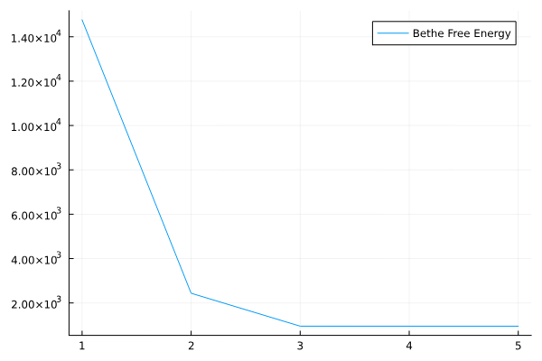
Message-passing approach: Belief-propagation
(3) Iteration
Evolves over iterations
VFE for each factor
Entropy for each edge
Loopy graph
Notes:
***Belief Propagation***
In addition to considering a simple factor graph, we also consider the simplest message-passing formulation, called alternatively Belief-propagation and Sum-product message-passing. Additionally, we perform simple asynchronous message-passing, and I’ll explain what that means.
There are really just two steps to belief propagation that we repeat iteratively until convergence.
The first step is computation of messages, and the second is computation of marginals.
Messages are the local information content about a variable that is sent out from a factor along the edge for that variable, considering that factor’s inputs and factor function. They are functions or potentials of the output variable and need not be normalized, though they often are.
For belief-propagation, the an output message is computed as the integral of the factor function multiplied by all input messages, from variables besides the one for whom we are computing the message. This is shown as so… For Gaussian-conjugate factors and Gaussian messages, these message computations are available in closed-form.
These messages then serve as input to the other factor along that edge.
Asynchronous message-passing then implies that when a factors inputs have changed, it sends out a new message. That’s it.
Second, we compute marginals. We note that the two connected factors both send messages along a variable’s edge. The current iteration’s approximate marginal belief for that variable is the normalized product of those two messages. This is shown as so…
So, factors send messages whenever inputs change, and marginals are computed whenever messages along an edge change.
In a probabilistic model with loops, convergence is not guaranteed, but when it does as it often does in practice, means correspond to the exact posterior marginal means, while covariances are found to be in general, not exact, and often over-confident.
Now we return to our factorized Gaussian model and we showcase the message computation rules for both factors.
For Phi(x_i), only a single message is computed, and as it has no other inputs that might change, it’s outgoing message is computed only once. Evaluating this integral, we find the message to be so…
For Psi(x_i, x_j), the factor is symmetric about x_i and x_j, and so the same message rule is used in either case. It takes the form of this integral, with this closed-form solution… It gets recomputed for x_j whenever the incoming message for x_i changes, and vice-versa.
Finally, for completeness, we display the closed-form product of the two messages along any of these edges that computes the current iterative marginal. That is simply the sum of precision-weighted means and precisions, also known as information vectors and matrices, respectively.

Slide 36
4. Message passing approach to $Ax=b$
A
Setup
B
Forney-style Factor Graphs
C
Belief propagation
D
Solving $Ax=b$ by Message-Passing on a Factor-Graph
Notes:
Outline

Slide 37

Message-passing approach: Solving $Ax=b$
Structure of $A$
Notes:
***Belief Propagation***
In addition to considering a simple factor graph, we also consider the simplest message-passing formulation, called alternatively Belief-propagation and Sum-product message-passing. Additionally, we perform simple asynchronous message-passing, and I’ll explain what that means.
There are really just two steps to belief propagation that we repeat iteratively until convergence.
The first step is computation of messages, and the second is computation of marginals.
Messages are the local information content about a variable that is sent out from a factor along the edge for that variable, considering that factor’s inputs and factor function. They are functions or potentials of the output variable and need not be normalized, though they often are.
For belief-propagation, the an output message is computed as the integral of the factor function multiplied by all input messages, from variables besides the one for whom we are computing the message. This is shown as so… For Gaussian-conjugate factors and Gaussian messages, these message computations are available in closed-form.
These messages then serve as input to the other factor along that edge.
Asynchronous message-passing then implies that when a factors inputs have changed, it sends out a new message. That’s it.
Second, we compute marginals. We note that the two connected factors both send messages along a variable’s edge. The current iteration’s approximate marginal belief for that variable is the normalized product of those two messages. This is shown as so…
So, factors send messages whenever inputs change, and marginals are computed whenever messages along an edge change.
In a probabilistic model with loops, convergence is not guaranteed, but when it does as it often does in practice, means correspond to the exact posterior marginal means, while covariances are found to be in general, not exact, and often over-confident.
Now we return to our factorized Gaussian model and we showcase the message computation rules for both factors.
For Phi(x_i), only a single message is computed, and as it has no other inputs that might change, it’s outgoing message is computed only once. Evaluating this integral, we find the message to be so…
For Psi(x_i, x_j), the factor is symmetric about x_i and x_j, and so the same message rule is used in either case. It takes the form of this integral, with this closed-form solution… It gets recomputed for x_j whenever the incoming message for x_i changes, and vice-versa.
Finally, for completeness, we display the closed-form product of the two messages along any of these edges that computes the current iterative marginal. That is simply the sum of precision-weighted means and precisions, also known as information vectors and matrices, respectively.

Slide 38
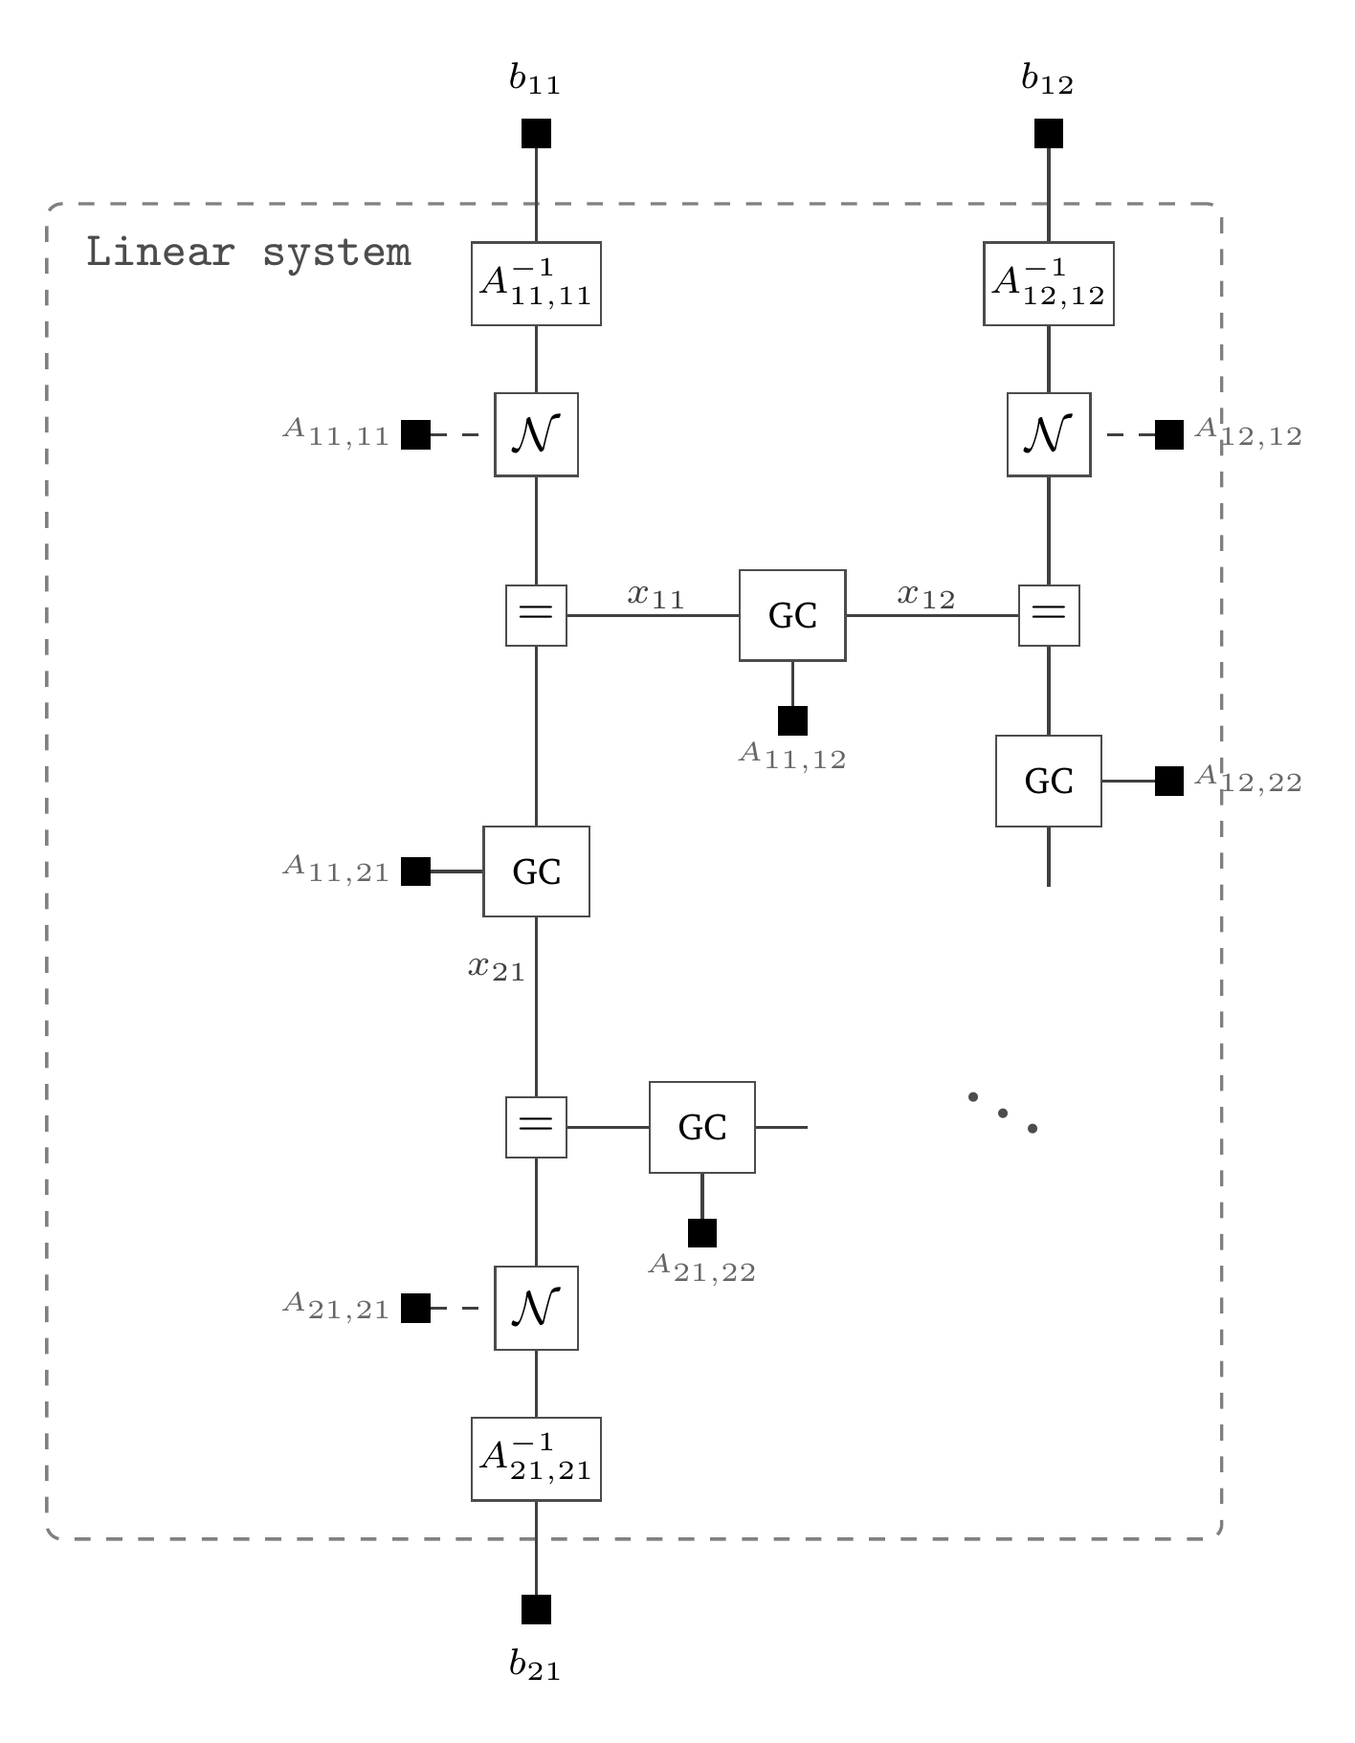

Message-passing approach: Solving $Ax=b$
Same graph,
different appearance
Next up:
!
Structure of $A$
Notes:
***Belief Propagation***
In addition to considering a simple factor graph, we also consider the simplest message-passing formulation, called alternatively Belief-propagation and Sum-product message-passing. Additionally, we perform simple asynchronous message-passing, and I’ll explain what that means.
There are really just two steps to belief propagation that we repeat iteratively until convergence.
The first step is computation of messages, and the second is computation of marginals.
Messages are the local information content about a variable that is sent out from a factor along the edge for that variable, considering that factor’s inputs and factor function. They are functions or potentials of the output variable and need not be normalized, though they often are.
For belief-propagation, the an output message is computed as the integral of the factor function multiplied by all input messages, from variables besides the one for whom we are computing the message. This is shown as so… For Gaussian-conjugate factors and Gaussian messages, these message computations are available in closed-form.
These messages then serve as input to the other factor along that edge.
Asynchronous message-passing then implies that when a factors inputs have changed, it sends out a new message. That’s it.
Second, we compute marginals. We note that the two connected factors both send messages along a variable’s edge. The current iteration’s approximate marginal belief for that variable is the normalized product of those two messages. This is shown as so…
So, factors send messages whenever inputs change, and marginals are computed whenever messages along an edge change.
In a probabilistic model with loops, convergence is not guaranteed, but when it does as it often does in practice, means correspond to the exact posterior marginal means, while covariances are found to be in general, not exact, and often over-confident.
Now we return to our factorized Gaussian model and we showcase the message computation rules for both factors.
For Phi(x_i), only a single message is computed, and as it has no other inputs that might change, it’s outgoing message is computed only once. Evaluating this integral, we find the message to be so…
For Psi(x_i, x_j), the factor is symmetric about x_i and x_j, and so the same message rule is used in either case. It takes the form of this integral, with this closed-form solution… It gets recomputed for x_j whenever the incoming message for x_i changes, and vice-versa.
Finally, for completeness, we display the closed-form product of the two messages along any of these edges that computes the current iterative marginal. That is simply the sum of precision-weighted means and precisions, also known as information vectors and matrices, respectively.

Slide 39
5. Stacking modular components
A
Anylyzing GaBP (Bayesian Jacobi solver)
B
Building

Slide 40
5. Stacking modular components
A
Anylyzing GaBP (Bayesian Jacobi solver)
B
Building

Slide 41
GaBP is a generalization of Jacobi
GaBP
Jacobi
No variance update
GaBP precision message:

Slide 42
GaBP iterations

Slide 43
You can play with schedules!

Slide 44
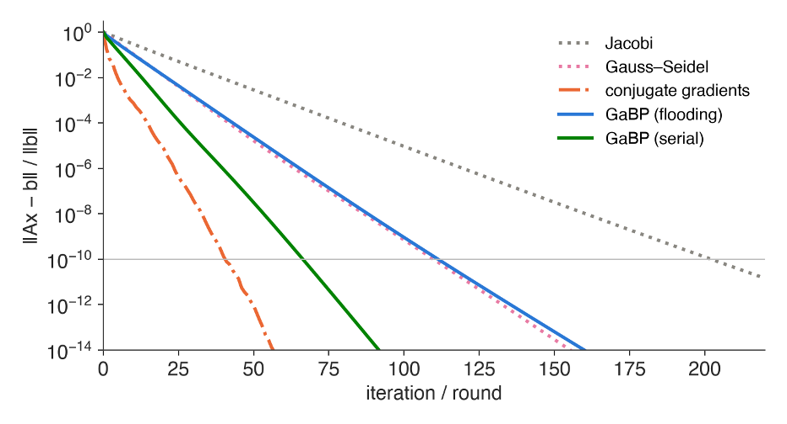
Is our generalization useful?
Notes:
Rounds to 10⁻¹⁰ on the 24×24 die, c = 0.4: Jacobi 203 · GaBP flooding 112 · Gauss–Seidel 110 · GaBP serial 67 · CG 41.
Same die as Wouter's section: 24×24 lattice, screening 0.4, same right-hand side, same target 1e-10. Jacobi needs 203 iterations. GaBP with the flooding schedule — every node sends every round, exactly Jacobi's communication pattern — needs 112. So the second moment that Jacobi throws away is worth a factor two in rounds. GaBP serial is the same algorithm with a Gauss–Seidel schedule: sweep the nodes in order and let each node use whatever is in its inbox right now, so messages from lower-numbered neighbours are already fresh this sweep. That gets 67 — the same trick Gauss–Seidel plays on Jacobi (110), for the same reason; red–black colouring gives it back at full parallelism, two half-sweeps per round. One round of serial costs the same number of message updates as one round of flooding; only the freshness differs. Say it unprompted: CG is still faster, 41. CG minimises the error over a growing global subspace; a local method has no global object to minimise over. On this problem that is a constant factor, not a change of order — the next two slides make the comparison fair. Also point at the tree: on the chain, GaBP terminates exactly after the diameter; CG does not.

Slide 45
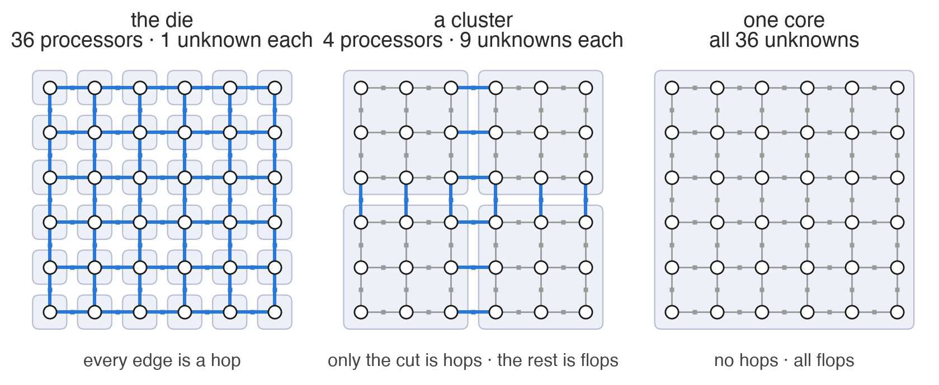
GaBP is distributed algorithm
Notes:
The textbook bound: the A-norm error contracts by (sqrt(kappa)-1)/(sqrt(kappa)+1) per step. For our die kappa = 19.4, which predicts 51 iterations to 1e-10; the measured number is 41. The bound is loose because the spectrum is clustered -- say that, because someone will know it. The honest problem is the second bullet: kappa and ||x*|| are as unknown as the solution, so the bound is not something you can evaluate at run time. And the cost per step is one local matvec plus two global reductions: on P processors that is 2 log2 P barriers per iteration, times 41.

Slide 46
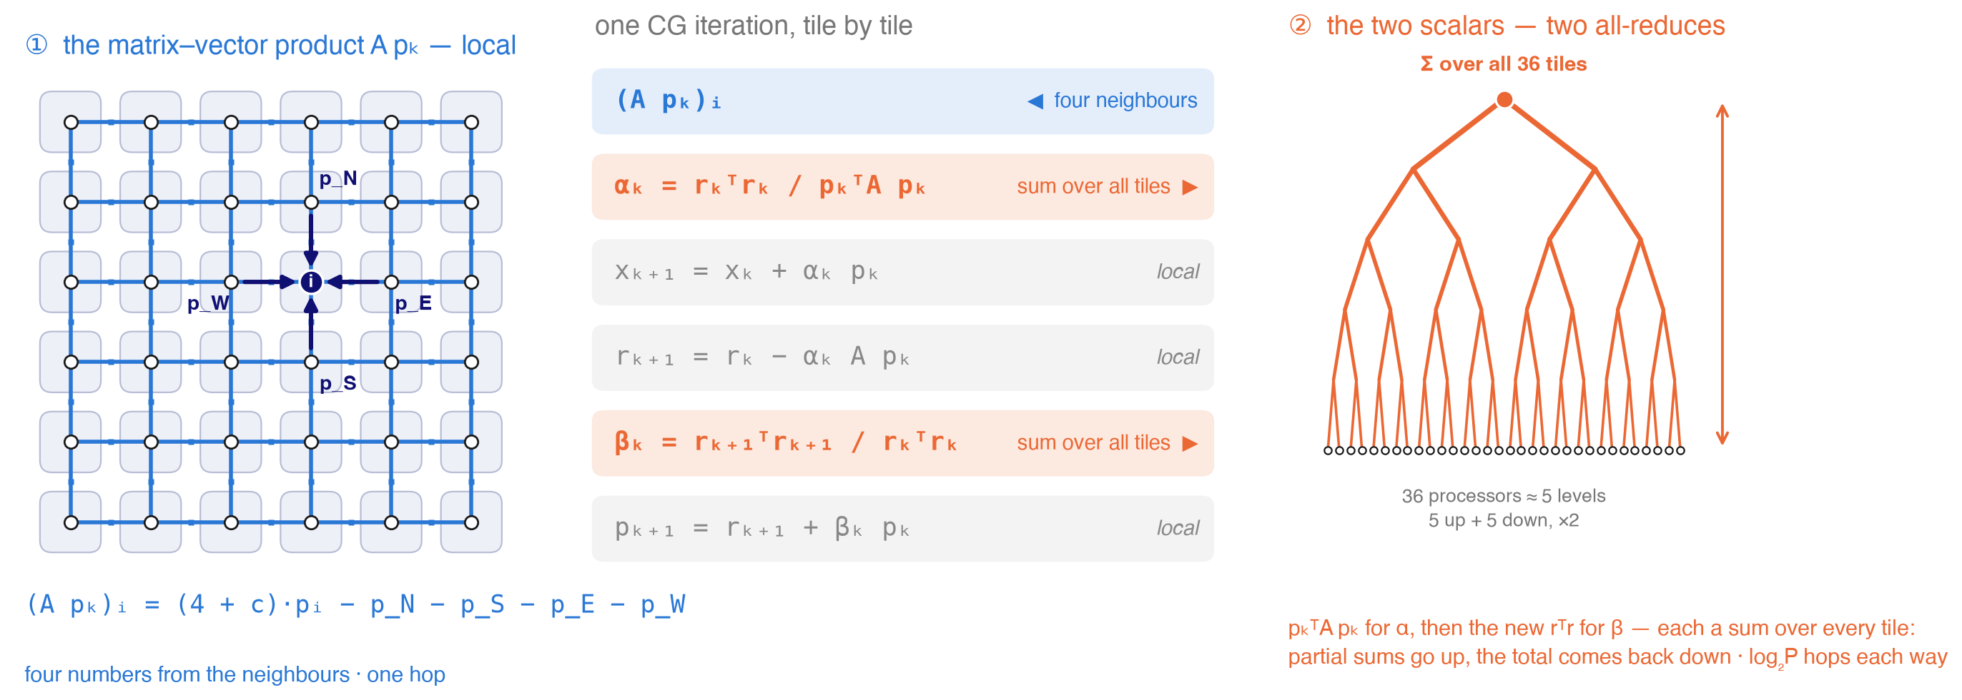
CG needs global synchronization steps
Notes:
The textbook bound: the A-norm error contracts by (sqrt(kappa)-1)/(sqrt(kappa)+1) per step. For our die kappa = 19.4, which predicts 51 iterations to 1e-10; the measured number is 41. The bound is loose because the spectrum is clustered -- say that, because someone will know it. The honest problem is the second bullet: kappa and ||x*|| are as unknown as the solution, so the bound is not something you can evaluate at run time. And the cost per step is one local matvec plus two global reductions: on P processors that is 2 log2 P barriers per iteration, times 41.

Slide 47
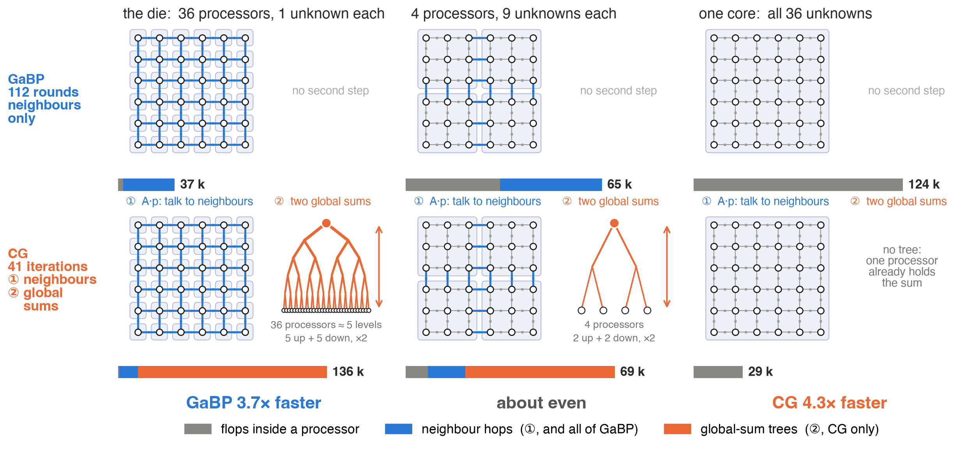
What algorithm wins and for what topology
Notes:
The textbook bound: the A-norm error contracts by (sqrt(kappa)-1)/(sqrt(kappa)+1) per step. For our die kappa = 19.4, which predicts 51 iterations to 1e-10; the measured number is 41. The bound is loose because the spectrum is clustered -- say that, because someone will know it. The honest problem is the second bullet: kappa and ||x*|| are as unknown as the solution, so the bound is not something you can evaluate at run time. And the cost per step is one local matvec plus two global reductions: on P processors that is 2 log2 P barriers per iteration, times 41.

Slide 48
5. Stacking modular components
A
Bayesian Jacobi solver
B
Building

Slide 49
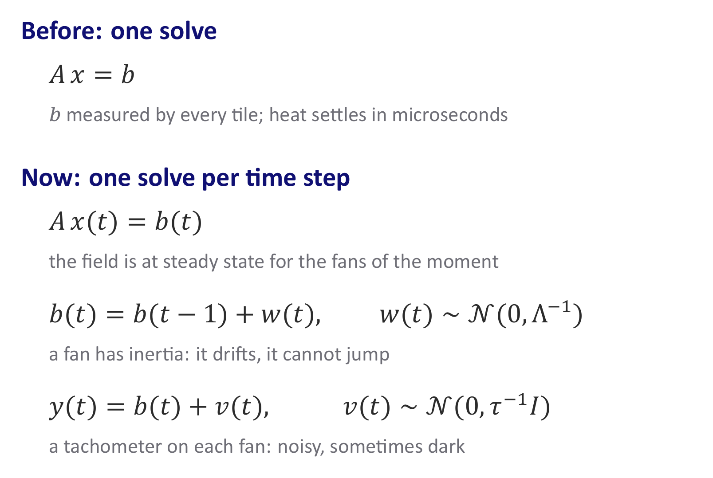

Adding some Fans
Notes:
The textbook bound: the A-norm error contracts by (sqrt(kappa)-1)/(sqrt(kappa)+1) per step. For our die kappa = 19.4, which predicts 51 iterations to 1e-10; the measured number is 41. The bound is loose because the spectrum is clustered -- say that, because someone will know it. The honest problem is the second bullet: kappa and ||x*|| are as unknown as the solution, so the bound is not something you can evaluate at run time. And the cost per step is one local matvec plus two global reductions: on P processors that is 2 log2 P barriers per iteration, times 41.

Slide 50
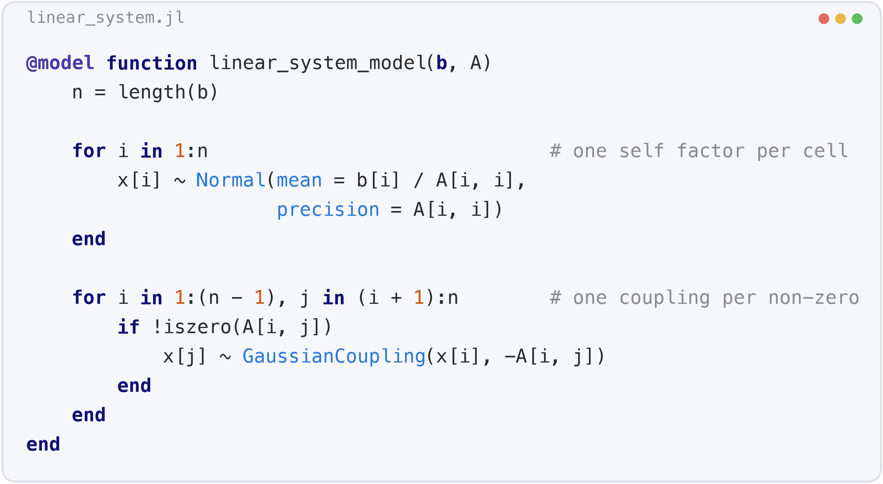
Translating from the FFG into Code
Notes:
The textbook bound: the A-norm error contracts by (sqrt(kappa)-1)/(sqrt(kappa)+1) per step. For our die kappa = 19.4, which predicts 51 iterations to 1e-10; the measured number is 41. The bound is loose because the spectrum is clustered -- say that, because someone will know it. The honest problem is the second bullet: kappa and ||x*|| are as unknown as the solution, so the bound is not something you can evaluate at run time. And the cost per step is one local matvec plus two global reductions: on P processors that is 2 log2 P barriers per iteration, times 41.

Slide 51
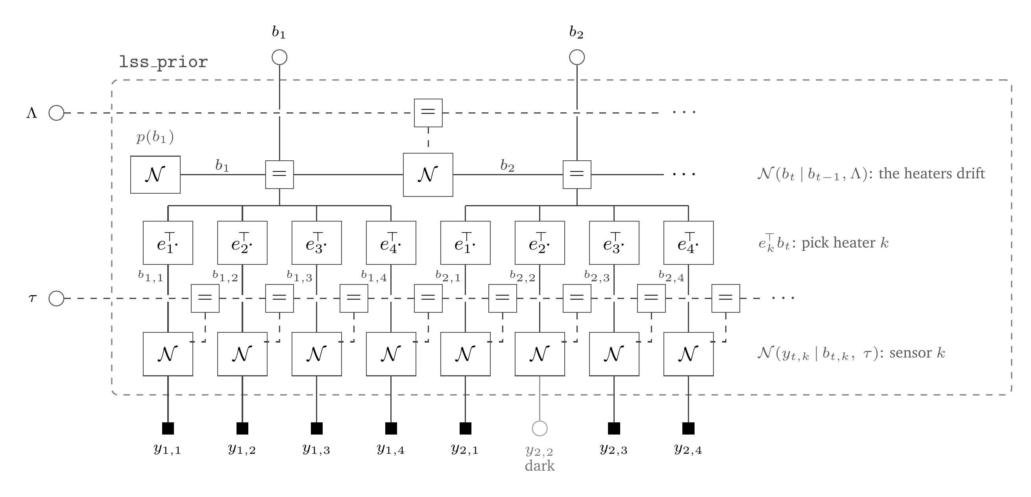
A linear state space model is a probabilistic block
Notes:
The textbook bound: the A-norm error contracts by (sqrt(kappa)-1)/(sqrt(kappa)+1) per step. For our die kappa = 19.4, which predicts 51 iterations to 1e-10; the measured number is 41. The bound is loose because the spectrum is clustered -- say that, because someone will know it. The honest problem is the second bullet: kappa and ||x*|| are as unknown as the solution, so the bound is not something you can evaluate at run time. And the cost per step is one local matvec plus two global reductions: on P processors that is 2 log2 P barriers per iteration, times 41.

Slide 52
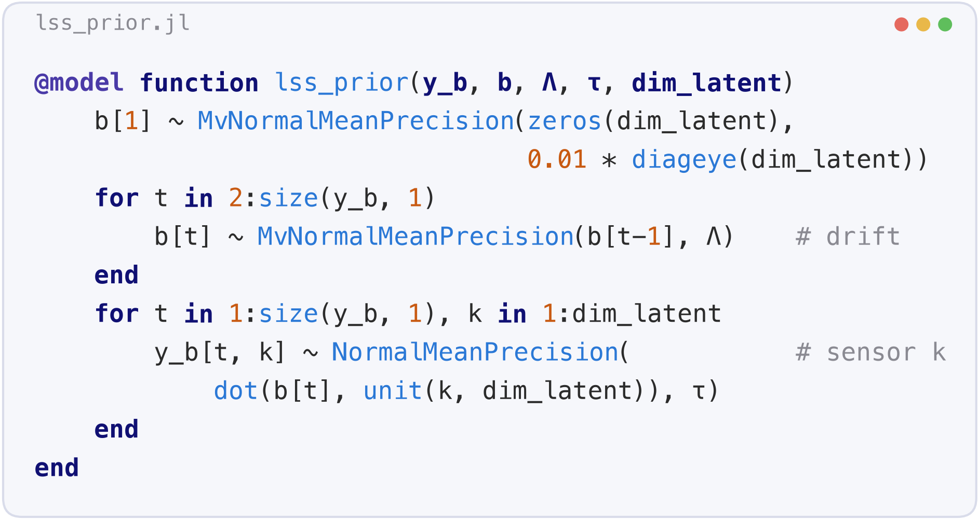
A linear state space in code
Notes:
The textbook bound: the A-norm error contracts by (sqrt(kappa)-1)/(sqrt(kappa)+1) per step. For our die kappa = 19.4, which predicts 51 iterations to 1e-10; the measured number is 41. The bound is loose because the spectrum is clustered -- say that, because someone will know it. The honest problem is the second bullet: kappa and ||x*|| are as unknown as the solution, so the bound is not something you can evaluate at run time. And the cost per step is one local matvec plus two global reductions: on P processors that is 2 log2 P barriers per iteration, times 41.

Slide 53
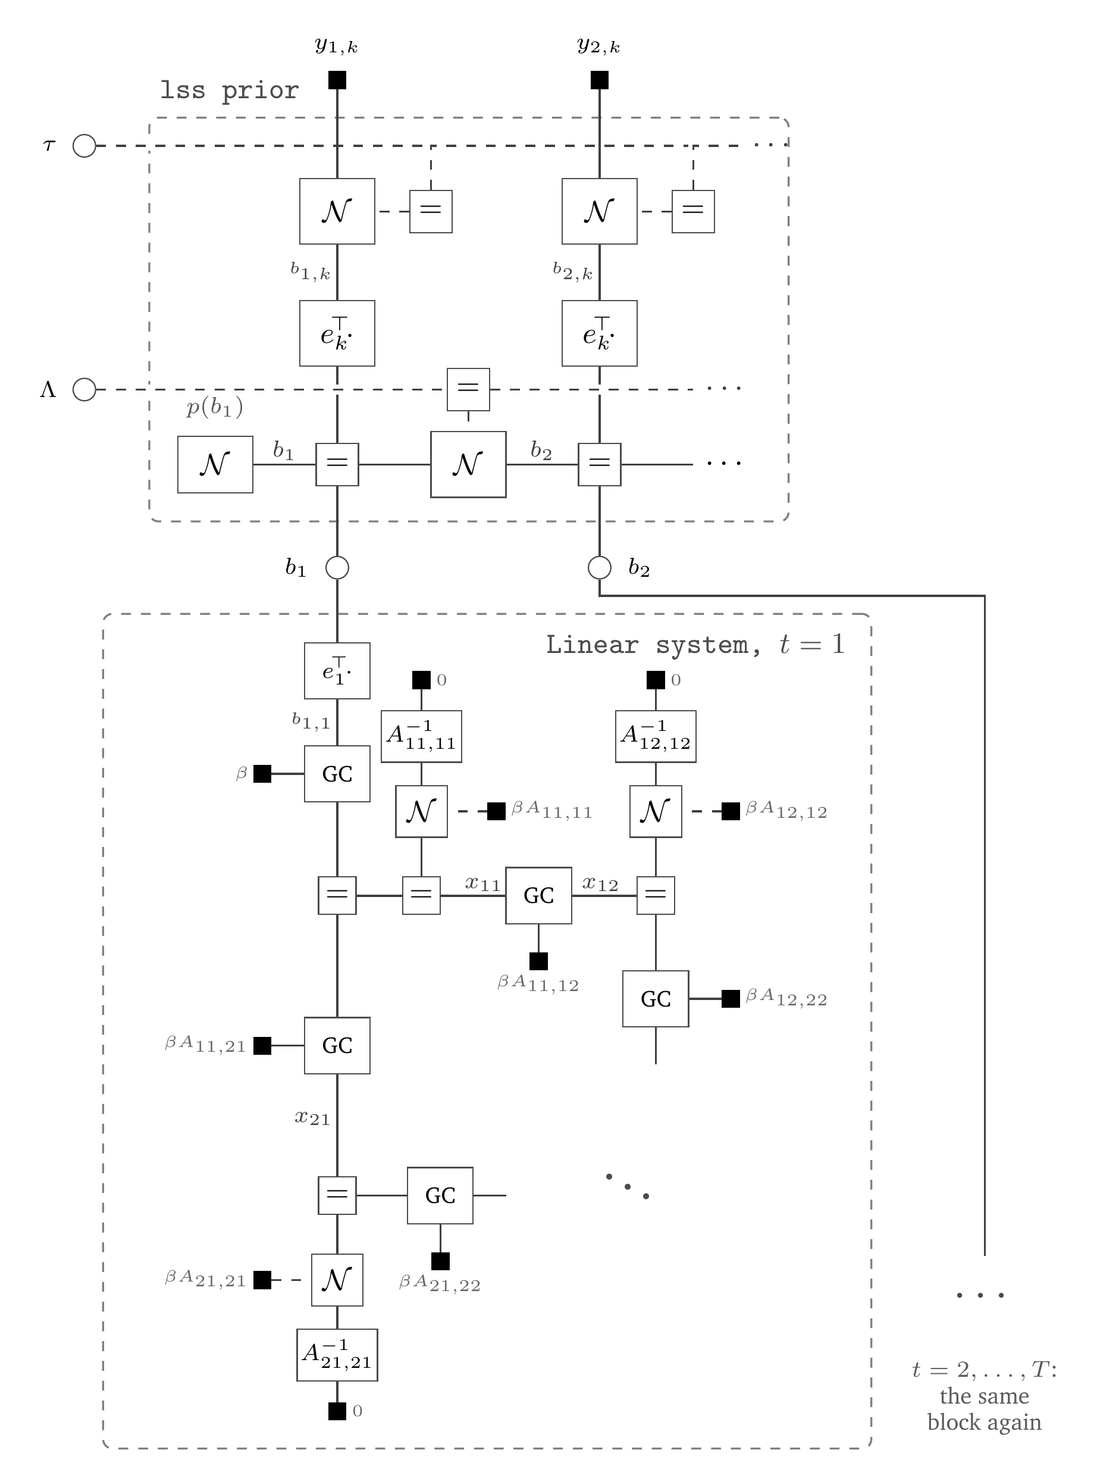
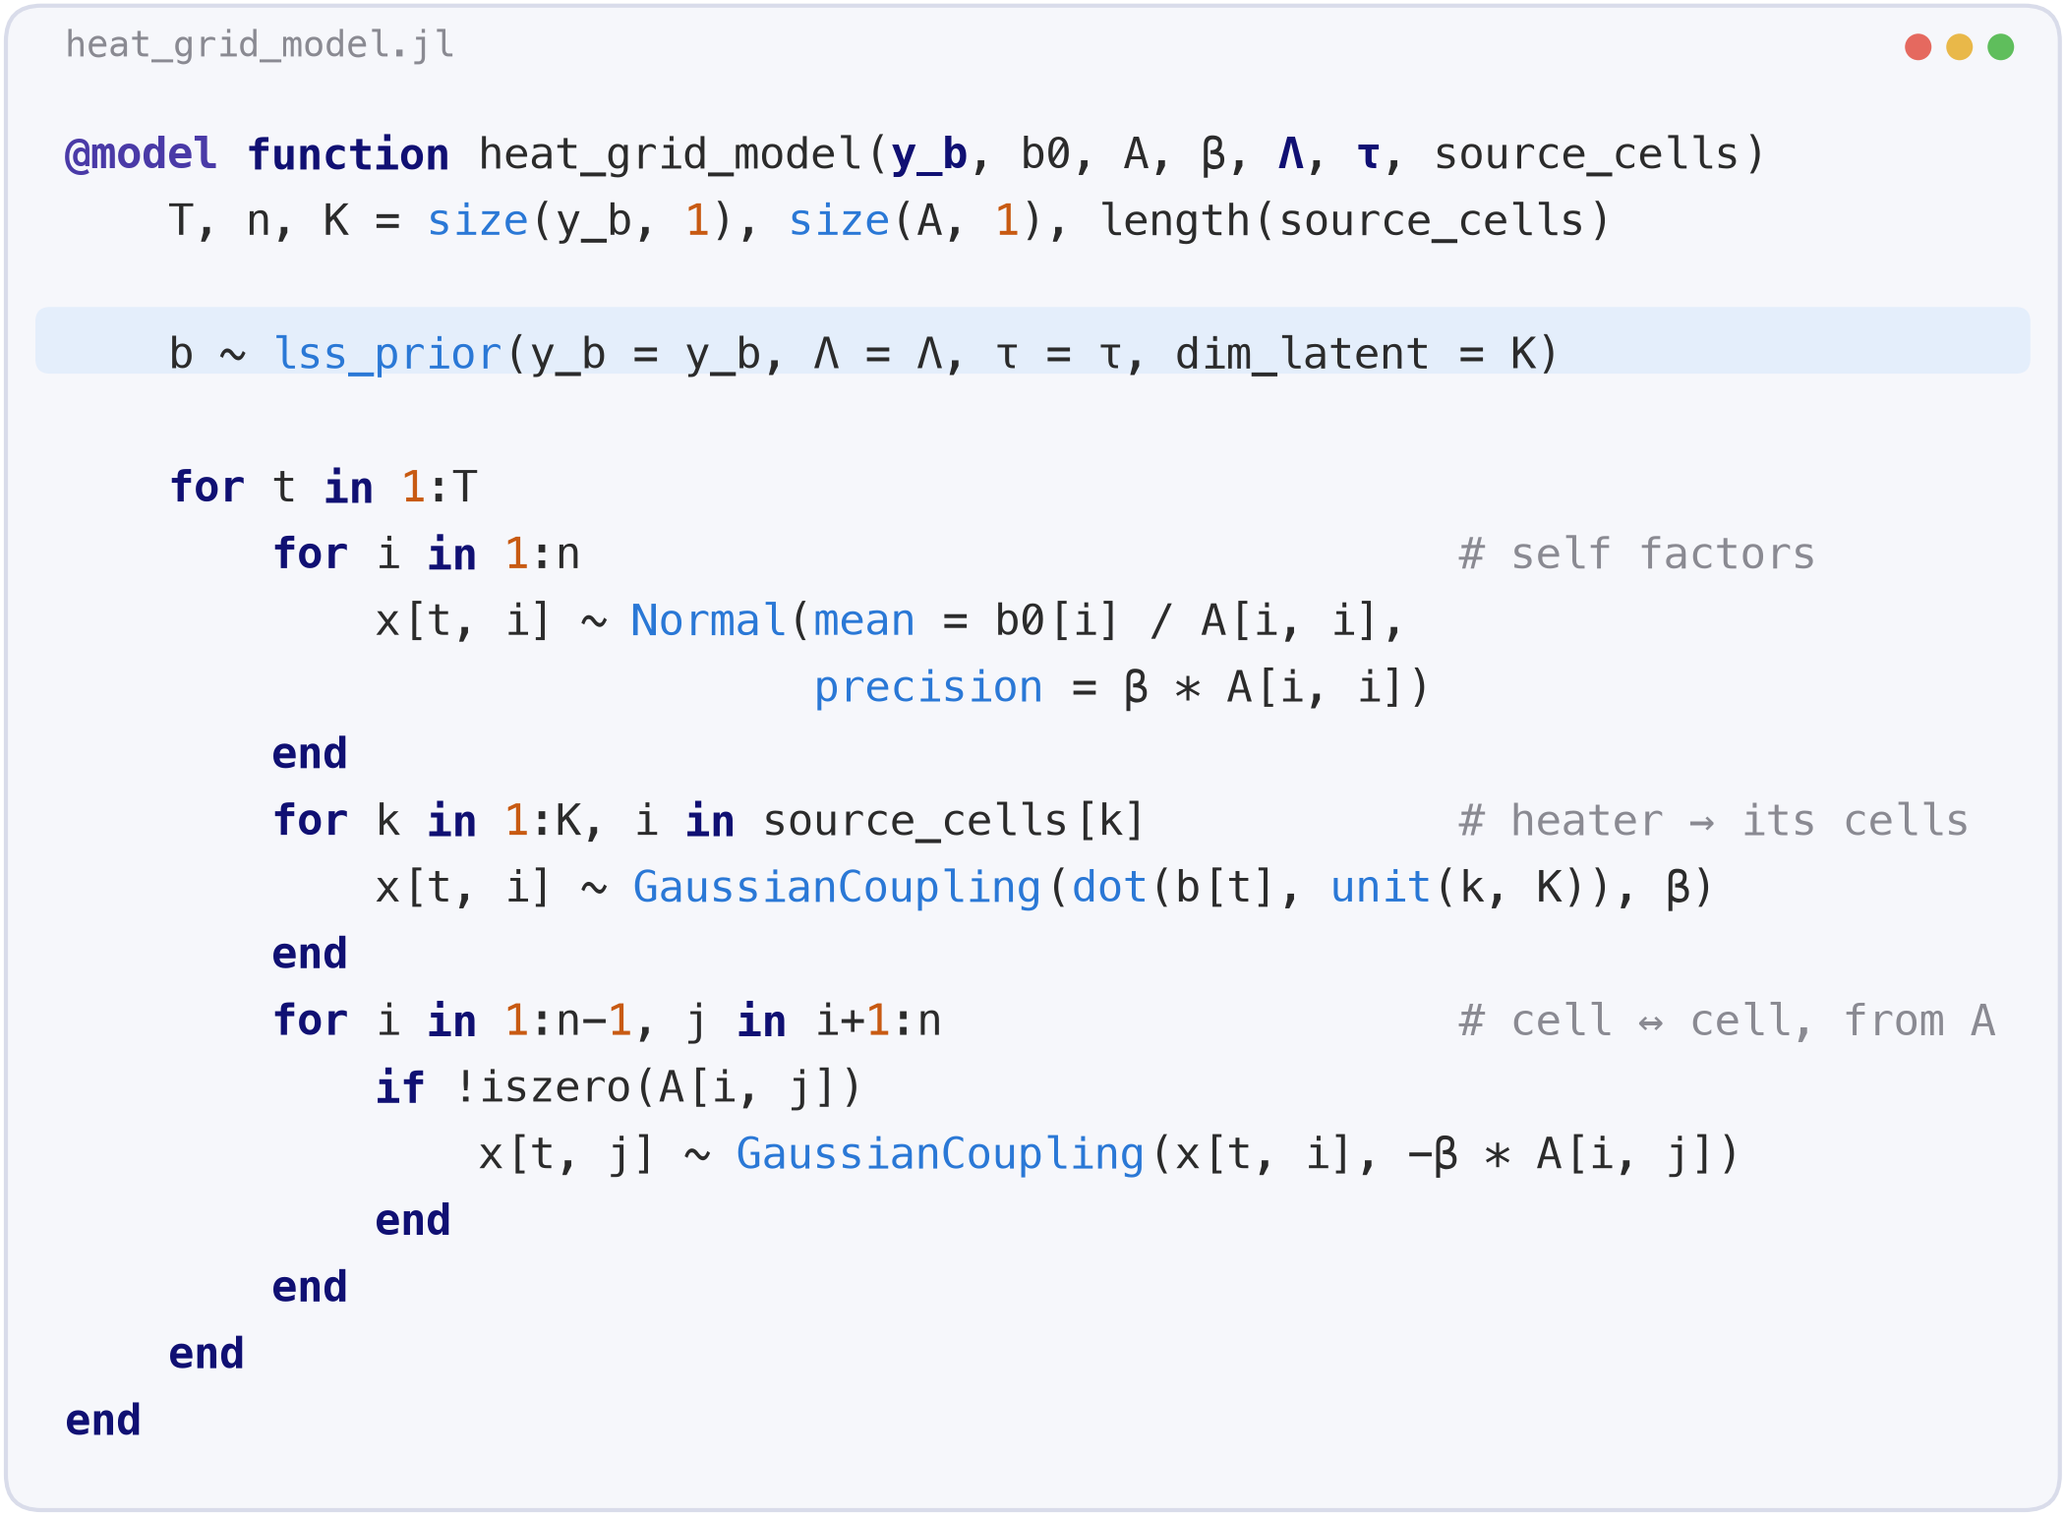
Compositional payoff
Notes:
The textbook bound: the A-norm error contracts by (sqrt(kappa)-1)/(sqrt(kappa)+1) per step. For our die kappa = 19.4, which predicts 51 iterations to 1e-10; the measured number is 41. The bound is loose because the spectrum is clustered -- say that, because someone will know it. The honest problem is the second bullet: kappa and ||x*|| are as unknown as the solution, so the bound is not something you can evaluate at run time. And the cost per step is one local matvec plus two global reductions: on P processors that is 2 log2 P barriers per iteration, times 41.

Slide 54
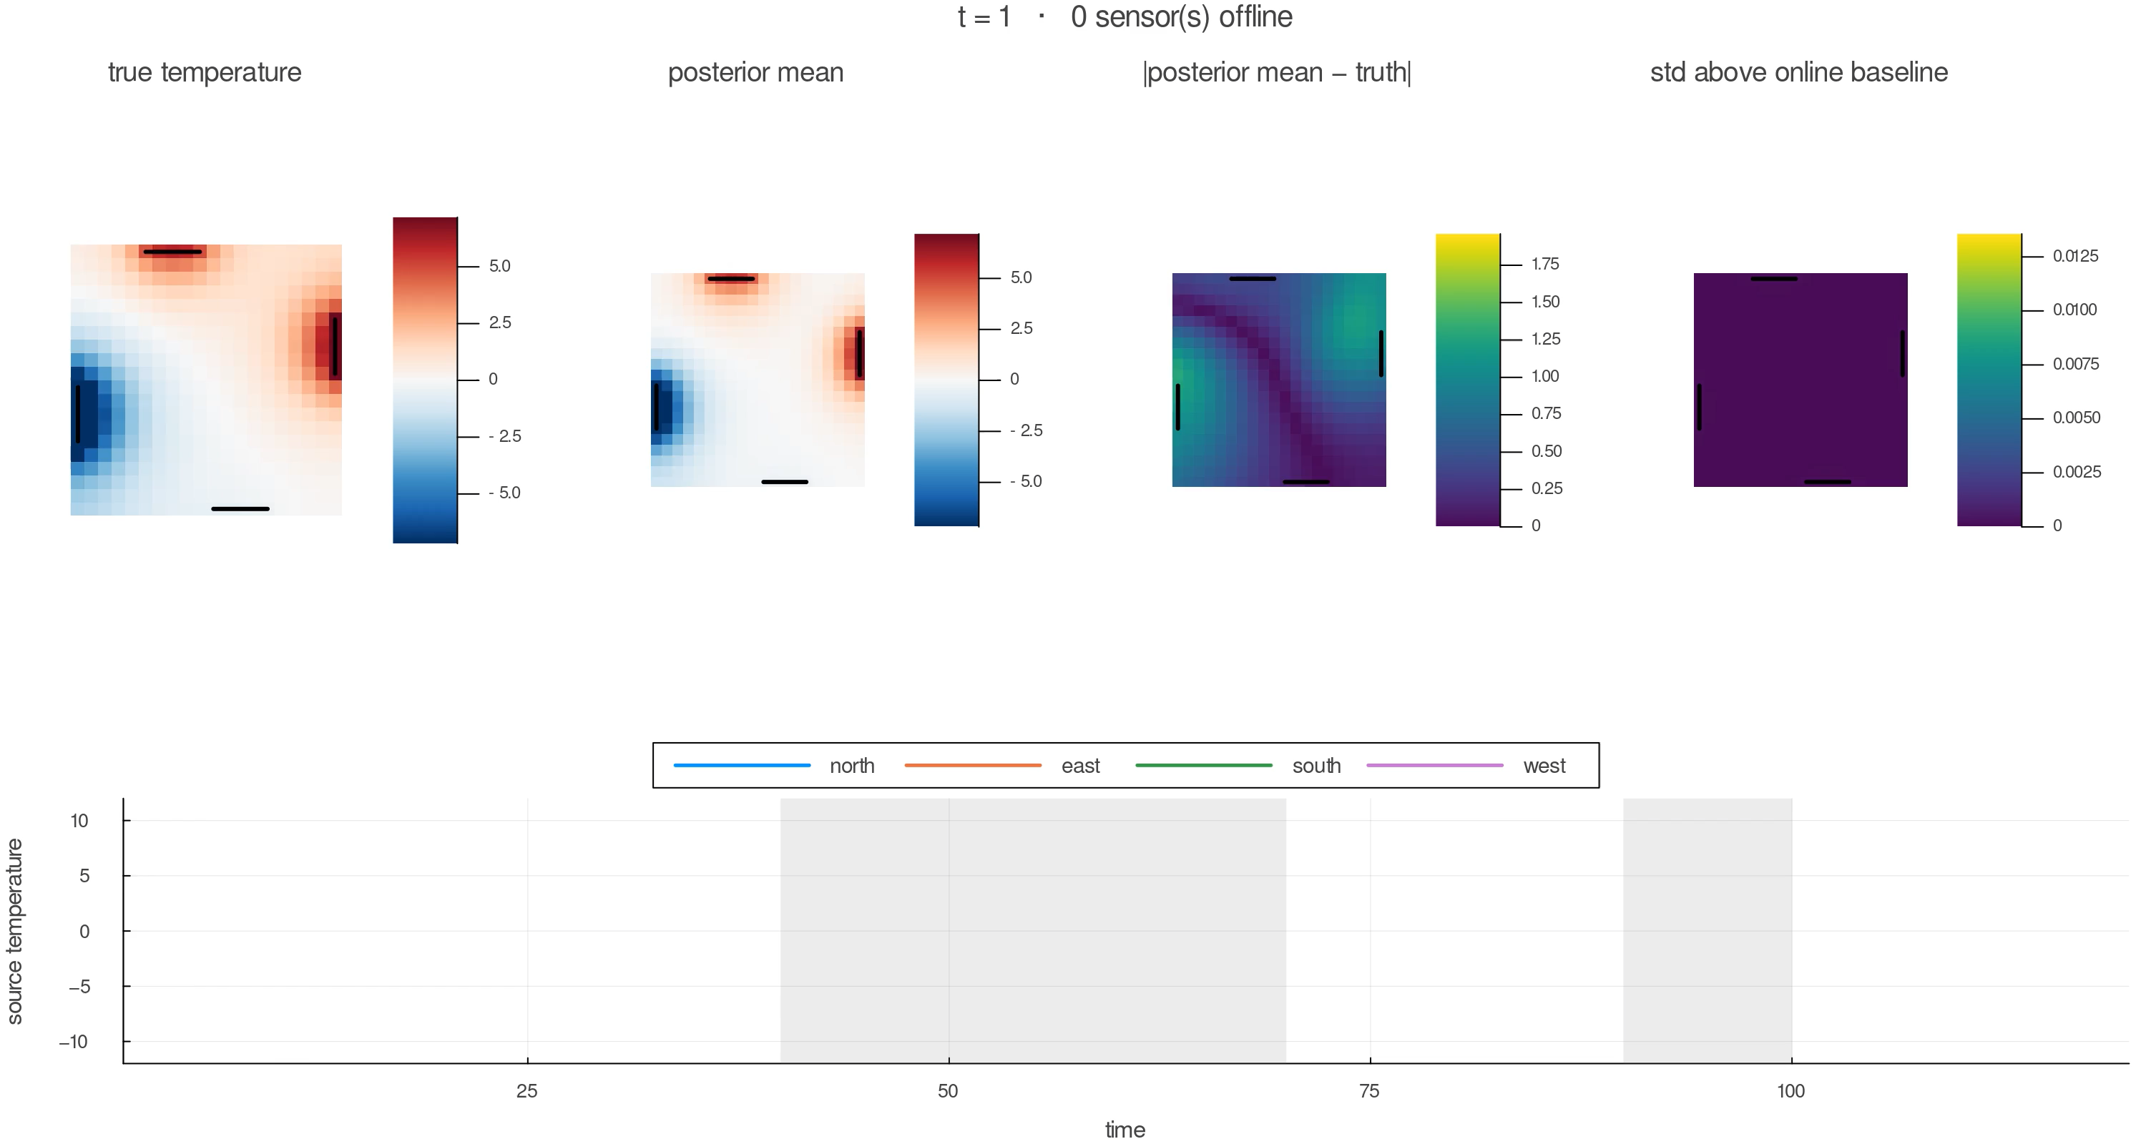
Let's do some Infer!
Notes:
The textbook bound: the A-norm error contracts by (sqrt(kappa)-1)/(sqrt(kappa)+1) per step. For our die kappa = 19.4, which predicts 51 iterations to 1e-10; the measured number is 41. The bound is loose because the spectrum is clustered -- say that, because someone will know it. The honest problem is the second bullet: kappa and ||x*|| are as unknown as the solution, so the bound is not something you can evaluate at run time. And the cost per step is one local matvec plus two global reductions: on P processors that is 2 log2 P barriers per iteration, times 41.

Slide 55
Thanks for your attention!

Slide 56
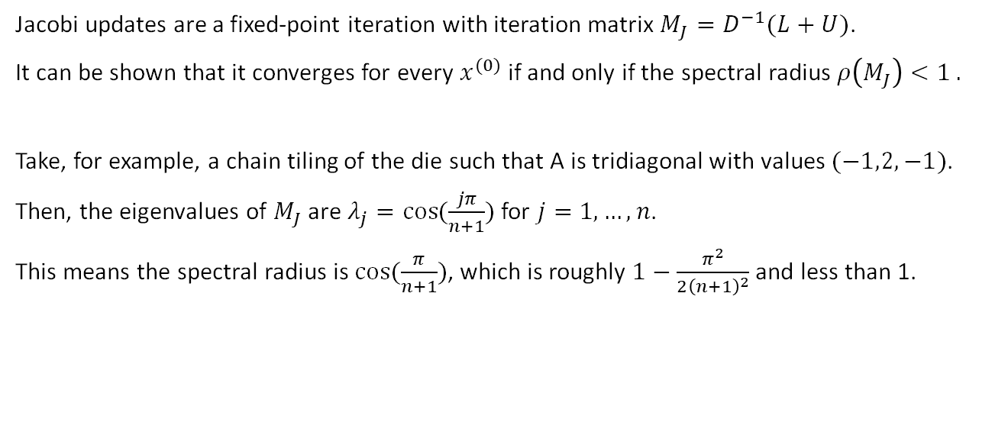
Extra: convergence of Jacobi iteration
Jacobi updates are a fixed-point iteration with iteration matrix $M_{J}=D^{−1}(L+U)$.
It can be shown that it converges for every $x^{(0)}$ if and only if the spectral radius $ρ\left(M_{J}\right)<1 .$
Take, for example, a chain tiling of the die such that A is tridiagonal with values $(−1,2,−1)$.
Then, the eigenvalues of $M_{J}$ are $λ_{j}=\cos{(\frac{jπ}{n+1})}$ for $j=1,…, n$.
This means the spectral radius is $\cos{(\frac{π}{n+1})}$, which is roughly $1−\frac{π^{2}}{2{\left(n+1\right)}^{2}}$ and less than 1.

Slide 57
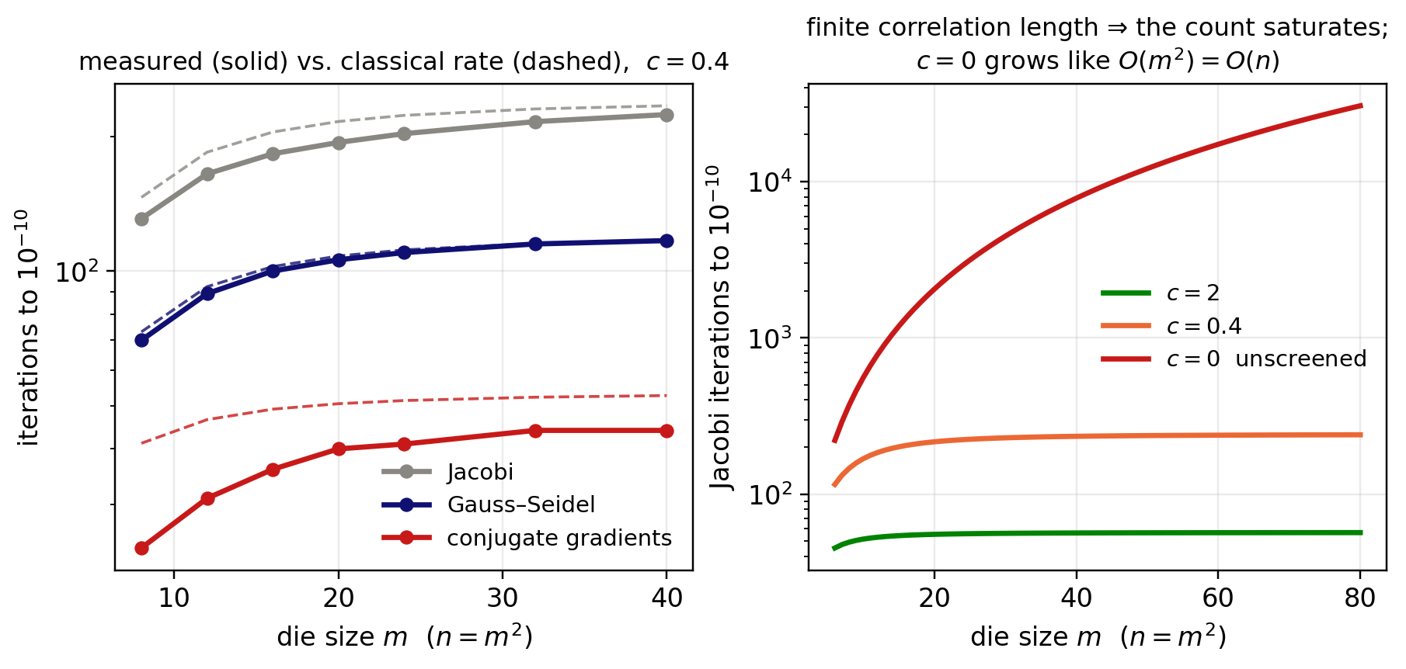

Extra: error rates
For $κ=λ_{max }/λ_{min }$, the error rate of the conjugate gradient method is $$∥x^{\left(t\right)}−x^{∗}∥_{A} ≤2 {\left(\frac{\sqrt{κ}−1}{\sqrt{κ}+1}\right)}^{t}∥x^{0}−x^{∗}∥_{A}$$

Slide 58

Extra: CG is posterior mean of BayesCG
If you choose $x^{(0)}=0$ and $Σ^{(0)}=A^{−1}$, then the posterior mean is exactly the result of CG:
$$x^{(m)}=x^{\left(0\right)}+Σ^{\left(0\right)}A^{T}S {\left(S^{T}AΣ^{0}A^{T}S\right)}^{−1}S^{T}\left(b−Ax^{\left(0\right)}\right) \\ =0+A^{−1}A^{T}S {\left(S^{T}AA^{−1}A^{T}S\right)}^{−1}S^{T}\left(b−A0\right) \\ =S {\left(S^{T}A^{T}S\right)}^{−1}S^{T}b$$

