Slide 1
BBC news:
A Text Mining application
Classification and text summarization
Alberto Odierna
Biagio Spiezia

Slide 2
Table of contents
01
02
03
04
Data description
Pre-processing
Text classification
Text summarization

Slide 3
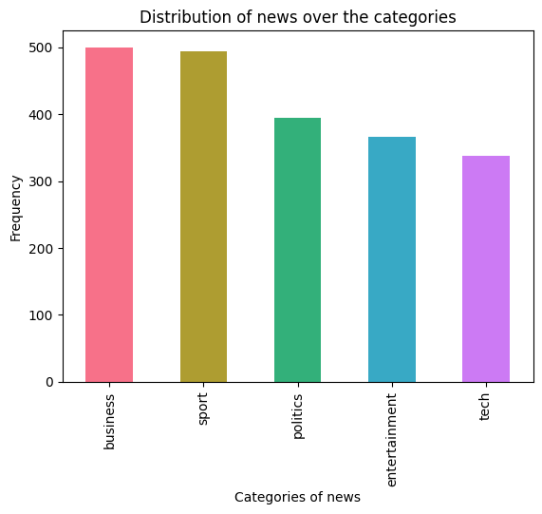
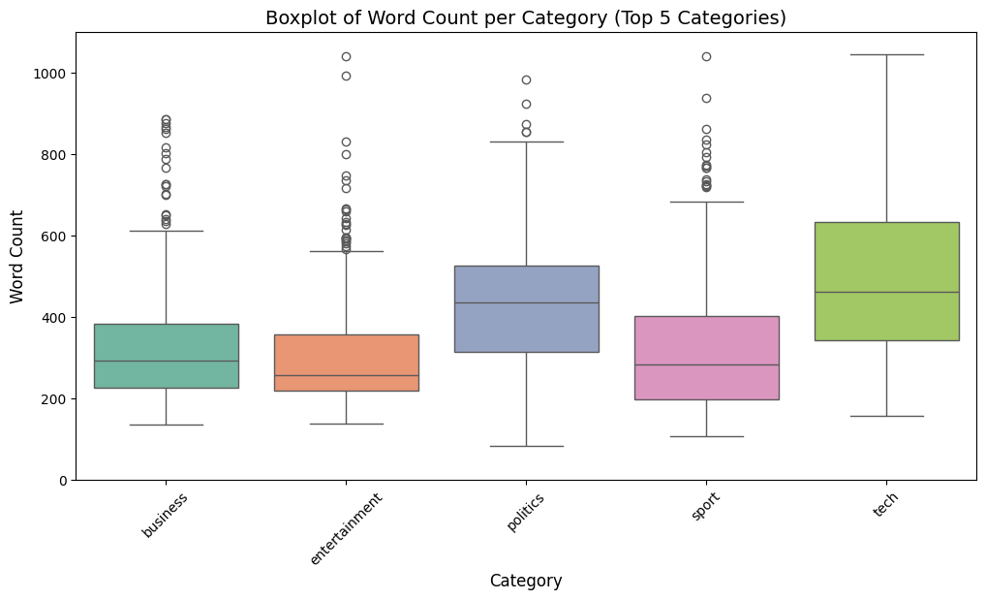
Data description
The dataset consist of 2.225 BBC news articles, covering the period from 2004 to 2005. Each article is associated with four key variables:
Category: indicates the respective category of article (Business, Sport, Tech, Entertainment or Politics);
Filename: identify the source CSV file containing the article;
Title: represents the article’s title;
Content: contains the textual content of each news article
Bar plot: the absolute frequencies of each category
Boxplot of word counts across category

Slide 4
PREPROCESSING
TITLE AND TWO NEWS
DUPLICATION
TOKEN
Check for duplicates news. 133 news were removed
Text was divided into tokens
NORMALIZATION
STOP WORD
Text was converted in a standard format
Stop words were excluded
DUPLICATION | TOKEN | NORMALIZATION | STOP WORD | DUPLICATION | TOKEN | NORMALIZATION | STOP WORD | DUPLICATION | TOKEN | NORMALIZATION | STOP WORD

Slide 5
01
TEXT CLASSIFICTION

Slide 6
Text Classification
Project Objective:
The aim is to develop a predictive model capable of accurately assigning articles to appropriate categories.
Text Representation Techniques:
We employ five distinct text representation methods:
Countvectorizer
TF-IDF
Word2Vec with Cbow
Word2Vec with Skip-gram
Word2Vec pre-trained
Model Training and Optimization
The dataset has been partitioned into training and testing sets to evaluate the model’s effectiveness.
We have trained several models to find the best fit for our data:
Support vector machine
Logistic regression
Random Forest
We utilize a 5-fold cross-validation for each model and text representation method.
Hyper-parameters are optimized through grid search to improve the model’s accuracy and generalization capabilities.

Slide 7
Evaluation
Let's move on to evaluating the performance of our chosen models on the test set for each representation. We'll use accuracy as a metric to assess how effectively they predict the category of news articles.
 | Support vector machine | Logistic Regression | Random Forest
Countvectorizer | 0.966 | 0.971 | 0.944
Tf-idf | 0.976 | 0.979 | 0.952
W2vec Cbow | 0.894 | 0.933 | 0.896
W2vec skip-gram | 0.966 | 0.961 | 0.953
W2vec pre-trained | 0.968 | 0.966 | 0.941

Slide 8
Consideration
TF-IDF with Logistic Regression (LR) achieves the highest accuracy at 0.979, demonstrating its strength in extracting class-specific features for classification tasks.
Word2Vec with Support Vector Classifier (SVC) provides a balance between efficiency and effectiveness. Accuracy at 0.968.
Deployment Considerations:
TF-IDF may face quicker model degradation due to issues like handling new words and the need for frequent vocabulary updates, increasing computational costs.
Pre-trained embeddings are favored for their efficiency and effectiveness, but the final choice should consider deployment priorities such as resource availability and efficiency needs
 | Training time | Prediction time | Total time
W2vec Pretrained (s) | 0.095 | 0.034 | 0.132
Tf-idf (s) | 5.572 | 1.007 | 6.579

Slide 9
02
TEXT SUMMARIZATION

Slide 10
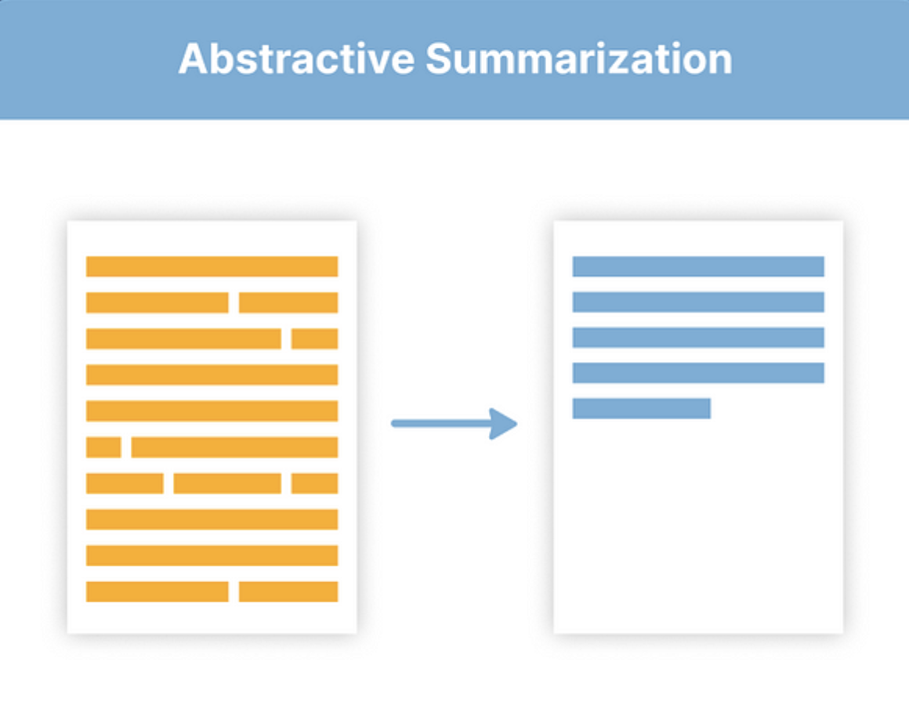
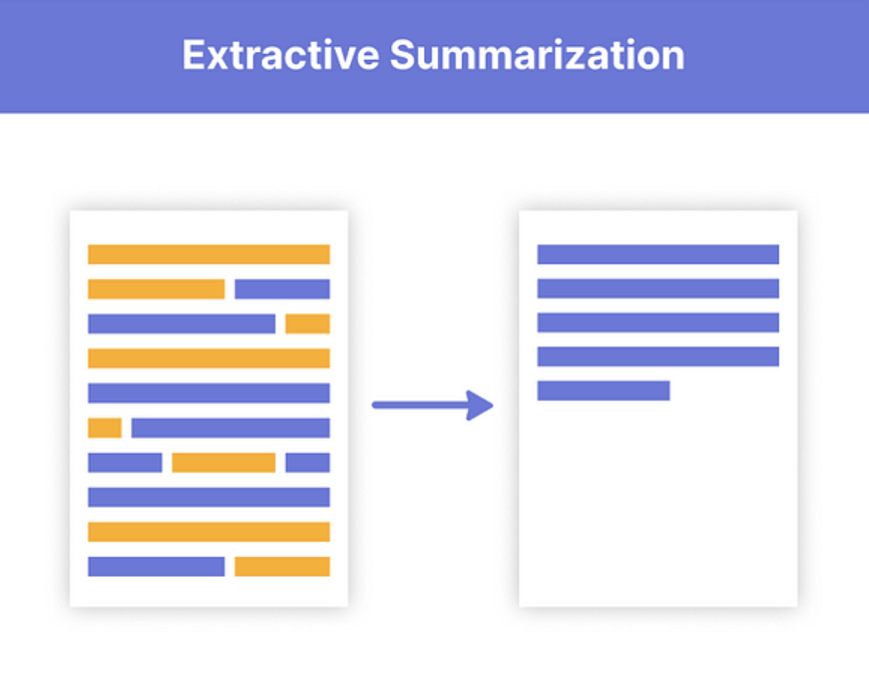
APPROACH
EXTRACTIVE
ABSTRACTIVE
Identifying and selecting
the most relevant sentences directly from the main text without editing them.
Understand the content of the text and generate new summaries using its own
language.

Slide 11
EXTRACTIVE APPROACH
BREAKING NEWS
The extractive approach used in the
project was implemented using the Latent Semantic Analysis (LSA) model, and
consists of the following steps
The text is processed using the PlaintextParser parser, whose tokenizer is
set to English.
The LSA technique synthesises the content by identifying a predefined number of sentences, in our case 5.
The sentences are then concatenated and the final summary is produced.
L I V E

Slide 12


The abstractive approach, on the other hand, aims to understand the content of the text and generate new summaries using its own
language.
In the abstractive approach, the pre-trained deep learning model we chose
was the BART (Bidirectional and Auto-Regressive Transformers) developed by
Facebook.

Slide 13
EVALUATION
METRICS
ROGUE-1
For both approaches, the evaluation metrics were calculated by comparing the generated summaries with the original titles.
Although comparison with titles is not an optimal choice for
assessing the quality of summaries, in the absence of abstracts this solution was adopted.
correspondence of uni-grams
correspondence of bi-grams
ROGUE-2
ROGUE-L
the overlap of longer sequences between texts
L I V E

Slide 14
RESULTS
 | MEAN-E | SD-E | MEAN-A | SD-A
ROGUE-1 | 0.055 | 0.026 | 0.090 | 0.045
ROGUE-2 | 0.008 | 0.014 | 0.013 | 0.023
ROGUE-L | 0.046 | 0.022 | 0.076 | 0.039

