Slide 1
Yamcs: TM/TC Ground Station Management Software
1. Key Features
2. Packet Parameters
3. Infoglobal Simulation :
a. Environment Spec (OS, SDK Version)
b. Setting Up a GS Instance
TODO:
Create GUI to display packet data using Yamcs Studio

Slide 2
File configuration :
- Yamcs.myproject.yaml
- simulator.py
- simulator multisat.py
- xtce.xml

Slide 3
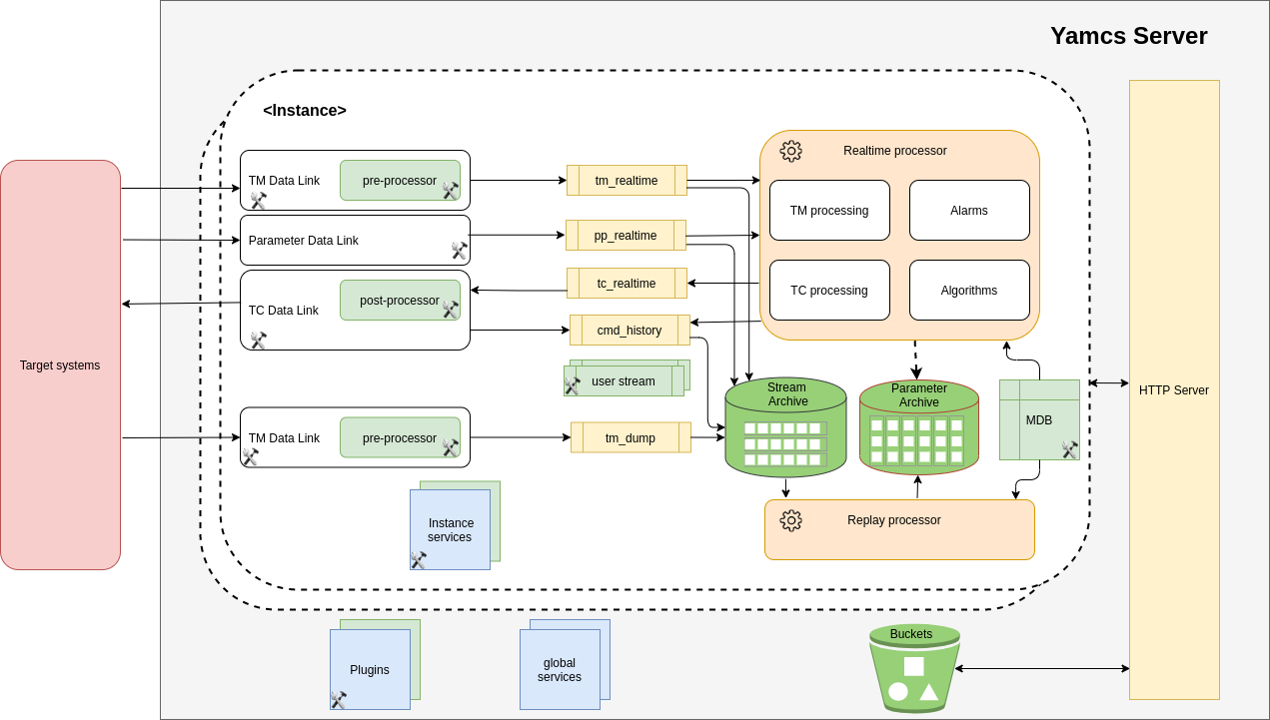

Slide 4
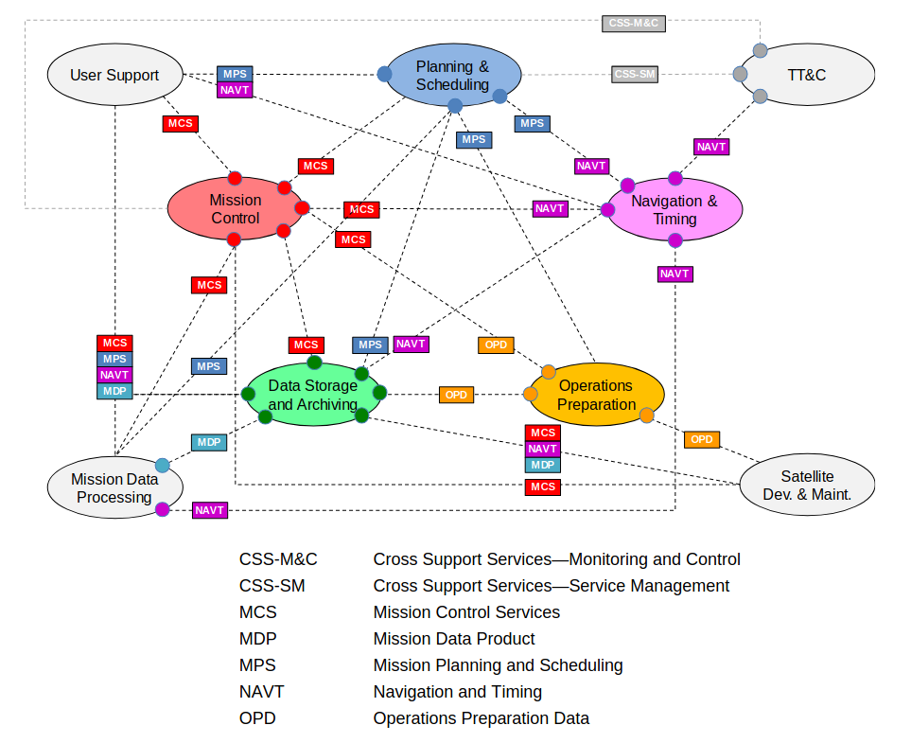

Slide 5
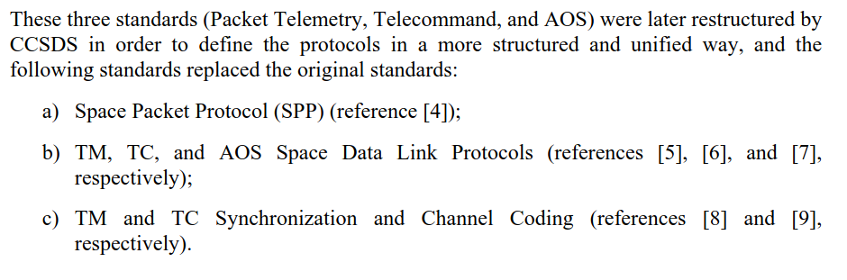
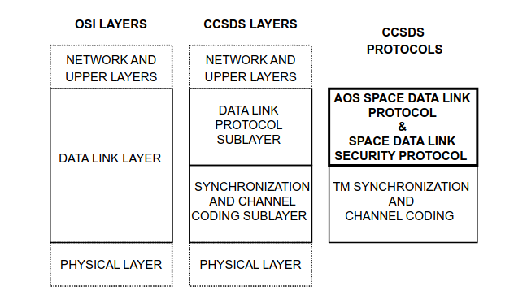
CCSDS Communication Protocol

Slide 6
CubeSat Space Protocol
PUS (Packet Utilization Standard) Protocol Header :
CCSDS Protocol Header :
- H1 48bit
- H2 variable
CSP Protocol Header :
- V1 32bit
- V2 48bit

Slide 7
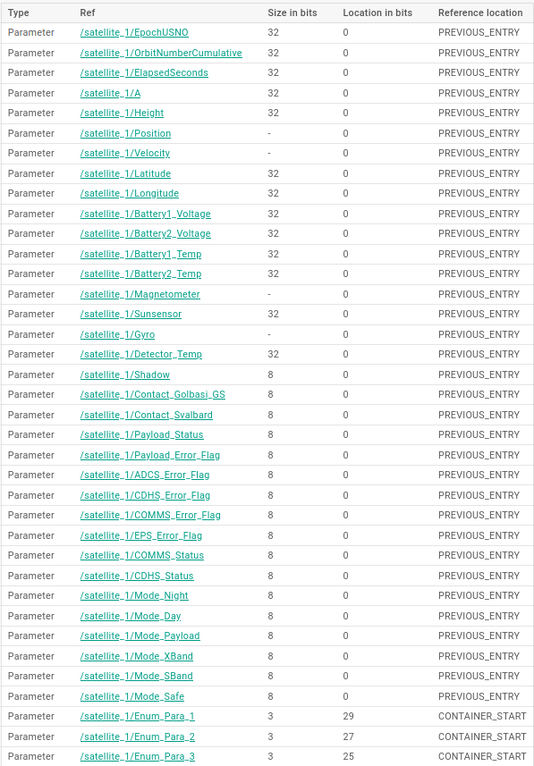
Telemetry Packet Protocol

Slide 8
Payload Specification
The APRS payload "Real Time Repeater" / "Store & Forwarding" applications are:
■ APRS - Vehicle and vessels positioning with data collection
■ APRS - Ecological & seismic / tracking & detection: birds, animals, landslides, etc.
■ APRS - Ocean windmills, widespread area power grid management
General Specification:
• Power Supply: 5V
• Power Consumption: 800mW.
• Operating Temperature: -20°C to +80°C
• Temperature Sensor
• Dimension: PC104 size compatible
APRS Specification:
• Receive Sensitivity: -126 dBm
• RX Frequency: 140-175MHz/ 400-480MHz
• TX Power: 30/27dbm (optional)
• Modulation Schemes: FSK
• Data Rates: AX.25 1200bps
• RF connector: IPX
• Data Interface: UART TTL standalone.

