Slide 1
GROUP 3’S LIBRARY MANAGEMENT SYSTEM (Imededdine Ben Kalia, Yohannes Sileshi, Andrew Twijukye)

Slide 2
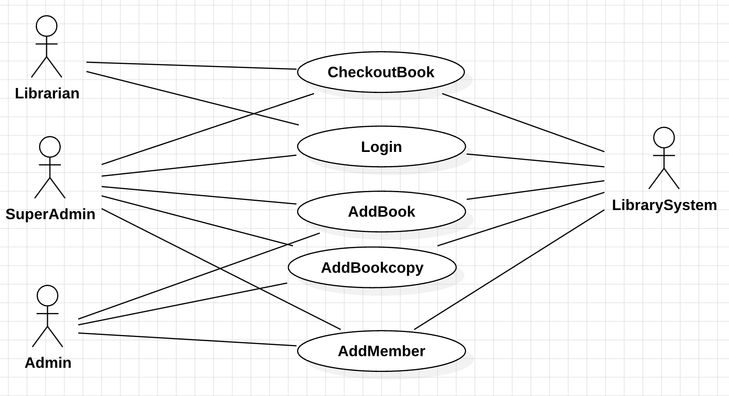
USECASE DIAGRAM

Slide 3
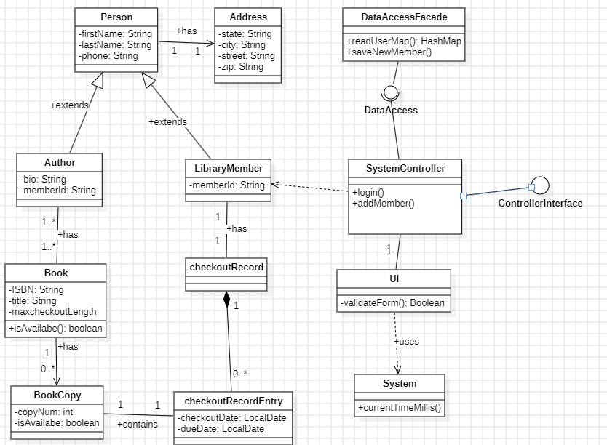
Class Model Diagram

Slide 4
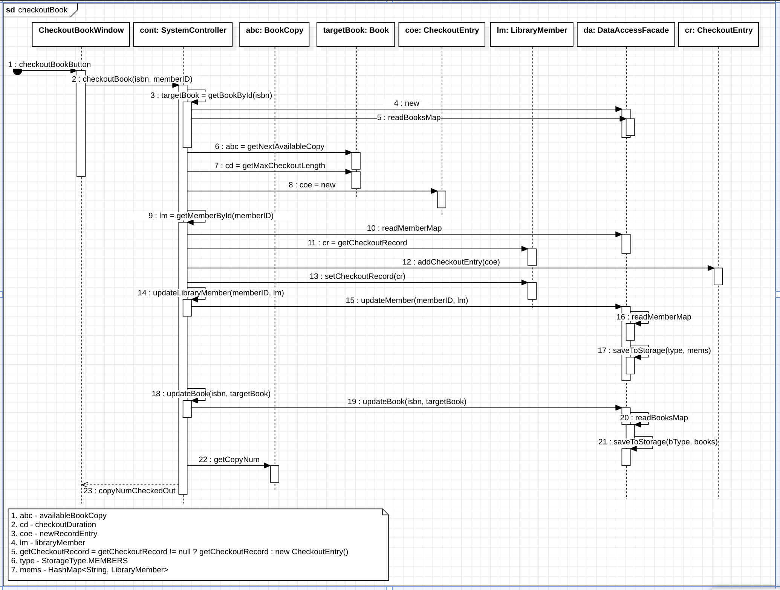
Checkout Book Sequence Diagram

Slide 5
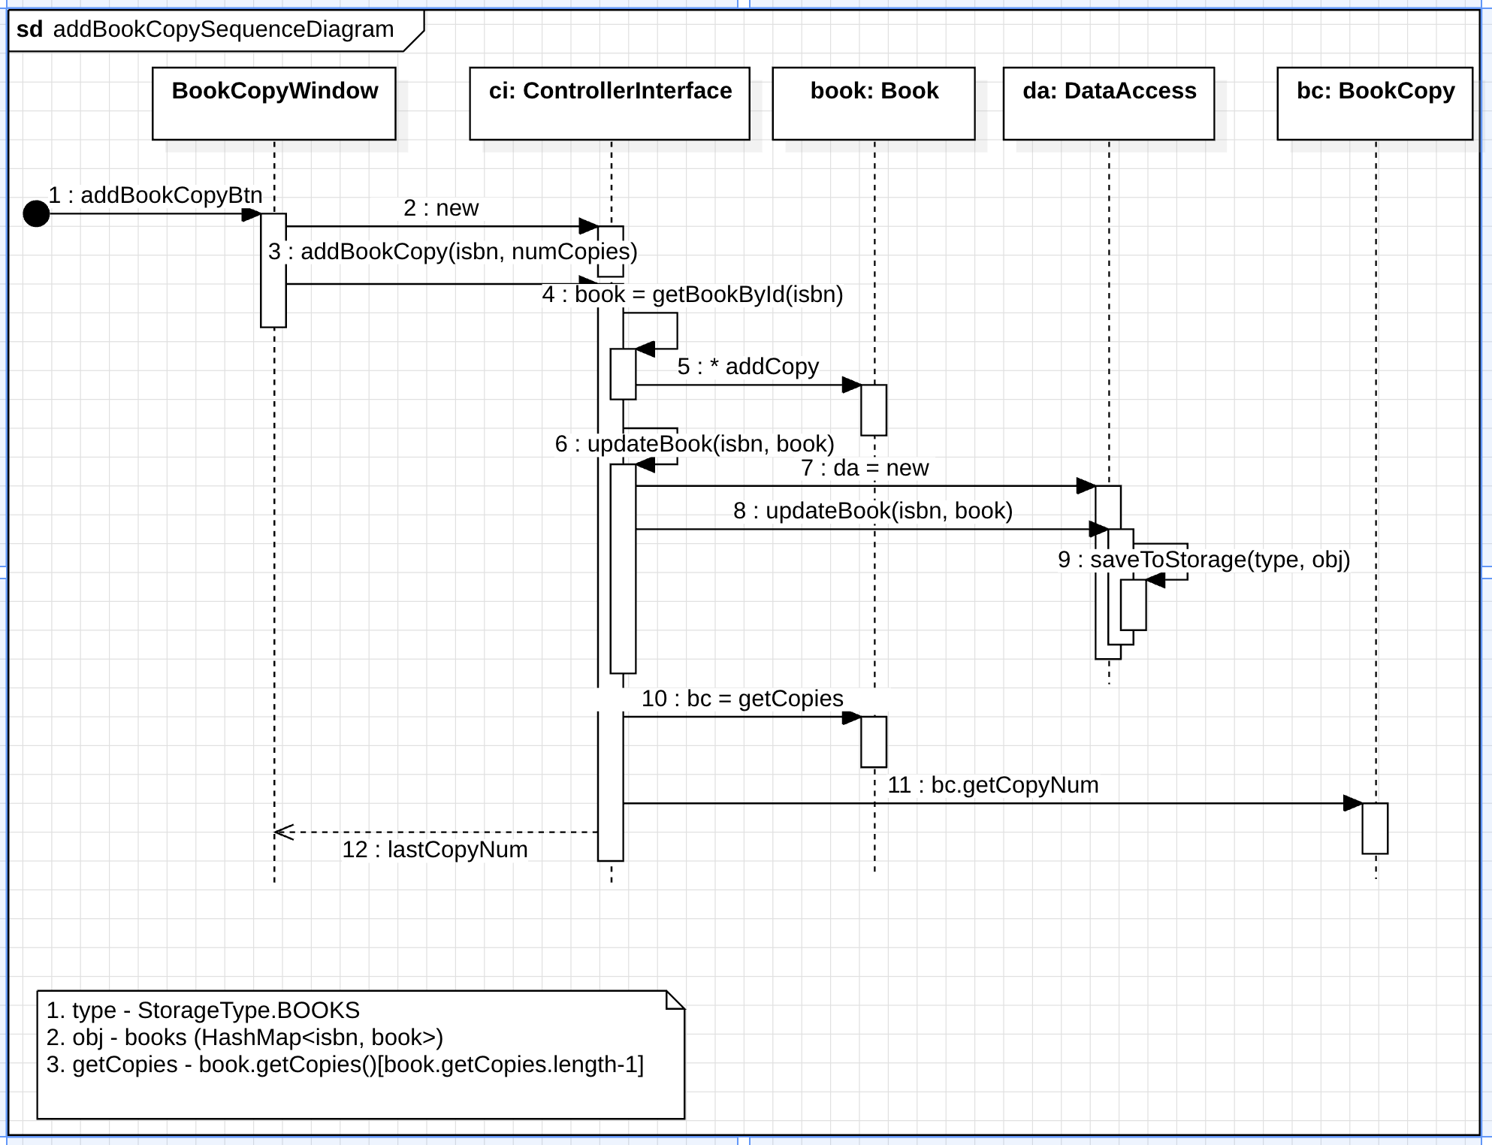
Add Book Copy

Slide 6
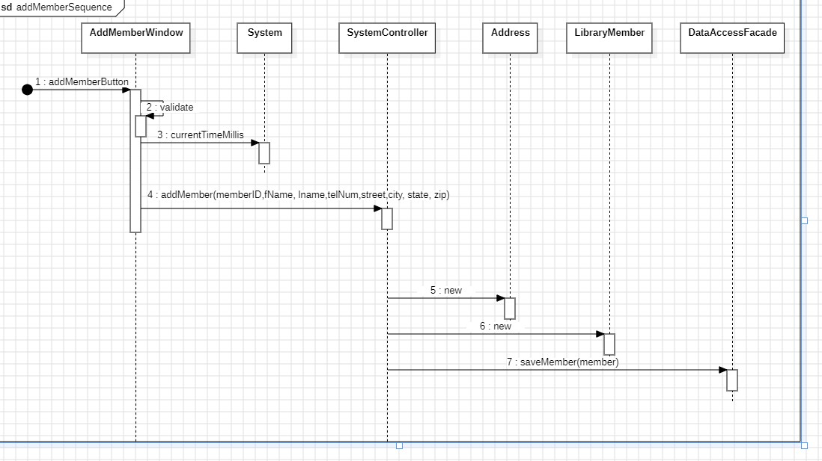
Add New Member

Slide 7
Discussion on Validation Rules of UI Windows
Empty fields validation for all input fields
Username and Password validation
Number of book copies validation to ensure input is a number greater than 0
ISBN format validation (12-12345 format) and duplicate check on submission
Phone number and Zip code length validation

Slide 8
Every Action has a Reaction. From the library mgmt. system, we show clearly how deeply ingrained this principle is to all aspects of life and systems. For every action a user takes on the system, there is a reaction. Whether it is to enter an invalid input (error messages/dialog boxes) or when they add data to the system and it is saved into the file database.
Outer Depends on Inner. This principle is well represented in the library management system because everything we see in the UI is as a result of code inside the application. The validation rules that we follow are all layered into the application and determine what we see when we click a save button for example. Even the data we show is based off of the file database that is within the application. All that we see and can interact with depends on the inner.

