Slide 1




BLAZE A TRAIL 3.0
“ PhytoGuard : Targeted Pesticide Delivery System ”
Problem Statement ID:
05
Problem Statement Title:
Intelligent Pesticide Sprinkling System Determined by the Infection Level of a Plant
PS Category :
Hardware
Theme :
Agriculture, FoodTech & Rural Development
Team Name :
Karmayog

Slide 2




“ PhytoGuard : Targeted Pesticide Delivery System ”
Karmayog
PROPOSED SOLUTION :
CLOSING THE GAPS :
Autonomous rover – GPS , durable, crop adaptable
Blanket Spraying → Precision Targeting
AI Vision – Detects fungal, bacterial, nematode
Single Pesticide → Correct Treatment
Multi Tank Sprayer – Separate tanks, exact pesticide, no waste
Manual Scouting → AI Automation
Confidence Algorithm - AI score guides low, medium or full spray
Environmental Harm → Eco-Conscious
No Data → Actionable Insights
Precision Spray – Spot spray, VRT, smart nozzles, rover precision
High Cost & Waste → Major Savings
IoT Dashboard – Alerts, logs, multilingual use
INNOVATION & UNIQUENESS :
Confidence-Based Spraying Algorithm
Modular Design for Easy Repairs
Multi-Tank, Multi-Disease Treatment System
Offline-First AI for Rural Realities
Raspberry Pi-CAM + Raspberry Pi Hybrid Architecture
Demo-Ready & Cost-Effective Prototype
2
Notes:
2

Slide 3
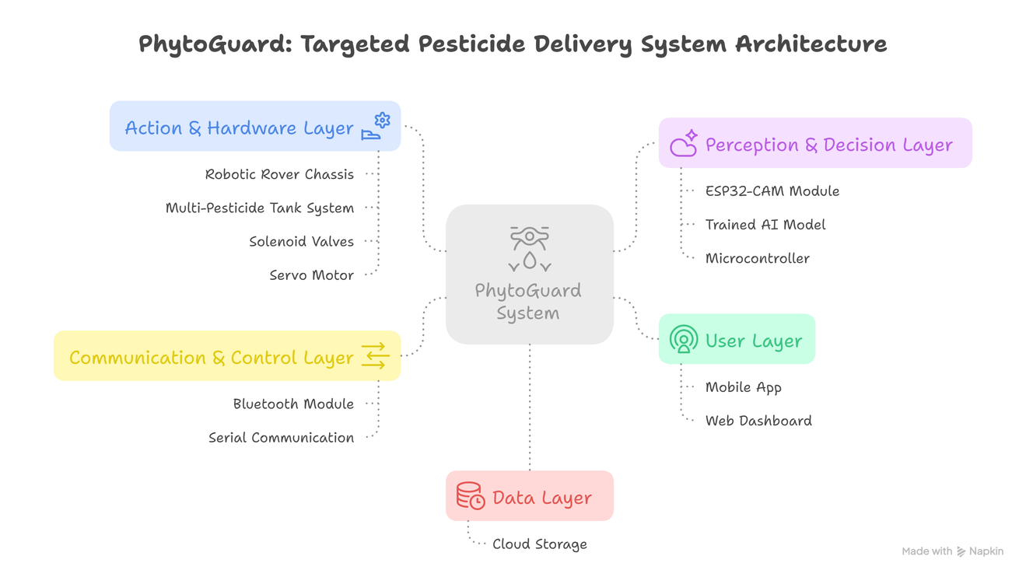

TECHNICAL APPROACH
Karmayog
ARCHITECTURE DIAGRAM
TECH STACK :
AI & ML :
CNN | Python | PlantVillage Dataset
Edge Hardware :
Camera Module (AI) | Raspberry Pi 4(control) | GPS Module (NEO-6M)
4WD Chassis | Solenoid Valves | DC Motors + L289N | SG90 Servo
Mechanical :
TECHNICAL WORKFLOW :
Connectivity :
Mobile controlled App
1.User drives rover via smartphone GPS control.
4.System selects correct pesticide tank automatically.
Arduino IDE | Edge Impluses | GitHub
2.Camera captures plant leaf image for analysis.
5. Precise spray applied only to infected leaves.
Tools :
3.AI model analyzes disease and confidence level.
6.Data logged for farmer review and analytics.
3
Notes:
3

Slide 4
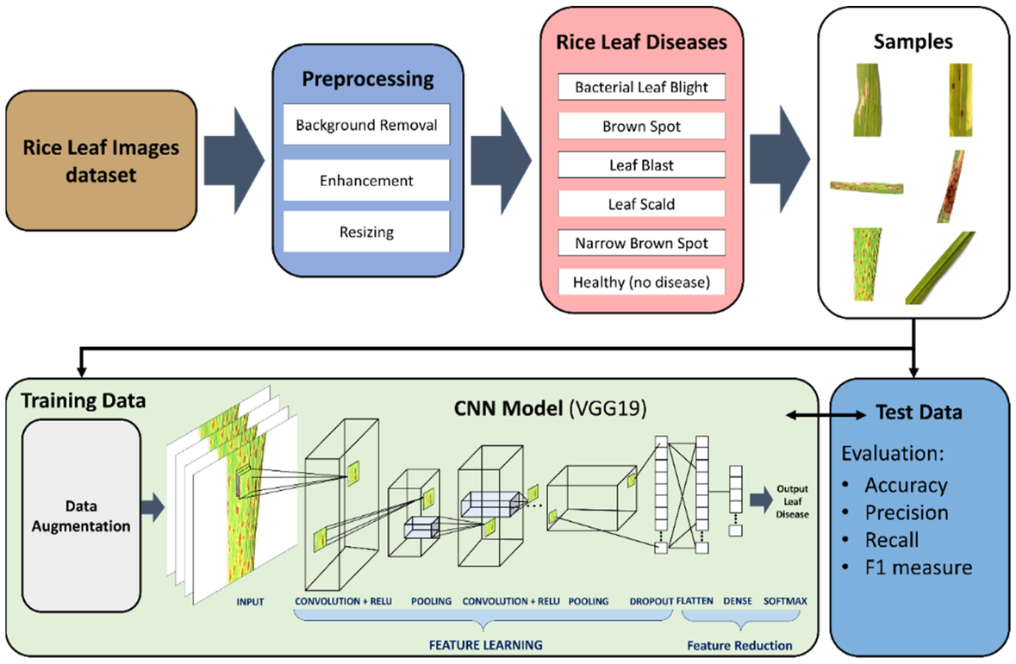
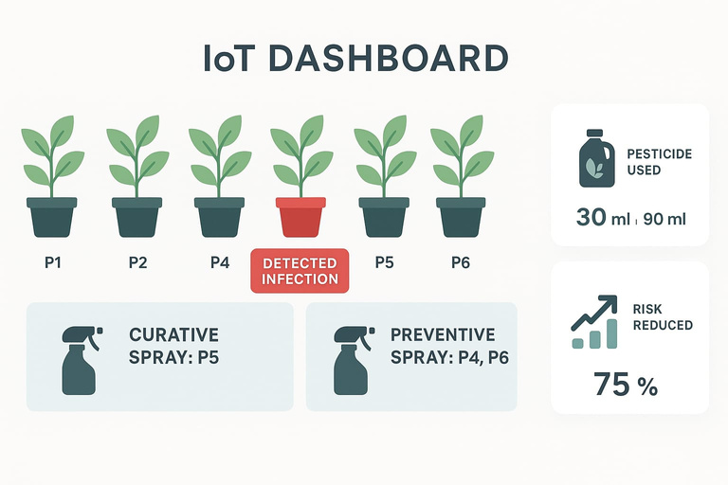
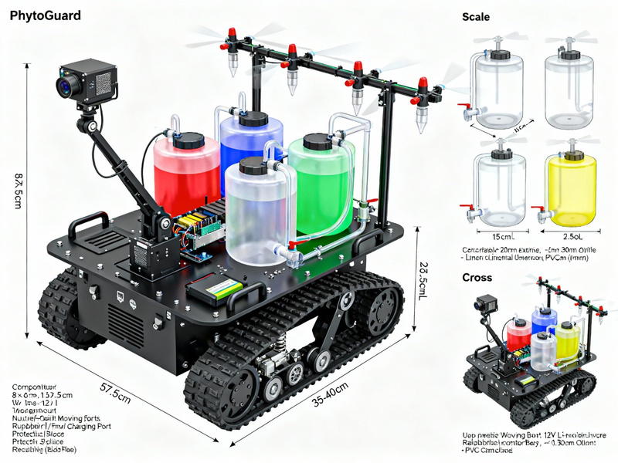

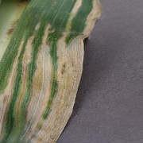
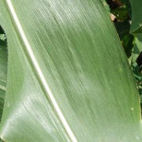
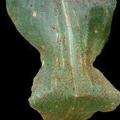
TECHNICAL APPROACH
Karmayog
CONFIDENCE ALGORITHM
INNOVATION
PROTOTYPE MODEL
Preventive Spray Approach
To stop spread, the neighboring plants P4 and P6 are sprayed with low dose preventive pesticide.
length :
50 - 60 cm
breadth :
55 - 65 cm
The rest (P1–P3, P7–P9) are left untouched.
4

Slide 5


MARKET DEMAND ANALYSIS
Karmayog
TARGET AUDIENCE & SPECIFIC NEED
UNIQUE VALUE PROPOSITION
Small & marginal farmers with limited resources.
AI-Powered Precision – Detects crop disease in real-time.
Agri-cooperatives managing large crop fields.
Multi-Tank Smart Selection – Sprays the right pesticide for each disease.
Government & NGOs promoting sustainable farming.
Agri-tech startups seeking affordable innovations.
Eco-Friendly – Cuts chemical use by 50% reducing pollution.
Rising crop losses due to late or incorrect disease detection.
Offline-First – Works without internet, ideal for rural areas.
Lack of real-time, on-field decision tools in rural areas.
User-Friendly – Controlled via a farmer’s smartphone.
MARKET POTENTIAL & SUPPORTING TRENDS
Huge Agriculture Market – India has 150M+ hectares of farmland.
Global AgriTech Boom – AgriTech market expected to reach $40B+ by 2030.
Rising Pesticide Costs – Farmers spend 25 – 40% of input cost on chemicals.
Shift to Precision Farming – Growing adoption of AI & IoT in agriculture.
5
Notes:
4

Slide 6

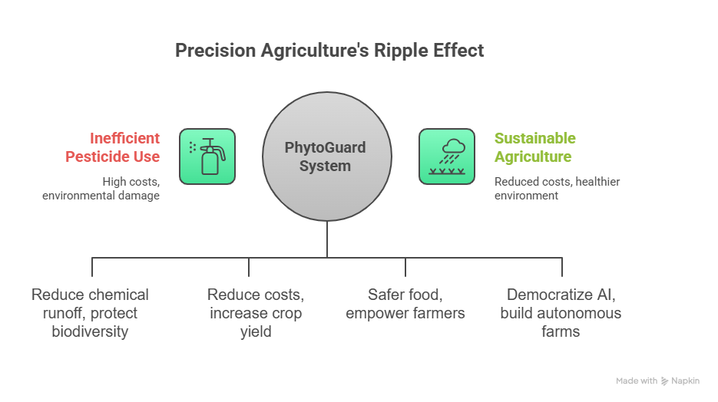
IMPACT & SOCIAL RELEVANCE
Karmayog
BENEFITS
SDG COVERED :
Cuts Costs
Reduces pesticide use & expenses
Eco-Friendly
Minimizes pollution & soil harm
SDG 2 – Zero Hunger → Improves crop yield & food security.
SDG 3 – Good Health & Well-being → Reduces harmful chemical exposure.
Targeted Treatment
Right pesticide for each disease
Time-Saving
Automated scouting reduces labor
SDG 9 – Industry, Innovation & Infrastructure → Promotes agri-tech innovation.
Smart Insights
Data-driven decisions for farmers
Sustainability
Promotes safe, long-term farming
SDG 12 – Responsible Consumption & Production → Cuts chemical overuse, ensures sustainable farming.
POTENTIAL IMPACT
SDG 13 – Climate Action → Lowers environmental damage from excessive pesticides.
SDG 15 – Life on Land → Protects soil health, biodiversity & ecosystems.
📊 Total SDGs Covered: 6
5
Notes:
5

Slide 7
RESEARCH AND REFERENCES
AI-Based Plant Disease Detection and Pesticide Spraying System(JETIR, 2025)
Artificial Intelligence and Machine Learning Operated Pesticide Sprayer (IRJET, 2022)
JERT. (2024). AI-Based Drone for Pesticide Recommendation and Spraying for Precision Agriculture.
Atlantis Press. (n.d.). Artificial Intelligence-based Autonomous Pesticide Spraying Drone.
AIP Publishing. (2025). Design of Self-Adaptable Autonomous Robotic Sprayer for Precision Agriculture.
IARJSET. (2024). Smart Pest Detection and Pesticide Sprayer with Machine Learning and IoT.
7
Notes:
7

