Slide 1
🛡️
NetSentry
ML-Based Network Intrusion Detection System
Built from scratch with NumPy — No sklearn, No TensorFlow, No PyTorch
Framework
ML Engine
Auth
Dashboard
FastAPI + Uvicorn
Pure NumPy
JWT + RBAC
Real-time WebSocket
NetSentry — Network Intrusion Detection System
1 / 10

Slide 2
Problem Statement
Why do we need a new approach to network intrusion detection?
🔓
Rising Cyber Threats
THE SCALE OF THE PROBLEM
Network attacks (DDoS, brute force, port scanning, botnets) are increasing in volume and sophistication, overwhelming traditional rule-based IDS.
2,200+
cyber attacks per day globally
⚙️
Signature Limitations
Traditional IDS like Snort/Suricata rely on known signatures and fail to detect zero-day attacks or novel attack variants.
$4.45M
average cost of a data breach (IBM 2023)
🔮
Black-Box ML Tools
Existing ML-based solutions use opaque libraries (sklearn, TensorFlow) making it impossible to audit the detection logic or understand why a flow was flagged.
277 days
average time to identify a breach
💰
Commercial Cost
Enterprise NIDS solutions are expensive and vendor-locked. Organizations need transparent, customizable, open-source alternatives.
68%
of breaches involve a human element
NetSentry — Network Intrusion Detection System
2 / 10

Slide 3
Objectives
What NetSentry sets out to achieve
01
From-Scratch ML Models
04
Automated Response (IPS)
Implement Decision Tree, Random Forest, MLP Neural Network, and Isolation Forest entirely in NumPy — no sklearn, TensorFlow, or PyTorch. Every line of math is auditable.
Automatically block attacker IPs via nftables integration with confidence gating, IP allowlisting, deduplication, and time-based expiry.
02
Real-Time Detection
05
Production Security
Classify network flows in under 5ms with live packet capture (Scapy), WebSocket streaming to a real-time dashboard, and automated alerting.
JWT authentication with HMAC-SHA256, PBKDF2 password hashing, role-based access control (Admin/Viewer), API key auth, and token-bucket rate limiting.
03
Ensemble + Zero-Day Detection
06
Full Observability
Combine supervised models (RF + MLP weighted vote) with unsupervised anomaly detection (Isolation Forest) to catch both known attacks and novel zero-day threats.
Prometheus metrics (counters, gauges, histograms), structured JSON logging, health/ready probes, and a comprehensive real-time dashboard with animated detection pipeline.
NetSentry — Network Intrusion Detection System
3 / 10

Slide 4
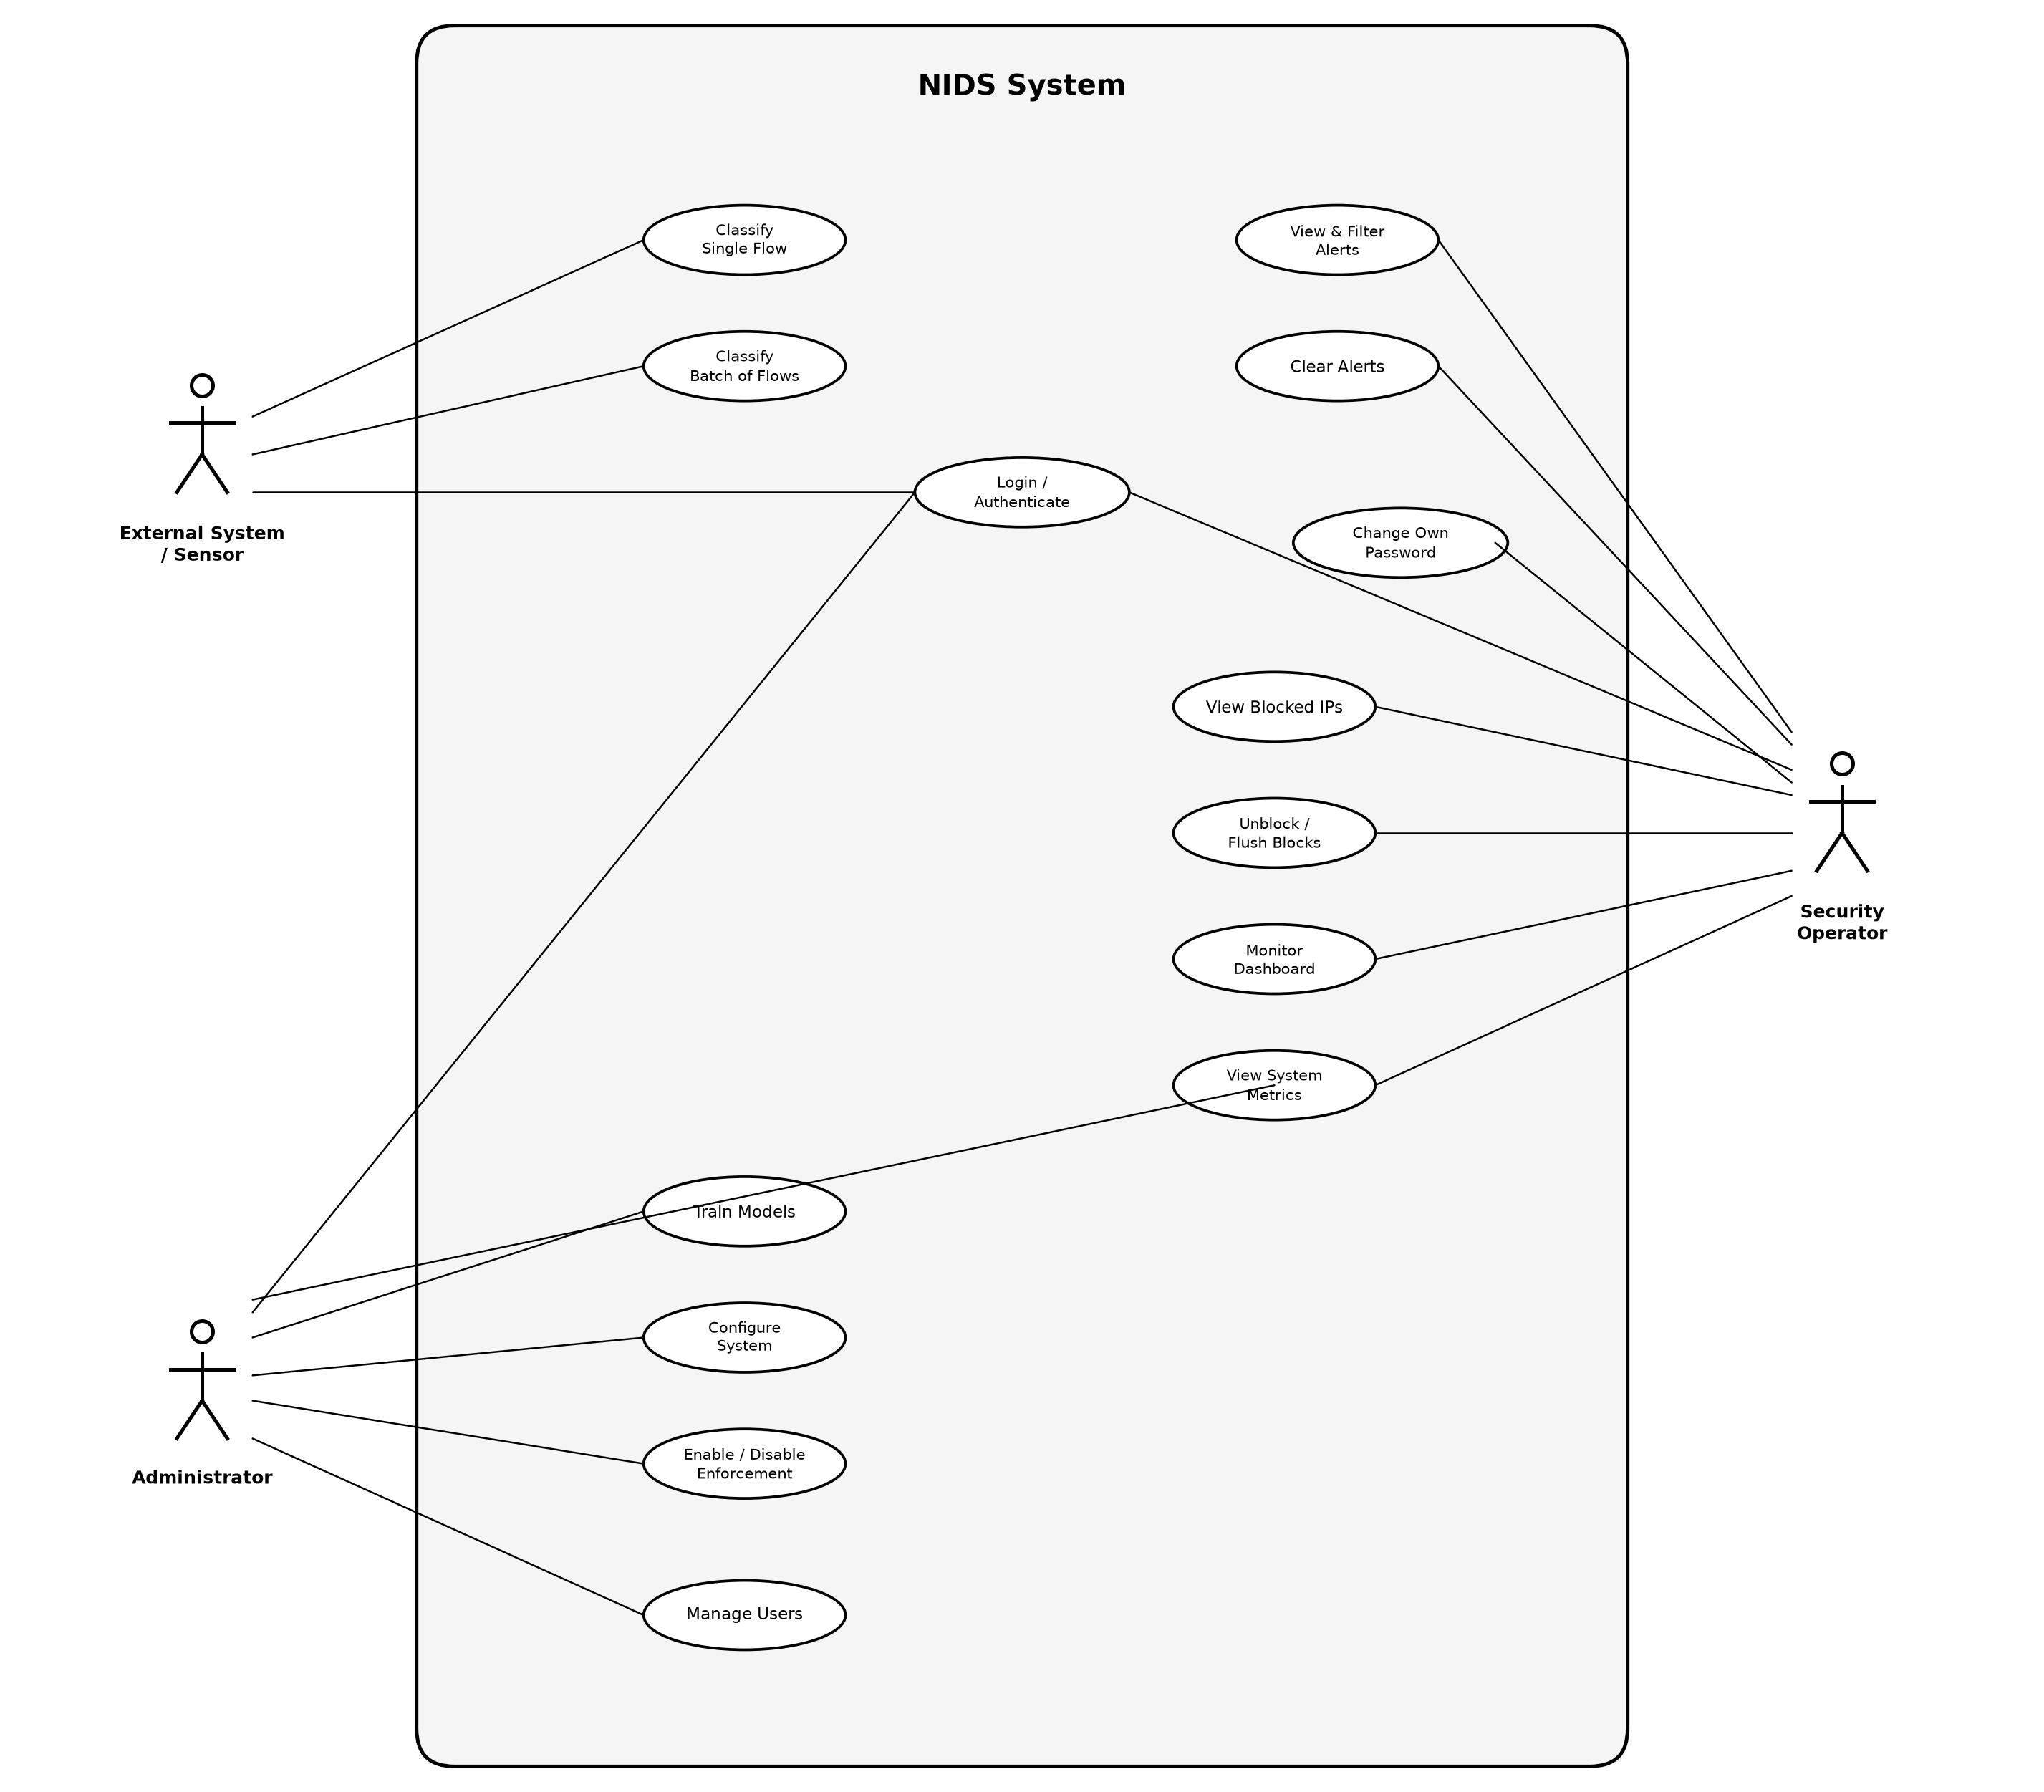
Use Case Diagram
System actors and their interactions with NetSentry
SYSTEM ACTORS
👤 Administrator
• Manage users (create, delete)
• Configure system settings
• Train ML models
• Enable/disable enforcement
• Full dashboard access
👁️ Security Operator
• Monitor dashboard in real-time
• View & filter alerts by severity
• View blocked IPs
• Unblock / flush blocks
• View system metrics
🌐 External System / Sensor
• Submit single flow for classification
• Submit batch of flows
• Authenticate via API key
• Receive prediction results
NetSentry — Network Intrusion Detection System
4 / 10

Slide 5
ML Models & Ensemble
All models implemented from scratch in pure NumPy
🌲
🌳
🧠
🔍
Decision Tree (CART)
Random Forest
Neural Network (MLP)
Isolation Forest
src/models/decision_tree.py
src/models/random_forest.py
src/models/neural_network.py
src/models/isolation_forest.py
• CART algorithm (Breiman 1984)
• Bagging ensemble of N decision trees
• Feed-forward: 128 → 64 → softmax
• Anomaly detection (Liu et al. 2008)
• Gini impurity & entropy criteria
• Bootstrap sampling + sqrt feature subsets
• He/Xavier weight initialization
• Random partitioning measures isolation
• Iterative build (no recursion limit)
• Out-of-bag validation (free estimate)
• Backprop with Adam optimizer
• Subsample size ψ = 256 per tree
• Laplace-smoothed leaf probabilities
• Soft voting (averaged probabilities)
• Inverted dropout regularization
• Score normalized to [0, 1]
• Pre-pruning: max_depth, min_samples
• Parallel training via ProcessPoolExecutor
• Early stopping with best-weight restore
• Catches zero-day attacks unseen in training
⚡ Ensemble (src/models/ensemble.py)
Supervised Vote
Anomaly Override
Audit Trail
P = 0.55 × RF + 0.45 × MLP (weighted soft-voting)
If supervised says 'benign' but IF score > 0.75 → reclassify as attack (zero-day catch)
predict_with_detail() returns per-model probabilities, IF score, and override flag
NetSentry — Network Intrusion Detection System
5 / 10

Slide 6
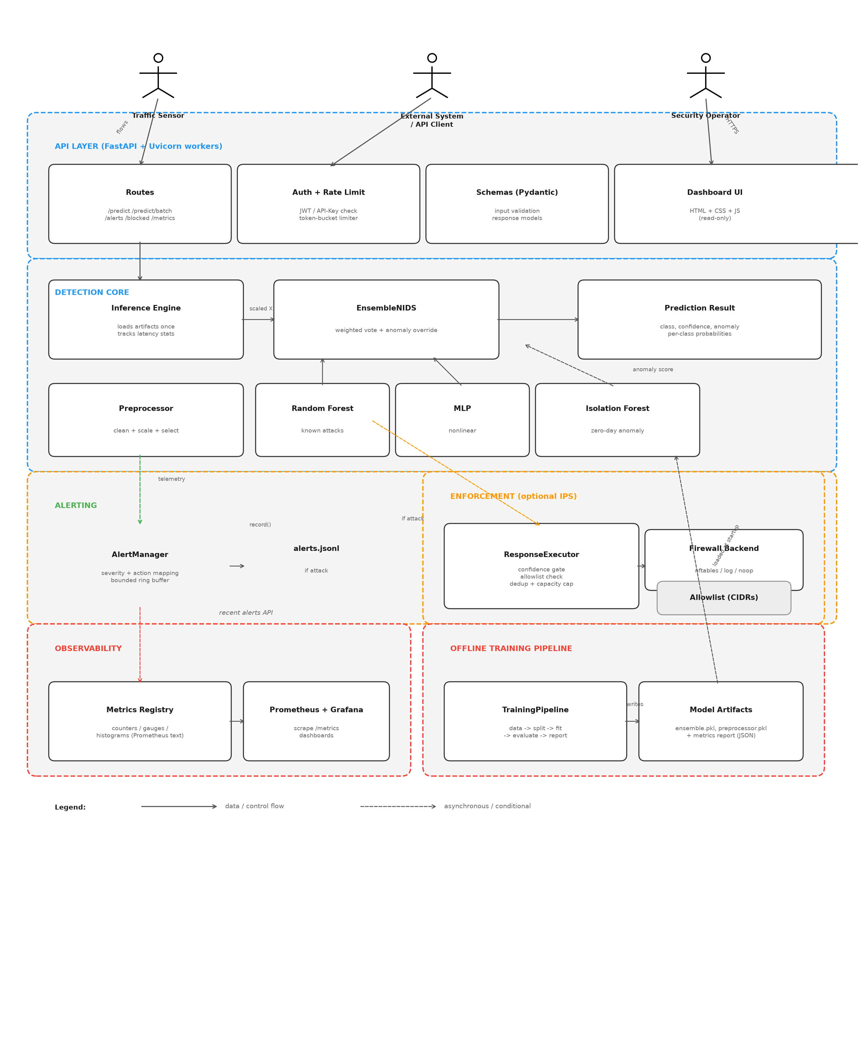
System Architecture
Layered design with strict dependency boundaries
ARCHITECTURE LAYERS
API Layer
FastAPI + Uvicorn, routes, auth middleware, rate limiter, Pydantic schemas, dashboard UI
Detection Core
InferenceEngine loads trained artifacts, runs ensemble prediction, returns class + confidence + anomaly score
Alerting
AlertManager records predictions, maps severity, maintains bounded ring buffer, writes alerts.jsonl
Enforcement
ResponseExecutor applies confidence gate, allowlist check, dedup, capacity cap, then delegates to firewall backend (nftables/log/noop)
Observability
Prometheus counters/gauges/histograms, structured JSON logging, /metrics endpoint
Training Pipeline
Offline: data → stratified split → fit models → evaluate → serialize artifacts (.pkl + report.json)
NetSentry — Network Intrusion Detection System
6 / 10

Slide 7
Dataset — CIC-IDS2017
Canadian Institute for Cybersecurity benchmark dataset
📊 About the Dataset
🎯 Attack Types in Dataset
• Published by the Canadian Institute for Cybersecurity (UNB)
DDoS
Distributed Denial of Service (volumetric flood)
Port Scan
Network reconnaissance / port enumeration
• 5 full days of real network traffic (Mon–Fri), captured July 2017
Brute Force
SSH & FTP credential guessing
• Contains both benign background traffic and realistic attack scenarios
Botnet
Ares botnet command-and-control traffic
Web Attack
XSS, SQL injection, brute force login
• Flows extracted using CICFlowMeter — 80+ statistical features per flow
Infiltration
Lateral movement / data exfiltration
• NetSentry uses 30 selected features (ANOVA F-ratio feature selection)
🔬 Feature Engineering Pipeline
• Widely cited in IDS research — the standard benchmark for ML-based NIDS
1. Clean
Replace ±inf → NaN → median imputation, clip outliers
2. Select
ANOVA F-ratio: keep top-30 features by class separability
Source: https://www.unb.ca/cic/datasets/ids-2017.html
3. Scale
Z-score normalization: (x − μ) / σ on training set
4. Split
Stratified 70/15/15 train/val/test — preserves class ratios
NetSentry — Network Intrusion Detection System
7 / 10

Slide 8
Authentication & RBAC
JWT-based security with role-based access control
🔐 Authentication Mechanism
🔄 Authentication Flow
• JWT Tokens
HMAC-SHA256 signed, configurable expiry (default 24h)
1
POST /api/v1/login
• Password Storage
PBKDF2-SHA256, 100k iterations, random 32-byte salt — stdlib only
Client sends username + password
• API Key Auth
Static API key for machine-to-machine integration (grants admin)
2
PBKDF2 Verify
• Rate Limiting
Token-bucket algorithm: configurable requests/minute per client
Server hashes password with stored salt, compares digests
• WebSocket Auth
JWT token passed as query parameter, validated on connect
JWT Issued
3
On success: signed token with {sub, role, exp} claims
👥 Roles (2-tier RBAC)
4
Bearer Header
Client sends Authorization: Bearer <token> on every request
ADMIN
✓ Predict / classify flows
✓ Manage users (CRUD)
5
Middleware Check
✓ View & clear alerts
✓ Start/stop live capture
verify_token() validates signature + expiry, extracts role
✓ Block/unblock IPs
✓ All viewer permissions
VIEWER
6
Role Gate
✓ View dashboard (read-only)
✓ View alerts & metrics
require_role() decorator checks role ∈ allowed set, rejects with 403
✓ View blocked IPs list
✓ Change own password
NetSentry — Network Intrusion Detection System
8 / 10

Slide 9
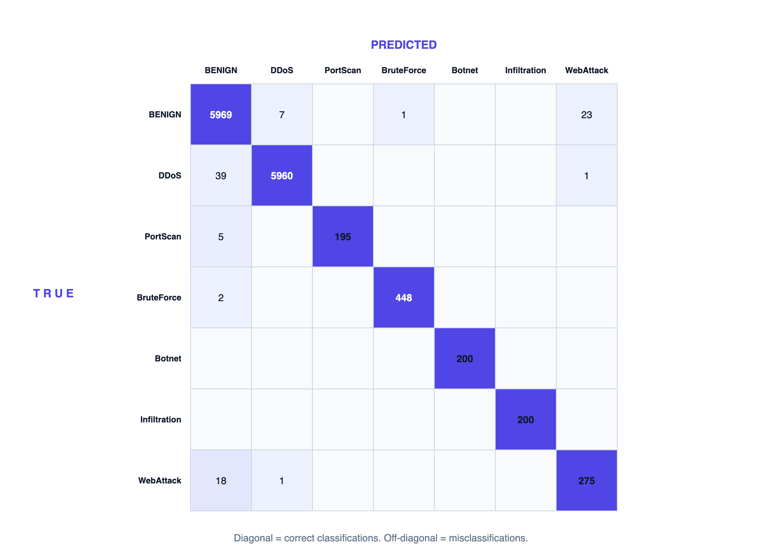
Model Performance & Test Results
Trained on CIC-IDS2017 — 66,721 flows, 30 features, 7 classes
MODEL ACCURACY COMPARISON
Model
Accuracy
F1 Macro
FPR
FNR
Latency
Random Forest
99.39%
98.90%
0.67%
0.55%
< 0.01 ms
MLP Neural Net
98.69%
96.91%
1.37%
1.27%
< 0.01 ms
Ensemble (RF+MLP+IF)
99.27%
98.57%
0.52%
0.87%
0.48 ms
Isolation Forest
74.71%
—
—
—
< 0.01 ms
ENSEMBLE PER-CLASS F1 SCORES
Benign
99.2%
Botnet
100%
DDoS
99.6%
Infiltration
100%
PortScan
98.7%
WebAttack
92.7%
BruteForce
99.7%
Ensemble Confusion Matrix — diagonal = correct, off-diagonal = misclassifications
Dataset: 66,721 flows | 30 features | Training time: 361s | 140/140 unit tests passing
NetSentry — Network Intrusion Detection System
9 / 10

Slide 10
Test Cases — 140 Tests Passing
Comprehensive test coverage across all system layers
140
7
0
< 5s
TESTS PASSING
TEST MODULES
FAILURES
TOTAL RUNTIME
test_api.py
7 tests
test_e2e_enforcement.py
15 tests
• Health & metrics endpoints
• DDoS/BruteForce/PortScan full pipeline
• Single & batch prediction
• Allowlist protection (private IPs)
• Alert listing
• Batch mixed traffic simulation
• Stats endpoint
• Block-unblock-flush lifecycle
• Stats reflect traffic
test_auth.py
35 tests
test_data_and_metrics.py
12 tests
• JWT create/verify/expire/tamper
• Data generator shape & labels
• User CRUD & persistence
• Preprocessor: scale, split, inf/NaN
• Login success/failure
• Confusion matrix, accuracy, P/R/F1
• RBAC: admin vs viewer gates
• ROC AUC (perfect & random)
• Password change & public endpoints
test_models.py
13 tests
test_real_dataset.py
36 tests
• Decision Tree: fit, predict, proba, impurity
• CIC-IDS CSV loader & parser
• Random Forest: OOB score, feature importance
• Label mapping (DoS→DDoS, Bot→Botnet)
• MLP: probabilities, early stopping
• Column index builder
• Isolation Forest: anomaly detection
• Balance classes (undersample + augment)
• Ensemble end-to-end
• Deduplication & full pipeline
test_enforcement.py
22 tests
• Response policy per attack type
• Allowlist (private IPs, localhost)
• Confidence gating
NetSentry — Network Intrusion Detection System
10 / 10
• Dedup, capacity cap, manual unblock
• NoOp backend lifecycle

