Slide 1
ECommerce Product Management System : Amnil Mart
Bibash ACharYA

Slide 2
Table of Contents
About the Project
Database ER Diagram
UI and Styling
API and Documentation
Learnings and Challenges Faced
Limitations
Future Enhancements

Slide 3
About the Project: Amnil Mart
An ECommerce Product Management System
Features : HomePage and Navigation, CRUD Operations, Dynamic Full Stack Content
Tech Stack Used: HTML, CSS, JS and Bootstrap for Frontend, ASP.NET and PostGRESQL for Backend
Problem Solved by Application : In the ever changing world of technology, people prefer online shopping from the comfort of your home.
Technical Approach : AmnilMart provides the solution to this problem

Slide 4
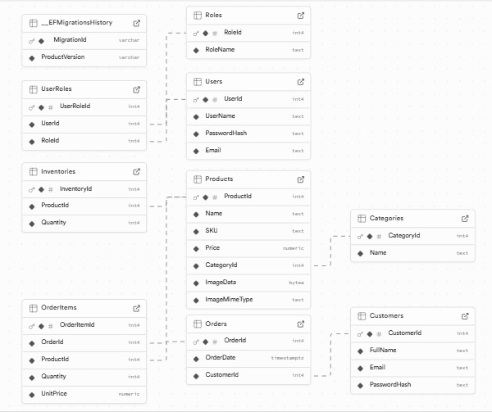
Database ER Diagram

Slide 5
Key Features
Home Page and Navigation
CRUD Operations and Full Stack Dynamic Content
UI makes use of mostly Red Color to align with the theme of Amnil Technology
Looking for my Products my Categories or by looking at product detail through Product Detail Button
Customer Support available on Website AboutUs page along with Email,Contact No and Google Map Location

Slide 6
UI And Styling
Bootstrap library used for Styling the User Interface
Custom CSS and Vanilla JavaScript also used to customize some styling

Slide 7
API and Documentation
Project Uses API Architecture instead of Server Side Rendering
API Endpoints tested with POSTMAN and published documentation link available on README.md file

Slide 8
Learnings and Challenges Faced
Learnings
Challenges Faced
Database Design
  Relationship between Entities
Project Planning and System Architecture Design
First Time Use of Object Relational Mapper in my Project
User Interface Styling
Barrier of Time

Slide 9
Limitations
Authentication and Authorization
Haven’t made use of all Entities and Relationships ,for instance, when a product is bought, I haven’t implemented the functionality to add the product to Order and OrderItem and decrease the Product Stock from the Inventory table

Slide 10
Future Enhancements
Hosting for real world scenario
Contents can be made more robust and dynamic by making use of all Database Entities and Relationship
Authentication and Authorization can be implemented to make the project work for Real World Scenario

Slide 11
Thank You

