Slide 1
Chapter 2
Review of Abstract Data Types
Prepared By: Er. Amrit Poudel(GCES)

Slide 2
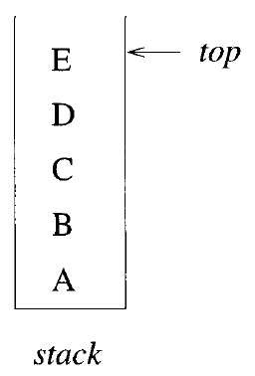
Stack
A stack is an ordered list in which all insertions and deletions are made at one end, called the top
Stacks are Last In First Out(LIFO) lists.
The simplest way to represent stack is by using a one-dimensional array, say stack[0 : n-1], where n is the maximum number of allowable entities
First element in the stack is stored as stack[0], second at stack[1], and ith at stack[i+1]
top points to the top element in the stack
Operations in Stack
Adding element
Deleting element

Slide 3
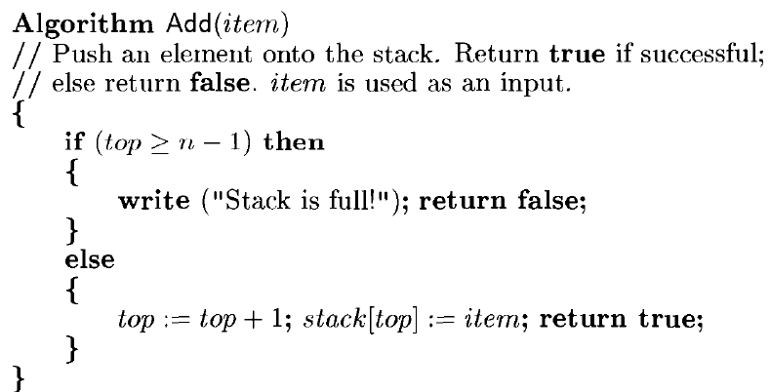
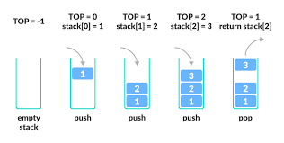
Algorithm to add item on stack

Slide 4
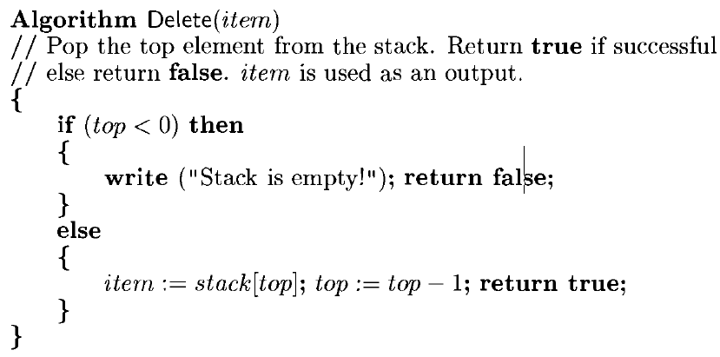
Algorithm to delete item from stack

Slide 5
Analysis of Add and Delete algorithm of stack
Each execution of Add or Delete takes a constant amount of time and is
independent of the number of elements in the stack.
Time Complexity : O(1) because they only work with one end of the data structure - the top of the stack

Slide 6
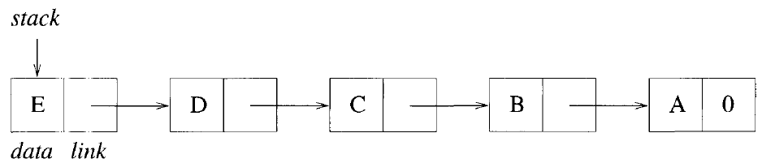
Linked Stack
Another way to represent a stack is by using links (or pointers).
A node is a collection of data and link information.
A stack can be represented by using nodes with two fields, called data and link.
The data field of each node contains an item in the stack and the corresponding link field points to the node containing the next item in the stack.
The link field of last node is zero, for others we assume that all nodes have an address greater than zero.

Slide 7
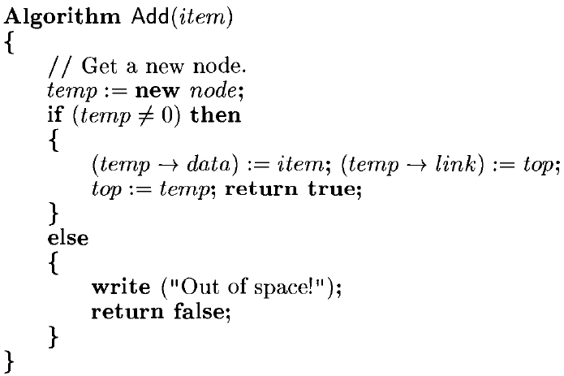
Add Item in Linked Stack

Slide 8
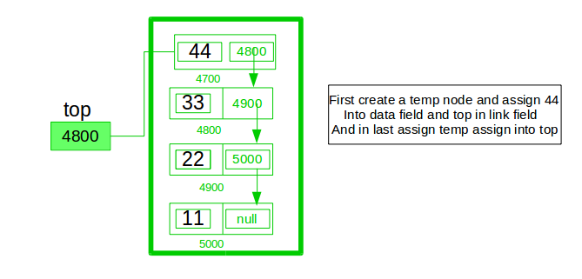

Slide 9
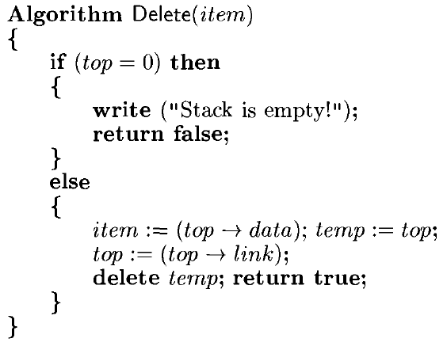
Delete Item from linked stack

Slide 10
Analysis of ADD and DELETE algorithms in linked stack
Each execution of Add or Delete takes a constant amount of time and is
independent of the number of elements in the stack.
Time Complexity : O(1) because they only work with one end of the data structure - the top of the stack

Slide 11
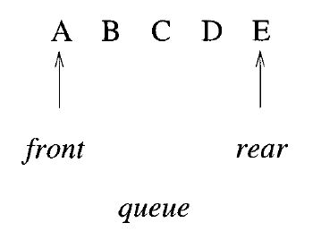
Queue
A queue is an ordered list in which all insertions take place at one end,the rear, where as all deletions take place at the other end,the front.
Queues are known as First In First Out (FIFO) lists

Slide 12
Circular Queue
An efficient queue representation can be obtained by taking an array q[0 : n-1] and treating it as if it were circular.
A circular queue is an improvement over the standard queue structure. In a standard queue, when an element is deleted, the vacant space is not reutilized. However in a circular queue, vacant space is utilized.
While inserting elements, when you reach the end of an array and you need to insert another element, you must insert that element at the beginning(given that the first element is deleted and the space is vacant)

Slide 13
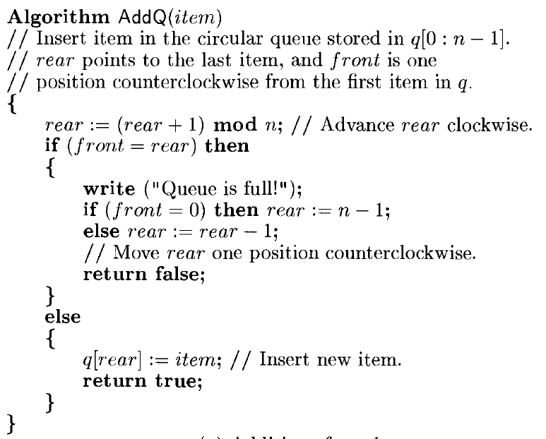

Slide 14
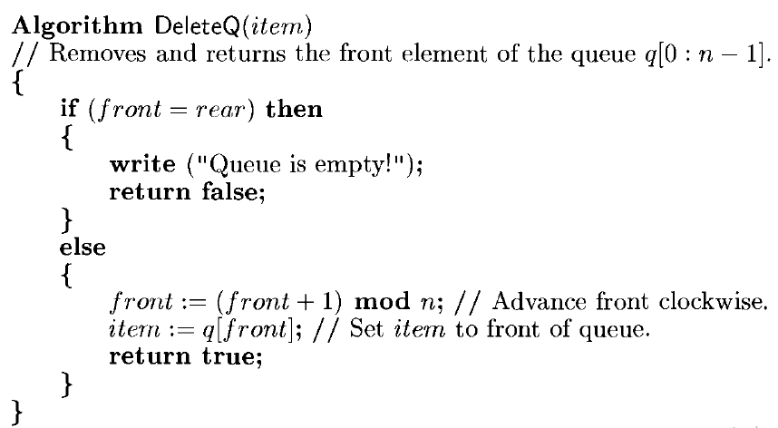

Slide 15
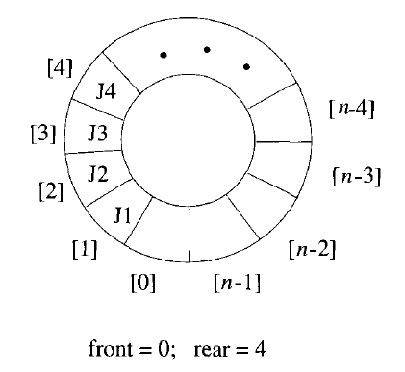
Analysis of algorithm
Time complexity of AddQ(), DeleteQ() operation is O(1) as there is no loop in any of the operation.
The test for queue full in AddQ and the test for queue empty in DeleteQ are the same..So, we signal queue full and permit maximum n-1 rather than n elements.

Slide 16
Trees
A tree is a finite set of one or more nodes such that there is a specially designated node called the root and the remaining nodes are partitioned into n > 0 disjoint sets Ti,.,.T.n ,where each of these sets is a tree.
The setsTi,.,.T.n are called the subtrees of the root

Slide 17
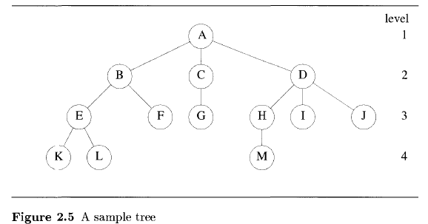

Slide 18
Trees
Root Node: the highest node in the tree, and has no parent.
Root Node in above tree: A
Degree: The number of subtrees of a node is called its degree
Degree of A is 3, of C is 1, and of F is 0
Leaf Nodes or Terminal Nodes: Nodes with degree 0
The set {K,L, F,G,M, I, J} is the set of leaf node
The roots of the subtrees of a node X are the children of X. The node X is the parent of its children.
Thus the children of D are H,I,and J, and the parent of D is A.
Children of the same parent are said to be siblings
For example H, I, and J are siblings

Slide 19
Trees
The level of a node is defined by initially letting the root be at level one.
If a node is at level p,then its children are at level p + 1
The height or depth of a tree is defined to be the maximum level of any node in the tree.
A forest is a set of n >0 disjoint trees
if we remove the root f a tree,we get a forest
If we remove A in above tree, we get a forest with 3 trees

Slide 20
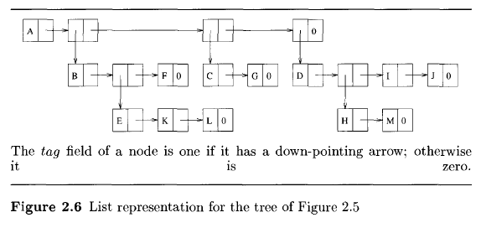
Notes:
In above figure, nodes have 3 fields, tag, data and link. The fields data and link are used as before with the exception that when tag = 1,data contains a pointer to a list rather than a data item. A tree is represented by storing the rootin the first node followed by nodes that point to sublists each of which contains one subtree of the root

Slide 21
Binary Tree
Tree where any node can have at most two children.
A binary tree is allowed to have zero nodes whereas any other tree must have at least one node.
A binary tree is a finite set of nodes that is either empty or consists of a root and two disjoint binary trees called the left and right subtrees.

Slide 22
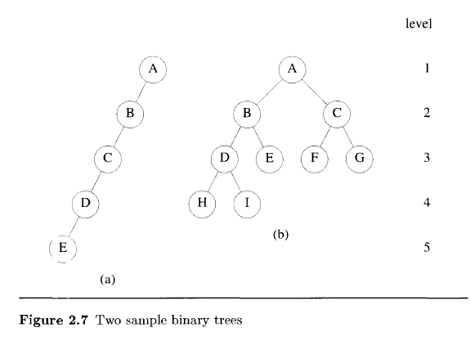
Skewed Tree(Skewed to the left) b) Complete Binary Tree

Slide 23
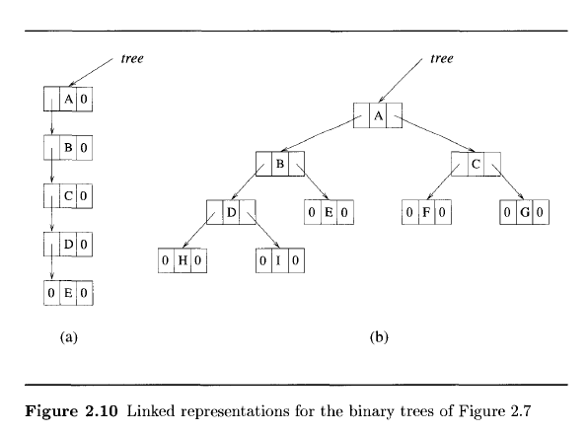
linked representation of binary tree. Each node has three fields:Ichild, data, and rchild.

Slide 24
Binary Tree
The maximum number of nodes on level i of a binary tree is 2^{i-1}. Also, the maximum number of nodes in a binary tree of depth k is 2^{k} -1,k >0.
The binary tree of depth k that has exactly 2^{k}-1 nodes is called a full binary tree of depth k

Slide 25
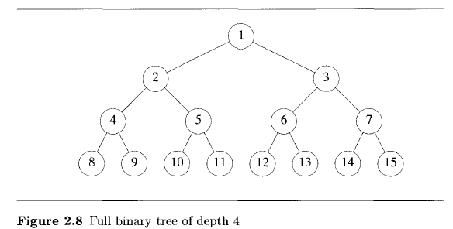

Slide 26
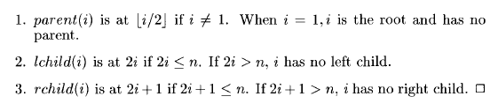
Binary Tree
If a complete tree with nodes is represented sequentially as described in figure 2.8, then for any node with index i, 1<=i<=n, we have,

Slide 27
