Slide 1

A presentation by:
Bibash Thapa Magar
Rajan Aryal
Sanket Adhikari
Supervisor:
Er. Rajendra Bahadur Thapa

Slide 2
INTODUCTION PROBLEM STATEMENT IMPLICATION OBJECTIVES LITERATIVE REVIEW TOOLS & METHODOLOGY LIMITATIONS FUTURE PLANNING DIAGRAMS BIBLIOGRAPHY
OUTLINE
01 02 03 04 05 06 07 08 09 10

Slide 3
01
INTRODUCTION
GCES Sports is a web application that
provides a platform for sharing information
regrading sport meet events.
It allows the organizers to accept feedbacks.

Slide 4
02
PROBLEM STATEMENT
It was difficult to conduct the game in
given time.
Mismanagement affected the other curriculum
activities of the college.

Slide 5
03
IMPLICATION
This website can be used by group of people
who are participating in the GCES sport meet
events.
This site solves the ultimate sporting
circumstances prevailed in GCES.

Slide 6
04
OBJECTIVES
To inform about the schedule regarding sport
meet events.
To provide a platform to share the captured
memories of sport meet events.

Slide 7


05
LITERATIVE REVIEW

Slide 8
06
TOOLS & METHODOLOGY
HTML, CSS & JavaScript for front-end
PHP for app logic
MySQL for database
Photoshop & Adobe XD for diagrams

Slide 9
07
LIMITATIONS
Internet access is required.
Technical persons are needed to manage
the system.

Slide 10
08
FUTURE PLANNING
Optimization of the system.
Addition of new features and functionalities.

Slide 11
09
DIAGRAMS

Slide 12
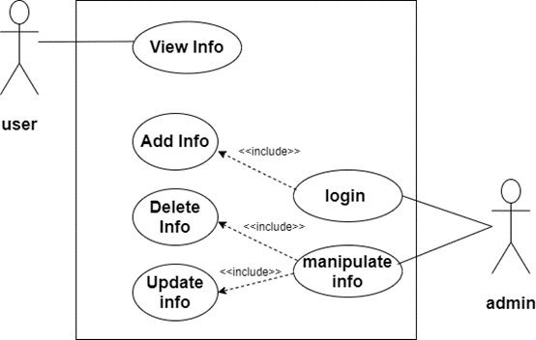


Fig: Use Case Diagram of GCES Sports

Slide 13
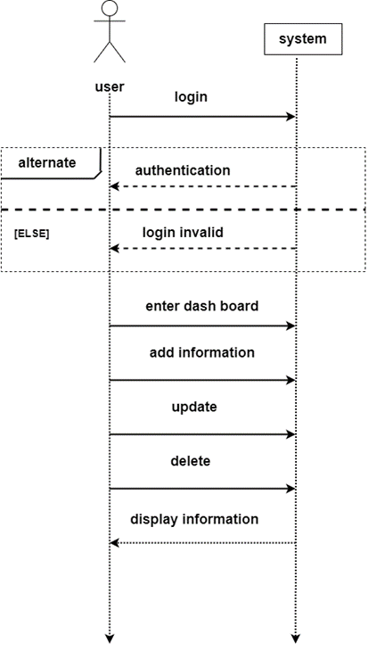


Fig: System Sequence Diagram of Players

Slide 14
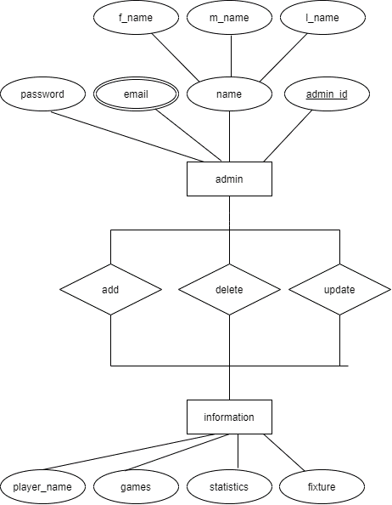


Fig: Entity Relationship Diagram of GCES Sports

Slide 15
10
BIBLIOGRAPHY
BBC. (2020, June 07).
BBC Sports. Retrieved from BBC Online:
https://www.bbc.com/sports
EPL. (2020, June 07).
Everest Premier league. Retrieved from
Everest Premier league:
https://eplt20.com.np/home

Slide 16
GOOD IS NOT GOOD WHEN BETTER IS EXPECTED.”
“
—Vin Scully

Slide 17
THANKS
ANY QUESTIONS?

