Slide 1

TIME SERIES ANALYSIS ON PASSENGERS FORECASTING
GROUP MEMBERS:
Ashish Neupane[2073/BCT/06]
Bibek Dhakal[2073/BCT/08]
Bijay Aryal[2073/BCT/10]
Anil Shrestha[2073/BCT/53]
SUPERVISOR:
Chetraj Pandey
PROJECT CO-ORDINATOR:
Ramesh Tamang

Slide 2
TIME SERIES FORECASTING

Slide 3
DATA SOURCE
Where we get the data?
How we analyze the data?

Slide 4
WHERE WE GET THE DATA?
Given datasets is used from https://courses.analyticsvidhya.com/courses/take/creating-time-series-forecast-using-python/texts/6142791-parameter-tuning-for-arima-model
Train dataset : provided with 18288 records for no. of passengers which includes:
Unique ID of each observation
DateTime(YY-MM-DD hr:mm) for each observation
No. of passengers count on each observation

Slide 5
OUR HYPOTHESIS FOR PROJECT
Traffic will increase as year pass by.
Traffic will increase from May to October.
Traffic will be more on week days.
Traffic will be more on during peak hour.

Slide 6
SYSTEM ANALYSIS AND DESIGN
Use Case Diagram
Sequence Diagram

Slide 7
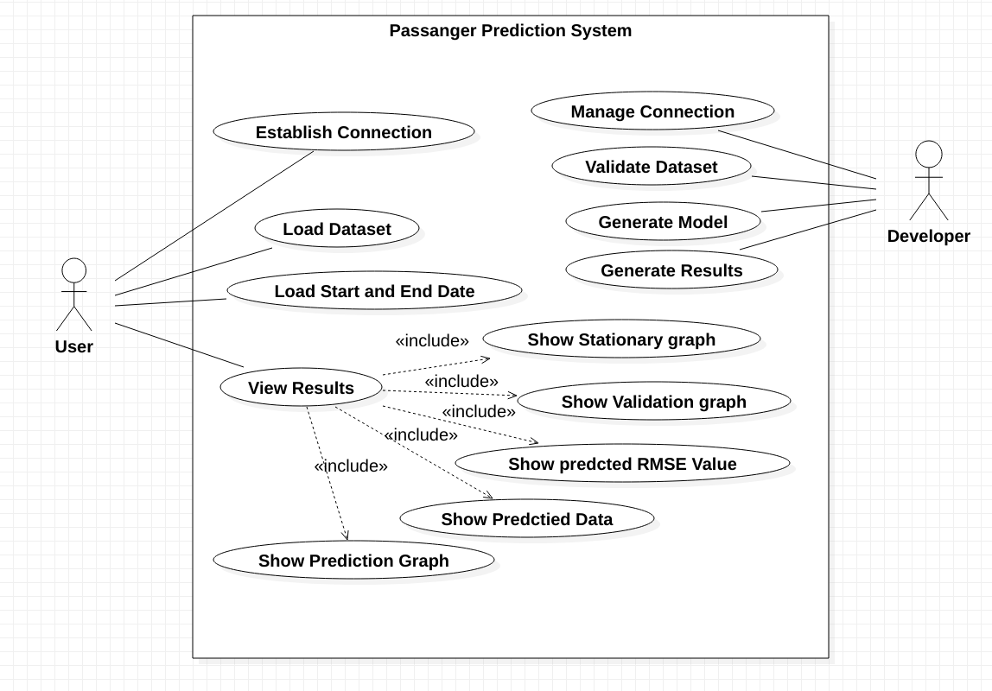

Slide 8
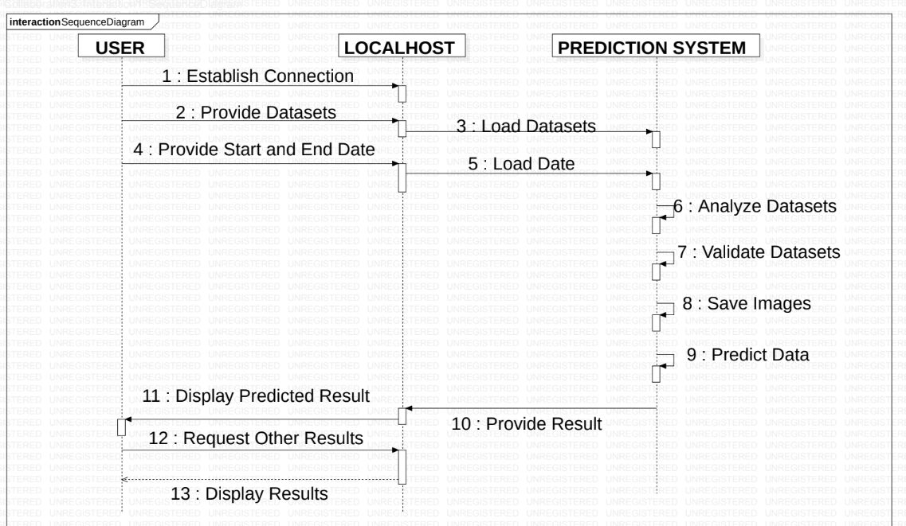

Slide 9
METHODOLOGY
System flow diagram
Work flow diagram

Slide 10
SYSTEM FLOW DIAGRAM
Analyzing and predicting data

Slide 11
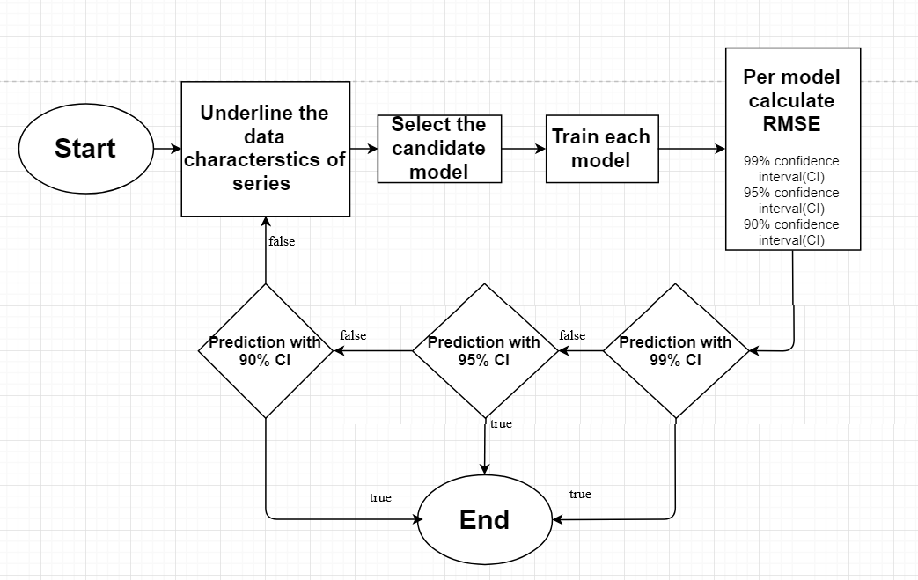

Slide 12
WORK FLOW DIAGRAM
How we solve problems?

Slide 13
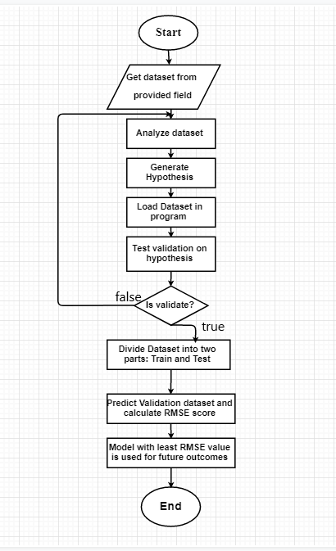

Slide 14
VALIDATION OF MODEL
Original data(train dataset) will be splitted into two parts:
training parts(80% of original dataset)
and validation parts(20% of original dataset).

Slide 15
Algorithm for our Project
1. Construction of an SARIMA model.
2. Fit the SARIMA model.
3. Make prediction with fit model.

Slide 16
Building SARIMA model(Construction)
Parameter : - p,d,q,P,D,Q,s
To find the optimized values of these above parameter ,we used ACF(Autocorrelation Function) and PACF(Partial Autocorrelation Fuction) graph.
Stationarize the series either by differencing or logging.
Study the pattern of autocorrelation and partial autocorrelation to determine if lags of forecast errors should be included in forecasting equation.
Calculate ACF and PACF(tools for identifying SARIMA model).
Develop the forecasting equation.

Slide 17
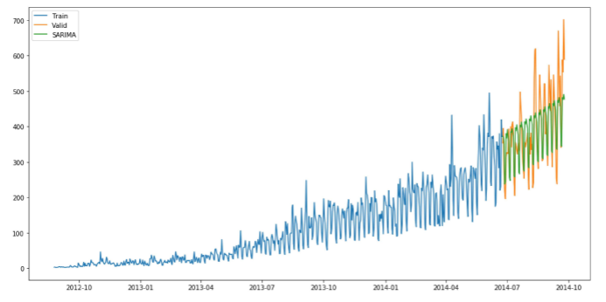
Fitting the SARIMA model

Slide 18
RESULT
RMSE Value
Predcited Graph

Slide 19
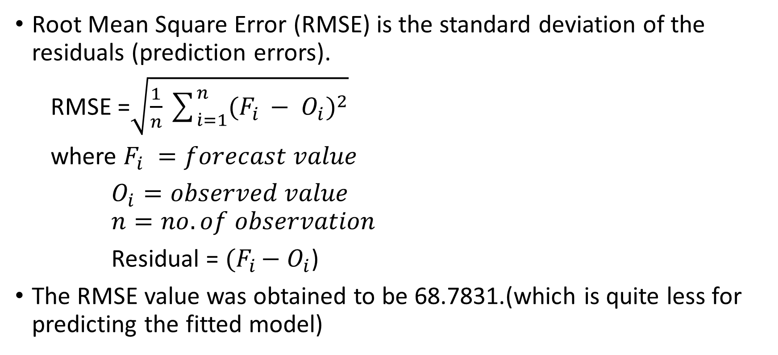
RMSE Value
Root Mean Square Error (RMSE) is the standard deviation of the residuals (prediction errors).
RMSE =$\sqrt{\frac{1}{n}\sum_{\dot{i}=1}^{n}{{(F_{i }− O_{i})}^{2}}}$
where $F_{i} =forecast value$
$O_{i}=observed value$ $n=no.of observation$
Residual = ${(F}_{i }− O_{i}$)
The RMSE value was obtained to be 68.7831.(which is quite less for predicting the fitted model)

Slide 20
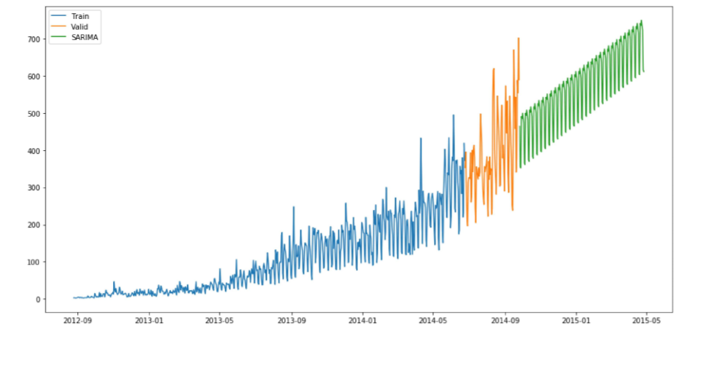
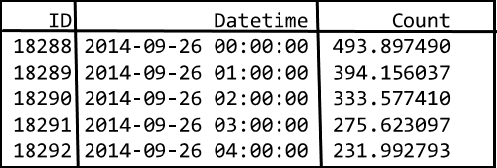
Predicted Graph
Observing Sarima.csv file
Observing Predicted graph

Slide 21
THANK YOU !!
For your precious time

