Slide 1
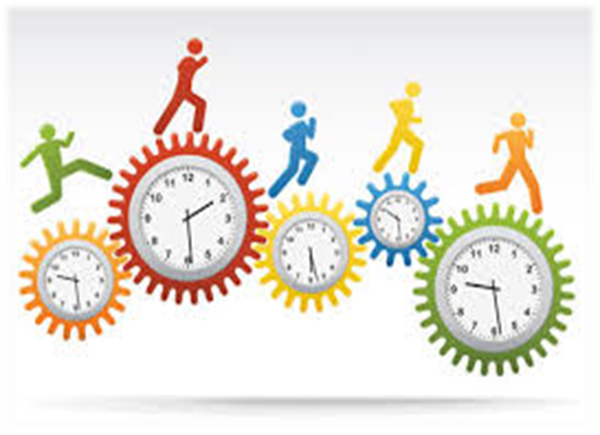
AUTOMATIC ATTENDANCE MANAGEMENT SYSTEM
By:
Vineet Patel (1851104)
Praveen Kumar (1851120)
Bibek Mondal (1851121)
Manmohan Kumar (1851150)

Slide 2
CONTENTS
Introductions
Block Diagram
Tools
Implementations and Steps
References and Conclusions

Slide 3
INTRODUCTIONS
Automatic Attendance Management System:
Is a user-friendly, flexible and full featured employee or student attendance management tool which allows controlling employees attendance OR students attendance in college by automating time keeping and attendance tracking.
captures data from Time and Attendance Terminals, and simultaneously allows optional PC entry

Slide 4
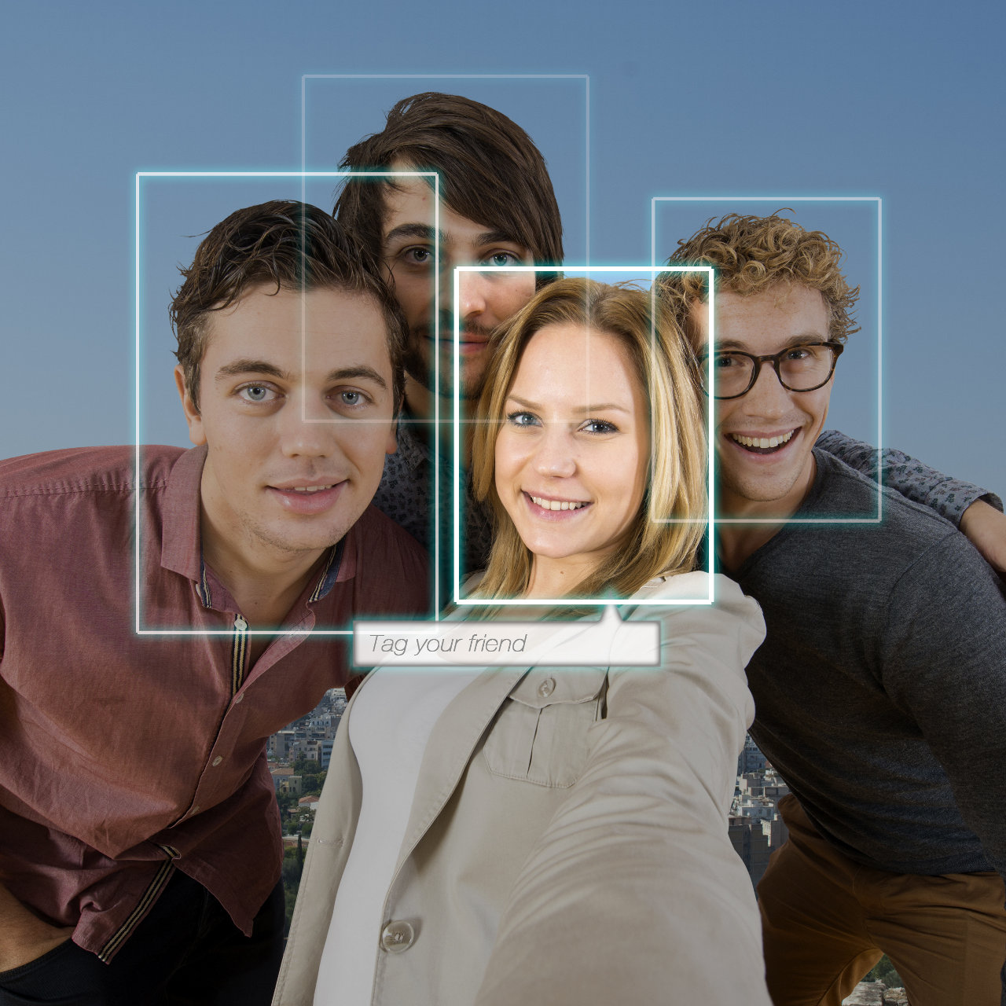
WHY FACE RECOGNITION?..
Non contact process
Zero effort from user
Computer based digital technology
Compare face of persons with training images

Slide 5
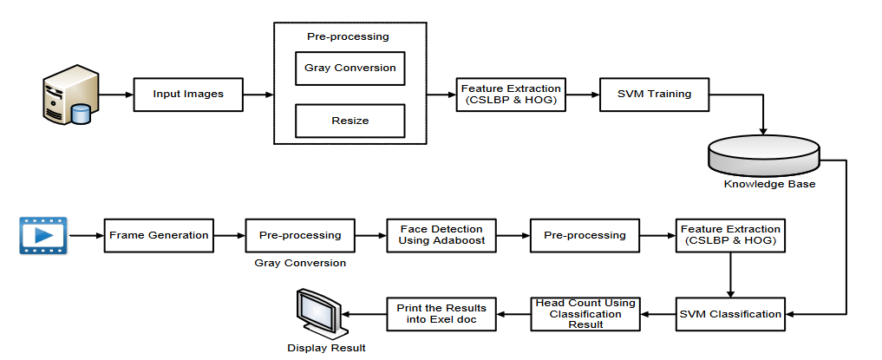
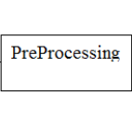
BLOCK DIAGRAM

Slide 6





TOOLS

Slide 7
IMPLEMENTATIONS
STEPS
Enrolment of student faces
Capturing the video of students.
Face detection and feature extraction.
Face recognition and marking attendance.

Slide 8
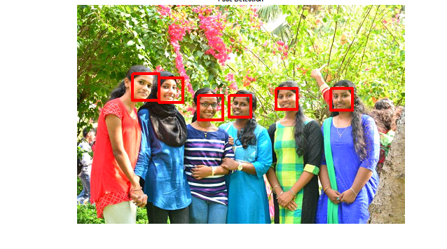
FACE DETECTION
The first step in our pipeline is face detection. Obviously we need to locate the faces in a photograph before we can try to tell them apart!

Slide 9
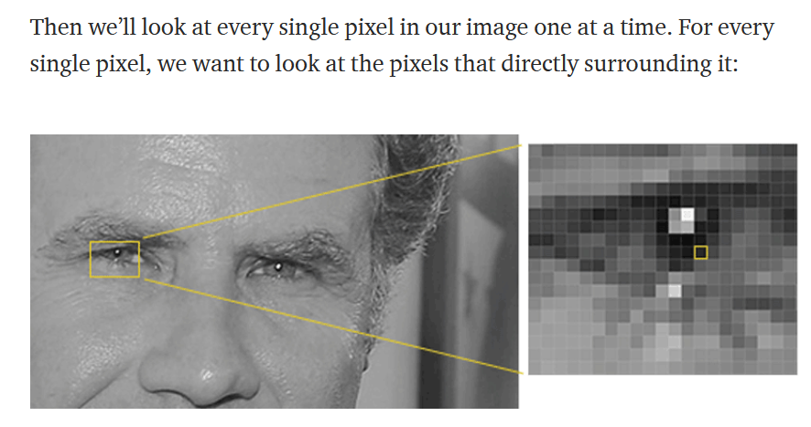
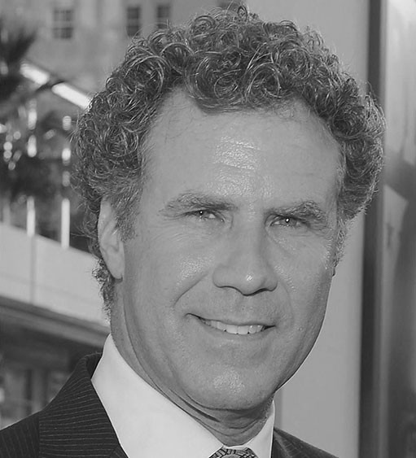
Face recognition of single face

Slide 10
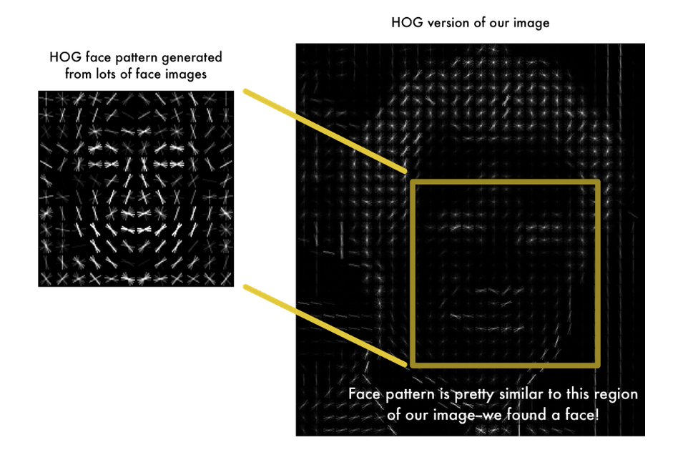
Histogram of Oriented Gradients — or HOG Method
HOG, is a feature descriptor that is often used to extract features from image data. It is widely used in computer vision tasks for object detection.
Using this technique, we can now easily find faces in any image:

Slide 11
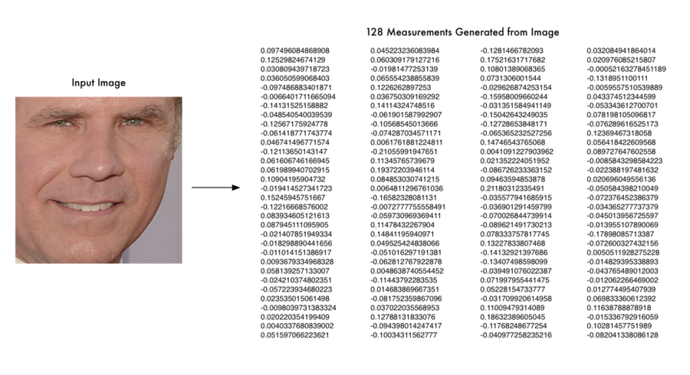
ENCODING FACES
The face_recognition API generates face encodings for the face found in the images. A face encoding is basically a way to represent the face using a set of 128 computer-generated measurements. Two different pictures of the same person would have similar encoding

Slide 12
FINDING THE PERSON’S NAME FROM THE ENCODING
This last step is actually the easiest step in the whole process. All we have to do is find the person in our database of known people who has the closest measurements to our test image.
You can do that by using any basic machine learning classification algorithm. No fancy deep learning tricks are needed. We’ll use a simple linear SVM classifier, but lots of classification algorithms could work.
All we need to do is train a classifier that can take in the measurements from a new test image and tells which known person is the closest match. Running this classifier takes milliseconds. The result of the classifier is the name of the person!

Slide 13

EXPORT DATA INTO EXCEL SHEET

Slide 14
Scope of Facial Recognition Technology in India
This system can be deployed for verification and attendance tracking at various government offices and corporates.
Passport and visa verification can also be done using this technology.
Preventing the frauds at ATMs in India.
For identification of criminals the system can be used by police force also.

Slide 15
CONCLUSIONS
Our proposed project, ―An Automated Attendance System‖ has been envisioned for the purpose of reducing the errors that occur in the traditional (manual) attendance taking system.
The aim is to automate and make a system that is useful to the organization such as an institute.
The camera plays a crucial role in the working of the system hence the image quality and performance of the camera in real-time scenario must be tested thoroughly before actual implementation.
This method is secure enough, reliable and available for use. No need for specialized hardware for installing the system in the classroom. It can be constructed using a camera and computer.

Slide 16
THANK YOU

