Slide 1
SQL COMMAND, CONSTRAINTS AND FUNCTIONS
Prepared By :- Bibek Rawat

Slide 2
AGENDA
SQL Command Types
SQL Constraints
SQL Functions
Windows Analytical Functions

Slide 3
What Is SQL ?
SQL is the standard language for Relational Database System.
It is used to communicate with the database .
It used to perform task such as retrieval , updation , insertion and deletion of data from database .
SQL is an ANSI (American National Standards Institute) standard language.

Slide 4
SQL Command Types
DDL (Data definition language)
DML (Data manipulation language)
DCL (Data control language)
TCL (Transaction control language)
Acid Properties Of DBMS
DQL (Data Query Language)
Importance Of DQL Command

Slide 5
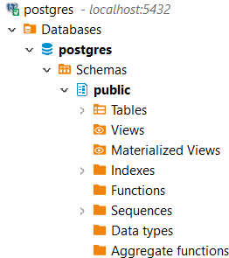
DDL (Data Definition Language)
Consists of command that can be used to define database schema.
CREATE,DROP,ALTER,TRUNCATE .

Slide 6
DML (Data Manipulation Language)
The SQL command that deals with manipulations of data present in database.
It is use with where clause.
INSERT,UPDATE,DELETE,UPSERT .

Slide 7
DCL (Data Control Language)
Includes the command that mainly deals with right permissions and other controls of database system .
GRANT,REVOKE .

Slide 8
TCL (Transaction Control Language)
Includes the command which mainly deals with the transaction of database.
COMMIT,ROLLBACK,SAVEPOINT .

Slide 9
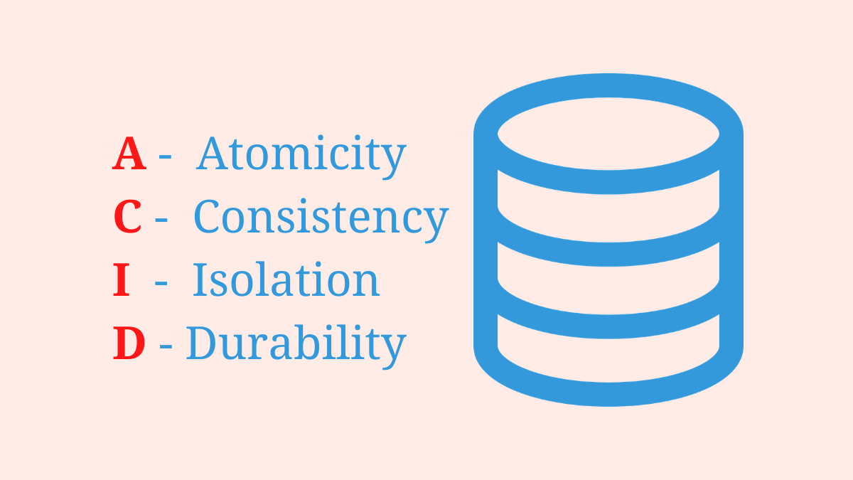
Acid Properties
In order to maintain consistency in a database, before and after the transaction, certain properties are followed. These are called ACID properties.

Slide 10
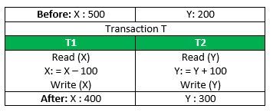
Atomicity
The entire transaction takes place at once or doesn’t happen at all .
Atomicity is also known as the ‘All or nothing rule’.
It involve two operations .
Abort: If a transaction aborts, changes made to database are not visible.
Commit: If a transaction commits, changes made are visible.
ATM Transactions .

Slide 11
Consistency
The database must be consistent before and after the transactions.
Before Transaction i.e. 700 is equal with After Completion .

Slide 12
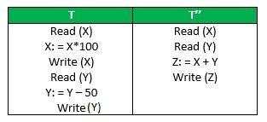
Isolation
Multiple Transaction Occur independently without interference.

Slide 13
Durability
This property ensures that once the transaction has completed execution, the updates and modifications to the database are stored in and written to disk and they persist even if a system failure occurs.
Store in non-volatile memory .

Slide 14
DQL (Data Query Language)
It provides SQL statements that allow you to retrieve data from a database.
SELECT

Slide 15
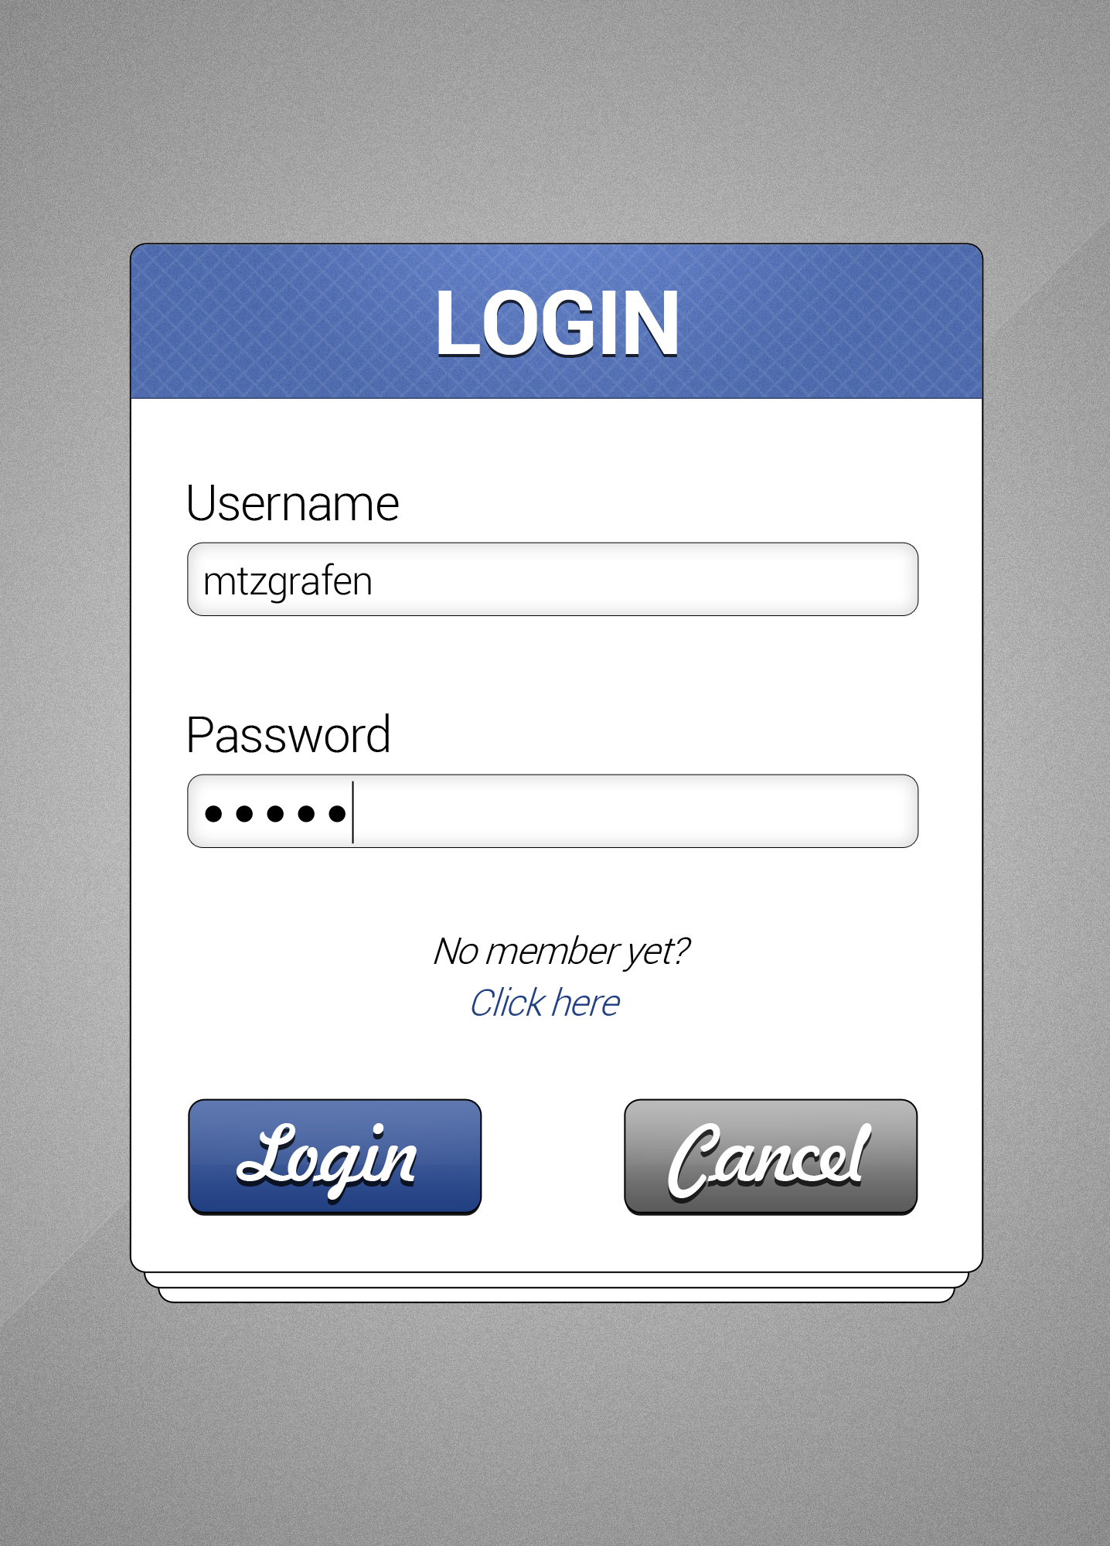
Importance Of DQL Command
DQL command is used for reporting purpose by users but what if user twist the reporting task .
Example :- select * from users where
username=‘user_name’ and password=****;

Slide 16
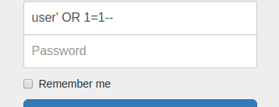
SQL Injections
select * from users where
username=‘jhsdfjhasd’ or 1=1 -- ;

Slide 17
SQL Constraints
SQL constraints are used to specify rules for the data in a table.
Constraints can be column level or table level.

Slide 18
SQL Constraints Types
NOT NULL
UNIQUE
CHECK
PRIMARY KEY
FOREIGN KEY
DEFAULT
UNIQUE INDEX
User Define constraints

Slide 19
NOT NULL
Ensures that a NULL value can’t be stored in a column .
E.g name varchar(30) NOT NULL ;

Slide 20
UNIQUE
This Constraint make sure that all the values in a column are different .
Multiple null value is possible .
E.g id int UNIQUE ;

Slide 21
CHECK
This Constraint ensure that all the values in a column satisfy a specific condition .
E.g CHECK (age >18) ;

Slide 22
PRIMARY KEY
A set of attributes that can be used to uniquely identify every tuple .
Only one primary key is possible in a table .
UNIQUE + NOT NULL

Slide 23
FOREIGN KEY
Maintains referential integrity by enforcing a link between the data in two tables .
Table with primary key is child table .

Slide 24
DEFAULT
This constraint consists of a set of default values for a column when no value is specified .
E.g city varchar(30) DEFAULT ‘Nepal’ ;

Slide 25
UNIQUE INDEX
It is used to overcome the issue with NOT NULL .
Only One null value is allowed in a column .

Slide 26
User Define constraints
Postgres Unique features .
It allows to create user define constraint according to business needs .

Slide 27
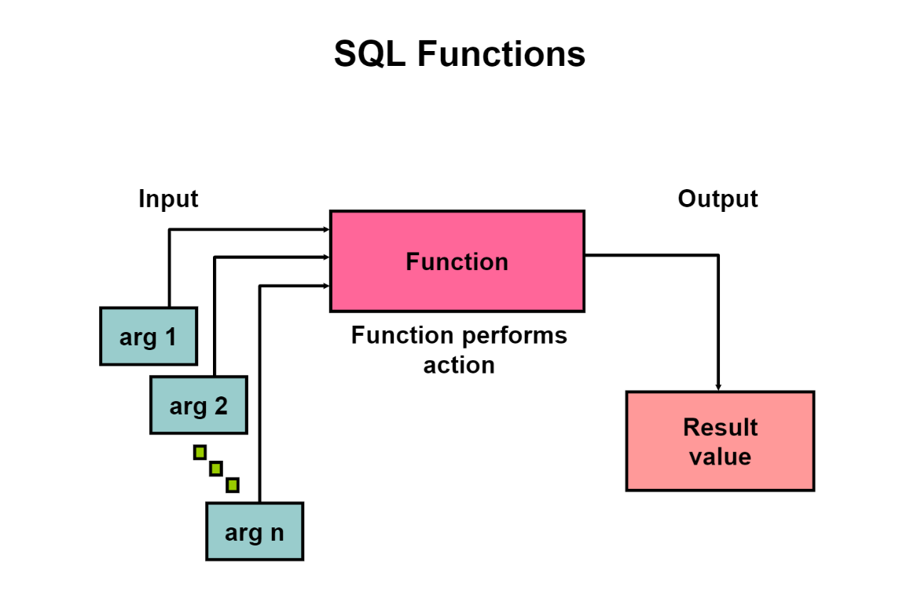
SQL Functions

Slide 28
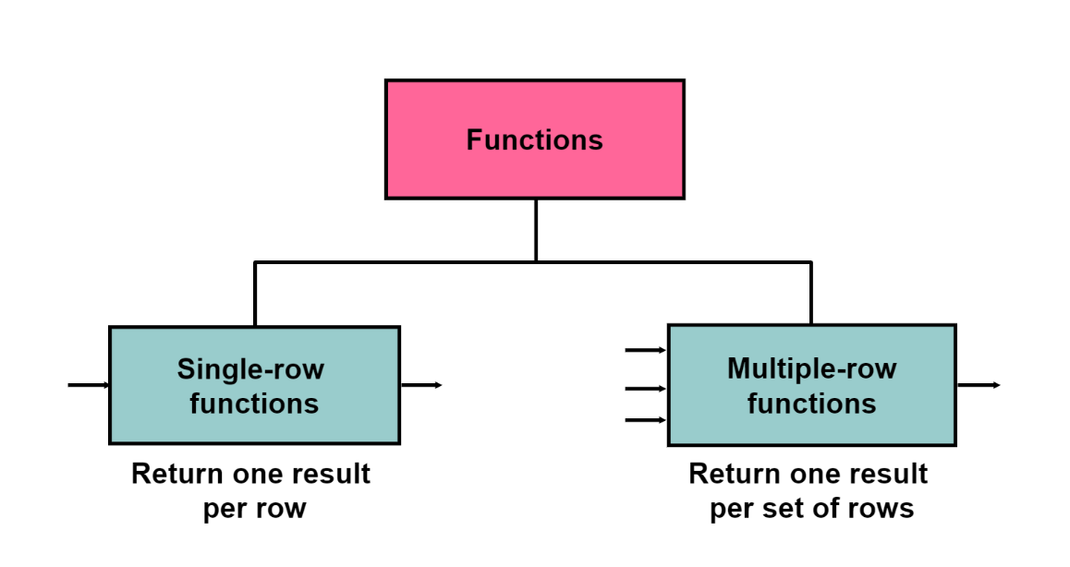
Types Of SQL Functions

Slide 29
Single Row Functions
Single row functions are the one who work on single row and return one output per row.
General function , Case Conversion Function , Character Function , Date Functions , Number Functions .
It can be used with select , where , order by clause .
For example, length and case conversion functions are single row functions.

Slide 30
Multi Row Functions
Multiple row functions work upon group of rows and return one result for the complete set of rows.
Also known as GROUP Functions .
AVG(),MAX(),MIN() ,SUM(),COUNT(),VARIANCE()

Slide 31
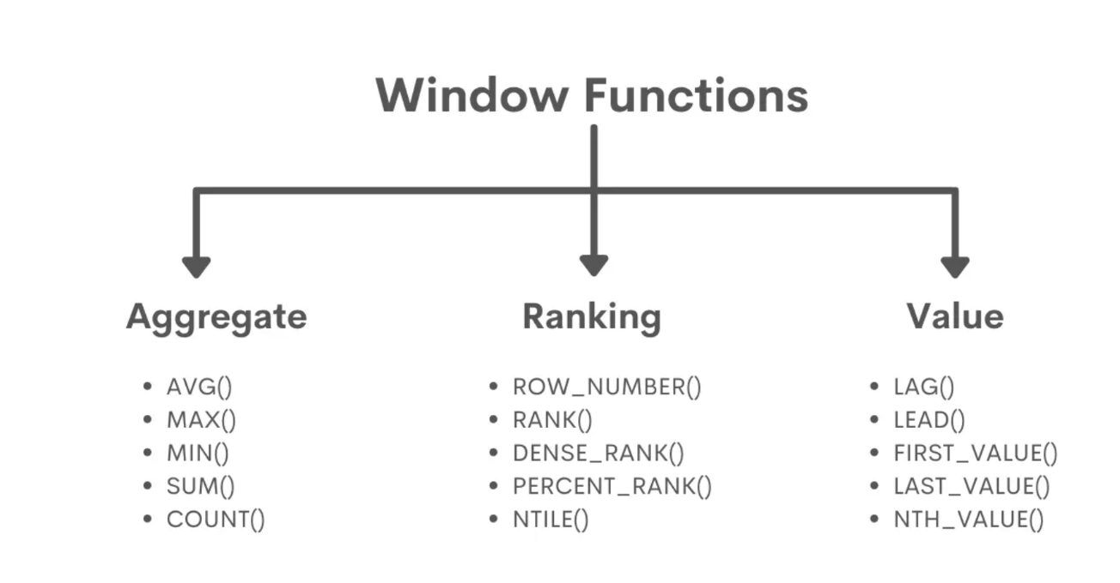
Window Analytical Functions
Window functions applies aggregate and ranking functions over a particular window (set of rows).

Slide 32
Types Of Window Functions
Aggregate Window Functions
Ranking Window Functions
Value Window Functions

Slide 33
Aggregate Window Function
Various aggregate functions such as SUM(), COUNT(), AVERAGE(), MAX(), MIN() applied over a particular window (set of rows) are called aggregate window functions.
Query Optimization Technique .

Slide 34
Ranking Window Functions
Row_Number() | Rank() | Dense_Rank()
Function will assign a unique row number to every row within each partitioned result set , It does not matter if the rows are duplicate or not . | Function will assign a rank to each row within each portioned result set ,If multiple rows have the same value then each of these rows will share the same rank. | Function will assign a rank to each row within each portioned result set ,If multiple rows have the same value then each of these rows will share the same rank.
Like Paginations . | Rank of the next rows will get skipped . | Dense_Rank() of the next row will not get skipped .
Use more than rank() but not than dense_rank() . | List use windows function. | Most used windows functions.

Slide 35
Value Window Functions
Value window functions in SQL are used to assign to rows values from other rows.
It is usually possible to replicate the result of value function by using two nested query .

Slide 36
Types Of Value Window Functions
LAG()
LEAD()
FIRST_VALUE()
LAST_VALUE()
NTH_VALUE()

Slide 37


