Slide 1
DBMS
Prepared by:Rojeena Tamang

Slide 2
TABLE OF CONTENT
Evolution of DBMS
DBMS
Types of DBMS
Terminologies
Data Anomalies
Database Normalization
ER Model
Data Relationships

Slide 3
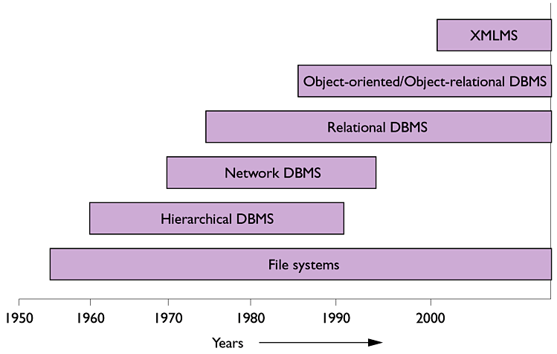
EVOLUTION OF DBMS

Slide 4
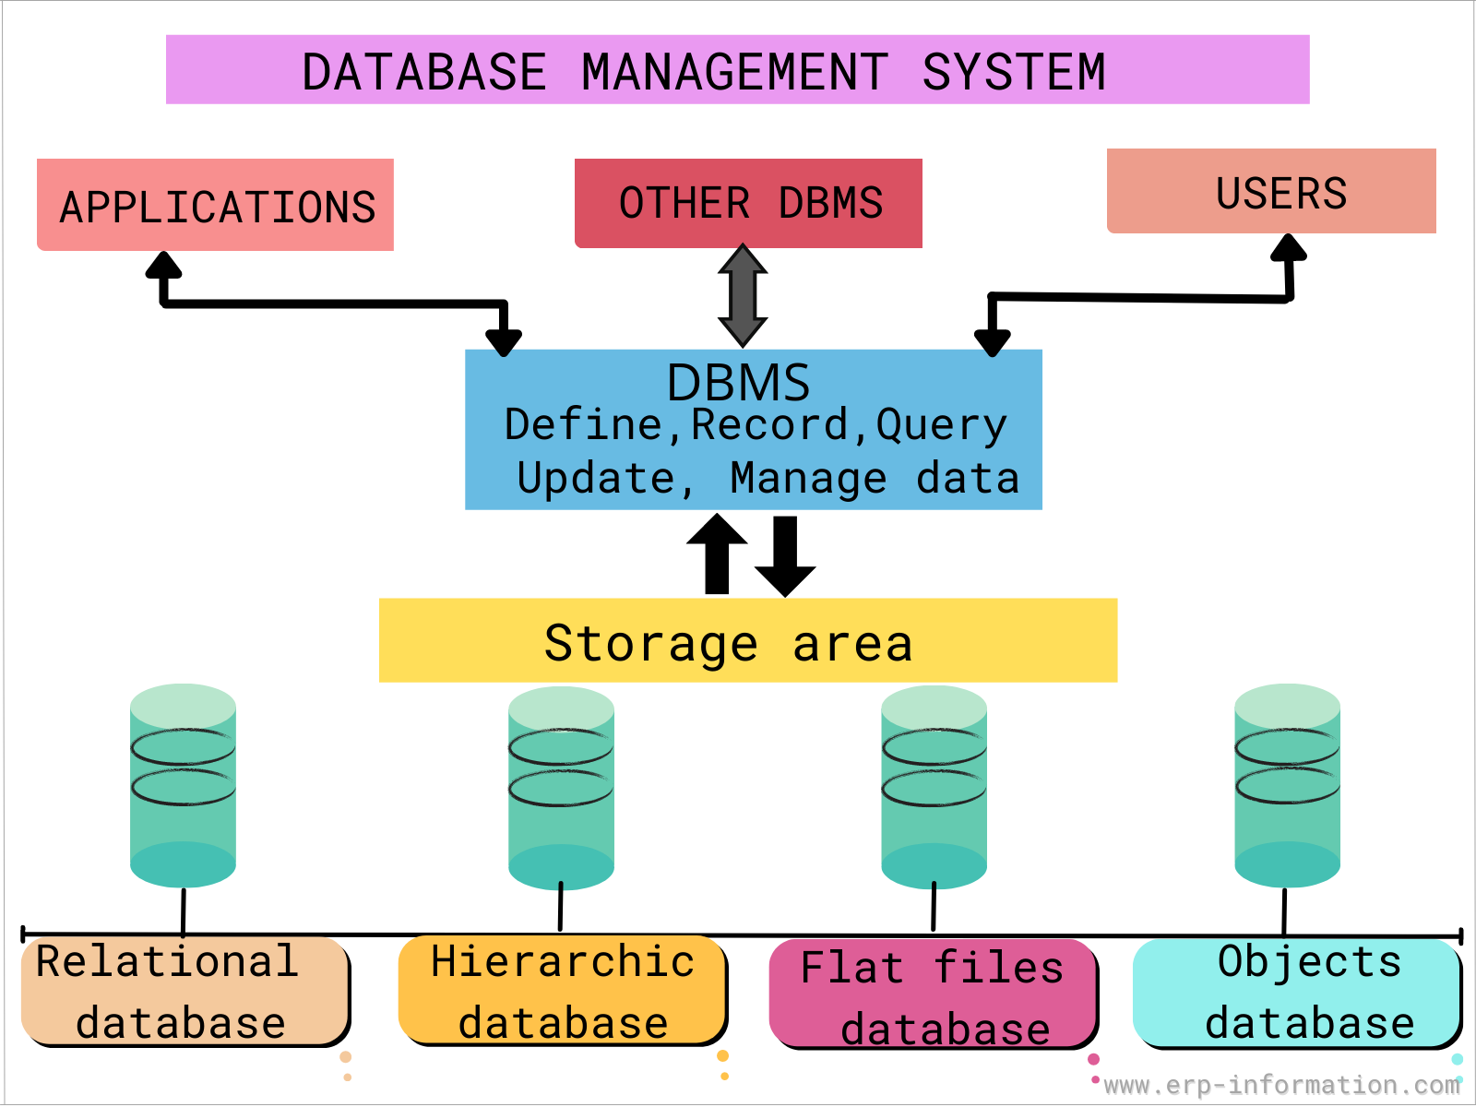
DBMS

Slide 5
TYPES OF DBMS
Hierarchical DBMS
Network DBMS
Relational DBMS
Object oriented DBMS

Slide 6
TERMINOLOGIES
Data Redundancy: condition created within a database or data storage technology in which the same piece of data is held in two separate places
Data Inconsistency: situation where there are multiple tables within a database that deal with the same data but may receive it from different inputs.
Primary key: used to ensure data in the specific column is unique and column cannot have NULL values
Foreign key: column or group of columns in a relational database table that provides a link between data in two tables
Functional Dependency: relationship that exists between two attributes. It typically exists between the primary key and non-key attribute within a table
A→B
The left side of FD is known as a determinant, the right side of the production is known as a dependent.

Slide 7
DATA ANOMALIES
Anything we try to do with database that leads to unexpected results
Pattern in the data that doesn’t conform to the expected behavior
Caused when there is too much redundancy in the database's information
Poor planning and storing everything in a flat database

Slide 8
TYPES OF DATA ANOMALIES
Insert anomalies: occurs when we are not able to insert certain attribute in the database without the presence of other attribute
Update anomalies: occurs in case of data redundancy and partial update
Delete anomalies: cannot delete data from the table without having to delete the entire record

Slide 9
TABLE ‘WICC’
prof_id | prof_name | dept | course_group
1 | Bibek | Project | Sec A
2 | Rojeena | Product | Sec B
3 | Santosh | Finance | Sec C
4 | Santosh | Finance | Sec C
5 | Kushal | HR | Sec D
6 | Kushal | HR | Sec E

Slide 10
WAYS TO REMOVE DATA ANOMALIES
Remove redundant data
Normalize all the tables within database

Slide 11
UN NORMALIZED DATABASE PROBLEM
Repetition of information
Inability to represent certain information
Difficulty to maintain information
Loss of information

Slide 12
DATABASE NORMALIZATION
Process of organizing the data in the database
Used to minimize the redundancy from a relation or set of relations
Divides the larger table into the smaller table and links them using relationship

Slide 13
OBJECTIVES OF NORMALIZATION
Control over data redundancy and data consistency
Allow data in different tables can be used in complex queries
Building a database in which it can be access and manipulate without compromising integrity of data storage
Arranging data into logical groups such that each group describes a small part of the whole
Organizing data in such a way that when it is modified, changes are made only in one place

Slide 14
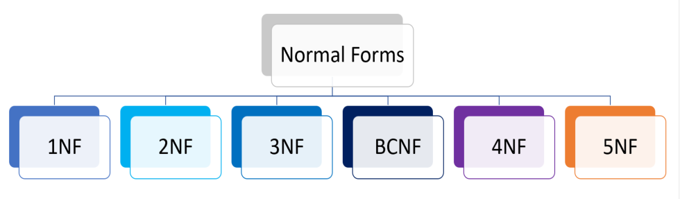
STAGES OF NORMALIZATION

Slide 15
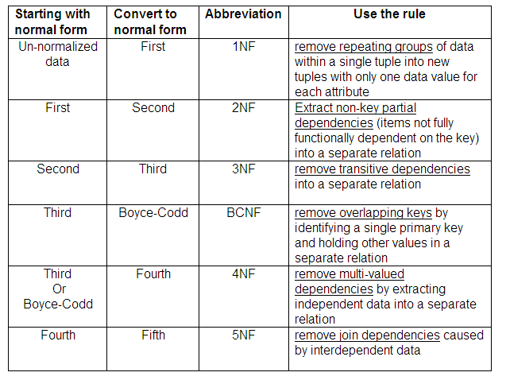
STAGES OF NORMALIZATION

Slide 16
PROBLEMS SOLVED AFTER NORMALIZATION
Use storage space efficiently
Minimize redundant data, inconsistent data
Minimize modification anomalies
Ease the database maintenance burden

Slide 17
DISADVANTAGE OF NORMALIZATION
The only drawback having a highly normalization database structure is that one may need a large number of joins to pull back the records the application needs to function.

Slide 18
CONLUSION OF NORMALIZATION
“WHEN IS IT APPROPRIATE TO NORMALIZE AND WHEN NOT TO?”

Slide 19
DENORMALIZATION
Technique in which we add the duplicate data to one or more table
Technique to speed up read oriented data retrieval performance in a relational database
Technique that is performed on the normalized data

Slide 20
ADVANTAGES OF DENORMALIZATION
Minimizing the need for joins
Reducing the number of tables
Queries to be retrieved can be simpler.
Less likely to have bugs
Reducing the number of relations
Reducing the number of foreign keys in relation
Retrieving data is faster due to fewer joins.

Slide 21
DISADVANTAGES OF DENORMALIZATION
Slow down updates, although maybe speeding up retrievals.
Make it more complex in others, although simplifying implementation.
Be inconsistent.
Increase the size of relations.
Make the update and insert codes harder to write.
Involve Data redundancy which necessitates more storage.

Slide 22
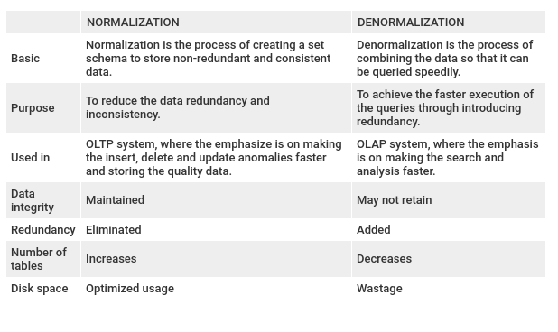
NORMALIZATION VS DENORMALIZATION

Slide 23
ER MODEL
Describes the structure of a database with the help of a diagram, which is known as Entity Relationship Diagram (ER Diagram).
Design or blueprint of a database that can later be implemented as a database

Slide 24
FACTS ABOUT ER MODEL
Allows you to draw Database Design
GUI representation of the logical structure of a Database
Helps to identify the entities which exist in a system and the relationships between those entities
Easy to use graphical tool for modeling data

Slide 25
WHY USE ER DIAGRAM?
Helps you to define terms related to entity relationship modeling
Provide a preview of how all your tables should connect, what fields are going to be on each table
Helps to describe entities, attributes
Allows you to build databases quickly
Can be used by database designers as a blueprint for implementing data in specific software applications

Slide 26
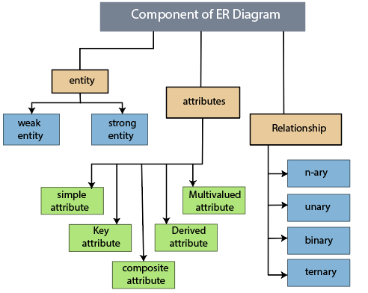
COMPONENTS OF ER DIAGRAM

Slide 27
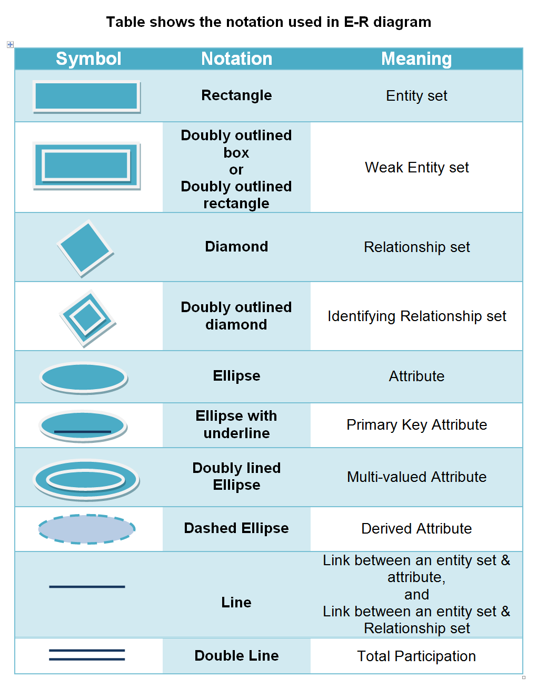
NOTATION USED IN ER DIAGRAM

Slide 28
HOW TO CREATE AN ER MODEL?
Let’s go through the documentation to know about process of creating ER model

Slide 29
ER DIAGRAM TOOLS
Lucidchart
Visual Paradigm Online
Draw.io
Microsoft Visio
sqlDBM
Toad Modular

Slide 30
CONCLUSION OF ER MODEL
Helps you to analyze data requirements systematically to produce a well-designed database
Considered best practice to complete ER modeling before implementing your database

Slide 31
DATA RELATIONSHIPS
Situation that exists between two relational database tables when one table has a foreign key that references the primary key of the other table
Allow relational databases to split and store data in different tables
Differentiates relational databases from other database types (e.g., flat-files)

Slide 32
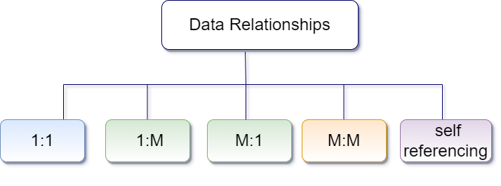
TYPES OF DATA RELATIONSHIPS

Slide 33

ONE TO ONE RELATIONSHIPS
When a single instance of an entity is associated with a single instance of another entity then it is called one to one relationship.

Slide 34

ONE TO MANY RELATIONSHIPS
When a single instance of an entity is associated with more than one instances of another entity then it is called one to many relationship.

Slide 35

MANY TO ONE RELATIONSHIPS
When more than one instances of an entity is associated with a single instance of another entity then it is called many to one relationship.

Slide 36
MANY TO MANY RELATIONSHIPS
When more than one instances of an entity is associated with more than one instances of another entity then it is called many to many relationship.

Slide 37
SELF REFERENCING RELATIONSHIPS
Occurs when a column in a table relates to another column in the same table.
In such a relationship, only one table is involved.
For example, the Staff table contains information about company employees and their managers, however, managers themselves belong to staff too.

Slide 38
ADVANTAGES OF DATA RELATIONSHIPS
Simplicity of Model
Ease of Use
Accuracy
Data Integrity
Normalization
Collaboration
Security

Slide 39
DISADVANTAGES OF DATA RELATIONSHIPS
Maintenance Problem
Cost
Physical Storage
Lack of Scalability
Complexity in Structure
Decrease in performance over time

Slide 40
REFERENCES
databse normalization in sql with examples. (n.d.). Retrieved from sqlservercentral: https://www.sqlservercentral.com/articles/database-normalization-in-sql-with-examples
data-redundancy. (n.d.). Retrieved from technopedia: https://www.techopedia.com/definition/18707/data-redundancy
dbms-normalization. (n.d.). Retrieved from javatpoint: https://www.javatpoint.com/dbms-normalization
javatpoint. (2022, March 14). Retrieved from javatpoint: www.javatpoint.com
normalization. (n.d.). Retrieved from slideshare: https://www.slideshare.net/ochesing/normalization-12066476
normalization of database the easy way. (n.d.). Retrieved from medium: https://medium.com/swlh/normalization-of-database-the-easy-way-98f96a7a6863
Relationship Databases. (n.d.). Retrieved from techopedia: www.techopedia.com
relationships-between-tables-in-sql. (n.d.). Retrieved from medium: https://medium.com/365datascience/relationships-between-tables-in-sql-2067d9b6ff3c

Slide 41
Thank You!

