Slide 1










Join, Sub-Query, Set Operations and Sequence
Presented by:
Sapana Maharjan

Slide 2
Agenda
Join and its types
Subquery and its types
Set Operations and its type
Sequence

Slide 3

Joins
Used to fetch data from two or more tables, which is joined to appear as single set of data.

Slide 4
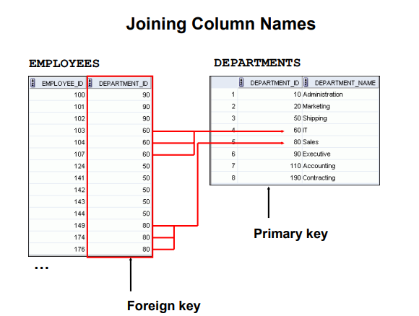


Slide 5
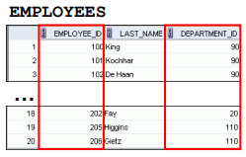
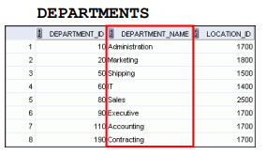
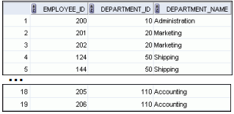
Obtaining Data from Multiple Tables

Slide 6

Types of Join
Inner Join
– ON clause
– USING clause
– WHERE clause
Outer joins:-
– LEFT OUTER JOIN
– RIGHT OUTER JOIN
– FULL OUTER JOIN
Cross joins

Slide 7
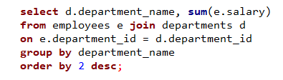
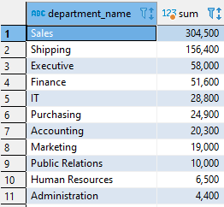
On Clause

Slide 8
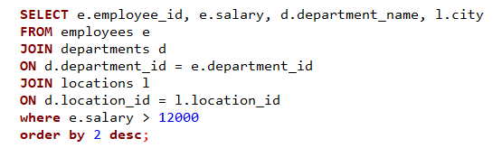
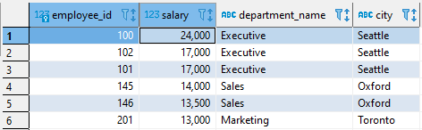
Creating Three-Way Joins with the ON Clause

Slide 9
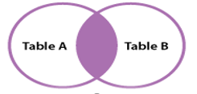

Inner Join
Most common type of join.
Return all rows from multiple tables where the join condition is met.
Syntax:-

Slide 10
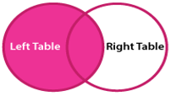

Left/Left Outer Join
Returns all rows from the LEFT-hand table and only those rows from the other table where the joined fields are equal.
Syntax:-

Slide 11
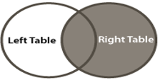

Right/Right Outer Join
Returns all rows from the RIGHT-hand table specified in the ON condition and only those rows from the other table where the joined
fields are equal.
Syntax:-

Slide 12
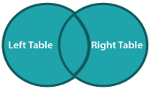

Full Outer Join
Returns all rows from the LEFT-hand table and RIGHT-hand table with nulls in place where the join condition is not met.
Syntax:-

Slide 13
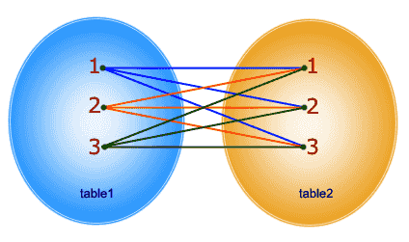

Cross Join
Produces the cross-product of two tables.
Also called a Cartesian product between the two tables.
Syntax:-

Slide 14
Advantages & Disadvantages
Executes faster.
Retrieval time almost always will be faster than that of a subquery.
Not as easy to read as subqueries.
Can be confusing as to which join is the appropriate type of join to use to yield the correct desired result set.

Slide 15
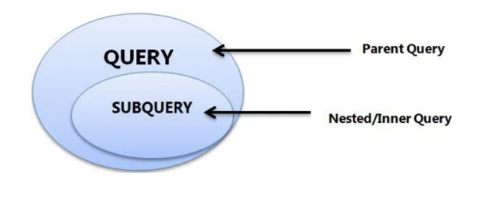
Sub-Queries
A query within another SQL query and embedded within the WHERE clause.
The main query that contains the subquery is also called the OUTER QUERY or OUTER SELECT.
Used with the SELECT, INSERT, UPDATE, and DELETE statements along with the operators like =, <, >, >=, <=, IN, BETWEEN, etc.

Slide 16
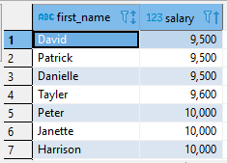
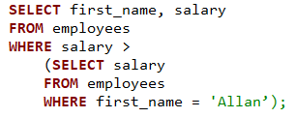

Using a Sub-Query:-

Slide 17
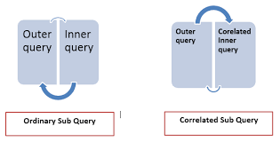
Types of Sub-Query
Non-correlated sub-query
Single row subquery
Multiple row subquery
2. Correlated sub-query

Slide 18

Non-Correlated Sub-Query
Obtains its results independently of its containing (outer) statement.
Faster than the Correlated sub-query.
In the case if inner query results the null values then the outer query also execute null values.
Example:-

Slide 19

Single Row Sub-Queries
Queries that return only one row from the inner SELECT statement.
Frequently used in the WHERE clause to filter the results of the main query.
They are usually used with operators like =, >, >=, <, <=, <>.

Slide 20
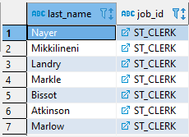
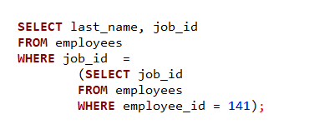

Example:-
To display the employees whose job ID is the same as that of employee 141.

Slide 21
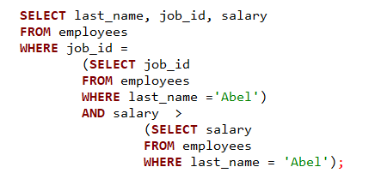



Executing Single-Row Subqueries:-

Slide 22

Multiple-Row Sub-Queries
Return more than one row from the inner SELECT statement.
Includes:-
1) Return one column with multiple rows (i.e. a list of values)
2) Return multiple columns with multiple rows (i.e. tables).
Used with operators like IN, ANY, ALL, etc.

Slide 23
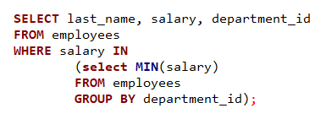
Example:- Using the IN Operator in Multiple-Row Subqueries

Slide 24
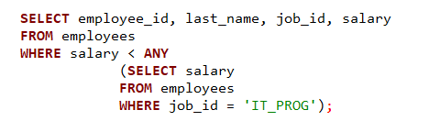
Using the ANY Operator in Multiple-Row Subqueries:-

Slide 25
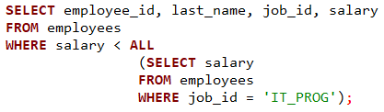
Using the ALL Operator in Multiple-Row Subqueries

Slide 26
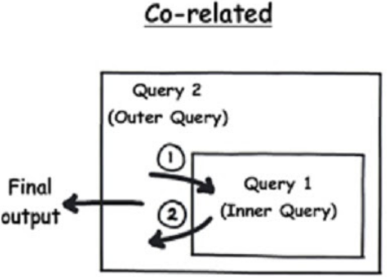

Correlated Sub-Queries
The inner query relies on information obtained from the outer query.
It is slower than non-correlated sub-query.
WHERE condition is applied in the inner query which also takes the null value.
Used in real way scenario (migration).
Example:-

Slide 27
Advantages & Disadvantages
Subqueries divide the complex query into isolated parts so that a complex query can be broken down into a series of logical steps.
Easy to understand and code maintenance is also at ease.
Allow to use the results of another query in the outer query.
It cannot modify a table and select from the same table within a subquery in the same SQL statement.
Takes longer to execute than a join.
Slower in comparison to Join.

Slide 28
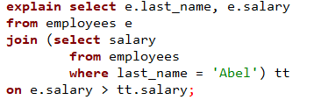
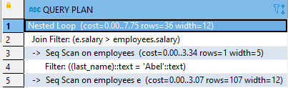
Join vs Sub-Query
Using Join:-

Slide 29
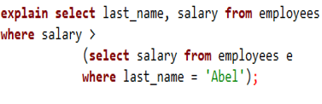
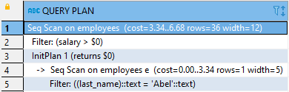
Using Sub_query:-

Slide 30
Set Operators
Used to combine results from two or more SELECT statements.
Combine the same type of data from two or more tables.
Queries containing set operators are called compound queries.
Guidelines:-
The result set of both queries must have the same number of columns.
The data type of each column in the both query must match.
ORDER BY clause can appear only at the very end of the statement.

Slide 31
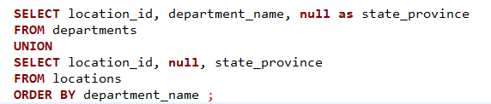
Matching the SELECT Statement & Using ORDER BY Clause

Slide 32
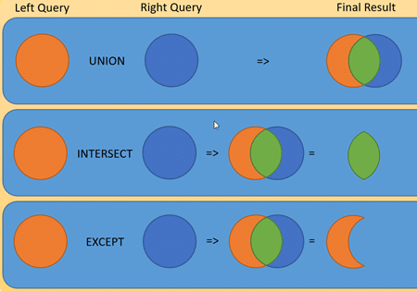
Types of Set Operation
Union
Union All
Intersect
Minus/Except

Slide 33
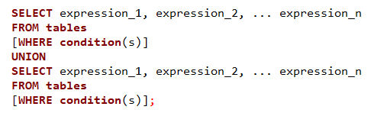
Union
Returns rows from both queries after eliminating duplication in sorted order without ignoring the NULL values.
Syntax:-

Slide 34
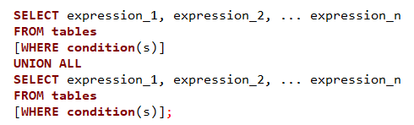
Union All
Set result without removing duplication and sorting the data, without removing null values.
Return all rows from multiple queries.
Syntax:-

Slide 35
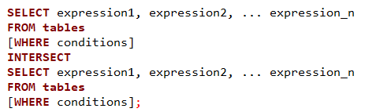
Intersect
Returns rows that are common to both queries.
Common rows from both the SELECT statements, with no duplicates and data arranged in sorted order.
It does not ignore NULL values.
Syntax:-

Slide 36
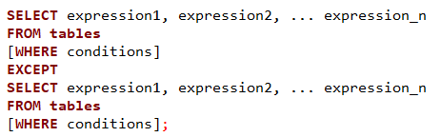
Minus/Except
Returns all the distinct rows selected by the first query, but not present in the second query result set.
Syntax:-

Slide 37
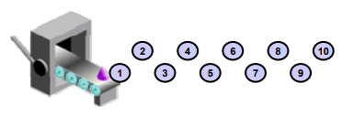
Sequence
It is a database object that creates integer values.
Create a primary key value, which must be unique for each row.
Provides an auto increment or decrement provision.
The same sequence can be used for multiple tables.

Slide 38
Nextval and Currval
Returns the next available sequence value. It returns a unique value every time it is referenced, even for different users.
Currval obtains the current sequence value.

Slide 39
Advantages
The sequence values can be cached.
No special table needs to be created. Sequences also solve concurrency issues.

Slide 40


